Slide 1

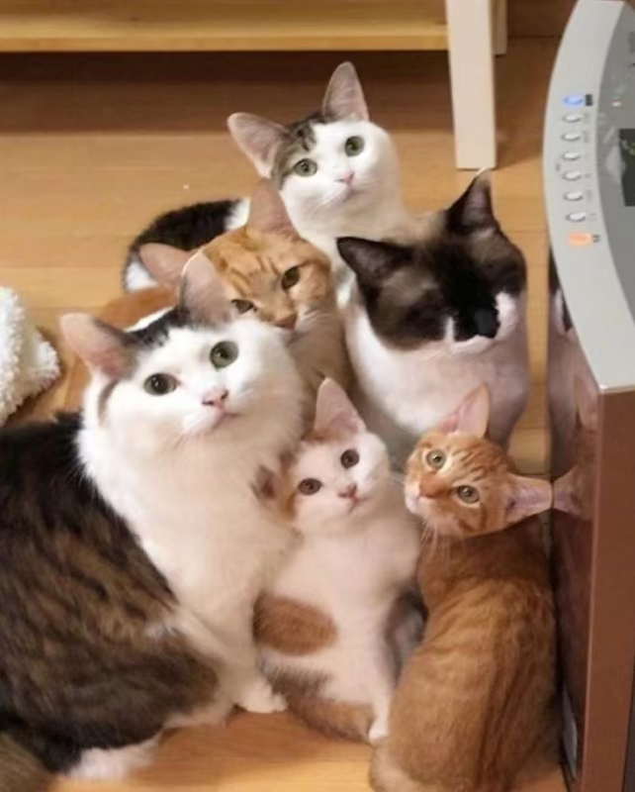
Computing-Aware Traffic Steering (cats) IETF 121, Dublin
Chairs: Adrian Farrel (adrian@olddog.co.uk)
Mohamed Boucadair(mohamed.boucadair@orange.com)
Peng Liu (liupengyjy@chinamobile.com)
Secretary: Cheng Li (c.l@huawei.com)
AD: Jim Guichard (james.n.guichard@futurewei.com)
6th Meeting of CATS WG
THIS MEETING WILL BE RECORDED

Slide 2
IETF Note Well
This is a reminder of IETF policies in effect on various topics such as patents or code of conduct. It is only meant to point you in the right direction. Exceptions may apply. The IETF's patent policy and the definition of an IETF "contribution" and "participation" are set forth in BCP 79; please read it carefully.
As a reminder:
By participating in the IETF, you agree to follow IETF processes and policies.
If you are aware that any IETF contribution is covered by patents or patent applications that are owned or controlled by you or your sponsor, you must disclose that fact, or not participate in the discussion.
As a participant in or attendee to any IETF activity you acknowledge that written, audio, video, and photographic records of meetings may be made public.
Personal information that you provide to IETF will be handled in accordance with the IETF Privacy Statement.
As a participant or attendee, you agree to work respectfully with other participants; please contact the ombudsteam (https://www.ietf.org/contact/ombudsteam/) if you have questions or concerns about this.
Definitive information is in the documents listed below and other IETF BCPs. For advice, please talk to WG chairs or ADs:
BCP 9 (Internet Standards Process)
BCP 25 (Working Group processes)
BCP 25 (Anti-Harassment Procedures)
BCP 54 (Code of Conduct)
BCP 78 (Copyright)
BCP 79 (Patents, Participation)
https://www.ietf.org/privacy-policy/ (Privacy Policy)
Also see: http://www.ietf.org/about/note-well.html

Slide 3
IETF Conduct Guidelines
The IESG has asked all chairs to remind their working groups of the need for appropriate behavior. This is described in more detail in BCP 54. In summary:
IETF participants extend respect and courtesy to their colleagues at all times.
IETF participants have impersonal discussions.
IETF participants devise solutions for the global Internet that meet the needs of diverse technical and operational environments.
Individuals are prepared to contribute to the ongoing work of the group.

Slide 4

Meeting Administrivia
We have three chairs as a short-term measure until NomCom have made their choices
Meetecho:
We are using Meetecho queue control
Chat available for use via Meetecho/Zulip
Note taking:
https://notes.ietf.org/notes-ietf-121-cats
Cheng Li will take minutes, but…
Please help with minute taking
Please check that your comments are recorded correctly
Session Materials: https://datatracker.ietf.org/meeting/121/session/cats
Data tracker: http://datatracker.ietf.org/wg/cats/
Zulip: https://zulip.ietf.org/#narrow/stream/cats

Slide 5


Meeting Tips
In-person participants
Make sure to sign into the session using the Meetecho (usually the “onsite tool” client) from the agenda
https://meetings.conf.meetecho.com/onsite121/?group=cats&short=&item=1
Use Meetecho to join the mic queue
Keep audio and video off at all times
Remote participants
Use of a headset is strongly recommended
Make sure your audio and video are off until it is your turn to speak

Slide 6
Deliverables & Milestones
All drafts are welcome
Post them in the Datatracker
Discuss them on the list
Solutions drafts in other working groups
All protocol work is fine if it has use cases and motivation
Our focus must be on our deliverables and milestones
Milestones are very clear…
Date | Milestone | Status
Jul 2023 | Adopt the CATS Problem Statement, Use Cases, Gap Analysis, and Requirements documents | Done
Jul 2024 | Adopt the CATS Framework and Architecture document | Done
Mar 2025 | Adopt document describing CATS metrics (NEW)
Nov 2025 | Submit the CATS Framework and Architecture document to the IESG for publication as Informational
Mar 2026 | Submit document describing CATS metrics to the IESG for publication as Informational (NEW)

Slide 7
Meeting Goals
Consolidate the Use Cases: Decide whether a set of individual use cases are:
overlapping with the ones already included in the CATS adopted document,
worth to be covered in the CATS documents, or
to be abandoned
Clarify how the requirements are derived from the various use cases
Agree on a plan for the metrics item

Slide 8
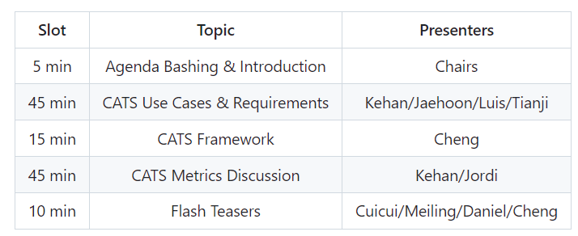
Agenda

Slide 9
Flash Teasers
Quick introduction to some individual I-D
Presenters to justify how their document fits the WG charter
Items that are not covered by the charter won’t be granted slots in future meeting

Slide 10
Detailed Agenda
Slot | Start | Duration | Information | Presenter
1 | 13:00 | 5 mins | Title: Meeting admin | Chairs
2 | 13:05 | 45 mins | Title: CATS Use Cases and Requirements
2.1 | 13:05 | 10 mins | Title: Status update Draft: https://datatracker.ietf.org/doc/draft-ietf-cats-usecases-requirements/ | Kehan Yao
2.2 | 13:15 | 15 mins | Title: Clarify the requirements and how these are derived/applicable to the various Use Cases Draft: https://datatracker.ietf.org/doc/draft-ietf-cats-usecases-requirements/ | Kehan Yao
2.3 | 13:30 | 20 mins | Title: Discussion about how use cases in I-Ds are overlapping with existing UCs/have to be captured Draft: https://datatracker.ietf.org/doc/draft-jeong-cats-its-use-cases/ 5mins Draft: https://datatracker.ietf.org/doc/draft-jiang-cats-usecase-5gedge/ 5mins Draft: https://datatracker.ietf.org/doc/draft-lcmw-cats-midhaul/ 5mins Discussion 5mins | Jaehoon Jeong Tianji Jiang Luis M.Contreras All
3 | 13:50 | 15 mins | Title: CATS Framework Draft: https://datatracker.ietf.org/doc/draft-ietf-cats-framework/ | Cheng Li
4 | 14:05 | 45 mins | Title: CATS Metrics Discussion
4.1 | 14:05 | 15 mins | Title: CATS Metric Description and Definition Drafts: https://datatracker.ietf.org/doc/draft-ysl-cats-metric-definition/ | Kehan Yao
4.2 | 14:20 | 10 mins | Title: Joint Exposure of Network and Compute Information for Infrastructure-Aware Service Deployment Draft: https://datatracker.ietf.org/doc/draft-rcr-opsawg-operational-compute-metrics/ | Jordi Ros Giralt
4.3 | 14:30 | 20mins | Plan for the WG | Chairs and All

Slide 11
Agenda 2 of 2
Slot | Start | Duration | Information | Presenter
5 | 14:50 | 10 mins | Flash Teasers (1-slide)
5. |  | 2 mins | Title: Security Considerations for Computing-Aware Traffic Steering Draft: draft-wang-cats-security-considerations | Yu Fu
5b |  | 2 mins | Title: A mechanism of security monitoring and management for service resources in Computing-Aware Traffic Steering (CATS) Draft: draft-lu-cats-smam-security | Meiling Chen
5c |  | 2 mins | Title: Microloop Prevention in a Hierarchical Segment Routing Solution for CATS Draft: draft-yuan-cats-hierarchical-loop-prevention | Daniel Huang
5d |  | 2 mins | Title: Analysis for Multiple Data Plane Solutions of Computing-Aware Traffic Steering Draft: draft-fu-cats-muti-dp-solution | Daniel Huang
5e |  | 2 mins | Title: Flow-Level Load Balancing of Computing-Aware Traffic Steering (CATS) Draft: draft-fu-cats-flow-lb | Daniel Huang
5f |  | 2 mins | Title: CATS BGP Extension Draft: draft-ll-idr-cats-bgp-extension | Cheng Li
6 |  | / | Title: Open Discussion and Next Steps | Chairs and All

