Slide 1
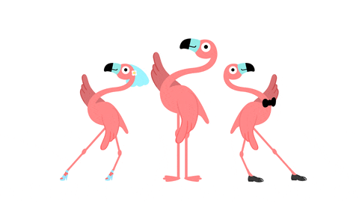
DANE Authentication for
Network Clients
Everywhere
(DANCE)
IETF 123 Thursday July 24 2025
12:00 local -- 10:00 UTC
Chairs:
Wes Hardaker
Joey Salazar
Mailing List:
https://www.ietf.org/mailman/listinfo/dance

Slide 2
Agenda
Chairs Introduction (Wes and Joey 5min)
  note taker needed
Current document statuses (Wes and Joey 10min)
draft-hallambaker-dns-dance (Phillip Hallam-Baker 30min)
Future of DANCE / Open MIC (Wes and Joey 10min)

Slide 3
Note Well
This is a reminder of IETF policies in effect on various topics such as patents or code of conduct. It is only meant to point you in the right direction. Exceptions may apply. The IETF's patent policy and the definition of an IETF "contribution" and "participation" are set forth in BCP 79; please read it carefully.
As a reminder:
By participating in the IETF, you agree to follow IETF processes and policies.
If you are aware that any IETF contribution is covered by patents or patent applications that are owned or controlled by you or your sponsor, you must disclose that fact, or not participate in the discussion.
As a participant in or attendee to any IETF activity you acknowledge that written, audio, video, and photographic records of meetings may be made public.
Personal information that you provide to IETF will be handled in accordance with the IETF Privacy Statement.
As a participant or attendee, you agree to work respectfully with other participants; please contact the ombudsteam (https://www.ietf.org/contact/ombudsteam/) if you have questions or concerns about this.

Slide 4
Note Well, part 2
Definitive information is in the documents listed below and other IETF BCPs. For advice, please talk to WG chairs or ADs:
BCP 9 (Internet Standards Process)
BCP 25 (Working Group processes)
BCP 25 (Anti-Harassment Procedures)
BCP 54 (Code of Conduct)
BCP 78 (Copyright)
BCP 79 (Patents, Participation)
https://www.ietf.org/privacy-policy/(Privacy Policy)

Slide 5
IETF Code Of Conduct Guidelines RFC7154
1. Treat colleagues with respect
2. Speak slowly and limit the use of slang
3. Dispute ideas by using reasoned argument
4. Use best engineering judgment
5. Find the best solution for the whole Internet
6. Contribute to the ongoing work of the group and the IETF

Slide 6
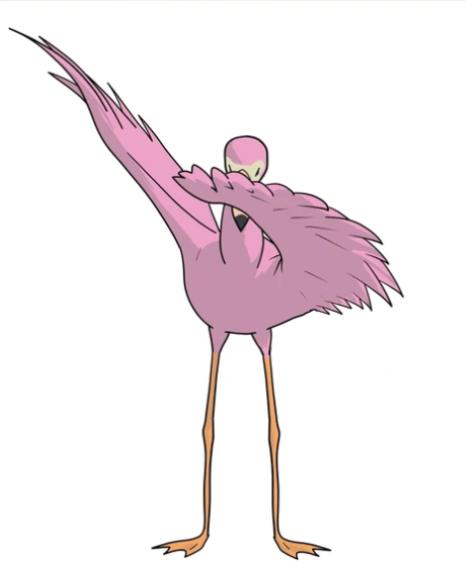
DANCE WG Information
Datatracker: https://datatracker.ietf.org/group/dance/about/
Purpose: Extend DANE to encompass TLS client authentication using certificates or Raw Public Keys (RPK).
GitHub: https://github.com/ietf-wg-dance
Mailing list information: dance@ietf.org
Subscribe: https://www.ietf.org/mailman/listinfo/dance
Active documents:
draft-dance-architecture
draft-dance-tls-dane-clientid
draft-dance-dane-client-cert
Drafts to consider:
draft-hallambaker-dns-dance

Slide 7

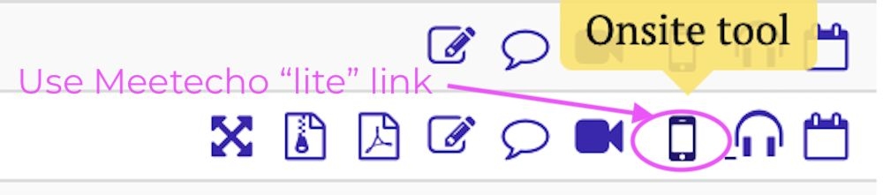
This session is being recorded
IETF 113 Meeting Tips
In-person participants
●
Make sure to sign into the session using the Meetecho
(usually the “onsite tool” client) from the Datatracker agenda
●
Use Meetecho to join the mic queue
●
Keep audio and video off if not using the onsite version
Remote participants
●
Make sure your audio and video are off unless you are
chairing or presenting during a session
●
Use of a headset is strongly recommended
6

Slide 8
Agenda
Chairs Introduction (Wes and Joey 5min)
  note taker needed
Current document statuses (Wes and Joey 10min)
draft-hallambaker-dns-dance (Phillip Hallam-Baker 30min)
Future of DANCE / Open MIC (Wes and Joey 10min)

Slide 9

The story so far
Active documents:
draft-dance-architecture
draft-dance-tls-dane-clientid
draft-dance-dane-client-cert

Slide 10

Presentation
draft-hallambaker-dns-dance

Slide 11
Deliverables
DANCE architecture document and use cases
DANE client authentication and publication practices
A TLS extension to indicate DANE identification capability and the client's DANE identity name

Slide 12
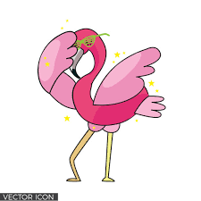
Discussion
Future of DANCE
Next slide is deliverables

