Slide 1


IETF 118 HTTPAPI
6 November 2023
Darrel Miller, Rich Salz - Chairs Mark Nottingham - Secretary
This session is being recorded
IETF 118 Prague
Internet Engineering Task Force
© 2022 IETF Trust Production by Meetecho
1

Slide 2

Note Well
This is a reminder of IETF policies in effect on various topics such as patents or code of conduct. It is only meant to point you in the right direction. Exceptions may apply. The IETF's patent policy and the deﬁnition of an IETF "contribution" and "participation" are set forth in BCP 79; please read it carefully.
As a reminder:
By participating in the IETF, you agree to follow IETF processes and policies.
If you are aware that any IETF contribution is covered by patents or patent applications that are owned or controlled by you or your sponsor, you must disclose that fact, or not participate in the discussion.
As a participant in or attendee to any IETF activity you acknowledge that written, audio, video, and photographic records of meetings may be made public.
Personal information that you provide to IETF will be handled in accordance with the IETF Privacy Statement.
As a participant or attendee, you agree to work respectfully with other participants; please contact the ombudsteam (https://www.ietf.org/contact/ombudsteam/) if you have questions or concerns about this.
Deﬁnitive information is in the documents listed below and other IETF BCPs. For advice, please talk to WG chairs or ADs:
BCP 9 (Internet Standards Process)
BCP 25 (Working Group processes)
BCP 25 (Anti-Harassment Procedures)
BCP 54 (Code of Conduct)
BCP 78 (Copyright)
BCP 79 (Patents, Participation)
https://www.ietf.org/privacy-policy/(Privacy Policy)
2

Slide 3
Note Really Well
IETF meetings, virtual meetings, and mailing lists are intended for professional collaboration and networking, as defined in the IETF Guidelines for Conduct (RFC 7154), the IETF Anti-Harassment Policy, and the IETF Anti-Harassment Procedures (RFC 7776). If you have any concerns about observed behavior, please talk to the Ombudsteam, who are available if you need confidentiality to raise concerns confident about harassment or other conduct in the IETF.
The IETF strives to create and maintain an environment in which people of many different backgrounds and identities are treated with dignity, decency, and respect. Those who participate in the IETF are expected to behave according to professional standards and demonstrate appropriate workplace behavior.
IETF participants must not engage in harassment while at IETF meetings, virtual meetings, social events, or on mailing lists. Harassment is unwelcome hostile or intimidating behavior—in particular, speech or behavior that is aggressive or intimidates.
If you believe you have been harassed, notice that someone else is being harassed, or have any other concerns, you are encouraged to raise your concern in confidence with one of the Ombudspersons.

Slide 4
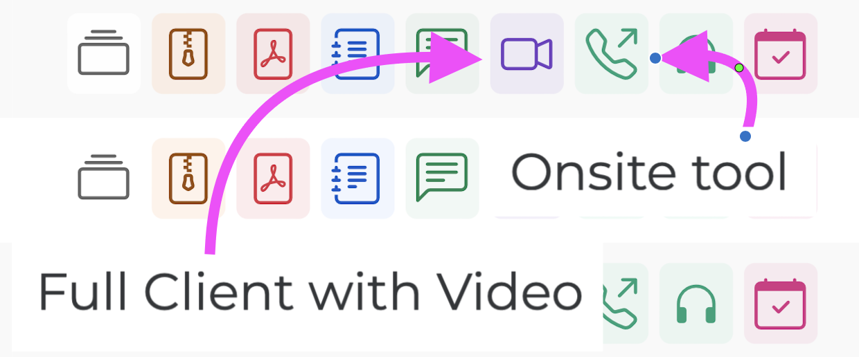
This session is being recorded
IETF 118 Meeting Tips
In-person participants
Make sure to sign into the session using the Meetecho (usually the “onsite tool” client) from the Datatracker agenda
Use Meetecho to join the mic queue
Keep audio and video off if not using the onsite version
Remote participants
Make sure your audio and video are off unless you are chairing or presenting during a session
Use of a headset is strongly recommended
3

Slide 5
Resources for IETF 118 Prague
Agenda
https: /datatracker.ietf.org/meeting/agenda
Meetecho and other information:
https: /www.ietf.org/how/meetings/preparation
If you need technical assistance, see the Reporting Issues page: http: /www.ietf.org/how/meetings/issues/
4

Slide 6
Agenda
WG Documents - Status Update (10 mins)
YAML Media Type, Link-Template HTTP Header Field, Problem Details
WG Document Presentations / Discussions (70 mins)
Adoption (10 mins)
Relative JSON Pointer
Discussions/Any Other Business (10 mins)
Administrivia (5 mins)
Note-taker
Zulip/Meetecho Scribe
Agenda bashing
Francesca is back; re-organization
API Catalog, Byte range, Link Hints, REST API Media Types, Auth Link Relations, Idempotency-Key HTTP Header Field, Rate Limit Headers
Deprecation or Lifecycle? (15 mins)
If there are no volunteers to do Lifecycle, we will move Deprecation forward.
5

Slide 7
WG Documents - Status Update (10 mins)
YAML Media Type
Link-Template HTTP Header Field
Problem Details
https://datatracker.ietf.org/doc/draft-ietf-httpapi-yaml-mediatypes/
In RFC Editor Queue
https://datatracker.ietf.org/doc/draft-ietf-httpapi-link-template
Revised I-D needed. Mark, update or need Help?
https://datatracker.ietf.org/doc/rfc9457/ 🎉
5

Slide 8
WG Document Presentations / Discussions (70 mins)
Idempotency-Key HTTP Header Field
Rate Limit Headers
REST API Media Types
API Catalog - Kevin Smith
Byte range - Austin William Wright
Link Hints Mark Nottingham
New version published; comments? GitHub Repo?
. New version; comments? GitHub Repo?
Recently adopted. No comments, no issues.
OpenAPI issues: plain name fragments, and security considerations
Editors draft includes ability for client to send field without knowledge of server support. No WG consensus yet.
Policy identifier PR is updated with feedback from IETF 117
Auth Link Relations – Evert Pot
Updates? Empty GitHub repo.
Move to WGLC with/without addressing that? New version first?
JSON Schema issues: ??
Minor editorial issues remain.
Scope parameter and quota units are open issues.
Do we need a parameter registry?
5

Slide 9
Nearly there…
Adoption (10 mins)
Relative JSON Pointer
Discussions/Any Other Business (10 mins)
Deprecation or Lifecycle? (15 mins)
If there are no volunteers to do Lifecycle, we will move Deprecation forward.
5

Slide 10

We made it!

