Slide 1


IETF 120 HTTPAPI
25 July 2024
Darrel Miller, Rich Salz - Chairs Mark Nottingham - Secretary
IETF 120 Vancouver hosted by
This session is being recorded
Internet Engineering Task Force
© 2022 IETF Trust Production by Meetecho
1

Slide 2

Note Well
This is a reminder of IETF policies in effect on various topics such as patents or code of conduct. It is only meant to point you in the right direction. Exceptions may apply. The IETF's patent policy and the deﬁnition of an IETF "contribution" and "participation" are set forth in BCP 79; please read it carefully.
As a reminder:
By participating in the IETF, you agree to follow IETF processes and policies.
If you are aware that any IETF contribution is covered by patents or patent applications that are owned or controlled by you or your sponsor, you must disclose that fact, or not participate in the discussion.
As a participant in or attendee to any IETF activity you acknowledge that written, audio, video, and photographic records of meetings may be made public.
Personal information that you provide to IETF will be handled in accordance with the IETF Privacy Statement.
As a participant or attendee, you agree to work respectfully with other participants; please contact the ombudsteam (https://www.ietf.org/contact/ombudsteam/) if you have questions or concerns about this.
Deﬁnitive information is in the documents listed below and other IETF BCPs. For advice, please talk to WG chairs or ADs:
BCP 9 (Internet Standards Process)
BCP 25 (Working Group processes)
BCP 25 (Anti-Harassment Procedures)
BCP 54 (Code of Conduct)
BCP 78 (Copyright)
BCP 79 (Patents, Participation)
https://www.ietf.org/privacy-policy/(Privacy Policy)
2

Slide 3

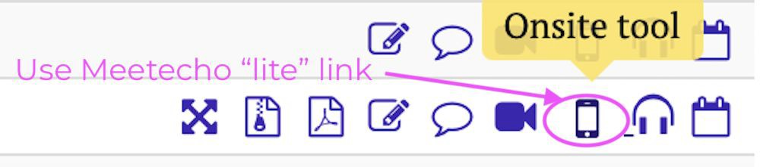
This session is being recorded
IETF 120 Meeting Tips
In-person participants
Make sure to sign into the session using the Meetecho (usually the “onsite tool” client) from the Datatracker agenda
Use Meetecho to join the mic queue
Keep audio and video off if not using the onsite version
Remote participants
Make sure your audio and video are off unless you are chairing or presenting during a session
Use of a headset is strongly recommended
3

Slide 4
Resources for IETF 120 Vancouver
Agenda
https: /datatracker.ietf.org/meeting/agenda
Meetecho and other information:
https: /www.ietf.org/how/meeting/preparation
If you need technical assistance, see the Reporting Issues page: http: /www.ietf.org/how/meetings/issues/
4

Slide 5
Agenda
Administrivia
Note well, meeting tips, minute-takers, agenda bashing
https: /notes.ietf.org/notes-ietf-120-httpapi
Doc Status
Link Template HTTP Header Field – RFC Edit Queue
Deprecation HTTP Header Field – Submitted to IESG
API Catalog – Ready for AD Review
Idempotency Key
draft-ietf-httpapi-idempotency-key-header
Other detailed doc updates
draft-ietf-httpapi-patch-byterange (New Draft)
draft-ietf-httpapi-authentication-link (SecDir Early Review)
New Work
Problem Types for HTTP digest fields
AOB
5

Slide 6
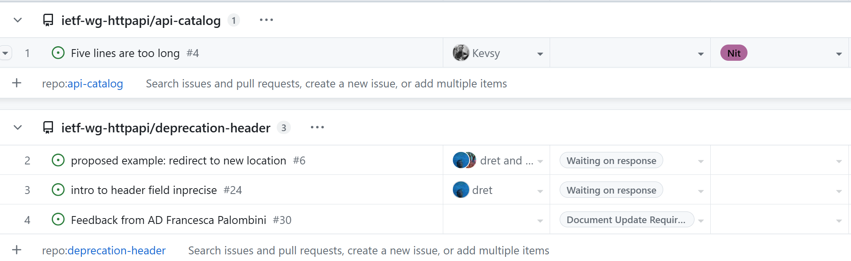
Doc Status
Link Template HTTP Header Field – RFC Edit Queue
Deprecation HTTP Header Field – Submitted to IESG
API Catalog – Ready for AD Review
https://github.com/orgs/ietf-wg-httpapi/projects/1/views/1
5

Slide 7
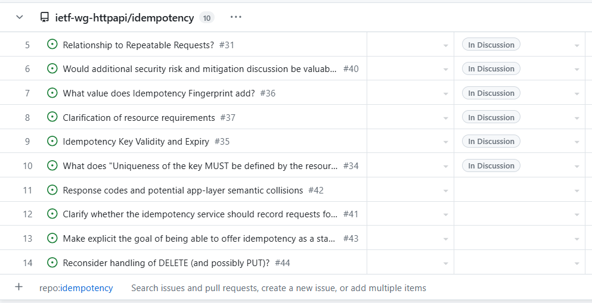
Idempotency Key
5
https://github.com/orgs/ietf-wg-httpapi/projects/1/views/1

Slide 8
Other detailed doc updates
draft-ietf-httpapi-patch-byterange (New Draft) https://github.com/awwright/http-progress
draft-ietf-httpapi-authentication-link SecDir Early Review No Open Issues
5
https://github.com/orgs/ietf-wg-httpapi/projects/1/views/1

Slide 9
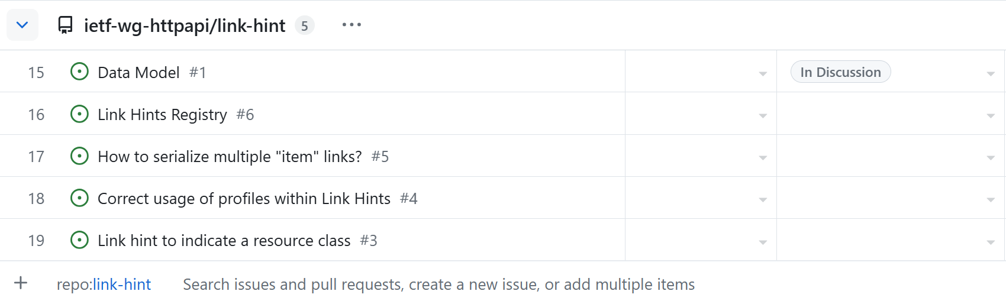
Link Hint
5
https://github.com/orgs/ietf-wg-httpapi/projects/1/views/1

Slide 10
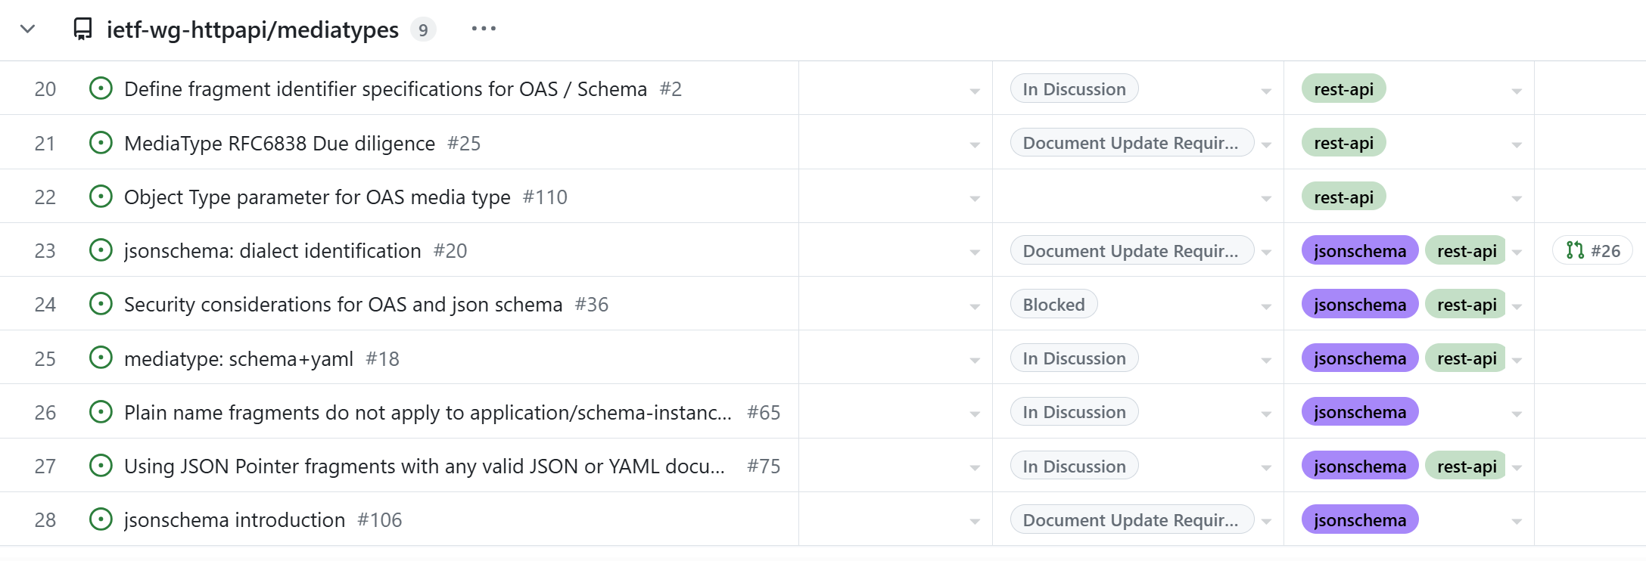
OpenAPI/JSON Schema Media Type
5
https://github.com/orgs/ietf-wg-httpapi/projects/1/views/1

Slide 11
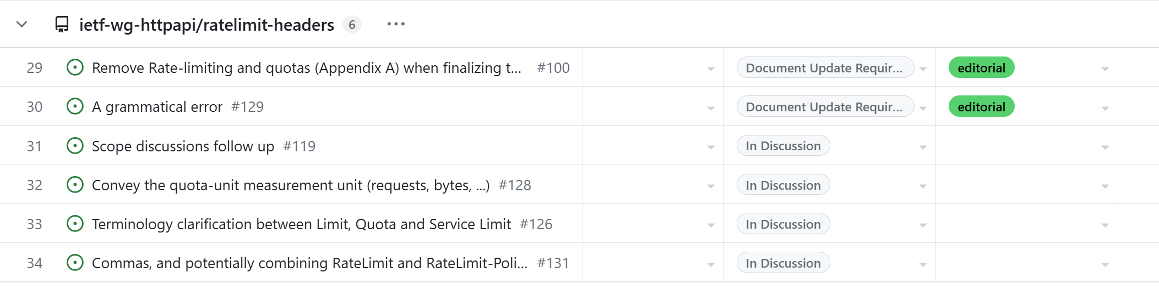
Rate Limit Headers
5
https://github.com/orgs/ietf-wg-httpapi/projects/1/views/1

Slide 12
New Work
Problem Types for HTTP digest fields
5

Slide 13
AOB
5

