Slide 1

Network Management Operations (nmop) Virtual WG Focus: SIMAP (Previously Digital Map)
Feb 14th, 2025
This session is being recorded
Internet Engineering Task Force
© 2025 IETF Trust
Production by Meetecho

Slide 2
Note Well
This is a reminder of IETF policies in effect on various topics such as patents or code of conduct. It is only meant to point you in the right direction. Exceptions may apply. The IETF's patent policy and the definition of an IETF "contribution" and "participation" are set forth in BCP 79; please read it carefully.
As a reminder:
By participating in the IETF, you agree to follow IETF processes and policies.
If you are aware that any IETF contribution is covered by patents or patent applications that are owned or controlled by you or your sponsor, you must disclose that fact, or not participate in the discussion.
As a participant in or attendee to any IETF activity you acknowledge that written, audio, video, and photographic records of meetings may be made public.
Personal information that you provide to IETF will be handled in accordance with the IETF Privacy Statement.
As a participant or attendee, you agree to work respectfully with other participants; please contact the ombudsteam (https://www.ietf.org/contact/ombudsteam/) if you have questions or concerns about this.
Definitive information is in the documents listed below and other IETF BCPs. For advice, please talk to WG chairs or ADs:
BCP 9 (Internet Standards Process)
BCP 25 (Working Group processes)
BCP 25 (Anti-Harassment Procedures)
BCP 54 (Code of Conduct)
BCP 78 (Copyright)
BCP 79 (Patents, Participation)
https://www.ietf.org/privacy-policy/(Privacy Policy)

Slide 3
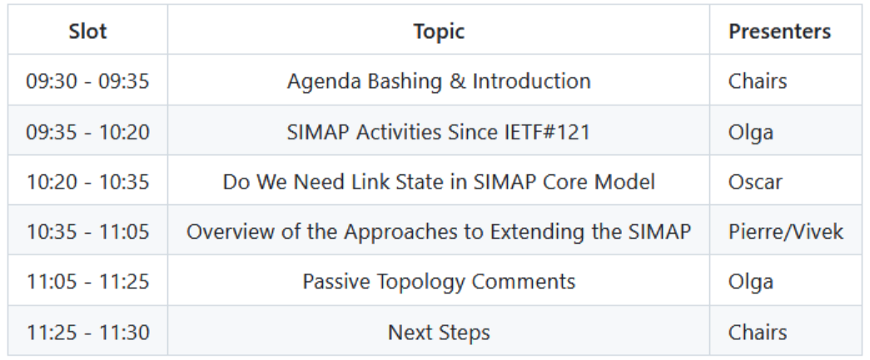
Compact Agenda

Slide 4
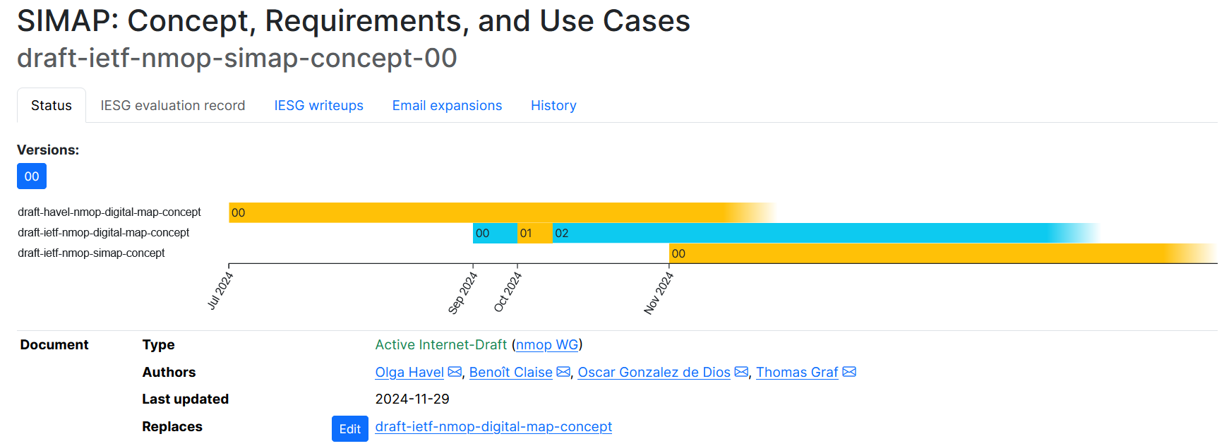
Documents Status
On the agenda

Slide 5
Meeting Objectives
Discuss issues related to the concept definition, applicability, etc.
Agree on a stable set of requirements (consolidate the requirements, agree on their meaning/purpose, avoid biased ones, etc.) so that assessment work can have a stable base for analysis
In other words, progress the “SIMAP: Concept, Requirements, and Use Cases” document

Slide 6
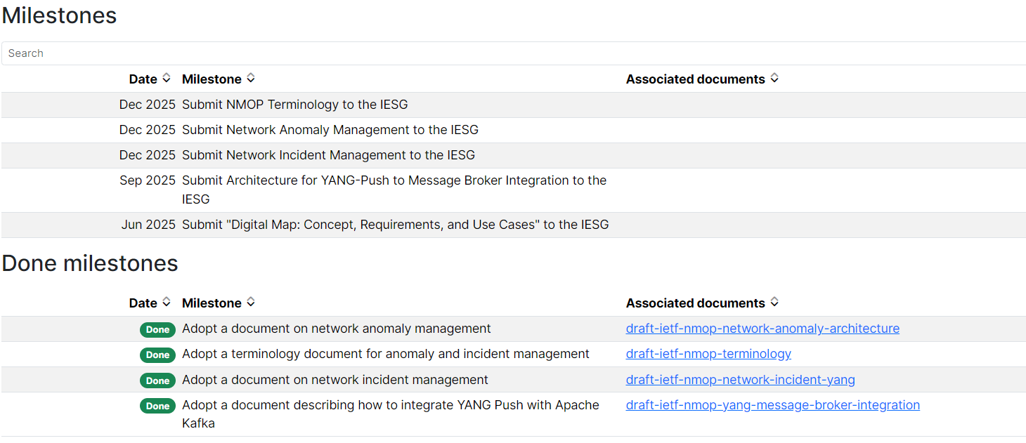
Milestones
NEW
i.e., Target WGLC by 04 or 05/25

Slide 7
Discussion

