Slide 1
Network Management Operations (nmop) WG – Session 1
IETF 127, November 18th, 2026
WG Chairs: B. Claise, R. Rahman
This session is being recorded
Internet Engineering Task Force
© 2026 IETF Trust
Production by Meetecho

Slide 2
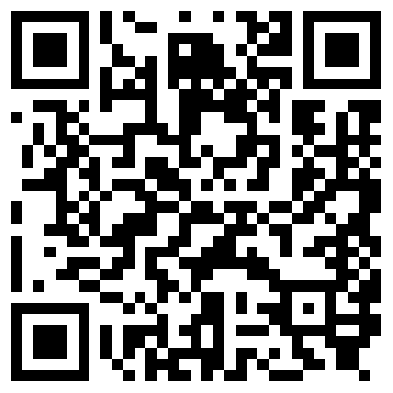
Note Well
By participating in the IETF you agree to follow IETF processes and policies. This Note Well is a reminder
of some of those policies. For a linked version of this text, please visit www.ietf.org/note-well or use the QR code below.
IETF participants are expected to behave in a professional manner and extend respect and courtesy to their colleagues at all times (see RFC 7154: IETF Guidelines for Conduct and IETF Anti-Harassment Policy). If you have any concerns about behavior, please contact the Ombudsteam who have a duty of confidentiality and extensive powers to act, as set out in RFC 7776: IETF Anti-Harassment Procedures.
If you are aware that any IETF contribution (as defined in RFC 5378: Rights Contributors Provide to the IETF Trust) is covered by patents or patent applications that are owned or controlled by you, your employer or your sponsor, you must disclose that fact, or not participate in the discussion
(see RFC 8179: Intellectual Property Rights in IETF Technology).
For detailed process information consult RFC 2026: Internet Standards Process and
RFC 2418: IETF Working Group Guidelines and Procedures and updates to those.
The IETF routinely makes public written, audio, video, and photographic records
of IETF activities, including your personal information as set out in the IETF Privacy Statement.
For advice, please talk to Working Group chairs or Area Directors.
Notes:
The IETF Note Well should be shown at the start of every IETF working session. The guidance below is adapted from IETF legal counsel presentation during IETF 120
DO
Do make sure people have enough time to read through the slide before you move on,
Do give a high-level summary of what’s covered in the Note Well: “IETF policies on conduct, privacy and IPR.”,
Do encourage people to read through all the linked policies & documents in detail before participating or contributing,
Do explain where people can direct questions or concerns (IETF Executive Director or Ombudsteam).
DON'T
Don’t dismiss the importance or relevance of any of the information on the Note Well.
Don’t interpret the meaning or get into the substance of any of the topics or content of the policies.
Don’t communicate that the Note Well conveys all the information participants need to know.
Don’t address questions or concerns in the meeting itself.

Slide 3
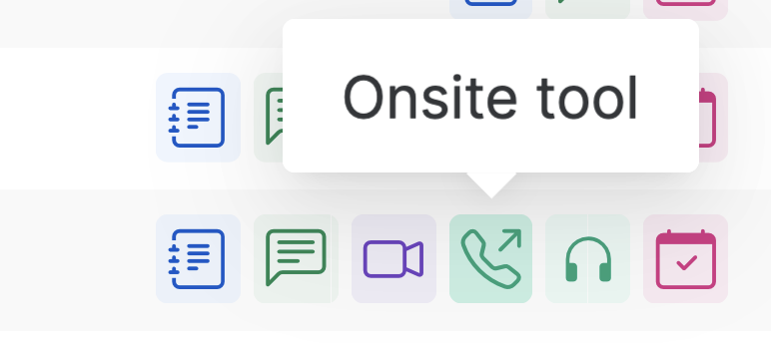
IETF 127 Meeting Tips
This session is being recorded
In-person participants
Make sure to sign into the session via Datatracker or the QR Code in this session.
Use Meetecho (usually the “Meetecho lite”) client to:
  join the mic queue
  participate in shows of hands
Keep audio and video off if not using the onsite version.
Remote participants
Make sure your audio and video are off unless you are chairing or presenting during a session.
Use of a headset is strongly recommended.

Slide 4
Notetaker
We need volunteers for notetaking.
https://notes.ietf.org/notes-ietf-127-nmop

Slide 5
Meeting Logistics
Unfortunately, Benoît Claise is not able to join us in SF
Our secretary Lucia Cabanillas Rodriguez is at the chairs table helping with meeting logistics
Our secretary Jéferson Campos Nobre is taking notes, please contribute to note-taking

Slide 6
Reminder for WG Requests
For “new” documents, if they meet 1 or more of the following criteria there is a bigger chance of getting WG time:
Documents which are in-charter or related to work already adopted by the WG
Documents which have had some discussions on the mailing list
Documents which were submitted early enough (to get reviews/discussions)

Slide 7
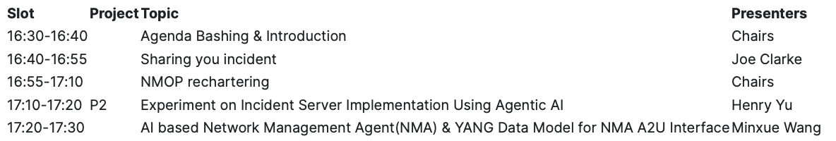
Agenda: Session 1
Notes:
The IETF Note Well should be shown at the start of every IETF working session. The guidance below is adapted from IETF legal counsel presentation during IETF 120
DO
Do make sure people have enough time to read through the slide before you move on,
Do give a high-level summary of what’s covered in the Note Well: “IETF policies on conduct, privacy and IPR.”,
Do encourage people to read through all the linked policies & documents in detail before participating or contributing,
Do explain where people can direct questions or concerns (IETF Executive Director or Ombudsteam).
DON'T
Don’t dismiss the importance or relevance of any of the information on the Note Well.
Don’t interpret the meaning or get into the substance of any of the topics or content of the policies.
Don’t communicate that the Note Well conveys all the information participants need to know.
Don’t address questions or concerns in the meeting itself.

Slide 8
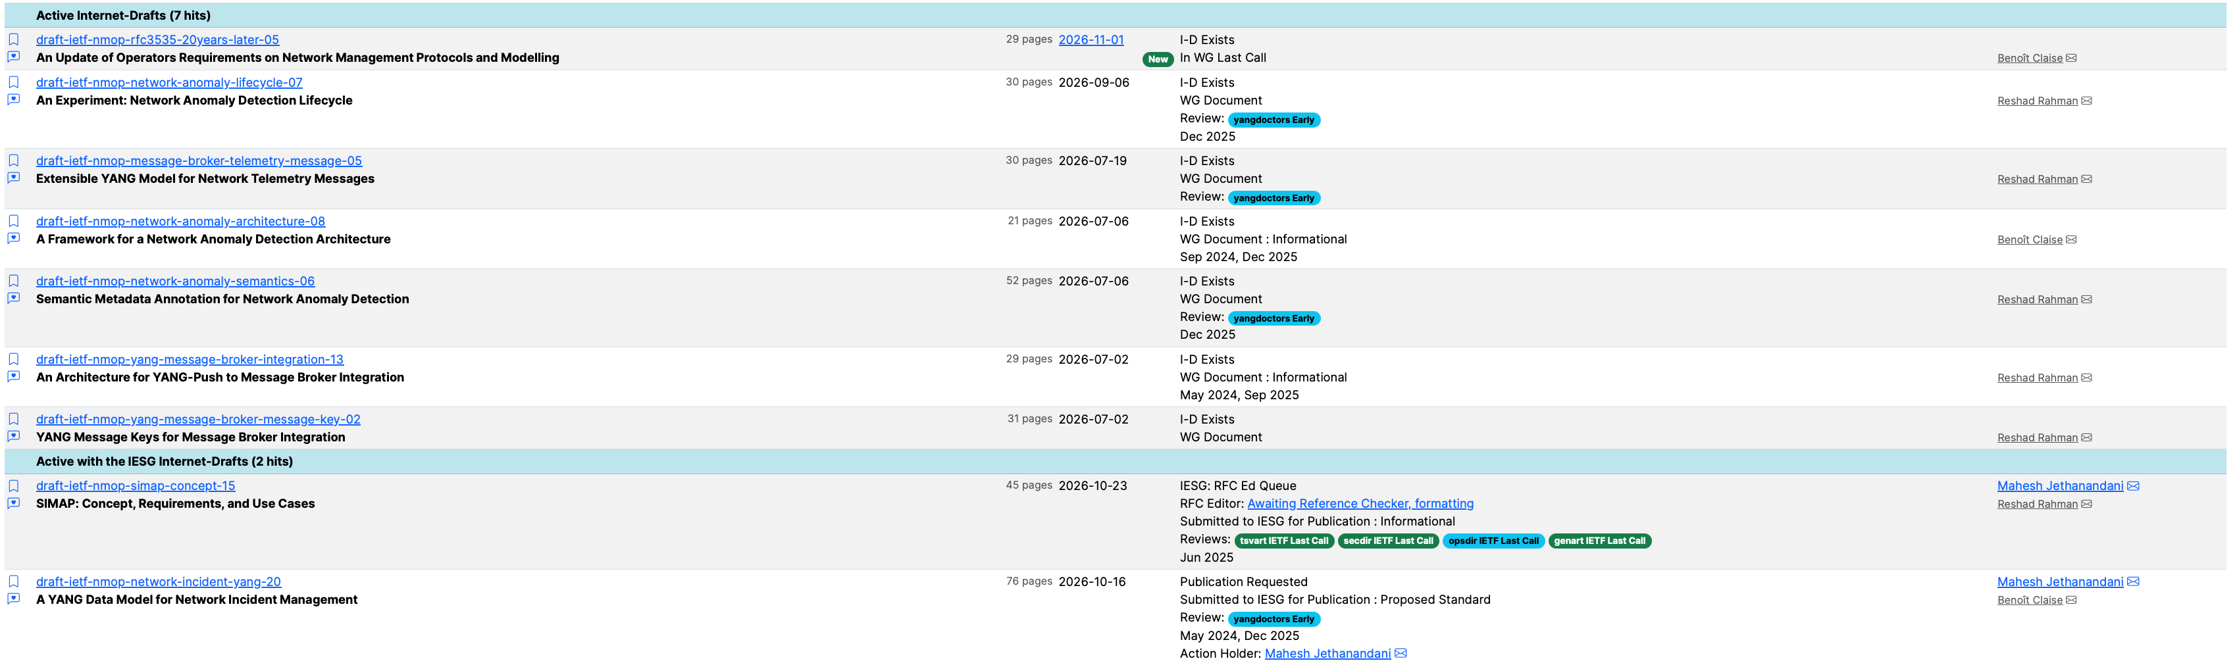
Document Status
In WGLC
RFC Editor
IESG Review
Notes:
The IETF Note Well should be shown at the start of every IETF working session. The guidance below is adapted from IETF legal counsel presentation during IETF 120
DO
Do make sure people have enough time to read through the slide before you move on,
Do give a high-level summary of what’s covered in the Note Well: “IETF policies on conduct, privacy and IPR.”,
Do encourage people to read through all the linked policies & documents in detail before participating or contributing,
Do explain where people can direct questions or concerns (IETF Executive Director or Ombudsteam).
DON'T
Don’t dismiss the importance or relevance of any of the information on the Note Well.
Don’t interpret the meaning or get into the substance of any of the topics or content of the policies.
Don’t communicate that the Note Well conveys all the information participants need to know.
Don’t address questions or concerns in the meeting itself.

Slide 9
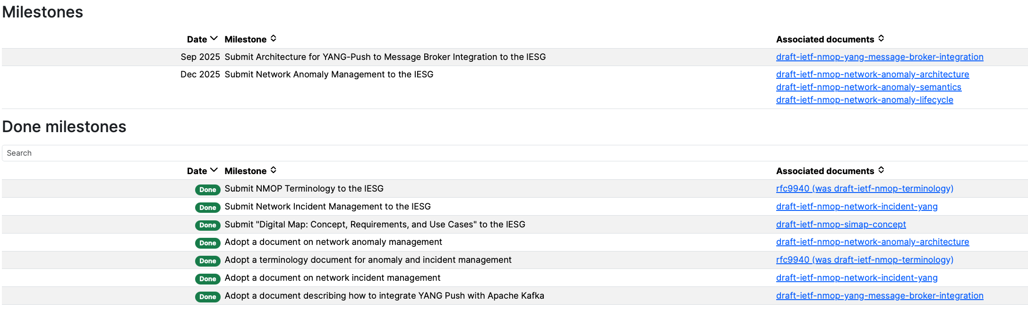
Milestones
WGLC soon
After msg-broker
November 2026
October 2026
New milestones needed soon? Let’s revisit post-rechartering.

Slide 10
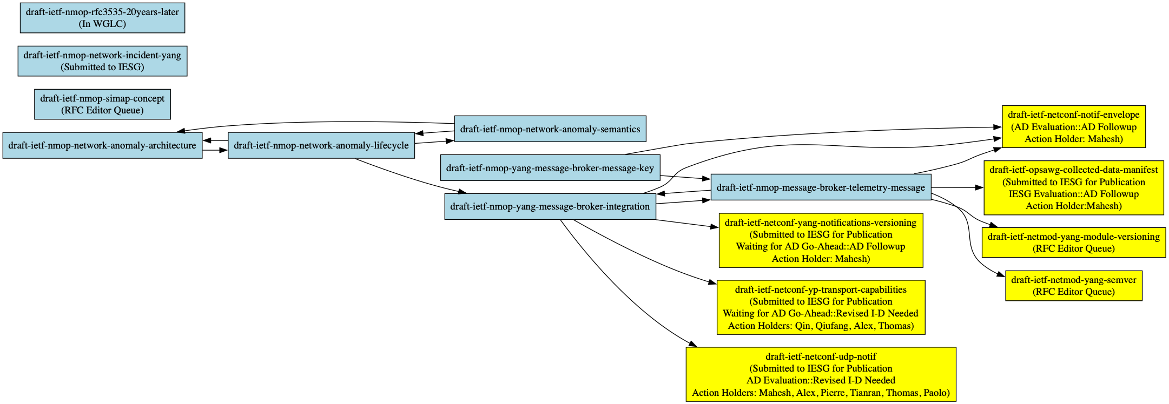
Document Dependencies (normative references)
One down dependency-wise: draft-ietf-netconf-yang-library-augmented-by became RFC 10035!

Slide 11

Document Dependencies (normative references)
Next 2 documents to progress

Slide 12
Previous responses to ”Request for feedback” (prior to IETF126)
Request for feedback email was sent on June 8th:
  Does the current scope align with your operational priorities?
  Are important topics missing?
  Issues in the WG?
  etc
Responses:
  Very interested in the “NETCONF/YANG Push integration with Apache Kafka and TSDB” work. Kudos for the focus on running code.
  More work to do on Binary YANG Push (e.g. SID file management)
  Suggestion to update charter for “AI for network management automation and related operational issues” e.g. management agent architecture etc

Slide 13
New (since IETF126) responses to ”Request for feedback”
Like the experiment approach, also:
  Presentations provide insight with what operators are struggling with
  Approachable for new audiences
  YANG-Push/Kafka and anomaly detection work are of interest
  Support collaboration between NMOP and NMRG, catch attention of researchers
Additional topics desired:
  Make all network observability related data (incl BMP and IPFIX) in a standardized fashion with YANG schema and semantics consumable for humans and agents
  Transforming YANG do DDL (because of current limits of AI agentic context windows)
  Human in the loop postmortem system implementation. How far should we go there?
  Explore network management use cases involving AIops
Please reply to the email if you have any feedback to share

Slide 14
Resources for IETF 127 San Francisco
Agenda
https://datatracker.ietf.org/meeting/agenda
Meetecho and other information:
https://www.ietf.org/how/meetings/preparation
If you need technical assistance, see the Reporting Issues page:
http://www.ietf.org/how/meetings/issues/

