Slide 1
Digital Map IETF Side Meeting
IETF 120
23 July 2024
Vancouver, Canada

Slide 2
Digital Map Problem Space (I)
What do we want to achieve?
How can operators use the IETF topology Yang models to represent a real carrier IP network.
Why? What are the use cases?
Perform the capacity planning of the network
Run what-if scenarios analysis based on representations of the real network.
Ultimately, feed a digital twin where the network can be analyzed.
Goal of current work:
Not boiling the ocean… we start with one particular problem space
How to use IETF topology model to represent a real carrier network based on IS-IS domains and OSPF domains for planning/simulation purposes
2 documents:
draft-ogondio-nmop-isis-topology: Focus on IS-IS domains
draft-ogondio-nmop-ospf-topology: Focused on OSPF domain

Slide 3
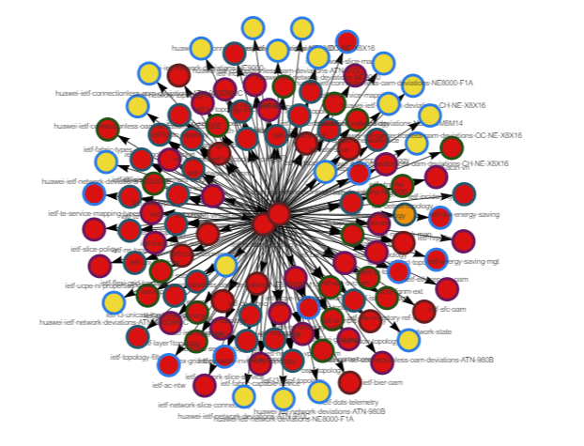
Digital Map Problem Space (II)
Impact analysis of IETF topology
(augmentations + deviations)
YANG Catalog
Topology Yang models
Topology information is widespread 10s of Yang modules
Augmentations cover technology specific details
But also cover generic traffic engineering, service attachment points…..
What happens when doing the exercise to model a real carrier network?
Most parameters required appear in several modules
Some gaps are found
And the limitations of RFC 8345 forces to model in a particular way, requiring some “hacks”
We are currently working on categorization of the augmentations, please review:
Misc/Digital-Map-Analysis at main · ietf-wg-nmop/Misc (github.com)
I asked authors for the feedback,

Slide 4
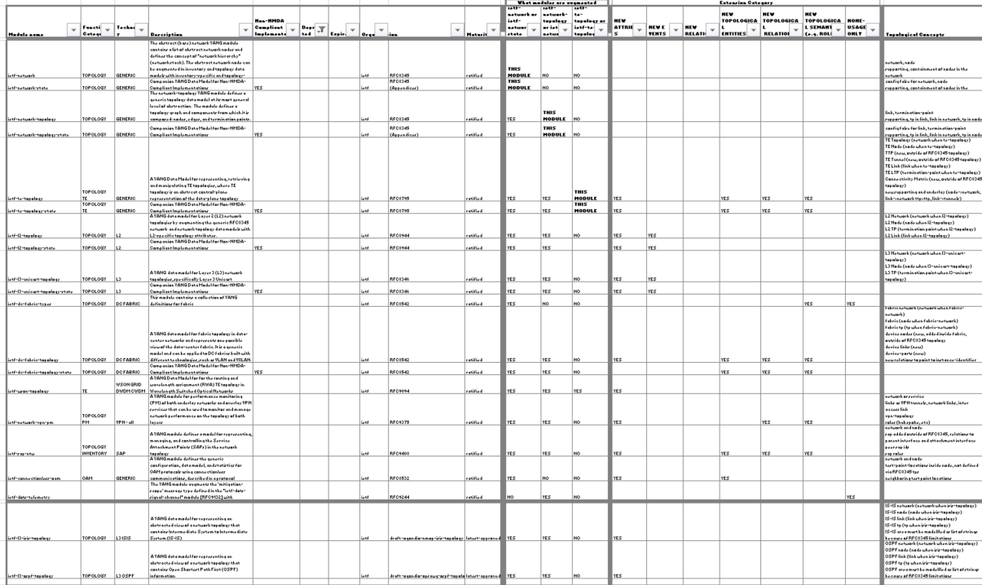
The RFC 8345
Augmentations
We started working on the analysis and categorization of all RFC8345 augmentations and usage
Categorization:
functional (Topology, TE, PM, Inventory, ..)
technology (generic, L3, L2, OSPF, IS-IS, ..)
extension
New attributes
New events
New relations
New topological entities
New topological relations
New topological semantics
New sublayer
Usage (e.g. types reuse)
Some challenges for multi-layer digital map (examples):
topological entities defines outside of RFC8345 for TE tunnel and ttps but pm augments link for VPN tunnels
topological entities defined outside for RFC8345 for fabric
subset of underlay defined outside of RFC8345 for TE underlay
some generic extensions (e.g. cross-domain links) defined in augmentations (e.g. te-topology) but needed for non te augmentations as well
some roles for topological entities defined in augmentations in custom ways
The RFC8345 augmentations are not consistent, which makes it very hard to deploy the multi-layer digital map
Goal: topological entities and topological relations for all layers of Digital Map could be modelled using RFC8345

Slide 5
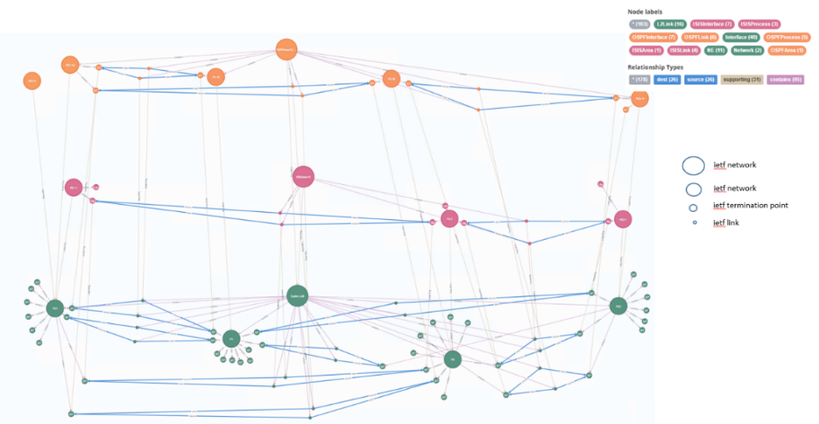
Digital Map Objectives
Can RFC 8345 YANG model be a good basis to model a Digital Map?
How the different topology related IETF YANG modules fit (or not) together?
Modelling of digital map entities & relationships, how to build aggregated entities and relationships from the device view to the network-wide and service views
Does the base RFC 8345 model support the key requirements that emerge for a specific layer?
Modelling multiple underlay/overlay layers from physical to customer service layer. To what extent it is easy to augment the base model to support new technologies?
Can the base model be augmented for any new layer and technologies?

Slide 6
Core Digital Map Use Cases and Requirements collected from Operators so far
draft-havel-nmop-digital-map-concept-00 - Digital Map: Concept, Requirements, and Use Cases (ietf.org)
RFC8345-based
Use Cases:
Network Inventory Queries
Service Placement Feasibility Checks
Service->Subservice->Resource
Resource->Subservice->Service
Intent / Service Assurance
Service E2R and Per-Link KPIs on the Digital Map (delay, jitter and loss)
Capacity Planning
Network Design
What-if / Simulation / Emulation
Closed Loop
Requirements:
Basic model with Network, Node, Link, Interface, Layers
Layered from physical to customer service (intent)
Open and programmable (read/write for what-if for DM)
Standard based Digital Map model and API
Cross-domain
Semantics for layered network topologies
Relationships
Extensible with metadata
Pluggable for specific functional modules
inventory, KPIs, ..
Note: not everything will be in YANG
Optimized for graph traversal
Ok
Ok
Ok
Ok
Ok
Partial
Partial
Different users may use different layers and have different requirements

Slide 7
Candidate Approaches to address RFC8345 Limitations for Digital Map Modelling
All enhancements will consider current usage and will be backward compatible wherever possible
 | Identified gap | Candidate Approaches | Proposal
1 | Bidirectional Links | Implement via multiple unidirectional links or via virtual nodes (current RFC8345 approach) Leave to different augmentations to solve the problem their own way Augment RFC8345 via basic approach from draft-davis-opsawg-some-refinements-to-rfc8345 Augment RFC8345 via sophisticated approach from draft-davis-opsawg-some-refinements-to-rfc8345 Consider RFC8345 bis | Start the work on RFC8345bis to provide the BACKWARD COMPATIBLE MODEL to support all these limitations 1 and 2: Start from basic BACKWARD COMPATIBLE approach from draft-davis-opsawg-some-refinements-to-rfc8345 Evaluate any implementations inside the current augmentations for simplicity and if generic 3, 6 and 7: consider RFC8795 approach 5: The solution needs further analysis as it has bigger impact on the topology tree than other enhancements
2 | Multipoint Connectivity
3 | Links between networks | Implement domains via properties in augmentations Leave to different augmentations to solve the problem their own way (see how it is done in RFC8795) Augment RFC8345 by adding some simple solution (e.g. move RFC8795 approach for multi-domain links to RFC8345) Consider RFC8345bis
4 | Networks part of another network | Implement via supporting relationship or via modelling domains in the IP network Leave to different augmentations to solve the problem their own way Augment Rfc8345 by adding some simple solution Consider RFC8345bis
5 | Nodes, tps, links in multiple networks | Use the current approach – this is not problem for read but may be an issue for write Augment RFC8345 to optionally allow nodes to be defined outside of the network tree and referenced. Consider RFC8345bis
6 | Missing Supporting Relationships | 1. Leave to different augmentations to solve the problem their own way (see how it is done in RFC8795) 2. Augment RFC8345 by adding some simple solution (e.g. move RFC8795 approach for multi-domain links to RFC8345) 3. Consider RFC8345bis
7 | Missing Topology Semantics
draft-havel-nmop-digital-map-01 - Modeling the Digital Map based on RFC 8345: Sharing Experience and Perspectives (ietf.org)
draft-davis-nmop-some-refinements-to-rfc8345-00 - Some Refinements to Network Topologies (RFC8345) (ietf.org)

Slide 8
Where to add solutions for the RFC8345 Gaps
RFC8345 Augmentation for Digital Map
RFC8345bis for Digital Map (Digital Map draft authors / Hackathon team members prefer this approach)
RFC 8795: YANG Data Model for Traffic Engineering (TE) Topologies (ietf.org) (Italo is suggesting)

Slide 9
Where to add solutions for the RFC8345 Gaps
Nigel’s slides
The history:
Nigels’s slides
Email exchange between Olga/Italo/Nigel
Olga and Nigel prefer the approach of using RFC8345bis for the Digital Map core topology module
Italo prefers the approach of using the RFC8795 for the Digital Map core topology module
There was some discussion about how the gaps were addressed in RFC8795 (but that will be important only if we agree the approach
Emails between
Olga, Italo and Nigel:

Slide 10
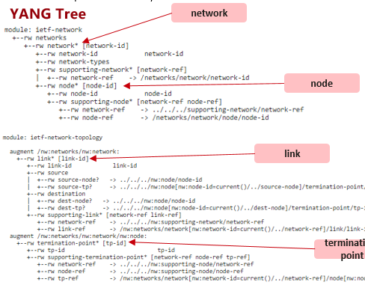
Some pros for having RFC8345 bis as a core Digital Map Topology Model (backward compatible)
Simplicity
Layered Topology from Physical to Service / Flow
RFC8345 supports any use case because it is focused on topology only – does not have any functional information - it can be added via augmentation or some other way
While RFC8795 has all functional information for traffic engineering, it may be too complex for core topology model and for some other use cases
RFC8795 YANG tree – 2243 lines
Italo presented profiles.
Simple json/xml instances
Can we get info about what profiles are supported via capabilities?
What do app developers need to understand. What is the API definition (TE YANG + profile?)
RFC8345 Network Topology Model

Slide 11
Next Steps / Share Feedback
We have different opinions, what to do next?
Suggestion: 2 Hackathons at IETF 121
Pros / cons of both approaches after hackathons, where we can compare API definitions and API request / response examples
Collect opinions from others now or wait until hackathon and more proofs of the approaches?

