Slide 1
ISP-Aided Neighbor Selection for P2P Systems
Vinay Aggarwal
vinay@net.t-labs.tu-berlin.de
Anja Feldmann, Obi Akonjang, Christian Scheideler (TUM)
Deutsche Telekom Laboratories
TU Berlin, Germany

Slide 2
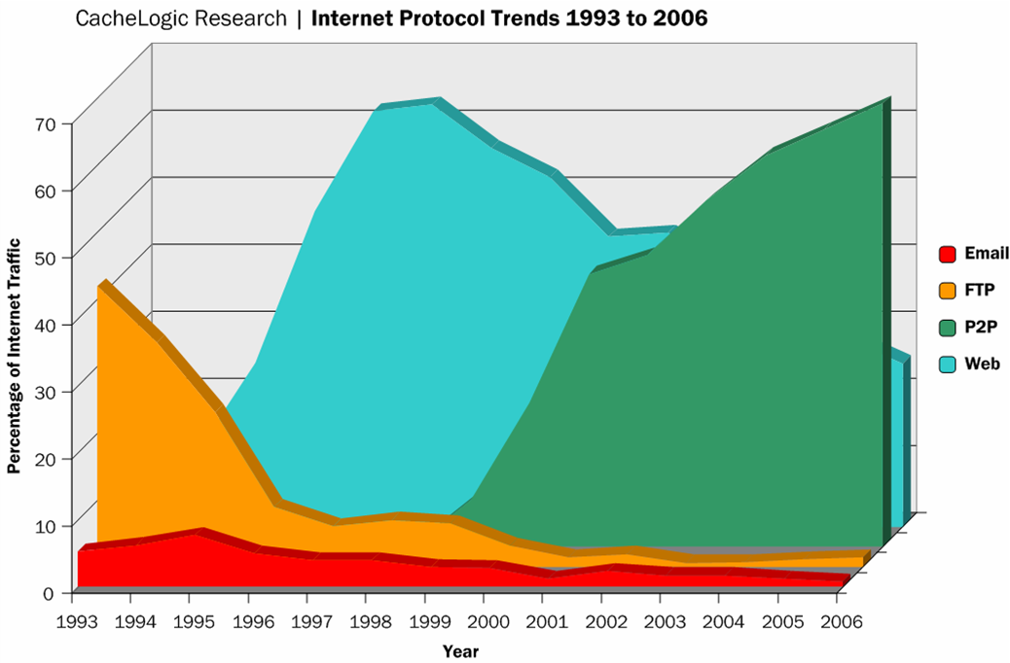
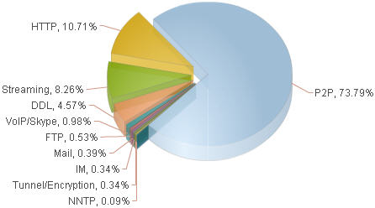
P2P traffic
>50% of Internet traffic
  Examples: Bittorrent, eDonkey, Skype, GoogleTalk…
Internet traffic distribution 2007 (Germany)
Source: ipoque GmbH (Nov 2007)

Slide 3
P2P from an ISPs view
Good:
  P2P applications fill a void
  P2P applications are easy to develop and deploy
  P2P applications spur broadband demand
Bad:
  P2P systems form overlays at application layer
  Routing layer functionality duplicated at app layer
  P2P topology agnostic of underlay→ performance loss
  Traffic engineering difficult with P2P traffic
ISPs are in a dilemma

Slide 4
Solution: ISP-P2P cooperation
Insight: ISP knows its network
  Node: bandwidth, geographical location, service class
  Routing: policy, OSPF/BGP metrics, distance to peers

Slide 5
Solution: ISP-P2P cooperation
Insight: ISP knows its network
  Node: bandwidth, geographical location, service class
  Routing: policy, OSPF/BGP metrics, distance to peers
Our idea:
  ISPs: offer oracle that provides network distance info
  P2P: use oracle to build P2P neighborhoods

Slide 6
Solution: ISP-P2P cooperation
Insight: ISP knows its network
  Node: bandwidth, geographical location, service class
  Routing: policy, OSPF/BGP metrics, distance to peers
Our idea:
  ISPs: offer oracle that provides network distance info
  P2P: use oracle to build P2P neighborhoods
Oracle concept
  Service of AS / ISP
  Input: list of possible dst IPs
  Ouput: ranked list of dst IPs
    E.g. according to distances between src IP and dst IPs

Slide 7
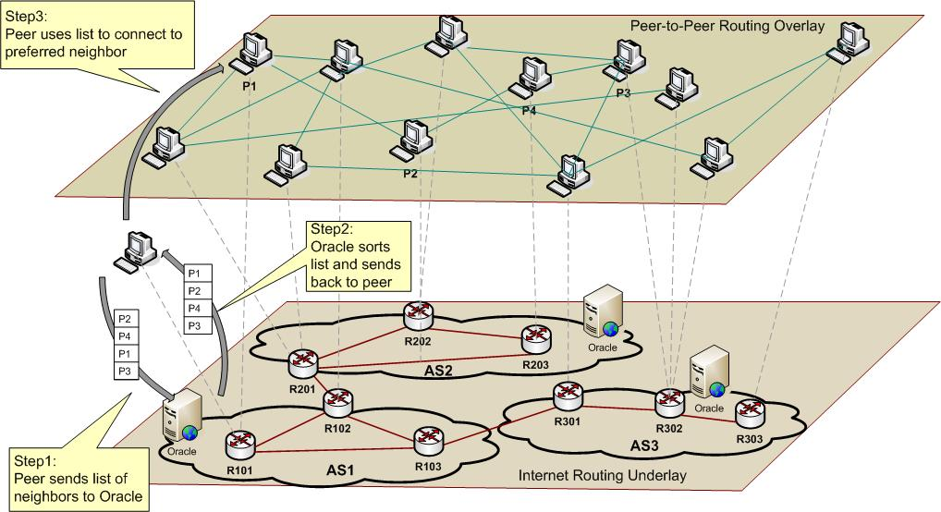
Oracle service
Oracle-based peer selection
→ for topology and content exchange

Slide 8
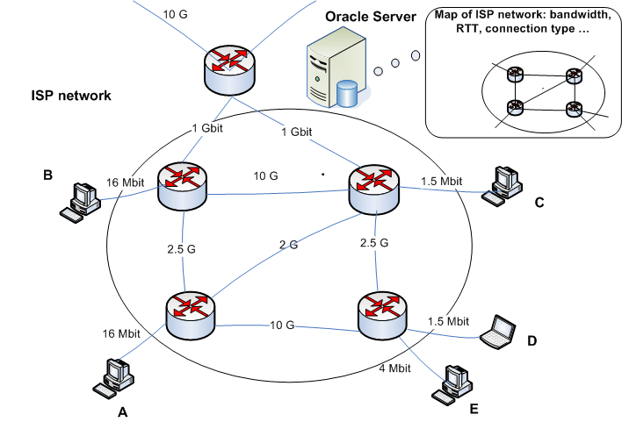
Oracle service (example)

Slide 9
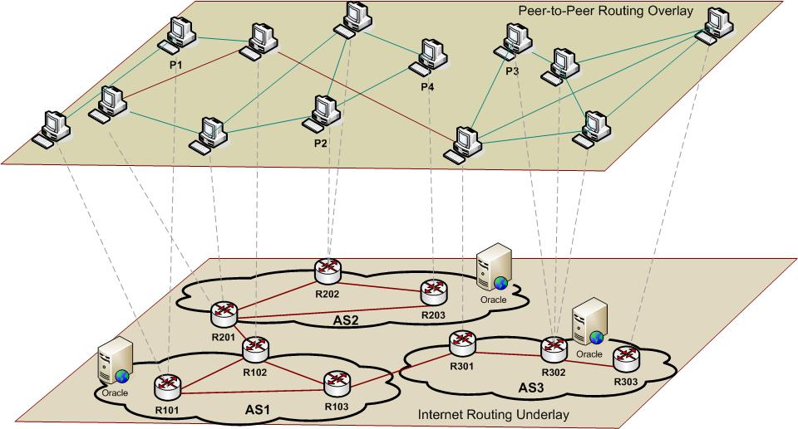
Oracle service (2.)
Oracle-based peer selection
→ localizes topology and traffic

Slide 10
ISP-P2P cooperation
ISP-aided optimal P2P neighbour selection
  Simple and general solution, open for all overlays
  Run as Web server or UDP service at known location
    Similar to bind (DNS)?
Benefits: P2P
  No need to measure path characteristics
  Easy to avoid bottlenecks => better performance
Benefits: ISPs
  Regains control over traffic
  Less traffic leaving network => cost savings
  Customer service improvement

Slide 11
ISP/P2P concerns
Network info
  ISP ranking algorithm confidential
  Output is ranked list or classification, actual statistics not revealed
  List can be anonymized and dynamically altered
  Network info „revealed“ is already possible to reverse-engineer using available tools
Legal Issues
  No caching of content at ISP
  Oracle is a peer mapping service => consulting oracle does not imply participation in file-sharing

