Slide 1
ISP/P2P concerns
Network info
  ISP ranking algorithm confidential
  Output is ranked list or classification, actual statistics not revealed
  List can be anonymized and dynamically altered
  Network info „revealed“ is already possible to reverse-engineer using available tools
Legal Issues
  No caching of content at ISP
  Oracle is a peer mapping service => consulting oracle does not imply participation in file-sharing

Slide 2
Graph experiments
In ACM SIGCOMM CCR‘07
Overlay graph structure not affected
  Node degree, overlay path length unchanged
  Graph connected, diameter constant
Intra-AS peerings increase heavily
Densely connected subgraphs local to ISPs
  P2P topology correlated with AS topology
Congestion analysis using flow conductance
  Traffic distribution with oracle near-optimal
Feasibility study in testbed and Planetlab

Slide 3
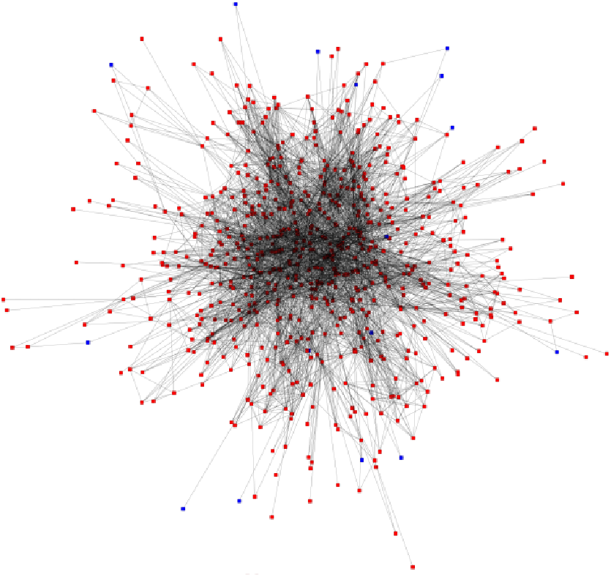
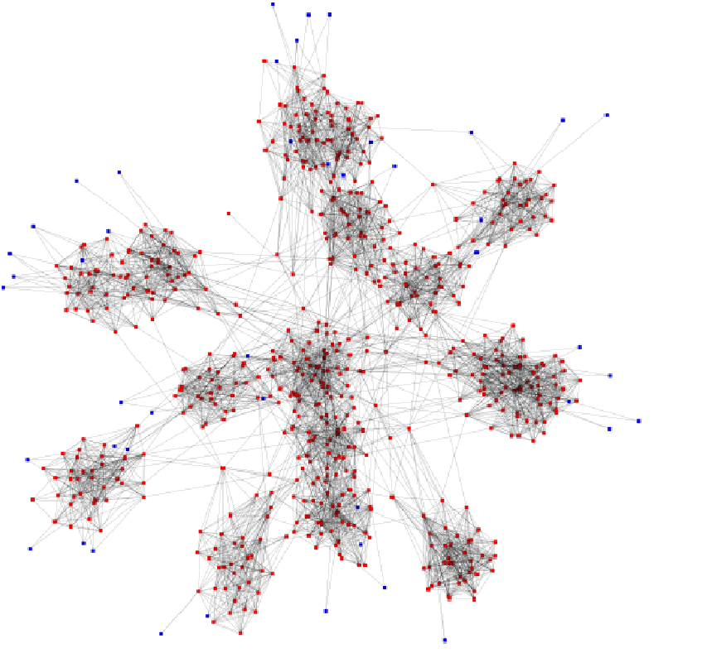
Overlay-underlay topology correlation
Random vs. biased P2P topology

Slide 4
Packet-level simulations
In Global Internet 08
Study the Impact of Topology and User-behavior patterns on end-user performance
Methodology
  Sensitivity study
  Use different ISP / P2P topologies
  Use different user behavioral patterns
    Content availability, churn, query patterns
  Evaluate effects of on end-user experience

Slide 5
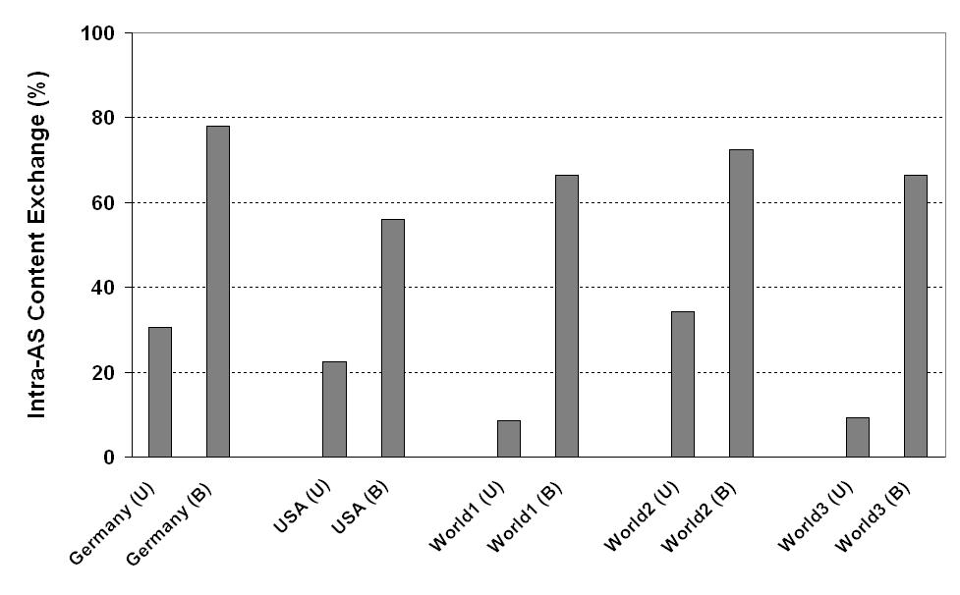
ISP experience: Intra-AS content
Content stays within ISPs network
  Without oracle 10 to 35%
  With oracle 55 to 80%

Slide 6
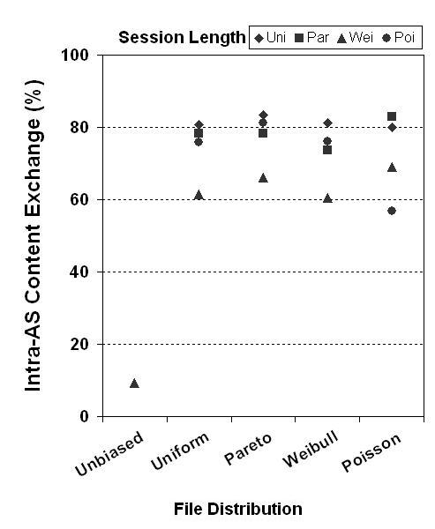
ISP experience: Intra AS content (2.)
Content stays within ISPs network

Slide 7
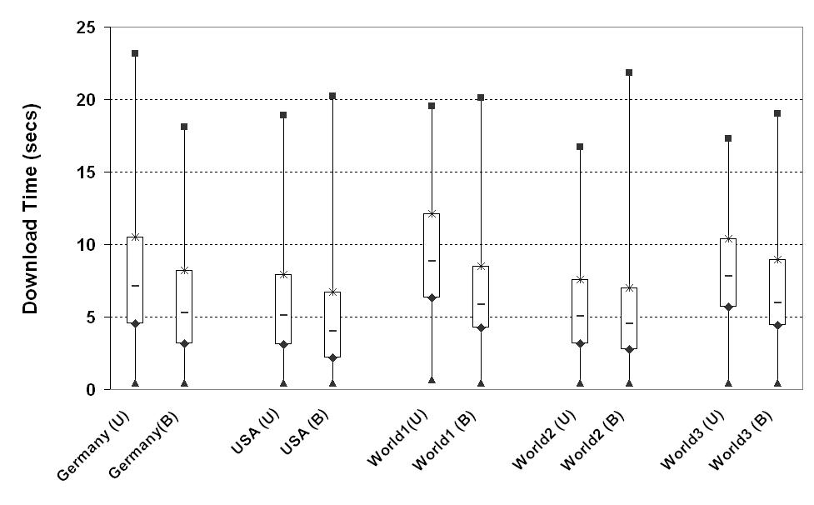
User experience: Download time
Mean download time reduction: 1 – 3 secs (16 – 34%)
Consistent across topologies

Slide 8
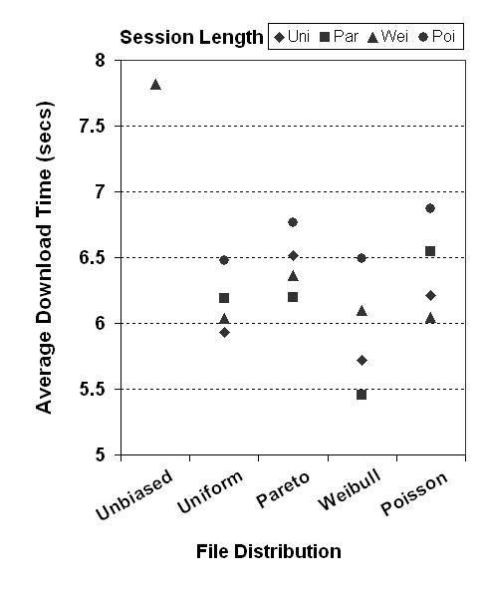
User experience: Download time (2.)
Reduced mean download time

Slide 9
Summary
Oracle
  Simple and easy to implement
Evaluation shows
  Overlay graph structure not affected
  Reduced AS distance
    P2P topology correlated with AS topology
  Traffic congestion analysis
    Traffic distribution close to theoretical optimum
Benefits
  ISPs: regain control of network traffic
  P2P network: sees performance improvements

Slide 10
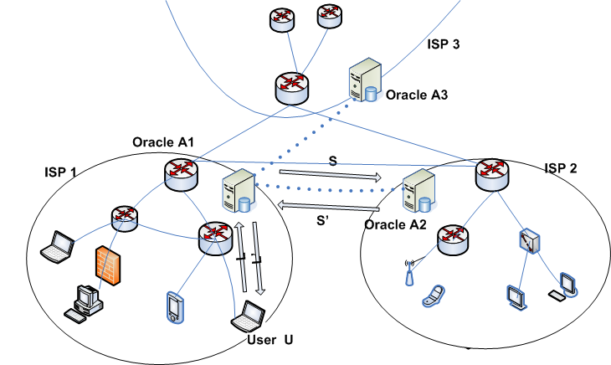
Extension: Multiple ISP collaboration

Slide 11
Oracle based global coordinate system
Question:
  What bandwidth is available to IP address A
  What is the delay to IP address B
Insight: ISP knows
  Backbone link capacities and current utilizations
  Routing policy to neighbouring ISPs
  Their IP address ranges
Combine oracles to build global coordinate system
  Use Oracle within AS
  Oracle contacts other ISPs oracles for additional info
  Provide summary information

Slide 12
Upcoming
Oracle software release
  Open source implementation will be available
  (Based on bind)
Software patches for popular P2P clients
  Gnutella
  BitTorrent
  eDonkey
  P2P TV
Project website:
http://www.net.t-labs.tu-berlin.de/isp-p2p/

