Slide 1
Peer to Peer Infrastructure :
QoS enabled traffic prioritization
Mary Barnes (mary.barnes@nortel.com)
Bill McCormick (billmcc@nortel.com)

Slide 2
Overview
Discuss the mechanisms and implications of deploying QoS enabled equipment to support traffic prioritization

Slide 3
Current Traffic Prioritization Approaches:
Many service providers are implementing deep packet inspection as a means of prioritizing traffic on their networks.
  This approach is not viable for the long term due to the limitations in being able to determine types of traffic.
Other alternatives include traffic analysis in an attempt to detect user networks engaged in peer to peer applications.
  Processing overhead for this approach limits the feasibility.

Slide 4
Current Network Infrastructure Mechanisms
P2P
Application
P2P
Application
Home
Network
ISP
Access
Network
ISP
Access
Network
Home
Network
Internet
Backbone
Home
Network
P2P
Application
DPI and “traffic shaping” to control impact of P2P

Slide 5
Traffic Prioritization Approach:
Rather than rely on ad hoc methods of traffic control, consider the use of designed in traffic prioritization such as DiffServ Code Points (DSCP).
This approach allows service providers and network operators to charge for use in a straightforward manner.
DSCP is a simple, reliable approach.

Slide 6
Network Infrastructure Implications
P2P
Application
Service
Provider
A
Service
Provider
B
P2P
Application
Home
Network
ISP
Access
Network
ISP
Access
Network
Home
Network
Internet
Backbone
Home
Network
P2P
Application
ISP Access Network interfaces primarily impacted

Slide 7



DiffServ Network Example
P2P
Application
Service
Provider
A
Service
Provider
B
P2P
Application
DS Boundary Nodes
Home
Network
Home
Network
Edge
Router
Internet
Backbone
Edge
Router
Router
Router
Core
Router
Home
Network
DS Interior Nodes
Core
Router
Edge
Router
P2P
Application
DS Edge Nodes

Slide 8
DiffServ Advantages:
DiffServ devices at the edge mark the packets in a manner to describe the service level they should receive.
  Appropriate class to support inelastic traffic is already in place.
Stateless approach of DiffServ minimizes the need for nodes in the network to remember anything about flows.
  Applications don’t need to request a particular service level or provide advance notice about where traffic is going
Practical to implement:
  Equipment to support DSCP is already available.

Slide 9
Additional Considerations:
Provisioning and managing the network to ensure adequate resources for high priority traffic is still required:
  Charging based on usage could help to minimize the impact of “always on” high bandwidth applications
  Alternatively or in addition, consider engineering the network to support max usage by top tier customers (still in effect “paying per use”).
  Additional modeling is likely required to fully understand the impacts.
Provisioning and managing must still consider events causing peak usage.

Slide 10
Backup
Diffserv overview

Slide 11
IP Differentiated Services (DiffServ)
Defines DiffServ Code Point (DSCP) tag in IP packet header
  to indicate QoS level packet is to receive
Defines network elements into 3 types based on functionality:
  Edge, Boundary, Interior
Defines how packets are treated hop-by-hop throughout network
  Referred to as Per Hop Behavior (PHB) treatment
Basic behaviors (with multiple levels within each behavior type)
  Expedited Forwarding - Used for Voice services
  Assured Forwarding - Used for Real-time and Non-real-time services
  Class Selector - Used to support legacy routers
  Default Forwarding (Best Effort) - Used for everything else
Notes:
Standardized Per Hop Behaviors (PHB)
Expedited Forwarding (EF) - RFC 2598
Assured Forwarding (AF) - RFC 2597
DEfault Forwarding (DE) - RFC 2474
Class Selector (CS) to support Legacy routers - RFC 2474
Standardized DiffServ Code Points
1 EF, 12 AF, 1 DE and 8 CS DiffServ Code Points
Prioritization of traffic flows means that traffic is classified in a network, and that the entire “class of service” is given a priority. Each network node point may have its own per-hop-behaviors, depending on the requirements of the traffic and the network.
For example, the network can be set up to classify all voice traffic as high, all data traffic as low, all video traffic as medium.
Traffic can be “shaped” or smoothed out to minimize the effect of burstiness
Traffic can be marked to designate lower-priority packets that can be dropped in cases of high congestion
Traffic can be policed, to ensure that it conforms to the levels set forth by Service-Level Agreement in place
Traffic is scheduled based on classification, through the priority queuing process
The above process of classifying, marking, policing and shaping, is managed at the edge and boundary routers that support DiffServ.

Slide 12

DiffServ (DS) Field vs. ToS Field
8-bit field in IP Header defined in RFC 2474
The DS Field contains the DS Code Point (DSCP)
DS Field
Notes:
The DiffServ (DS) Field is an 8-bit field in the IP header and is defined in RFC 2474.
ToS Field in IPv4 Header
Traffic Class Octet in IPv6 Header
The DS Field definition replaces the former Type of Service (ToS) Field definition in RFC 791. ToS has experienced very limited deployment.
The DiffServ Code Point (DSCP) encompasses 6 bits (bits 0-5) of the DS field and bits 6 and 7currently not used and are always set to 0.
The DS Field is not compatible with the old ToS Field definition. The ToS Field consists of 3 IP Precedence bits and 3 ToS bits (D, T, R - Delay Throughput, Reliability).
In order to achieve some level of backward compatibility with legacy routers, a set of DSCPs called the Class Selector code points defined in RFC 2474 allow for a level of compatibility with legacy routers. The Class Selector code points use bits 0-2 (IP Precedence bits) and ignore mark the remaining 5 bits (all set to 0).
Old TOS Definition
111 - Network Control
110 - Internetwork Control
101 - CRITIC/ECP
100 - Flash Override
011 - Flash
010 - Immediate
001 - Priority
000 – Routine
Bits 0-2: Precedence.
Bit 3: 0 = Normal Delay, 1 = Low Delay.
Bits 4: 0 = Normal Throughput, 1 = High Throughput.
Bits 5: 0 = Normal Reliability, 1 = High Reliability.
Bit 6-7: Reserved for Future Use.

Slide 13
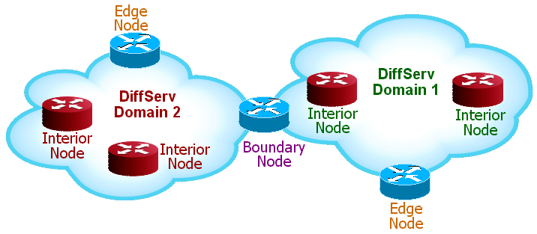
DiffServ Network Elements
A DiffServ Domain has a set of common QoS Policies or rules
DiffServ Edge Nodes interconnect untrusted and trusted sources
  The DS Edge Node is typically the first “IP-aware” device in the network
DiffServ Interior Nodes interconnect trusted sources
  in the same DiffServ Domain
DiffServ Boundary Nodes interconnect DiffServ Domains
  Each DS Domain may have different network resources and QoS policies implemented

Slide 14







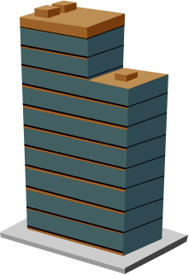


DS Edge Nodes
Core
Router
DS Interior Nodes
Policy
Switch
ISP’s
DS Domain
Service
Provider A
DS Domain
L3 Switch
DS Boundary Nodes
Radio Access
Point
Service
Provider B
DS Domain
Edge
Router
Enterprise
DS Domain
DS Edge Nodes

Slide 15


DiffServ Interface Types
DiffServ Nodes with different DiffServ I/F Types
  Core (Interior)
  Edge
  Boundary (acts as an Edge between different DiffServ Domains
DS Core
Ports
DS Edge
Port
L2
Switches
L3
Switch
Core Switches
and Routers
Edge
Router
DS Edge
Ports
DS Core
Notes:
In the DiffServ architecture, the Network Edge devices perform the complex traffic filtering and policing where there are few traffic flows. The Network Core devices perform only simple queuing functions where there are very large aggregates of traffic flows. This partitioning of network functionality permits a high degree of scalability.
A DiffServ domain (not to be confused with a “routing” domain) is managed by a common set of polices. The policies describe how the traffic is to be “differentiated” by the DS network elements.

Slide 16
DiffServ Packet Treatment
After packets are classified they may be:
  Metered
  Policed
  Marked
  Shaped
  Dropped
Traffic Conditioner
Drop or
Re-mark?
Meter / Policer
Drop
Re-mark
Incoming
Packet
Classifier
Marker
Shaper/
Dropper
Ingress
Interface
Egress
Interface

