Slide 1
The Role of the Transport Layer in Delivering an Assured Elastic Service
Chris Christou (Booz Allen Hamilton/GIG EWSE)
ICCRG
12 February 2007

Slide 2
Outline
Overview of the GIG
Goals of today’s talk
Explanation of the GIG networking environment
GIG Converged Services and the Assured Elastic Service
Mechanisms to Support Precedence for Inelastic Traffic
Behavioral Model and Functional Allocation for the Assured Elastic Service
Summary and Suggestions

Slide 3
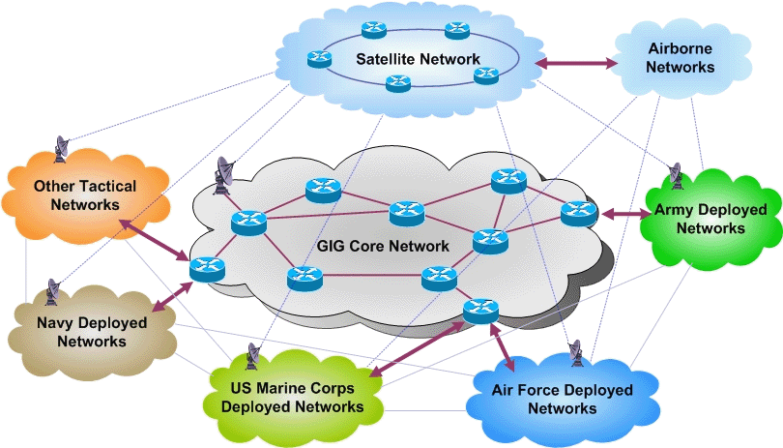
Background: Global Information Grid (GIG)
The U.S. Department of Defense (DoD) is pursuing a transformation in communication infrastructure to enable any-to-any communication and improved information sharing across all GIG users and networks
The vision is for the GIG to provide an Internet-like capability that meets the operational needs of multiple US Government agencies
  Interconnects with civilian infrastructure at federal, state, and local levels
  Interfaces with international networks, including NATO and coalition partners
Component networks of the GIG
include both:
  Fixed & Mobile Assets
  Ground, Air & Space Assets
The GIG technical community is
  working on designing an
  interoperable architecture and
  protocols across all of these
  disparate networks
High-Level View of the Global Information Grid

Slide 4
Goals of Today’s Talk
It is our aim to adopt existing open standards while encouraging development of standards and technology to support our infrastructure requirements
Today’s talk is aimed at introducing the GIG problem space as it relates to Congestion Control as well as describing our current technical approach
In doing so, we solicit your feedback on the following questions as they relate to the transport layer and congestion control:
  What congestion control mechanisms can satisfy the elastic application performance requirements over a wide range of networking environments?
  How can the transport layer contribute to delivery of the Preferred Elastic service? What is the functional allocation between network nodes and end hosts in providing this service?
  What is the role of congestion control, and the transport layer in particular, in satisfying the precedence requirements for elastic traffic?
  What distinguishes Preferred Elastic from the Default Service? Specifically, are there distinctions with regard to congestion control and other mechanisms at the transport layer?

Slide 5
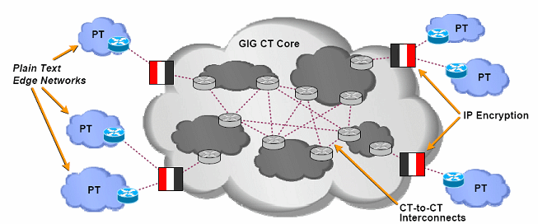
GIG Cipher Text (CT) Core / Plain Text (PT) Edge Networks
The GIG includes the GIG CT Core surrounded by PT Edge Networks
The GIG IP topology is divided into sections based on the nature of the user traffic carried in that part of the network
  Plain-text (PT) network - user traffic is not IP encrypted
  Cipher-text (CT) network - user traffic is IP encrypted
A PT network is connected to a CT network via IPsec (tunnel mode) gateway(s)
PT networks are grouped into different Communities of Interests (COIs); PT-PT communication is permitted within a COI
This PT/CT separation separates the GIG address space and limits data, control and management plane information exchange across the PT-CT interface
Objective End-to-End Global Information Grid Infrastructure

Slide 6
GIG Network Types
This GIG is composed of several networks exhibiting a range of capabilities characterized in terms of:
  Bandwidth, Size, Weight and Power (SWaP), node mobility, and link reliability
Networks operating in the fixed environment
share many properties of today’s Internet
  Most networks will be stationary or will
  remain within a single hop of the fixed
  infrastructure
  Over-provisioning of subscriber links
Networks operating in the tactical environment
are subject to node mobility and challenging link characteristics
  Ad-hoc connectivity
  RF-based, high-latency links
  SWaP constraints
  Subject to topology changes over time
  Reachability to/from fixed infrastructure may be intermittent
GIG Fixed Networks
  Fixed or stationary nodes/Stable network topology
  IP-capable/Highly reliable links/high bandwidth
  Not severely constrained by SWaP
  High level of physical security protection
GIG Advantaged Tactical Networks
  Mostly stationary nodes
  Reliable links, approaching “highly reliable”
  IP-capable/mostly stable network topology
  Moderate bandwidth/Not severely constrained by SWaP
  Moderate level of physical security protection
GIG Disadvantaged Tactical Networks
  All or mostly mobile nodes/Least reliable links
  High latency communications
  Not all end-hosts and networks are IP-capable
  Least stable network topology (highly dynamic)
  Bandwidth constrained, constrained by SWaP
  Low level of physical security protection

Slide 7
GIG Converged Services and Precedence
Categories | Service Class
Network Control | Network Control
Real-Time | Telephony
 | Signaling
 | MM Conferencing
 | Real-Time Interactive
 | Broadcast Video
Assured Elastic | MM Streaming
 | Low-Latency Data
 | OAM
 | High Throughput Data
Default Elastic | Elastic
The GIG will support and control the usage of multiple traffic types over the same infrastructure
  Inelastic/Real-Time Traffic
  Elastic
Precedence is defined as the user designated importance of an application session
  Long been defined for circuit switched voice
  Policy is being revised and extended to address IP voice, other real-time traffic, and (eventually) elastic traffic
The second half of this briefing focuses on implementing the Assured Elastic Service

Slide 8
Mechanisms to Support QoS
The GIG has adopted data plane, control plane, and application layer control mechanisms in providing QoS to end hosts
  Data Plane- Implementation of Per Hop Behavior (PHBs): a description of the externally observable forwarding behavior of a node
  Control Plane- Network Admission Control allows applications to request resources from the network. The network responds by explicitly admitting/rejecting QoS requests.
  Application Layer Signaling- application layer control protocols that can establish, modify, and terminate multimedia sessions (conferences) such as Internet telephony calls
  Management Plane: management systems play a role in planning, configuring, monitoring, and auditing this service

Slide 9
Precedence Support for Assured Inelastic Service
Real-time inelastic applications such as voice and video have well-defined mechanisms and protocols available (e.g., EF PHB, RSVP, SIP)
  Can ensure resources and mechanisms within the network will adequately support application requirements
  Can help meet the precedence requirements through control plane, application layer, and management plane mechanisms
Are similar approaches applicable in providing a Assured Elastic Service?

Slide 10
Behavioral Model for an Assured Elastic Service
For inelastic traffic, a behavioral model to provide “Assured Inelastic Service” is fairly well understood
For the assured elastic service, the behavioral model described in RFC 1633 and elsewhere will need to be extended
  Service Model for different elastic application types allows for different delays for interactive burst, interactive bulk, and asynchronous bulk applications
  The behavioral model for Assured Elastic will need to allow for improved throughput for higher precedence traffic
    For example, low precedence application sessions will experience lower average throughput than higher precedence
    However, this raises several questions, such as is there the equivalent of a “call blocking probability” for elastic application sessions? If there is a relative service for Assured Elastic, how “relative” should it be?
  We anticipate an expanded role for planning and management in offering the Assured Elastic Service
Given its relative immaturity, this technical area remains a work in progress

Slide 11
Current Approach to the Assured Elastic Service
The GIG technical community has focused on the requirements of the network in providing the Assured Elastic Service
  We have not described the role of the Transport Layer in providing this service
The current baseline has defined separate service classes for high precedence traffic and low precedence traffic
For higher precedence traffic, our current architecture suggests the use of differential drop probabilities with the intention of providing further granularity
However, debate continues; the use of differential drop probabilities may not provide the service that is required

Slide 12
Implementing the Assured Elastic Service
Requirements for the Assured Elastic Service and the work to date raise several questions
How is this Assured Elastic Service differentiated from a Default Service at end hosts? In the network?
What are the responsibilities of the transport layer in satisfying our Precedence requirements?
How does the transport layer interface with the application to provide Assured Elastic Services? With the Network?

Slide 13
The Role of the Transport Layer: Performance Challenges
The GIG’s reliance on long-delay, satellite networks will constrain the performance of transport layer protocols; Our networks also employ links and topologies that introduce additional challenges
  Intermittent Links with varying BW
  Mobile/Dynamic Topologies with asymmetric and variable paths
PEPs/middleboxes have been deployed to improve TCP performance over satellite links and may suffice as a short-term solution
  Difficult to implement in a shared, CT based infrastructure
  Not traditionally used in networks with dynamic topologies
In the research community, much work has been conducted in enhancing transport layer performance for each of these environments
We require a solution that can control congestion over an infrastructure incorporating all of these environments while providing preferential treatment of higher precedence traffic

Slide 14
The Role of the Transport Layer: Precedence
Different categories of Congestion Control mechanisms have been proposed to improve performance
Should these or other Transport Layer mechanisms be extended to support Precedence?
Performance Enhancement Approach | Examples
End-Host Upgrade | TCP NewReno F-RTO Recovery Increasing TCPs Initial Window Selective Acknowledgement (SACK) High-Speed TCP (HS-TCP)
End-Host and Network Upgrade | Quickstart for TCP eXplicit Congestion Protocol (XCP) Explicit Congestion Notification (ECN)

Slide 15
Functional Allocation to Support Precedence
Various models could be proposed to support a Precedence Based Assured Elastic Service, for example:
  Transport Layer is precedence aware: The Network treats all elastic traffic similarly. Higher Precedence sessions react differently to congestion than lower precedence sessions
  Transport Layer is not precedence aware/network differentiates: The network forwards the Assured Elastic traffic in one Service Class; the Elastic Traffic in another
  Transport Layer and Network are precedence aware while incorporating a direct interface between the Transport Layer and the Network : The transport layer and the network directly communicate regarding the precedence level of the sessions as well as the availability of resources
  Additionally, what is the role of the control plane in providing an Assured Elastic Service?
What is the right functional allocation? Perhaps the WG could help shed light on this discussion?

Slide 16
Summary and Suggestions
DoD intends to implement the RFC 4594 service classes in the GIG, including Assured Elastic
  DoD may require differentiation of elastic traffic according to military precedence
  In either case, it remains an important goal and design objective to (be able to) leverage new commercial technology as it emerges and becomes standardized
We seek a broad view of Assured Elastic implementation that enables the transport layer and congestion control to play a major role
We are interested in contributing to the ICCRG Problem Statement drafts
We also seek feedback on how to avoid limiting or inhibiting the use of future congestion control mechanisms in the course of implementing the Assured Elastic service

