Slide 1
Edge Data Discovery
draft-mcbride-edge-data-discovery-overview-00
Eve Schooler @ Intel
Carlos J Bernardos @UC3M
Mike McBride @Huawei
Dirk Kutscher @Huawei

Slide 2
Evolved out of a EC side meeting
Gap 1: to define the mapping between any two popular machine languages
Gap 2: In order to achieve the interconnection of multiple Industrial networks that use various physical layers, an overlay is required.
Gap 3: unified information model for all kinds of verticals
Gap 4: content push in a more secure (SUIT) and efficient (multicast) way
Gap 5: Provide containers and VMs on edge computing gateways to facilitate App mobility. Sync up of states in between Edge Computing Gateways. Definition of common APIs.
Gap 6: Edge data discovery. Process of finding required data from edge databases and consolidating it into a single source, perhaps name, that can be evaluated
Gap 7: add the deterministic feature into wireless networks (Wifi, RF)
Gap 8: policy indications about the task division for the Edge-Cloud Orchestration

Slide 3
What’s the problem?
The problem of distributed data discovery primarily in edge computing.
Increasing numbers of IoT devices and sensors are generating a torrent of data that originates at the very edges
Sometimes that data must be processed or transformed (transcoded, subsampled, compressed, analyzed, annotated, combined, aggregated, etc.) on edge equipment.
Support for edge data analysis is critical to make local, low-latency decisions (e.g., regarding predictive maintenance, the dispatch of emergency services, identity, authorization, etc.).
In addition, (transformed) data may be cached, copied and/or stored at multiple locations in the network on route to its final destination.
Although the data might originate at the edge, for example in factories, automobiles, video cameras, wind farms, etc., as more and more distributed data is created, processed and stored, it becomes increasingly dispersed throughout the network and there needs to be a standard way to find it.
New and existing protocols may need to be identified/developed/enhanced for distributed data discovery at the network edge and beyond.
Page <number>

Slide 4
Questions for COIN
COIN typically requires data input and often results in data output. From where do we expect the data to come or to where do we expect it to be cached or to flow afterwards?
How to ensure COIN protocols that corral it or direct it appropriately, particularly in Edge settings where the data may not be movable (because of its abundance)?
How to ensure COIN comprehends how to expose the data, where appropriate, while at the same time preserving its privacy?
Page <number>

Slide 5



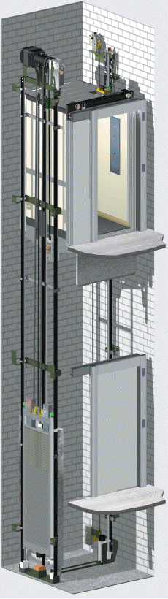

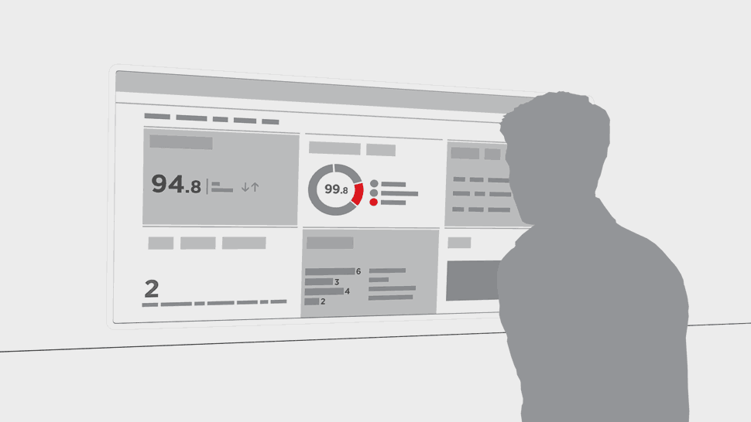
Elevator use case
2G/3G/4G
Machine Room
Top Car
Data
Data
Big Data Analysis and Predictive Maintenance on the Cloud
Inside Car
Elevator shaft
Data
100’s
of
sensors
Internet
data needs to be discovered and searched in a standard and granular way.

Slide 6
Naming the Data
What if we generalize the IP layer to name any information (or content), not just endpoints? We make it easier to develop, manage, secure, and use our networks. ICN can be applied to edge data discovery to make it much easier to extract data by naming it. If data was named we would be able to discover the appropriate data simply by its name.

Slide 7
What’s next?
Determine if existing protocols exist to do this.
  resource directories for named data?
Determine where a new standard protocol may be needed.
  Do we involved CoAP and metadata?
Page <number>

Slide 8
Thank you !
Thank You

