Slide 1

CLUE Framework 01 – comments and issues
Interim meeting October 2011
Roni Even

Slide 2
Major issues
The capture area, point and scale attributes.
The architecture, what is the relation between EPs, Scene, capture set and how does presentation or presentations fit in the model.
Hierarchy of attributes, should they be available for each layer of the model. Scene, capture set, media captures?
Where should the protocol be specified, do we split this document to two? And what is the extensibility mechanism.
Relation of attributes and encoding parameters to SDP (duplicate?)

Slide 3
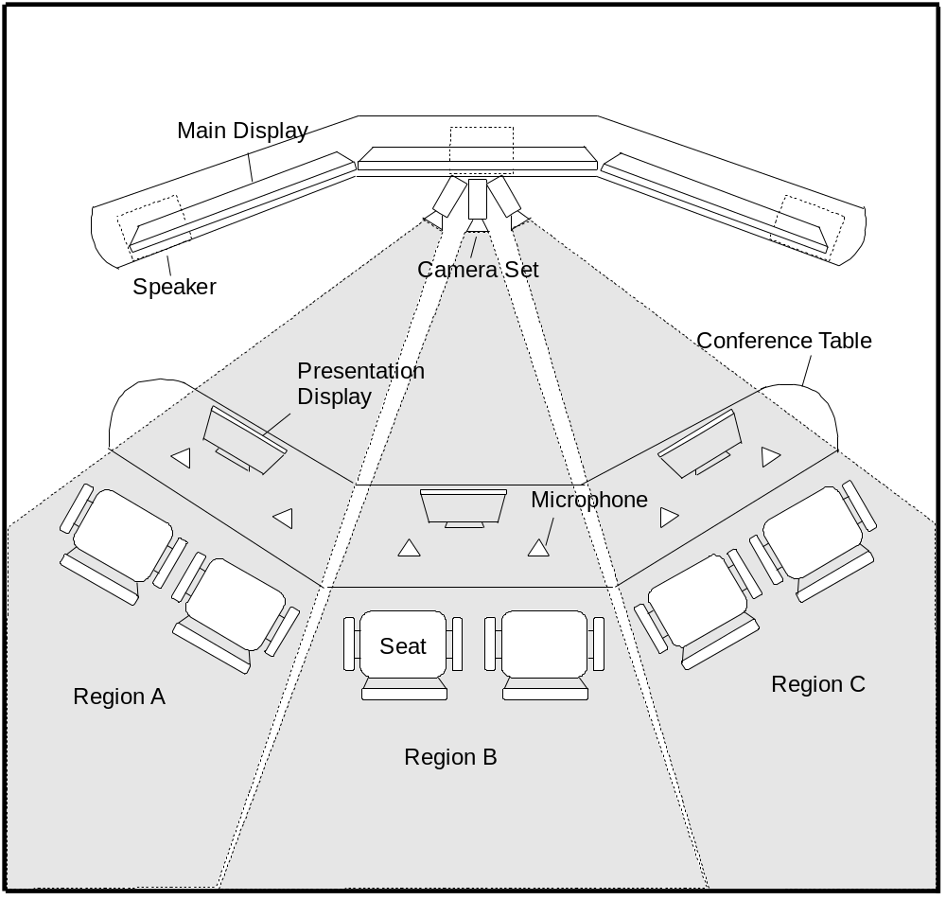
Capture area – example three screen system – from Christian Groves contribution to ITU-T.

Slide 4
Capture area
As can be seen from the drawing, if we want no overlap at the back of the room there will be gap between the seating in row/rows.
The gap can be hidden by the monitors frame, this require information about the gap from the provider to the consumer.
Current proposal suggest some undefined numbers that will just give spatial information and not real measurement. Propose to provide as default, the units for measuring the gap (width and distance from camera, or angle, or other– can be decided later)
The point of capture as defined stands by itself with no relation to the capture area, in order to get a full description suggest to define the origin of axes for the capture area and the range for the dimensions. This will enable to map the point of capture in the room.

Slide 5
Capture area
The area scale millimeters is an optional parameter to indicate that the values in capture area are in millimeters. I think that instead of Boolean it should provide the units, the point of origin of the axes and the range. This parameter can be specified for the capture set or scene (see discussion on model) and not for a specific media capture.
The current description of auto switch in term of capture area does not provide any information about the actual size of each view. Note that auto switch algorithm is not defined and is not meant to be unique. (voice activated is an option). (the interpretation of VC3 in section 7 is not unique, it can be a switch between cameras every 30 second for example)

Slide 6
The architecture model
The model defines Endpoints (EP), Scene, capture set, media captures (with Attributes and encode groups). The model does not show the full hierarchy.
  The figure in section 5 starts from the capture set.
  The example in section 7 shows two capture sets (main people and presentation)
Suggest to have a full description
  EP that can have one or more capture scene (Main people scene, presentation1 scene, presentation 2 scene).
  Capture sets – one capture set per scene (not sure, what is the use for multiple capture sets)
  Media captures (as today)
Attributes and encode group can be defined at each level, if defined per capture set is applicable to all media captures in the set and are overridden by definition at the media capture level.

Slide 7
Hierarchy of attributes
The framework defines attributes and group encodes as part of a media capture. I propose to allow attributes also for a scene or capture set. An example is the capture area range and point of origin for axes (or what method we will take to describe the room) which should be at the higher level than the media capture.

Slide 8
How should the protocol be specified
The framework document defines attributes and encoding parameters.
  Is this the right place for them or should we have two documents.
  Need to agree on what is the mandatory basic set of attributes and encoding.
  Add an SDP parameter TelePresence capability (Tpcap) that will indicate support for the mandatory set of attributes and encoding parameters. This will enable adding extensions and signaling support for the extensions.
  Need to define how to define extensions, what an extension document must have.

Slide 9
Relation to SDP
Section 5.2 has an editor comment about duplication of SDP parameters.
  The purpose attribute is similar to the SDP content attribute (RFC 4796) yet I can see the need for it to describe the specific capture.
  The encoding parameters duplicate H.264 parameters – at least we can say that SDP is codec specific while here we want general parameters.
The framework or protocol will need to address the issue of merging SDP and TP attributes by the consumer.
Once we decide on protocol we will need to address the interoprability with SDP systems and the fact that the SDP and TP protocol may not follow the same data path. (SDP with SIP signalling and TP may go end to end).

Slide 10
Other comments
Video compose does not provide any informtaion about what is the content of the composed stream. The current text says what the parameter is not and does not discuss the use for it.
  I propose that it should at least provide information about which individual media captures are part of the composed image and scale for each. This will allow the provider to offer a couple of options to the consumer. (the interpetation of VC4 in section 7 is not unique to what is described)
The media capture description is about cameras. There is no clear definition of the presentation support. This starts from the capture device definition in section 3 and in media capture in 5.1.
MCU case in section 7.1 does not provide much information, what I think is needed is a way to associate a media capture with the endpoint and capture device from where the information is coming.
How do we keep consistency between use cases, requirements and framework. There is an email thread on the topic.

