Slide 1

GEOPRIV WG
Interim Meeting
Location Filters
draft-ietf-geopriv-loc-filters-06.txt
R. Mahy, B. Rosen, H. Tschofenig
Tuesday September 15, 2009

Slide 2
Version -06
Added a description about rate control based on the recent discussions
Updated the introduction to illustrate the relationship to the specifications this documents reuses
Removed text related to the HELD responseTime attribute
Corrected the schema
Re-wrote the security consideration section
Added a few references

Slide 3
Open Issues
More reviews needed!
  Volunteers?
No implementation experience with it (at least none known) ;-(
  Volunteers?
Error handling not defined.
  Example: What happens if the LIS cannot determine the location of the Target? How should it react?

Slide 4
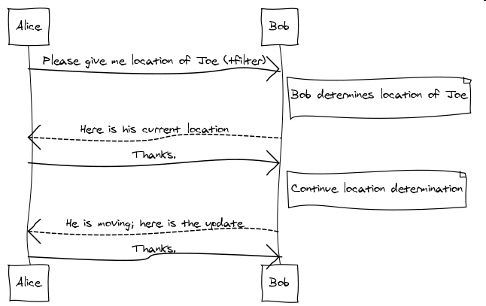
Stepping back (a bit)
Here is what we want

Slide 5
Stepping back (cont.)
The document only defines location filters, right?
But in order to be useful it has to build on a number of other things, namely
  SIP event notification [RFC3265]
  Presence Event package [RFC3856]
  PIDF-LO [RFC4119] (plus respective updates)
  Filter framework [RFC4661]
Till version -5 the reader had to guess what these other building blocks are. A good standardization approach?
What glues all this together to make sense out of it?
  Maybe the same stuff that says what the semantics of error messages are?

Slide 6
Potential Way Forward?
With -06 I added some text on the relationship to other documents
Why don’t we just write a document that says the following:
  These are the specifications you have to use for asynchronous event notification of location information
  Here is how the error codes look like (as an XML payload taken from the HELD spec.)
  And, btw, here are a number of location filters you could use to limit the amount of notifications you would get. This part includes the pointer to [I-D.ietf-sipcore-event-rate-control].
We would be as strict as possible to avoid too much freedom. We can always extend the spec later when we got some implementation experience.
Other persons (from outside the working group) would have one place to look at and would know what is going on.

