Slide 1
pim wg multicast YANG team
Meeting 20170619
https://www.ietf.org/mailman/listinfo/yang-multicast
http://trac.tools.ietf.org/wg/pim/trac/wiki/yang
https://github.com/mcallisterjp/pim-yang

Slide 2
Records for last meeting
When igmp snooping is enabled globally, it is enabled for per vlan by default.----it is needed to define a suitable structure for igmp-snooping model to adopt enable igmp snooping for all vlans.
How to deal with the scenario when the interface doesn't join any vlan? ----it maybe needs a param to determine whether the interface enable igmp-snooping.
About the hierarchy, there seems to be no difference between the global view and the vlans view. They need to be merged into one. ----accepted
Not all the vendors support ssm map in igmp snooping. It is needed to remove. ----accepted
Regarding the structure, maybe we won't augment /rt:routing/rt:control-plane-protocols ? setup a total new structure? --- there are 2 possible structure about the igmp-snooping model.
Notes:
Regarding the first item, it is needed to define a suitable structure for igmp-snooping model to adopt enable igmp snooping for all vlans.
Regarding the second item, it maybe needs a param to determine whether the interface enable igmp-snooping. It still needs further discussion.
Regarding the last item, there are 2 possible structure about the igmp-snooping model. It still needs further discussion.

Slide 3
module: ietf-igmp-mld-snooping
The IGMP and MLD Snooping YANG module defined the common building blocks for the IGMP and MLD Snooping protocol.
IGMP and MLD Snooping Configuration
IGMP and MLD Snooping Operational State
IGMP and MLD Snooping RPC
Notes:
The IGMP and MLD Snooping YANG module defined the common building blocks for the IGMP and MLD Snooping protocol.
The YANG module includes IGMP and MLD Snooping configuration data, Operational state data, and the RPC method for clearing the specified IGMP and MLD Snooping.

Slide 4
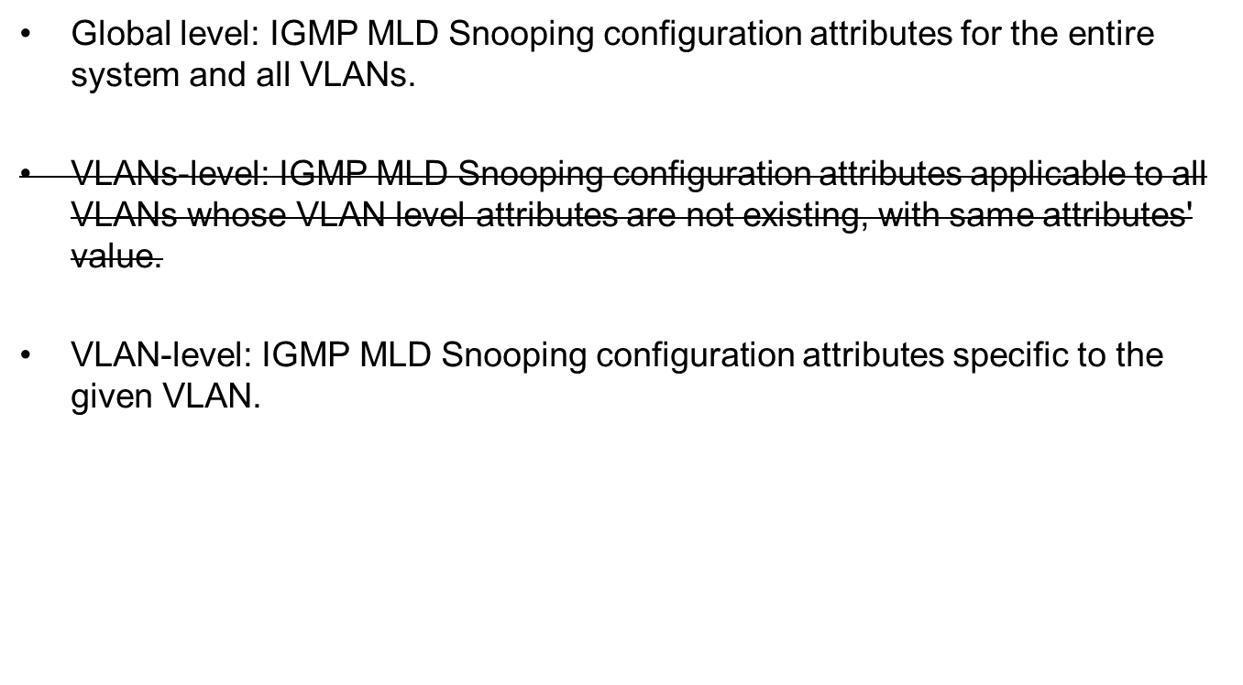
Two-level hierarchy for configuration
Notes:
The IGMP and MLD Snooping modules define the configuration and operational state in a three-level hierarchy as listed below

Slide 5
IGMP snooping Global
IGMP snooping configuration augment /rt:routing/rt:control-plane-protocols
module: ietf-igmp-mld-snooping
augment /rt:routing/rt:control-plane-protocols:
+--rw igmp-snooping
+--rw global
+--rw enable? boolean {global-admin-enable}?
+--rw (last-member-query-interval)?
| +--:(last-member-query-interval-basic)
| | +--rw last-member-query-interval-basic? uint16
| +--:(last-member-query-interval-extended)
| +--rw last-member-query-interval-extended? uint16 {vlan-last-member-query-interval-extended}?
+--rw (query-interval)?
| +--:(query-interval-basic)
| | +--rw query-interval-basic? uint16
| +--:(query-interval-extended)
| +--rw query-interval-extended? uint16 {vlan-query-interval-extended}?
+--rw (query-max-response-time)?
| +--:(query-max-response-time-basic)
| | +--rw query-max-response-time-basic? uint16
| +--:(query-max-response-time-extended)
| +--rw query-max-response-time-extended? uint16 {vlan-query-max-response-time-extended}?
+--rw require-router-alert? boolean {require-router-alert}?
+--rw (robustness-variable)?
| +--:(robustness-variable-basic)
| | +--rw robustness-variable-basic? uint8
| +--:(robustness-variable-extended)
| +--rw robustness-variable-extended? uint8 {vlan-robustness-variable-extended}?
+--rw version? uint8
Define extended parameters for different value range. Different vendors can restrict different range to them.
Notes:
Last Member Query Interval --- The amount of time between Group-Specific Query messages.
query-interval ---The Query Interval is the interval between General Queries sent by the Querier.
query-max-response-time---"Query maximum response time specifies the maximum time
allowed before sending a responding report.
require-router-alert ---When the value is true, router alert exists in the IP head of IGMP or MLD packet.
robustness-variable --- Querier's Robustness Variable allows tuning for the expected packet loss on a network. If a subnet is expected to be lossy, the Robustness
Variable may be increased.

Slide 6
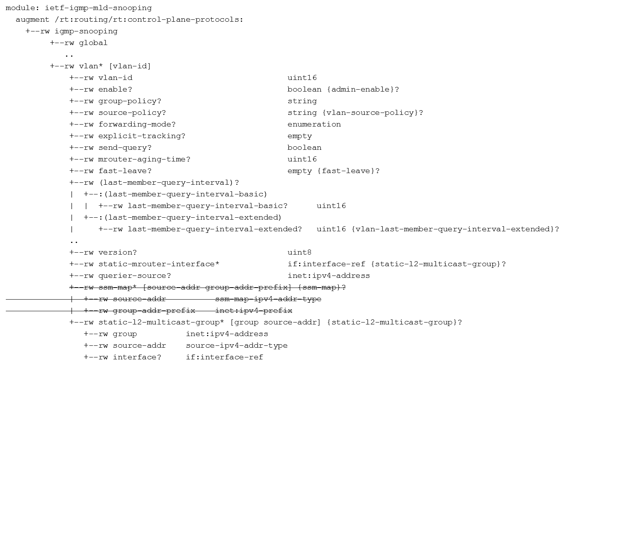
IGMP snooping Per VLAN
Notes:
group-policy---Name of the access policy used to filter IGMP or MLD membership.
source-policy---Name of the access policy used to filter sources.
forwarding-mode---The default forwarding mode for IGMP and MLD Snooping is ip.
explicit-tracking---Tracks IGMPv3 membership reports from individual hosts for each port of each VLAN.
mrouter-aging-time---Aging time for mrouter interface. The mrouter interface is multicast router interface which is connected to the multicast router.
fast-leave---When fast leave is enabled, the IGMP software assumes that no more than one host is present on each VLAN port.
send-query---Enable quick response for topo changes
Querier-source ---The source ip address for General Query when you enable the attribute “send-query”.

Slide 7
MLD snooping Global
MLD snooping is same as IGMP snooping except changing IPv4 to IPv6 addresses.
augment /rt:routing/rt:control-plane-protocols:
+--rw mld-snooping
+--rw global
+--rw enable? boolean {global-admin-enable}?
+--rw (last-member-query-interval)?
| +--:(last-member-query-interval-basic)
| | +--rw last-member-query-interval-basic? uint16
| +--:(last-member-query-interval-extended)
| +--rw last-member-query-interval-extended? uint16 {vlan-last-member-query-interval-extended}?
+--rw (query-interval)?
| +--:(query-interval-basic)
| | +--rw query-interval-basic? uint16
| +--:(query-interval-extended)
| +--rw query-interval-extended? uint16 {vlan-query-interval-extended}?
+--rw (query-max-response-time)?
| +--:(query-max-response-time-basic)
| | +--rw query-max-response-time-basic? uint16
| +--:(query-max-response-time-extended)
| +--rw query-max-response-time-extended? uint16 {vlan-query-max-response-time-extended}?
+--rw require-router-alert? boolean {require-router-alert}?
+--rw (robustness-variable)?
| +--:(robustness-variable-basic)
| | +--rw robustness-variable-basic? uint8
| +--:(robustness-variable-extended)
| +--rw robustness-variable-extended? uint8 {vlan-robustness-variable-extended}?
+--rw version? uint8

Slide 8
MLD snooping Per VLAN
augment /rt:routing/rt:control-plane-protocols:
+--rw mld-snooping
+--rw global
+--rw vlan* [vlan-id]
+--rw vlan-id uint16
+--rw enable? boolean {admin-enable}?
+--rw group-policy? string
+--rw source-policy? string {vlan-source-policy}?
+--rw forwarding-mode? enumeration
+--rw explicit-tracking? empty
+--rw send-query? boolean
+--rw mrouter-aging-time? uint16
+--rw fast-leave? empty {fast-leave}?
+--rw (last-member-query-interval)?
| +--:(last-member-query-interval-basic)
| | +--rw last-member-query-interval-basic? uint16
| +--:(last-member-query-interval-extended)
| +--rw last-member-query-interval-extended? uint16 {vlan-last-member-query-interval-extended}?
..
+--rw version? uint8
+--rw static-mrouter-interface* if:interface-ref {static-l2-multicast-group}?
+--rw querier-source? inet:ipv6-address
+--rw static-l2-multicast-group* [group source-addr] {static-l2-multicast-group}?
+--rw group inet:ipv6-address
+--rw source-addr source-ipv6-addr-type
+--rw interface? if:interface-ref

Slide 9
Two-level hierarchy for state
Global level: IGMP MLD Snooping operational state attributes for the entire system and all VLANs
VLAN-level: IGMP MLD Snooping operational state attributes specific to the given VLAN.
Notes:
The IGMP and MLD Snooping module contains operational state information also in a three-level hierarchy as mentioned earlier.

Slide 10
IGMP snooping Global State
augment /rt:routing-state/rt:control-plane-protocols:
+--ro igmp-snooping
+--ro global
+--ro enable? boolean {global-admin-enable}?
+--ro entries-count? uint32
+--ro statistics
| +--ro error
| | +--ro checksum? yang:counter64
| | +--ro too-short? yang:counter64
| +--ro received
| | +--ro total? yang:counter64
| | +--ro query? yang:counter64
| | +--ro report? yang:counter64
| | +--ro leave? yang:counter64
| +--ro sent
| +--ro total? yang:counter64
| +--ro query? yang:counter64
| +--ro report? yang:counter64
| +--ro leave? yang:counter64
+--ro (last-member-query-interval)?
| +--:(last-member-query-interval-basic)
| | +--ro last-member-query-interval-basic? uint16
| +--:(last-member-query-interval-extended)
| +--ro last-member-query-interval-extended? uint16 {vlan-last-member-query-interval-extended}?
+--ro (query-interval)?
| +--:(query-interval-basic)
| | +--ro query-interval-basic? uint16
| +--:(query-interval-extended)
| +--ro query-interval-extended? uint16 {vlan-query-interval-extended}?
+--ro (query-max-response-time)?
| +--:(query-max-response-time-basic)
| | +--ro query-max-response-time-basic? uint16
| +--:(query-max-response-time-extended)
| +--ro query-max-response-time-extended? uint16 {vlan-query-max-response-time-extended}?
+--ro require-router-alert? boolean {require-router-alert}?
+--ro (robustness-variable)?
| +--:(robustness-variable-basic)
| | +--ro robustness-variable-basic? uint8
| +--:(robustness-variable-extended)
| +--ro robustness-variable-extended? uint8 {vlan-robustness-variable-extended}?
+--ro version? uint8

Slide 11
IGMP snooping VLAN State
augment /rt:routing-state/rt:control-plane-protocols:
+--ro igmp-snooping
+--ro global
..
+--ro vlan* [vlan-id]
+--ro vlan-id uint16
+--ro enable? boolean {admin-enable}?
+--ro group-policy? string
+--ro source-policy? string {vlan-source-policy}?
+--ro forwarding-mode? enumeration
+--ro explicit-tracking? empty
+--ro send-query? boolean
+--ro mrouter-aging-time? uint16
+--ro fast-leave? empty {fast-leave}?
+--ro (last-member-query-interval)?
| +--:(last-member-query-interval-basic)
| | +--ro last-member-query-interval-basic? uint16
| +--:(last-member-query-interval-extended)
| +--ro last-member-query-interval-extended? uint16 {vlan-last-member-query-interval-extended}?
...
+--ro static-mrouter-interface* if:interface-ref {static-l2-multicast-group}?
+--ro querier-source? inet:ipv4-address
+--ro static-l2-multicast-group* [group source-addr] {static-l2-multicast-group}?
| +--ro group inet:ipv4-address
| +--ro source-addr source-ipv4-addr-type
| +--ro interface? if:interface-ref
+--ro mrouter-interface* if:interface-ref
+--ro group* [address]
+--ro address inet:ipv4-address
+--ro mac-address? yang:phys-address
+--ro expire? uint32
+--ro up-time? uint32
+--ro interface? if:interface-ref
+--ro last-reporter? inet:ipv4-address
+--ro source* [address]
+--ro address inet:ipv4-address
+--ro up-time? uint32
+--ro expire? uint32
+--ro last-reporter? inet:ipv4-address
Notes:
Querier-source---"The source ip address for General Query when you enable the attribute “send-query”;
port-info--- "The port-info shows the interfaces that attach the hosts, which join in the multicast group“
mac-address---"Destination mac address for L2 multicast forwarding.“
Expire --- “The time left before multicast group timeout.”
up-time --- “The time after the device created L2 multicast record”
Interface --- "The outgoing interface for L2 multicast stream.“
last-reporter --- "The last host address which has sent the report to join the multicast group.“
There is a last-reporter regarding each source.
Maybe there are several sources regarding one group. So the last-reporter under the group means the real last one among all the (S,G) records.

Slide 12
MLD snooping Global State
augment /rt:routing-state/rt:control-plane-protocols:
+--ro mld-snooping
+--ro global
+--ro enable? boolean {global-admin-enable}?
+--ro entries-count? uint32
+--ro statistics
| +--ro error
| | +--ro checksum? yang:counter64
| | +--ro too-short? yang:counter64
| +--ro received
| | +--ro total? yang:counter64
| | +--ro query? yang:counter64
| | +--ro report? yang:counter64
| | +--ro leave? yang:counter64
| +--ro sent
| +--ro total? yang:counter64
| +--ro query? yang:counter64
| +--ro report? yang:counter64
| +--ro leave? yang:counter64
+--ro (last-member-query-interval)?
| +--:(last-member-query-interval-basic)
| | +--ro last-member-query-interval-basic? uint16
| +--:(last-member-query-interval-extended)
| +--ro last-member-query-interval-extended? uint16 {vlan-last-member-query-interval-extended}?
...
+--ro require-router-alert? boolean {require-router-alert}?
+--ro (robustness-variable)?
| +--:(robustness-variable-basic)
| | +--ro robustness-variable-basic? uint8
| +--:(robustness-variable-extended)
| +--ro robustness-variable-extended? uint8 {vlan-robustness-variable-extended}?
+--ro version? uint8

Slide 13
MLD snooping VLAN State
augment /rt:routing-state/rt:control-plane-protocols:
+--ro mld-snooping
+--ro global
+--ro vlans
+--ro vlan* [vlan-id]
+--ro vlan-id uint16
+--ro enable? boolean {admin-enable}?
+--ro group-policy? string
+--ro source-policy? string {vlan-source-policy}?
+--ro forwarding-mode? enumeration
+--ro explicit-tracking? empty
+--ro send-query? boolean
+--ro mrouter-aging-time? uint16
+--ro fast-leave? empty {fast-leave}?
+--ro (last-member-query-interval)?
...
+--ro static-mrouter-interface* if:interface-ref {static-l2-multicast-group}?
+--ro querier-source? inet:ipv6-address
+--ro ssm-map* [source-addr group-addr-prefix] {ssm-map}?
| +--ro source-addr ssm-map-ipv6-addr-type
| +--ro group-addr-prefix inet:ipv6-prefix
+--ro static-l2-multicast-group* [group source-addr] {static-l2-multicast-group}?
| +--ro group inet:ipv6-address
| +--ro source-addr source-ipv6-addr-type
| +--ro interface? if:interface-ref
+--ro mrouter-interface* if:interface-ref
+--ro group* [address]
+--ro address inet:ipv6-address
+--ro mac-address? yang:phys-address
+--ro expire? uint32
+--ro up-time? uint32
+--ro interface? if:interface-ref
+--ro last-reporter? inet:ipv6-address
+--ro source* [address]
+--ro address inet:ipv6-address
+--ro up-time? uint32
+--ro expire? uint32
+--ro last-reporter? inet:ipv6-address

Slide 14
IGMP/MLD snooping RPCs
IGMP and MLD Snooping RPC clears the specified IGMP and MLD Snooping group tables.
rpcs:
+---x clear-igmp-snooping-groups {rpc-clear-groups}?
| +---w input
| +---w vlan-id? uint16
| +---w group? inet:ipv4-address
| +---w source? inet:ipv4-address
+---x clear-mld-snooping-groups {rpc-clear-groups}?
+---w input
+---w vlan-id? uint16
+---w group? inet:ipv6-address
+---w source? inet:ipv6-address
Notes:
Group --- "Multicast group IP address.
If it is not specified, all IGMP snooping group tables are
cleared.";
Source --- "Multicast source IP address.
If it is not specified, all IGMP snooping source-group tables are
cleared.";

