Slide 1
pim wg multicast YANG team
IGMP snooping module
Meeting 2017-08-21
https://www.ietf.org/mailman/listinfo/yang-multicast
http://trac.tools.ietf.org/wg/pim/trac/wiki/yang
https://github.com/mcallisterjp/pim-yang

Slide 2
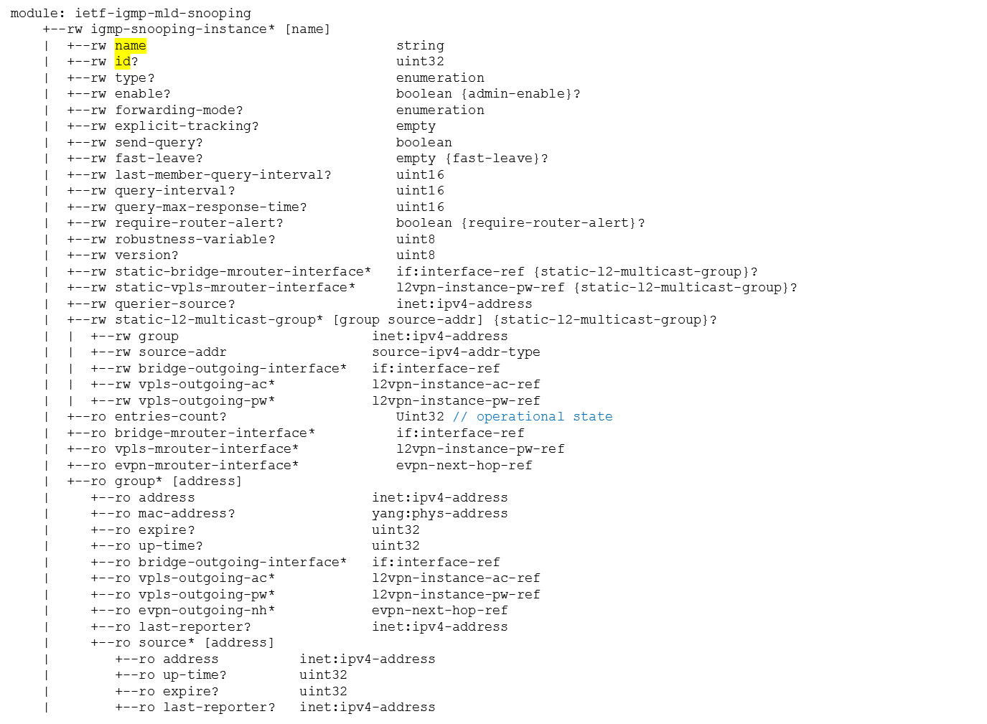
igmp-snooping instance
Define a fully functional schema for igmp-snooping instance
Notes:
Set the value to true to enable IGMP Snooping in the global view

Slide 3
igmp-snooping instance
The instance can be referenced by bridge, vpls, or evpn.
+--rw bridges
| +--rw bridge* [name]
| +--rw name dot1qtypes:name-type
| +--rw igmp-snooping-instance? igmp-snooping-instance-ref
| +--rw component* [name]
| +--rw name string
| +--rw bridge-vlan
| +--rw vlan* [vid]
| +--rw vid dot1qtypes:vlan-index-type
| +--rw igmp-snooping-instance? igmp-snooping-instance-ref
| +--rw interfaces
| +--rw interface* [name]
| +--rw name string
| +--rw igmp-snooping-instance? igmp-snooping-instance-ref
+--rw vpls-instances
| +--rw vpls-instance* [name]
| +--rw name string
| +--rw igmp-snooping-instance? igmp-snooping-instance-ref
+--rw evpn-instances
+--rw evpn-instance* [name]
+--rw name string
+--rw igmp-snooping-instance? igmp-snooping-instance-ref
+--rw igmp-snooping-instance* [name]
| +--rw name string
| +--rw id? uint32
…
Notes:
Set the value to true to enable IGMP Snooping in the global view

Slide 4
igmp-snooping instance
module: ietf-igmp-mld-snooping
rpcs:
+---x clear-igmp-snooping-groups {rpc-clear-groups}?
+---w input
+---w id? uint32
+---w group? inet:ipv4-address
+---w source? inet:ipv4-address
Notes:
Set the value to true to enable IGMP Snooping in the global view

