Slide 1


File Format for the Session Initiation Protocol (SIP)
Common Log Format (CLF)
Presenter: Gonzalo Salgueiro
SIP CLF Interim meeting
January 19, 2011
gsalguei@cisco.com
SIP CLF Interim Meeting, January 2011

Slide 2
Current Status Format Drafts
WG will adopt the ASCII draft as a working doc to specify logging file format
Open issues need to be resolved before publication of draft-ietf-sipclf-format-00
gsalguei@cisco.com
SIP CLF Interim Meeting, January 2011

Slide 3
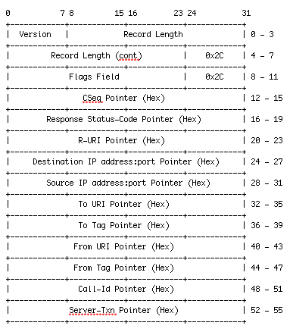
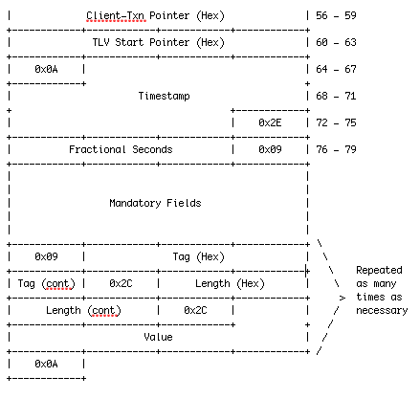
Current SIP CLF Format
gsalguei@cisco.com
SIP CLF Interim Meeting, January 2011

Slide 4
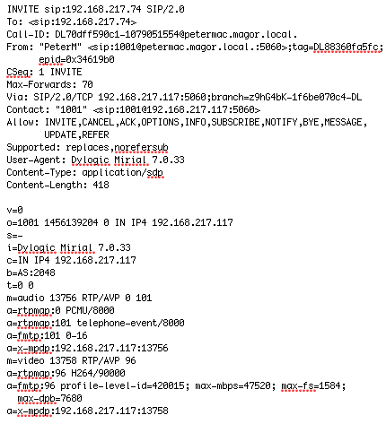
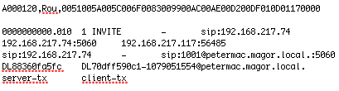
Sample of Current SIP CLF Record
Example:
gsalguei@cisco.com
IETF 79, Beijing, November 2010

Slide 5
Open Issues
Shall we use a TAB or a SPACE as field delimiters?
      Issue: TABs don’t survive Telnet or web pages very well, especially when copy/pasting.
gsalguei@cisco.com
SIP CLF Interim Meeting, January 2011

Slide 6
Open Issues
What format do we use to log a non-parsable field?
    Proposed solution: Use a simple unadorned “?”
How do we log a missing field?
    Proposed solution: Use a simple unadorned “-”
Note: In the extremely rare situation where “-” or “?” are the ONLY character in a field, the implementation SHOULD log an escaped %2D or %3F (as necessary) in the SIPCLF record.
gsalguei@cisco.com
SIP CLF Interim Meeting, January 2011

Slide 7
Open Issues
Do we need to update the syntax of the optionally logged fields?
    From the current simple TLV representation:
    <mandatory fields> 01,07,foo.bar 02,0b,hello world
    to something more easily readable like:
    <mandatory fields> 1="foo.bar" 2="hello world”
gsalguei@cisco.com
SIP CLF Interim Meeting, January 2011

Slide 8
Open Issues
Should we define in the draft a syntax to log vendor-specific fields in the optionally logged portion?
    Introduce enterprise number before the tag name:
    <mandatory fields> 2="Alice" 22736.1="foo" 22736.2="bar”
    Implement like in Syslog (section 6.3.2 of RFC 5424):
<mandatory fields> 2="Alice" 1@22736="foo" 2@22736="bar"
gsalguei@cisco.com
SIP CLF Interim Meeting, January 2011

Slide 9
Open Issues
Logging message bodies is undesirable. Is it OK to optionally allow it in optional fields?
Do we need to decide on how to represent a multi-line body (SDP or otherwise) in a format which tries to use a single text line?
    A few possible solutions:
    Allow line break and use reference from pointer block
    Use different EOL character
    Make each line it's own TLV (or list-like TLV entity)
    Use the literal "\r\n”

Slide 10
Thanks!
gsalguei@cisco.com
IETF 79, Beijing, November 2010

