Slide 1
Strategy and Algorithms for Lab 14
2.S998
Issac Evans and Robert Truax

Slide 2
Overall Strategy
Use Bayesian theory to maintain probabilities of hazards and generate priorities.
Use one robot to lawnmow and the other to do spot high classification tasks.
Periodically rendezvous to exchange state information and pass orders.

Slide 3
Division of Labor
Sensor Estimation
and Classification
Path Planning
And Control
MarkerMap
And Orders

Slide 4
Communications
Message Types
  MarkerMap: Local collection of object locations, probabilities, labels, and sensor histories.
  Orders: vector of commands including waypoints, behavior changes, etc.
MarkerMap messages were sent every ~5 sec.
Order messages were sent upon receipt of MarkerMap message
Next rendevous assigned in an order message

Slide 5
Sensing Strategy
Bayesian updates
Implement negative detector
Priority generation
Choices for Pd, swath width, and priors

Slide 6
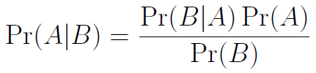
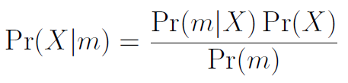
Sensing - Bayes

Slide 7
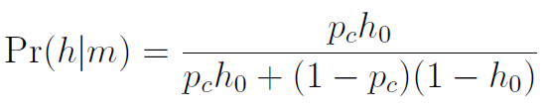
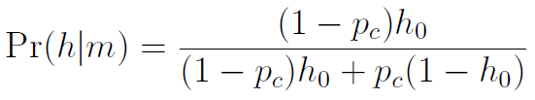
Sensing – Classification Update
Hazard Classification
Benign Classification

Slide 8
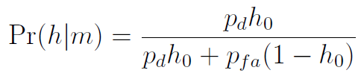
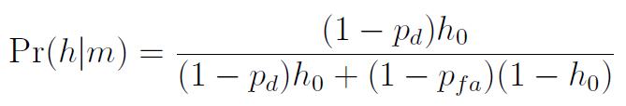
Sensing - Detection
Positive Detection
Negative Detection

Slide 9
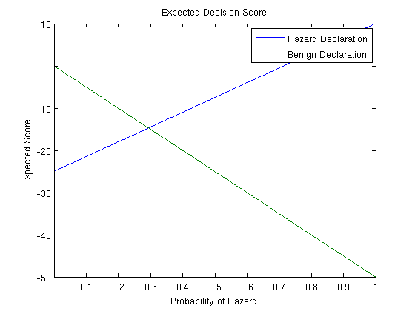
Priority – Expected in Score

Slide 10
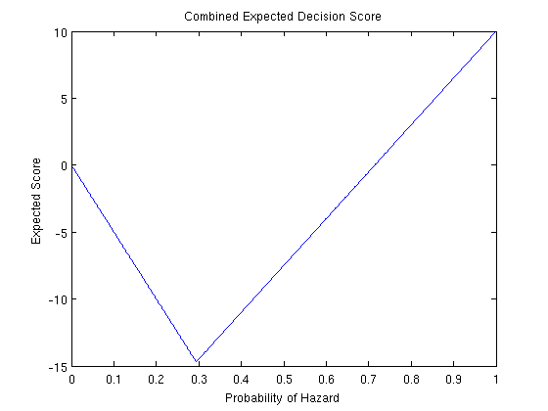
Expected Score Combined

Slide 11
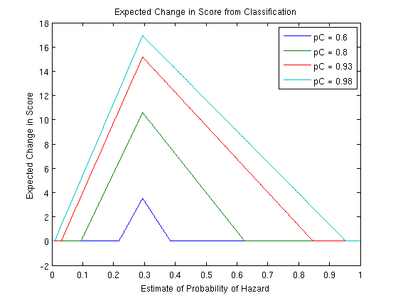
Priority - Change in Score from Classification

Slide 12
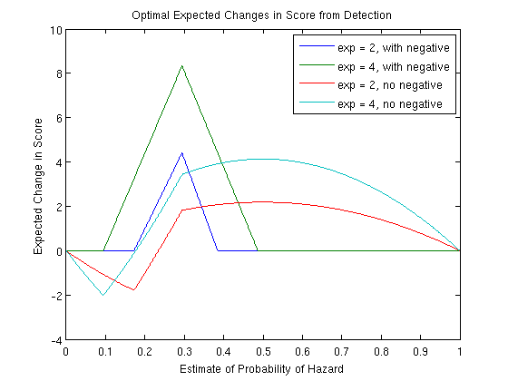
Priority – Change in Score from Detection

Slide 13
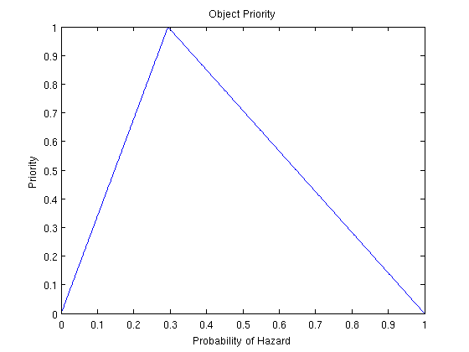
Priority Chosen

Slide 14
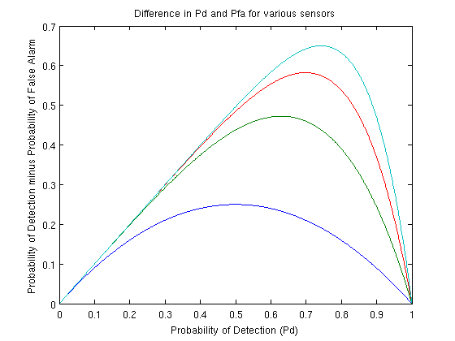
Choosing Pds

Slide 15
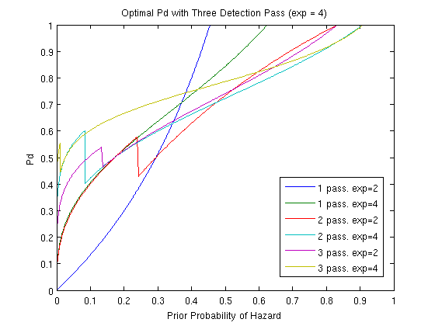
Optimal Pds for various widths and passes

Slide 16
Expected Change in Score from Detection with Optimal Pds

Slide 17
Parameters Chosen
Archie
  Width = 25
  Pd = 0.9
Betty
  Width = 5
  Pd = 0.99
Prior likelihood of hazard - 0.1

Slide 18
Division of Development
Rob – Sensing
Isaac – Path Planning/Orders

Slide 19
Next Time
Better integration between modules.
More / earlier end-to-end testing.
Better choices for priority, pd, etc.

