Slide 1
Strategy and Algorithms for Lab 14
2.S998
Issac Evans and Robert Truax

Slide 2
Overall Strategy
Use Bayesian theory to maintain probabilities of hazards and generate priorities.
Use one robot to lawnmow and the other to do spot high classification tasks.
Periodically rendezvous to exchange state information and pass orders.

Slide 3
Division of Labor
Sensor Estimation
and Classification
Path Planning
And Control
MarkerMap
And Orders

Slide 4
Division of Development
Rob – Sensing
Isaac – Path Planning/Orders

Slide 5
Sensing Strategy
Bayesian updates
Implement negative detector
Priority generation
Choices for Pd, swath width, and priors

Slide 6
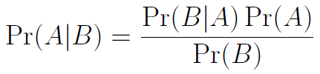
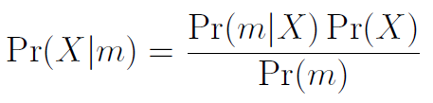
Sensing - Bayes

Slide 7
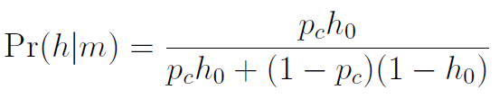
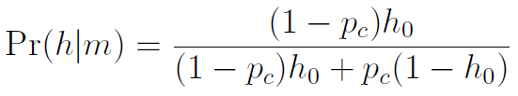
Sensing – Classification Update
Hazard Classification
Benign Classification

Slide 8
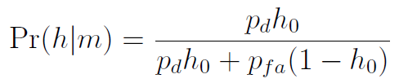
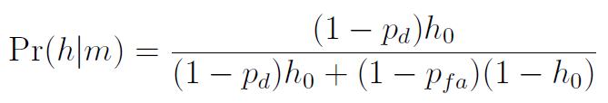
Sensing - Detection
Positive Detection
Negative Detection

Slide 9
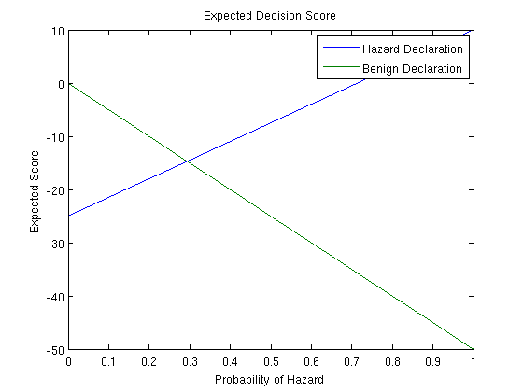
Priority – Expected in Score

Slide 10
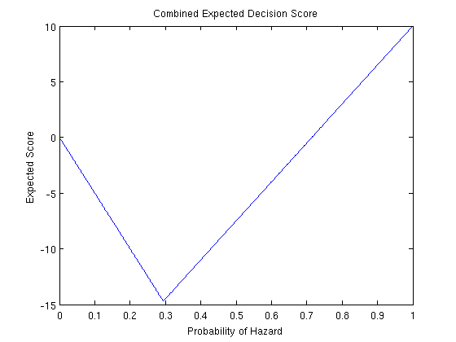
Expected Score Combined

Slide 11
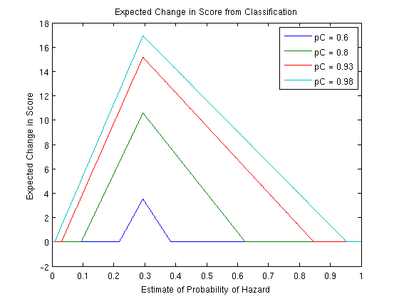
Priority - Change in Score from Classification

Slide 12
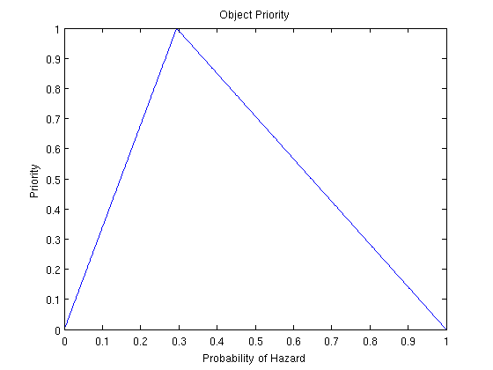
Priority Chosen

Slide 13
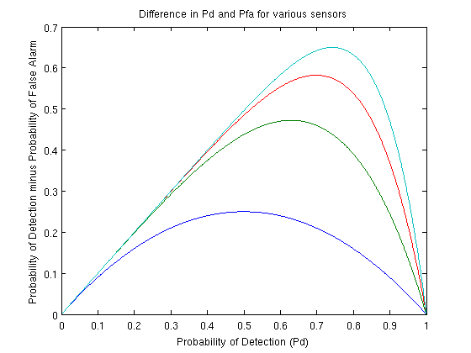
Choosing Pds

Slide 14
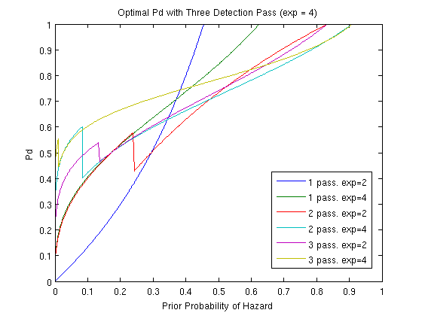
Optimal Pds for various widths and passes

Slide 15
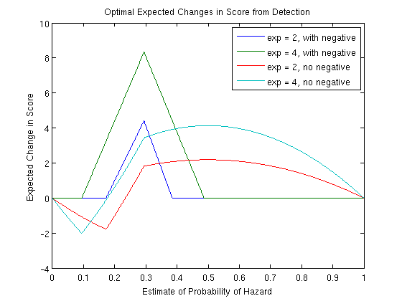
Expected Change in Score from Detection with Optimal Pds

Slide 16
Parameters Chosen
Archie
  Width = 25
  Pd = 0.9
Betty
  Width = 5
  Pd = 0.99
Prior likelihood of hazard - 0.1

Slide 17
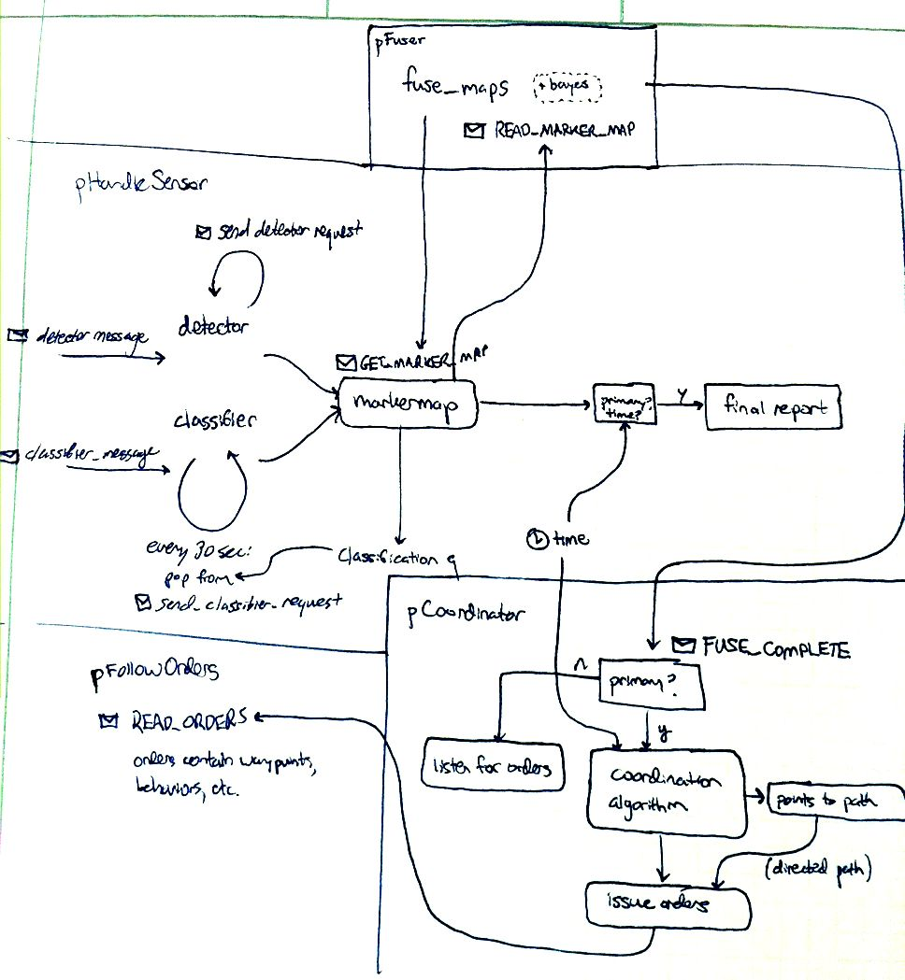
Communication & Planning

Slide 18
Communications
Message Types
  MarkerMap: Local collection of object locations, probabilities, labels, and sensor histories.
  Orders: vector of commands including waypoints, behavior changes, etc.
MarkerMap messages were sent every ~5 sec.
Order messages were sent upon receipt of MarkerMap message
Next rendevous assigned in an order message

Slide 19
Communication
abstract class Order
  Contains OrderType field
  Subclassed by WaypointOrder and BehaviorOrder
    WaypointOrder holds a 2D point
    BehaviorOrder contains a string corresponding to a behavior in the .bhv file
  Provides toString() and fromString(string s) methods for transmission as text

Slide 20
Command, p2
pCoordinator creates a vector of orders. These orders are received and executed by pFollowOrders, a separate application.
BehaviorOrder lawnmow = BehaviorOrder(LAWNMOW_BEHAVIOR_STRING);
vector<string> orders;
orders.push_back(lawnmow.toString());
...
// create an order to go to this mine
WaypointOrder wp = WaypointOrder(mine.getPoint());
wps.push_back(wp);
...
sendOrdersTo(orders, MASTER_ORDERS_STRING);
sendOrdersTo(orders, SLAVE_ORDERS_STRING);
The master robot runs both pCoordinator and pFollowOrders. All other robots run only pFollowOrders.

Slide 21
Command Algorithm
Master:
extract the top N mines

Slide 22
Mine Extraction
getPriorityNodes(Point2D currentPos, double sensorRadius)
For each mine m:
  Let utility be the map’s overall priority for m
  For each neighboring mine n:
    If the Euclidean distance(m, n) < sensorRadius:
      utility += the map’s overall priority for n
  Add the mine to a priority queue with a score of
  score = utility / (distance(m, currentPos) ^ distancePenalty)
Return the priority queue of mines

Slide 23
Command Algorithm
Master:
extract the top N mines from a priority queue
solve TSP on their corresponding waypoints (upper bound N to make this feasible)
calculate the time for the slave to complete the path. Set our rendezvous time to be this added to the current tiemstamp.
Send the corresponding waypoints to the slave(s)_x0018_
  used k-means clustering if multiple slaves

Slide 24
Command Algorithm
continuously looking at “fused” maps
command robot always has the maximum possible amount of information

Slide 25
algorithm post-mortem
Used a behavior to do landmow pattern -> could not reliably predict master location at the rendezvous time. Should have rewritten behavior and then solved an optimization problem to decide where to meet.

Slide 26
software post-mortem
Lots of tests
cout << "Testing MarkerMap...";
MarkerMap m = MarkerMap();
//assert(m.toString() == "");
Uuo a = Uuo(3, 38.83, 1, 0.238);
Uuo b = Uuo(2, -28.28, 328.2, 0.0001);
m._map.insert(pair<int,Uuo>(3, a));
m._map.insert(pair<int,Uuo>(2, b));
assert(m2._map[3].toString() == a.toString());
assert(m2._map[2].toString() == b.toString());
Did not perform testing or integration soon enough

Slide 27
Next Time
Better integration between modules.
More / earlier end-to-end testing.
Better choices for priority, pd, etc.

