Slide 1
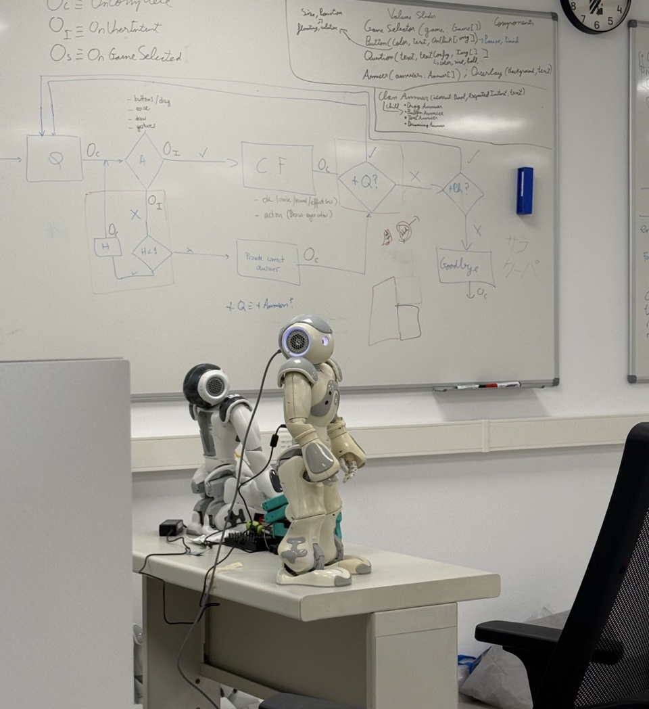

MASTER'S THESIS DEFENCE
Design, Integration, and
Validation of a Modular
LLM-Based Interactive
Architecture
A NAO-centred ROS 2 architecture for grounded dialogue, structured planning, deterministic execution, and evidence-based reporting.
Juan David Bendek Williamson • Supervised by Raquel Ros • 2025–2026
IIIA-CSIC / Universitat Autònoma de Barcelona
MSc Modelling for Science and Engineering
OPENING
01
Notes:
MAIN SLIDE 1/32 · rehearsal budget 20 seconds
20 s. State the thesis title and the complete-stack scope. Original title typography, wording, authorship and institutional elements are preserved. Photo: supplied by Juan David Bendek Williamson. Crop displays the standing NAO; no claim about the equipment in the background.
[Sources]
C:/Users/Admin/Downloads/TFM_JUAN_BENDEK_FINAL (1).pdf — final thesis
C:/Users/Admin/.codex/codex-remote-attachments/01a06368-8c1c-7cb2-b172-0ca3b19255fe/8CDB8185-DE17-4E24-8EEE-4DC878BBB7A1/2-Photo-2.jpg

Slide 2
INTRODUCTION
Language must become verifiable action
Language is flexible
Execution needs explicit state
• References depend on people, objects and prior turns.
• One instruction can combine dialogue, knowledge and action.
• A plausible answer may omit a target or invent a capability.
• Ground symbols in the available scene and knowledge.
• Validate capabilities, arguments and ordered steps.
• Establish completion from results, not from predicted effects.
Problem: connect flexible interpretation to bounded, inspectable execution.
INTRODUCTION
02
Notes:
MAIN SLIDE 2/32 · rehearsal budget 35 seconds
Introduce the subsymbolic-to-symbolic boundary without suggesting that all robot control is symbolic. Motivate the full architecture, not only planning.
[Sources]
C:/Users/Admin/Downloads/TFM_JUAN_BENDEK_FINAL (1).pdf — final thesis
C:/Users/Admin/Downloads/TFM_JUAN_BENDEK_FINAL (1).pdf — §1.1–1.2

Slide 3
INTRODUCTION
Five questions guide the integrated stack.
How can a modular robot architecture integrate dialogue, symbolic grounding, planning, deterministic execution, and feedback while preserving clear responsibility boundaries and evidence-based communication?
RQ1–2 · Plan / ground
RQ3 · Admission
RQ4–5 · Feedback
Can the stack preserve ordered tasks, target sets and the roles of people, objects and locations?
Can reviewed skills and deterministic checks reject unsupported or malformed proposals before dispatch?
Can failures trigger recovery or truthful closure while responsibilities remain inspectable?
RQ1 plans
RQ2 grounding
RQ3 admission
RQ4 recovery
RQ5 ownership
INTRODUCTION
03
Notes:
MAIN SLIDE 3/32 · rehearsal budget 45 seconds
45 s. These are grouped paraphrases of the five research questions. RQ1: coherent multi-step plans and ordered supported skills. RQ2: compact grounding preserves objects, people, locations and roles. RQ3: reject unsupported skills, malformed arguments, invalid lineage and direct robot calls. RQ4: use typed feedback for recovery, clarification, revision or safe stop. RQ5: establish inspectable responsibility and interface boundaries.
[Sources]
C:/Users/Admin/Downloads/TFM_JUAN_BENDEK_FINAL (1).pdf — final thesis
C:/Users/Admin/Downloads/TFM_JUAN_BENDEK_FINAL (1).pdf — §1.3

Slide 4
INTRODUCTION
Implementation and validation objectives
Integrate dialogue, routing, grounding, planning, orchestration and skills through ROS 2.
Define contracts for turn output, context, requests, skills, plans, results, feedback and evidence.
1
2
Expose capabilities through reviewed skill definitions, not generated robot API calls.
Support dialogue, knowledge and simple/composite actions with clear ownership.
3
4
Validate candidate plans deterministically before dispatch.
Return typed evidence for failure, clarification, replanning and truthful reporting.
5
6
7. Validate full user turns, focused subsystems, controlled outcomes and symbolic postconditions.
INTRODUCTION
04
Notes:
MAIN SLIDE 4/32 · rehearsal budget 40 seconds
40 s. Seven objectives from the final thesis; the earlier presentation compressed objectives 5 and 6. Introduce integration, execution control and validation as the three themes. Do not read every line.
[Sources]
C:/Users/Admin/Downloads/TFM_JUAN_BENDEK_FINAL (1).pdf — final thesis
C:/Users/Admin/Downloads/TFM_JUAN_BENDEK_FINAL (1).pdf — §1.4

Slide 5
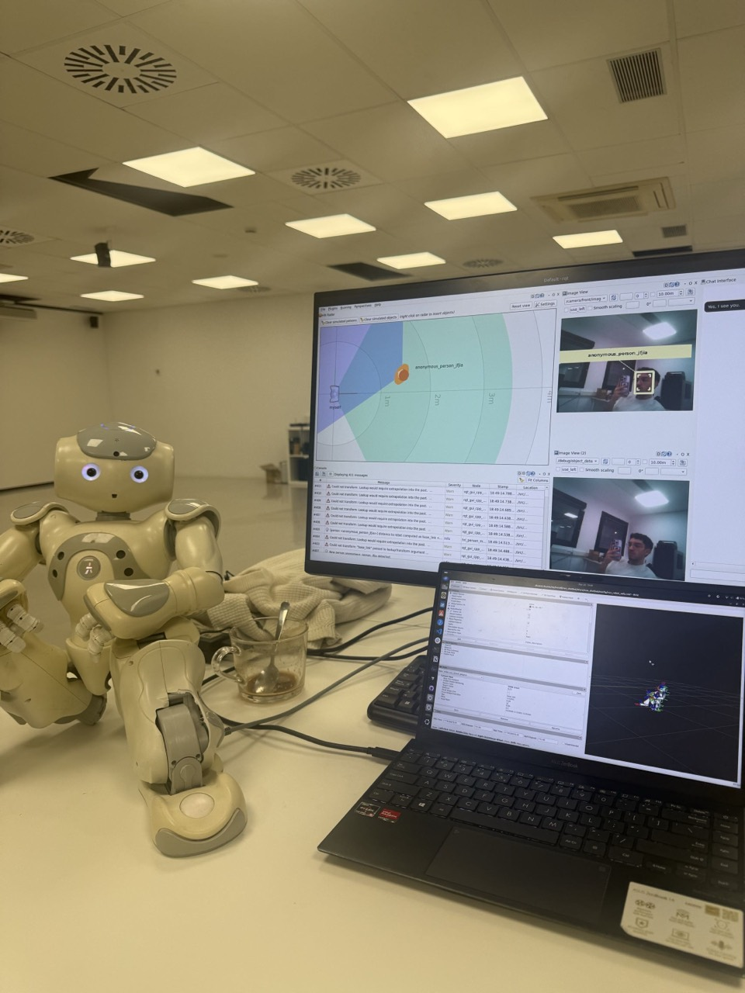
FOUNDATIONS
NAO, ROS 2 and ROS4HRI
A humanoid connected through ROS nodes
NAO: speech, cameras, articulated motion and gaze.
ROS 2: independently running nodes with typed interfaces.
ROS4HRI: shared people, speech and interaction conventions.
TOPIC · publish/subscribe streams or events (.msg)
/scene/summary → std_msgs/msg/String
SERVICE · request → response (.srv)
DialogueInteraction → a dialogue turn
ACTION · goal → feedback → result; supports cancellation
/nao/say → communication_skills/action/Say
The ROS interface carries the message; the application contract defines its meaning.
FOUNDATIONS
05
Notes:
MAIN SLIDE 5/32 · rehearsal budget 55 seconds
55 s. A ROS node is a software process/component, not a neural network node. Services can have asynchronous clients; do not equate the pattern with mandatory blocking. Actions expose cancellation; physical cancellation capability still depends on implementation. Robot photo supplied by the author. Reused ROS4HRI infrastructure is credited explicitly.
[Sources]
C:/Users/Admin/Downloads/TFM_JUAN_BENDEK_FINAL (1).pdf — final thesis
C:/Users/Admin/Downloads/TFM_JUAN_BENDEK_FINAL (1).pdf — §2.2–2.4
C:/Users/Admin/.codex/codex-remote-attachments/01a06368-8c1c-7cb2-b172-0ca3b19255fe/8CDB8185-DE17-4E24-8EEE-4DC878BBB7A1/1-Photo-1.jpg
https://docs.ros.org/en/jazzy/How-To-Guides/Topics-Services-Actions.html
C:/Users/Admin/PROJECTS/nao-ros4hri-bridge/src/communication_skills/action/Say.action

Slide 6
BACKGROUND · LITERATURE
An LLM agent is more than a model
Model + agent harness
Two specialised agent roles
LLM · large language model
A trained model generates text or structured output. Multimodal models can also process images.
Agent harness
Supplies context, tools, state and output rules.
Feedback
Observations and results guide the next decision.
chatbot_llm
Interprets a turn, selects its route and prepares a grounded request.
planner_llm
Selects reviewed skills, proposes a plan and reacts to execution feedback.
Agent pattern: observe → propose → validate/act → inspect the result.
BACKGROUND
06
Notes:
MAIN SLIDE 6/32 · rehearsal budget 50 seconds
An operational definition for this framework, not a claim of independent unrestricted autonomy. ReAct motivates coupling reasoning and external interaction; this stack does not claim to reproduce its algorithm. The two ROS components may use the same backend model. Qwen3-VL-30B-A3B is internally MoE; that is distinct from the two-agent application design and is not a focus of this talk.
[Sources]
C:/Users/Admin/Downloads/TFM_JUAN_BENDEK_FINAL (1).pdf — final thesis
C:/Users/Admin/Downloads/TFM_JUAN_BENDEK_FINAL (1).pdf — §2.5
https://arxiv.org/abs/2210.03629
https://huggingface.co/Qwen/Qwen3-VL-30B-A3B-Instruct

Slide 7
BACKGROUND · LITERATURE
Grounded planning in embodied systems
Relevant approaches
Position of this thesis
PDDL / HTN
Explicit actions, conditions, effects and task decomposition.
SayCan · Ahn et al., 2022
Language-level skill selection linked to robot affordances.
PaLM-E · Driess et al., 2023
Multimodal inputs connected to embodied reasoning.
• Multimodal capability alone is not reliable grounding or execution.
• The stack uses compact symbolic context and reviewed skill contracts.
• Contribution: integrate language reasoning with validated execution and feedback—not train an end-to-end VLA.
The planner interface connects flexible reasoning to explicit robot capabilities.
BACKGROUND
07
Notes:
MAIN SLIDE 7/32 · rehearsal budget 45 seconds
Different approaches are context, not baselines tested here. PDDL/HTN supply vocabulary for explicit capabilities; the implementation is not presented as a classical planner. Primary semantic evaluation used symbolic fixtures with object detection disabled. A multimodal model backend does not establish image-conditioned performance.
[Sources]
C:/Users/Admin/Downloads/TFM_JUAN_BENDEK_FINAL (1).pdf — final thesis
C:/Users/Admin/Downloads/TFM_JUAN_BENDEK_FINAL (1).pdf — §2.5–2.9
https://arxiv.org/abs/2204.01691
https://arxiv.org/abs/2303.03378

Slide 8
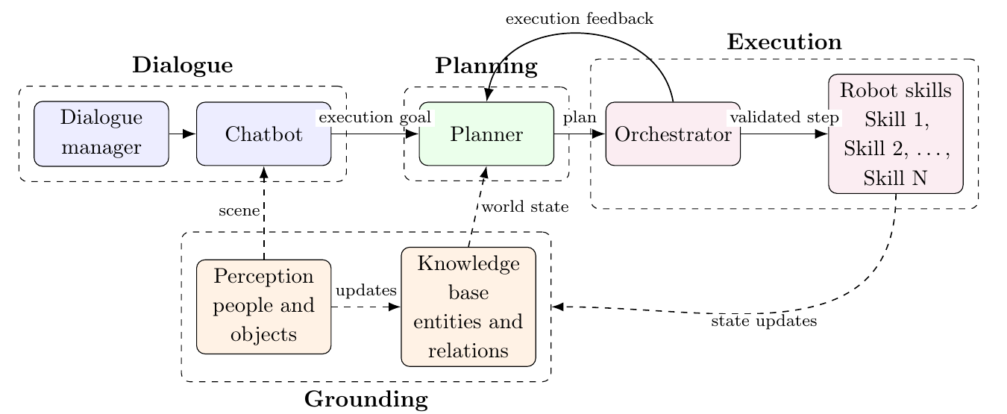
SYSTEM DESIGN
System architecture and ownership
Reused: dialogue, HRI and KnowledgeCore · Local: planning, orchestration and NAO integration
SYSTEM DESIGN
08
Notes:
MAIN SLIDE 8/32 · rehearsal budget 50 seconds
50 s. Original Figure 3.1 from the final thesis, cropped without redrawing. This is the conceptual graph: the implementation inserts orchestrator admission between chatbot and planner, and applies skill effects through kb_skills. Chatbot is an extended upstream component, not a wholly new local package. The planner never speaks or executes skills; the orchestrator does not become an LLM policy or world-model node.
[Sources]
C:/Users/Admin/Downloads/TFM_JUAN_BENDEK_FINAL (1).pdf — final thesis
C:/Users/Admin/Downloads/TFM_JUAN_BENDEK_FINAL (1).pdf — Fig. 3.1; §3.2–3.3

Slide 9
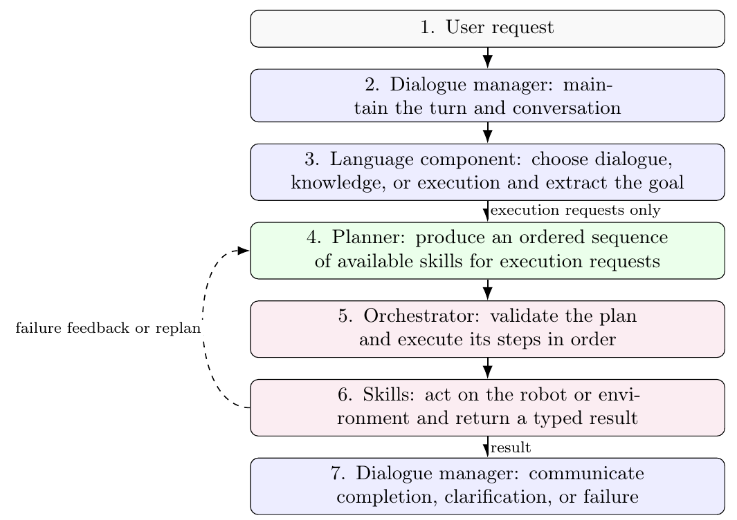
SYSTEM DESIGN
Runtime: request, action and feedback
Execution-only planning
Dialogue / knowledge
Answer without a robot-action plan.
Execution
Admit the goal, generate a plan, validate and dispatch.
Feedback
Replan, clarify or close using observed results.
Implementation adds explicit admission and dialogue-act relay boundaries.
SYSTEM DESIGN
09
Notes:
MAIN SLIDE 9/32 · rehearsal budget 40 seconds
40 s. Original Figure 3.2. Explain the execution branch and the feedback loop once. The next slides expand the omitted API boundaries. Planner communication is a request to the dialogue owner, not direct robot speech.
[Sources]
C:/Users/Admin/Downloads/TFM_JUAN_BENDEK_FINAL (1).pdf — final thesis
C:/Users/Admin/Downloads/TFM_JUAN_BENDEK_FINAL (1).pdf — Fig. 3.2; §3.4

Slide 10
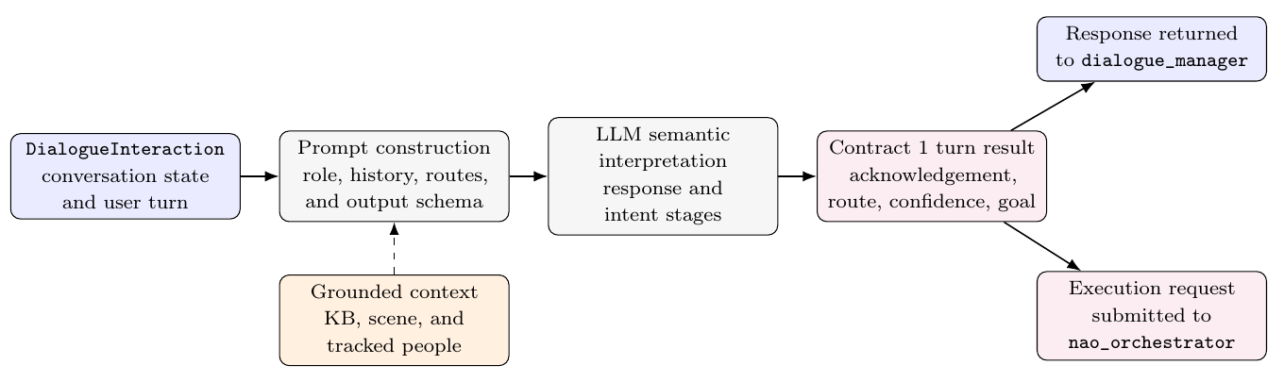
IMPLEMENTATION · CONTRACT 1
Dialogue ownership and chatbot routing
dialogue_manager · reused
chatbot_llm · extended
Owns conversation lifecycle and speaking. Calls chatbot_msgs/srv/DialogueInteraction.
Returns verbal_ack, route, confidence and user_intent; submits execution requests, never executable plans.
route ∈ {dialogue, knowledge_query, execution} · goal_text is an objective, not a step list.
IMPLEMENTATION
10
Notes:
MAIN SLIDE 10/32 · rehearsal budget 60 seconds
The final thesis evaluated response_first: response and route first, then intent extraction under that route. The intent_first ablation reverses stage order. Both preserve the same output contract. confidence is a model/stage confidence value, not proof of correctness. scene_targets are hints until grounded. DialogueInteraction is a ROS service despite potentially nontrivial LLM latency.
[Sources]
C:/Users/Admin/Downloads/TFM_JUAN_BENDEK_FINAL (1).pdf — final thesis
C:/Users/Admin/Downloads/TFM_JUAN_BENDEK_FINAL (1).pdf — Fig. 4.2; Table 4.2; §4.2.1–4.2.2
C:/Users/Admin/PROJECTS/nao-ros4hri-bridge/src/nao_orchestrator/nao_orchestrator/orchestrator.py

Slide 11
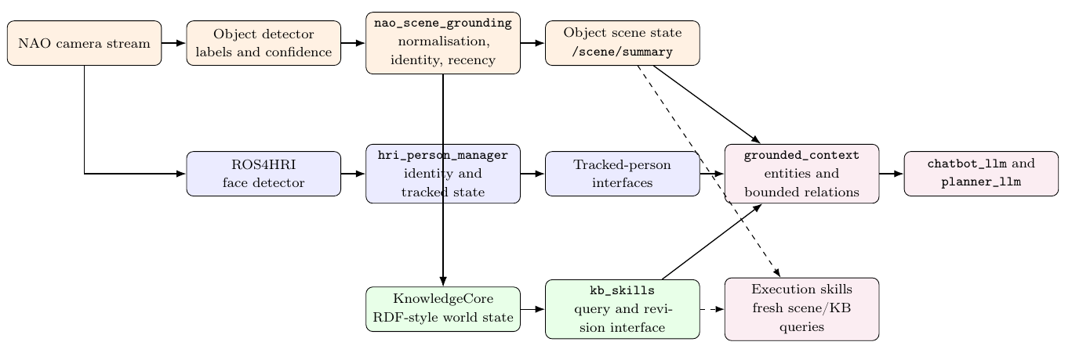
IMPLEMENTATION · CONTRACT 2
Grounding builds a bounded scene context
Normalise and preserve roles
Project, do not duplicate the world
nao_scene_grounding: detector labels → stable IDs and transient facts. Reused HRI nodes retain person identity.
chatbot_llm merges scene/KB/person evidence into entities, locations and bounded relations. Raw evidence stays at its owner.
id = handle · label = readable name · kind/class = semantics · visible = current state · relations = context
IMPLEMENTATION
11
Notes:
MAIN SLIDE 11/32 · rehearsal budget 60 seconds
Grounding construction is deterministic; downstream entity selection and interpretation remain model-dependent. The detector and EMOROBCARE dataset are reused work. Image-plane centres are not metric-distance evidence. Source default freshness: KB lifespan 4 s, local scene expiry 4.5 s; no general guarantee of execution-time availability. Detector disabled in principal semantic qualification. Context JSON appears in appendix so the diagram remains readable.
[Sources]
C:/Users/Admin/Downloads/TFM_JUAN_BENDEK_FINAL (1).pdf — final thesis
C:/Users/Admin/Downloads/TFM_JUAN_BENDEK_FINAL (1).pdf — Fig. 4.5; Table 4.3; §4.3

Slide 12
IMPLEMENTATION · CONTRACT 3
The planner request is an admitted objective
Intent.data · abbreviated contract
Each field has a responsibility
{
"dialogue_turn_id": "__default__:d343701c:1",
"goal_id": "goal_default___d343701c_1",
"request_kind": "new_goal",
"goal_text": "look at ALEX and report completion",
"normalized_intents": ["look_at"],
"grounded_context": {
"entities": [
{"id": "alex_person", "kind": "person", "visible": true}
]
}
}
dialogue_turn_id links to the conversation.
goal_id links plans and feedback.
request_kind proposes a goal transition.
goal_text states the objective.
normalized_intents guide skill selection.
grounded_context supplies bounded evidence.
Chatbot → orchestrator admission → planner.
/nao_orchestrator/planner_request → /planner/request
hri_actions_msgs/msg/Intent · JSON in data
IMPLEMENTATION
12
Notes:
MAIN SLIDE 12/32 · rehearsal budget 50 seconds
A contract comprises structure, semantics, allowed values and owner obligations. This is the final thesis Contract 3 example with abbreviated grounding, not a captured runtime event. Intent is the ROS envelope; JSON lives in data. The orchestrator normalises and admits transition and lineage before forwarding. No hidden executable plan from chatbot.
[Sources]
C:/Users/Admin/Downloads/TFM_JUAN_BENDEK_FINAL (1).pdf — final thesis
C:/Users/Admin/Downloads/TFM_JUAN_BENDEK_FINAL (1).pdf — Table 4.4; §4.1.4

Slide 13
IMPLEMENTATION · CONTRACT 4
A skill definition is the planner’s vocabulary
pick_object · registry excerpt
Identity is not an invocation
{
"object_id": "pick_object",
"kind": "skill",
"category": "manipulation",
"aliases": ["pick", "grab", "grab_object"],
"params": ["object_id", "target", "object", "support", "gripper", "result_mode"],
"required_params": ["target"]
}
object_id: canonical capability name.
kind/category: skill and semantic family.
aliases: accepted compatibility names.
params: allowed argument names.
required_params: mandatory subset.
A plan invokes this capability with concrete args; the registry is its definition.
AB=1: runtime skill. AB=0: primitive.
AB≥2: non-runtime proposal.
Registry object_id identifies the skill; args.object_id identifies a target entity.
IMPLEMENTATION
13
Notes:
MAIN SLIDE 13/32 · rehearsal budget 60 seconds
Exact selected fields from the local canonical-format registry mirror docs/architecture/ab_registry_input.json, checked against src/planner_llm/config/skill_registry.json. The canonical Neural-Wokbench nested source is absent in this Windows checkout. Do not imply params is itself JSON Schema: this projection lists names; value semantics and validation live in shared contracts and adapters. The thesis describes 12 planner-visible skills; not every primitive or proposal is runtime-callable.
[Sources]
C:/Users/Admin/Downloads/TFM_JUAN_BENDEK_FINAL (1).pdf — final thesis
C:/Users/Admin/Downloads/TFM_JUAN_BENDEK_FINAL (1).pdf — Table 4.5
C:/Users/Admin/PROJECTS/nao-ros4hri-bridge/docs/architecture/ab_registry_input.json
C:/Users/Admin/PROJECTS/nao-ros4hri-bridge/src/planner_llm/config/skill_registry.json

Slide 14
IMPLEMENTATION · CONTRACT 4
Declared effects must become observed evidence
pick_object · semantics excerpt
Selection, checking and dispatch
{
"preconditions": ["target object must be grounded or explicitly scenario-owned", "robot gripper should be free"],
"expected_effects": ["robot holds the object", "previous support relation is removed or replaced"],
"observable_success": ["status", "evidence.held", "evidence.kb_effects"],
"failure_modes": ["object_unavailable", "unreachable", "already_held", "grasp_failed"]
}
planner_guidance: selection and ordering.
result_schema: required result fields.
safety_flags: admission/dispatch labels.
runtime_callable: exposure gate.
implementation_status: real/fake/hybrid.
robot_adapter_mapping: execution adapter.
supports_failure_injection: test support.
preconditions: assumptions to check.
expected_effects: predicted state change.
observable_success: evidence to inspect.
failure_modes: known failure outcomes.
Definition → invocation → execution result: three different objects with different authority.
IMPLEMENTATION
14
Notes:
MAIN SLIDE 14/32 · rehearsal budget 60 seconds
Exact selected registry fields. Additional exact pick metadata: guidance resolves a grounded object; result requires skill,status,summary_text,evidence; safety flags manipulation/object_contact; runtime callable true; implementation_status fake; adapter fake_skills.pick_object; injection true. Preconditions may be scenario-owned in controlled tests. None proves a physical grasp. Full record split across appendix slides.
[Sources]
C:/Users/Admin/Downloads/TFM_JUAN_BENDEK_FINAL (1).pdf — final thesis
C:/Users/Admin/Downloads/TFM_JUAN_BENDEK_FINAL (1).pdf — Table 4.5
C:/Users/Admin/PROJECTS/nao-ros4hri-bridge/docs/architecture/ab_registry_input.json

Slide 15
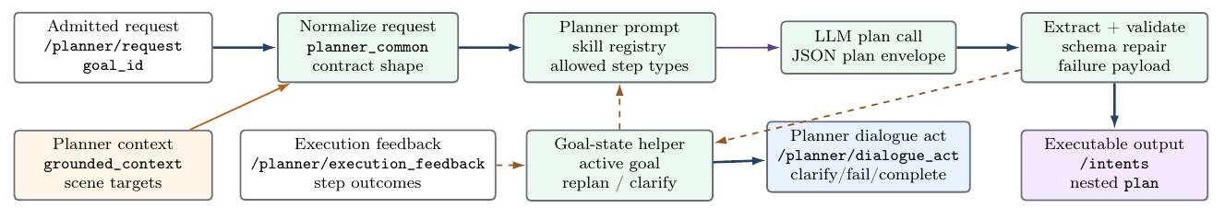
IMPLEMENTATION · CONTRACT 5
The planner proposes and supervises plans
A reviewed capability vocabulary
Lineage survives revision
Admitted goal + grounded context + skill entries condition the model. Parse and validate the candidate before publication.
plan.goal_id, plan_id and plan_version identify the proposal. steps contain id, name, args, requires and on_failure.
/planner/request → planner_llm → /intents · hri_actions_msgs/msg/Intent, JSON nested under plan
IMPLEMENTATION
15
Notes:
MAIN SLIDE 15/32 · rehearsal budget 65 seconds
The goal-keyed planning-state helper reacts to correlated feedback, not an independent executor. Each step has a stable id, type and allowed skill name. retry_budget bounds retry; retry is not a separate on_failure enum. The next plan is independently validated at the orchestrator. The model cannot call robot APIs or insert speech as a normal executable plan step. Appendix includes a full readable plan excerpt.
[Sources]
C:/Users/Admin/Downloads/TFM_JUAN_BENDEK_FINAL (1).pdf — final thesis
C:/Users/Admin/Downloads/TFM_JUAN_BENDEK_FINAL (1).pdf — Fig. 4.3; Table 4.6; §4.2.3–4.2.4

Slide 16
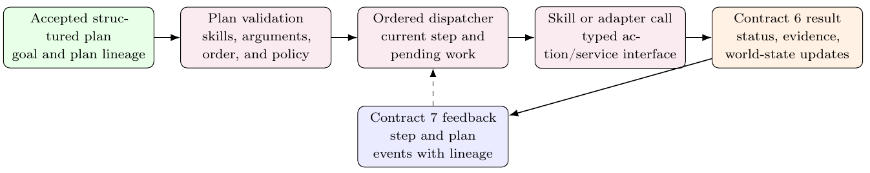
IMPLEMENTATION · VALIDATION & DISPATCH
The orchestrator controls execution
Check before dispatch
Dispatch and verify
Validate skill names, arguments, target roles, dependencies, policy and lineage. Track accepted and pending work.
Call the configured skill interface. Correlate typed results; apply successful KB effects via kb_skills and check postconditions.
nao_orchestrator owns deterministic execution—not task-planning policy or natural-language generation.
IMPLEMENTATION
16
Notes:
MAIN SLIDE 16/32 · rehearsal budget 55 seconds
Figure 4.4. Execution feedback is std_msgs/msg/String on /planner/execution_feedback. Skill calls are actions in the demonstrated routes; fake endpoints use nao_skills/action/ScanScene. Real posture, head and gaze use their adapters. Failure follows validated policy; replan returns control to planner_llm. Checks constrain supported malformed cases but are not a complete safety proof.
[Sources]
C:/Users/Admin/Downloads/TFM_JUAN_BENDEK_FINAL (1).pdf — final thesis
C:/Users/Admin/Downloads/TFM_JUAN_BENDEK_FINAL (1).pdf — Fig. 4.4; §4.2.6
C:/Users/Admin/PROJECTS/nao-ros4hri-bridge/src/nao_orchestrator/nao_orchestrator/orchestrator.py

Slide 17
IMPLEMENTATION · CONTRACTS 6–8
Results drive feedback and truthful closure
Skill result · thesis excerpt
Result → feedback → dialogue act
{
"skill": "place_object",
"status": "succeeded",
"summary_text": "I placed cup_1 on table_1.",
"evidence": {
"object_id": "cup_1",
"destination_id": "table_1",
"kb_effects": [
{"operation": "add", "statement": "cup_1 oro:isOn table_1"}
]
},
"failure": null,
"metadata": {"fake": true}
}
C6 · skill result
status + summary_text + evidence + failure + metadata.
C7 · executor feedback
goal/plan/version + event + step + status/reason + result_payload.
C8 · planner communication request
act + reason + required slots → dialogue owner.
Action result → /planner/execution_feedback → /planner/dialogue_act → dialogue layer
IMPLEMENTATION
17
Notes:
MAIN SLIDE 17/32 · rehearsal budget 50 seconds
Excerpt of thesis Contract 6: the remove-holds operation is omitted for space, not a complete effect transaction. metadata.fake=true must remain visible. C7 carries result evidence, C8 requests communication and does not speak. In current frozen v1 source, orchestrator relays the act; dialogue_manager invokes chatbot wording and owns the Say dispatch. Do not copy obsolete direct-wording launch controls from older skill docs.
[Sources]
C:/Users/Admin/Downloads/TFM_JUAN_BENDEK_FINAL (1).pdf — final thesis
C:/Users/Admin/Downloads/TFM_JUAN_BENDEK_FINAL (1).pdf — §4.1.7–4.1.9
C:/Users/Admin/PROJECTS/nao-ros4hri-bridge/docs/launch_profiles.md

Slide 18
IMPLEMENTATION · SKILL ADAPTERS
Real and fake skills share a result boundary
Robot-facing adapters
Controlled fake_skills
Speech · /nao/say
Posture / head · motion adapters
Gaze · ROS4HRI-compatible look_at
Physical integration was exercised. The main semantic profile did not establish physical navigation, grasping or safety rates.
Action endpoints: /skill/fake/<skill>
Carrier: nao_skills/action/ScanScene
Scenario, success, failure, alternating or seeded policy; targeted fail-once profiles.
Real KB guards + simulated outcome + typed result + declared KB effects.
Keep metadata.fake=true visible; a simulated “held” result is not evidence of a physical grasp.
IMPLEMENTATION
18
Notes:
MAIN SLIDE 18/32 · rehearsal budget 50 seconds
The execution path is not a physics simulator. FakeSkillActionServer wraps FakeSkillEngine and scenario policy. Current native ScanScene fields: target,target_kind,max_sweeps,evidence_policy,result_mode; result success,message,summary_text,result_payload_json,duration; feedback status,progress. Structured request data is encoded by the adapter. Parameters include global_mode,active_scenario_id,mode_overrides_json,deterministic_seed. perform_motion is real by default; look_at fake by default in frozen v1 despite installed real adapter. Exact config is appendix.
[Sources]
C:/Users/Admin/Downloads/TFM_JUAN_BENDEK_FINAL (1).pdf — final thesis
C:/Users/Admin/Downloads/TFM_JUAN_BENDEK_FINAL (1).pdf — §4.4
C:/Users/Admin/PROJECTS/nao-ros4hri-bridge/src/fake_skills/fake_skills/action_server.py
C:/Users/Admin/PROJECTS/nao-ros4hri-bridge/src/nao_skills/action/ScanScene.action
C:/Users/Admin/PROJECTS/nao-ros4hri-bridge/docs/launch_profiles.md

Slide 19
VALIDATION METHODOLOGY
Evaluation qualifies a configuration
Controlled unit of analysis
What the main profile isolates
One user request under a declared:
• model and generation settings;
• software, prompts and contracts;
• launch profile and selected adapters;
• symbolic scene and conversation state;
• harness and scoring procedure.
Full-turn integration
Routing → planning → execution → closure.
Controlled skill outcomes
Repeatable success/failure for recovery.
Symbolic postconditions
State change checked independently from fluent speech.
Scenario-based software validation—not unrestricted autonomy or a human-subject study.
VALIDATION METHODOLOGY
19
Notes:
MAIN SLIDE 19/32 · rehearsal budget 60 seconds
Primary backend Qwen3-VL-30B-A3B-Instruct-AWQ via vLLM. Planner temperature 0.1 and output limit 800 per thesis. Detector disabled in the principal semantic profile; fixtures establish world state. Evidence unit is a case record, not one independent human trial. Explain freeze, repeated cases and why development retests do not replace retained failures.
[Sources]
C:/Users/Admin/Downloads/TFM_JUAN_BENDEK_FINAL (1).pdf — final thesis
C:/Users/Admin/Downloads/TFM_JUAN_BENDEK_FINAL (1).pdf — §5.1–5.3; Table 5.1–5.3

Slide 20
VALIDATION METHODOLOGY
A pass requires the whole relevant trajectory.
A
B
C
D
Semantic route
Accepted plan
Controlled outcome
Verified closure
Correct dialogue, knowledge, or execution path
Complete targets, roles, skills, order, and lineage
Success, failure, clarification, or bounded replan
Postcondition and final report agree with evidence
Route + plan + execution evidence + postconditions + truthful closure
Missing correlated evidence is not automatically a model failure; preserve exclusions explicitly.
VALIDATION METHODOLOGY
20
Notes:
MAIN SLIDE 20/32 · rehearsal budget 60 seconds
60 s. Four gates shown: correct semantic route; complete admitted plan; required controlled outcome; verified closure. Questionnaire22 includes6dialogue7KB4simple5composite; scene11; statefulKB7; controlled multistep9; robustness5 repeated3; multi-capability7; navigation recovery1. Use expected outcomes, not one generic successful-action rule: a clarification can be a pass for an underspecified request and a failure when all context is present. Exactly-once means per semantic event, not one utterance for the entire multi-stage task.
[Sources]
C:/Users/Admin/Downloads/TFM_JUAN_BENDEK_FINAL (1).pdf — final thesis
C:/Users/Admin/Downloads/TFM_JUAN_BENDEK_FINAL (1).pdf — §5.3–5.7

Slide 21
VALIDATION METHODOLOGY
Human-supervised, agent-assisted validation
Bounded development loop
Evidence-based runtime review
robot-stack-iteration-loop
“Establish A Red Gate”
“Patch The Owning Seam”
“Accept a round only when source and live evidence agree.”
Delegated task → test/probe → proposed change → verification → human acceptance.
robot-runtime-performance-review
“Read raw evidence, not summaries only.”
“Separate fact absence from model failure.”
“Score state and wording independently.”
Review routing, grounding, lineage, recovery and duplicate speech.
Author-directed: all agent-generated project code was reviewed, revised and tuned by Juan.
VALIDATION METHODOLOGY
21
Notes:
MAIN SLIDE 21/32 · rehearsal budget 60 seconds
Authorship/supervision statement supplied directly by the user. Explain engineering support, not a causal measured efficiency gain or independently validated new algorithm. Runtime and development agents share the model+tools+constraints+feedback pattern; they are not the same running instances. Human judgement and responsibility remain with the author. The skill operational X/10 review score is not the experimental metric. Quotes checked against current SKILL.md; do not infer every historical run followed every current rule.
[Sources]
C:/Users/Admin/Downloads/TFM_JUAN_BENDEK_FINAL (1).pdf — final thesis
C:/Users/Admin/PROJECTS/nao-ros4hri-bridge/.codex/skills/robot-stack-iteration-loop/SKILL.md
C:/Users/Admin/PROJECTS/nao-ros4hri-bridge/.codex/skills/robot-runtime-performance-review/SKILL.md
Author statement in this review conversation

Slide 22
RESULTS
One primary campaign; separate supporting sets.
108
72
191
Retained case records
Primary records
Model supplement
33 source artifacts across the primary provenance index.
Qwen3-VL: 64 passes and 8 non-passes under the primary qualification.
Three-model supplement. Kept outside the primary denominator.
108 = 72 primary + 26 ablation + 10 archived records
RESULTS
22
Notes:
MAIN SLIDE 22/32 · rehearsal budget 35 seconds
35 s. Confirm denominators: primary64pass8nonpass. Other26ablation21pass5nonpass; archive10=1pass7fail2excluded. Separate191supplement150pass32fail9excluded. Raw primary includes one degraded row, so call all8 non-pass, not8fails. Supplement file printed hash mismatch was noted during source verification; counts match. Do not make an integrity guarantee from printed hashes.
[Sources]
C:/Users/Admin/Downloads/TFM_JUAN_BENDEK_FINAL (1).pdf — final thesis
C:/Users/Admin/Downloads/TFM_JUAN_BENDEK_FINAL (1).pdf — Table 6.1; Appendix D

Slide 23
RESULTS
64 of 72 primary cases passed.
What the suites test
• Named scenes and relation grounding
• Stateful KB mutation and verification
• Five robustness prompts repeated three times
• Multi-step and multi-capability tasks
Interpretation
Controlled symbolic success is not physical performance. Safe rejection does not make an incomplete task successful.
RESULTS
23
Notes:
MAIN SLIDE 23/32 · rehearsal budget 55 seconds
55 s. Native chart is updated with clear suite names, percentages and counts. Main22=20pass2nonpass; environment11/11; KB7/7; deep7/9; robustness12/15; capability5/7; navigation recovery1/1. These total72, with64passes. Case mix matters; report suite-level context rather than only the aggregate.
[Sources]
C:/Users/Admin/Downloads/TFM_JUAN_BENDEK_FINAL (1).pdf — final thesis
C:/Users/Admin/Downloads/TFM_JUAN_BENDEK_FINAL (1).pdf — Tables 6.2–6.5

Slide 24
RESULTS
Semantic failures remained attributable.
ROUTE
KB update entered the execution planner
Route and ownership failure
SELECTION
One member omitted from an “all objects” set
Target-set failure
ROLE
Kitchen treated as the delivery recipient
Entity-role failure
COVERAGE
Required action absent from a long composite
Plan-completeness failure
CLOSURE
Recovery occurred without reliable terminal speech
Report/closure failure
Harness and wiring defects were classified separately; fluent output was not sufficient evidence.
RESULTS
24
Notes:
MAIN SLIDE 24/32 · rehearsal budget 45 seconds
45 s. Preserve the five strong taxonomy rows. Route: KB update incorrectly entered robot planner despite state change. Selection: target omitted. Role: kitchen mistaken as recipient. Coverage: required capability dropped. Closure: recovery lacked final outcome. Source/launch mismatch, QoS/ingress defects and absent correlation are engineering/observability findings; do not silently count them as semantic successes or model failures.
[Sources]
C:/Users/Admin/Downloads/TFM_JUAN_BENDEK_FINAL (1).pdf — final thesis
C:/Users/Admin/Downloads/TFM_JUAN_BENDEK_FINAL (1).pdf — §6.1–6.4; §7.2–7.3

Slide 25
RESULTS
Shared interfaces; different semantic behaviour.
Stable interfaces
Variable behaviour
Matched supplement
Same scenario definitions
Same ROS ownership
Same symbolic transport
Same request schema
Same result contracts
Comparable strict profiles:
Gemma4:31b-cloud 50/59
Gemma4:cloud 51/60
Nemotron-3-super 43/56
Descriptive results, not a statistical model ranking.
Route selection
Target coverage
Role assignment
Clarification
Plan and report completeness
Backend compatibility permits substitution; each model still needs behavioural qualification.
RESULTS
25
Notes:
MAIN SLIDE 25/32 · rehearsal budget 40 seconds
40 s. Rates84.7%,85.0%,76.8% use the comparable strict profile denominators, not all191retained records. All models passed environment11/11; stress profiles differed. One retained campaign per model, exclusions and case mix prevent a universal ranking. The full table is appendix.
[Sources]
C:/Users/Admin/Downloads/TFM_JUAN_BENDEK_FINAL (1).pdf — final thesis
C:/Users/Admin/Downloads/TFM_JUAN_BENDEK_FINAL (1).pdf — §6.5; Tables 6.6–6.8; §7.1

Slide 26
RESULTS · TRACE
A failed pick triggered a revised plan.
find object
pick object
typed feedback
plan v2
report
→
→
→
→
succeeded
failed
goal + plan lineage
scan → find → pick
completed
find → pick failed → feedback → scan / find / pick → report
Why this trace matters
The retained run completed after a middle-stage failure. The successful find was repeated. This is simulated recovery, not a physical grasp trial.
RESULTS
26
Notes:
MAIN SLIDE 26/32 · rehearsal budget 65 seconds
65 s. Historical July13 F13 retained pick-recovery case, separate provenance from the72primary denominator; final thesis Table6.4 also discusses it. Exact user text Pick up the phone. goal_default___718b0d50_2. Initial plan_1783979351305: find succeeded then pick failed. New plan_1783979355769: scan/find/pick/report succeeded, plan_completed. Do NOT claim that successful find was never repeated: it was repeated in the recovery plan. Mirrored logs contain duplicates; use correlated unique events, not log-line counts. Appendix holds the actual trace excerpt.
[Sources]
C:/Users/Admin/Downloads/TFM_JUAN_BENDEK_FINAL (1).pdf — final thesis
C:/Users/Admin/Downloads/TFM_JUAN_BENDEK_FINAL (1).pdf — §6.3; Table 6.4
C:/Users/Admin/PROJECTS/nao-ros4hri-bridge/docs/evaluation/runs/F13_semantic_audit/raw/nao_fake_fail_once_pick_20260713_heavy_changes.json

Slide 27
DEMONSTRATION
Three turns expose the main routes.
01
“Hey, how are you?”
Dialogue route
one response, no planner request
02
“What can you see now?”
Knowledge route
answer from the declared symbolic state
03
“Move your head up.”
Execution route
accepted plan, one skill result, one closure
Live demo illustrates the stack; frozen traces remain the scored evidence.
DEMONSTRATION
27
Notes:
MAIN SLIDE 27/32 · rehearsal budget 120 seconds
120 s maximum including transitions. Stack already running. Rehearsed dialogue, declared-symbolic-scene query, simple head action. State the chosen model and selected real/fake adapter honestly. If unavailable, use the supervisor video or retained trace immediately. No startup or troubleshooting during the defence. The video file has not been supplied to this workstation and is not embedded. Live illustration does not alter the frozen experimental denominator.
[Sources]
C:/Users/Admin/Downloads/TFM_JUAN_BENDEK_FINAL (1).pdf — final thesis
C:/Users/Admin/Downloads/TFM_JUAN_BENDEK_FINAL (1).pdf — §5.1
C:/Users/Admin/PROJECTS/nao-ros4hri-bridge/docs/presentation/TFM_DEFENCE_DEMO_RUNBOOK_2026-09-03.md

Slide 28
DISCUSSION
What the evidence supports
RQ1
Plans work within tested task families
Composite and multi-capability failures remain.
RQ2
Symbolic grounding supports role-aware tasks
Selection and role interpretation remain model-sensitive.
RQ3
Deterministic rejection contains tested errors
No general physical-safety or completeness guarantee.
RQ4
Feedback enables observed recovery
Beginning/middle evidence is stronger than final-stage recovery.
RQ5
Ownership and interfaces remain inspectable
Transfer to other robots still requires validation.
DISCUSSION
28
Notes:
MAIN SLIDE 28/32 · rehearsal budget 45 seconds
45 s. Explicitly return to each research question. Claim the complete interaction architecture rather than one superior planning algorithm. Explain why rejection is valuable while retaining the task non-pass.
[Sources]
C:/Users/Admin/Downloads/TFM_JUAN_BENDEK_FINAL (1).pdf — final thesis
C:/Users/Admin/Downloads/TFM_JUAN_BENDEK_FINAL (1).pdf — §6.6; Chapter 7

Slide 29
LIMITATIONS
Strong software evidence; limited physical claims.
Supported
Not established
Transfer conditions
• ownership and interface architecture
• deterministic admission and dispatch
• controlled failure and replanning
• symbolic postconditions and reporting
• navigation or grasp accuracy
• detector performance
• human safety or acceptance
• unrestricted autonomy or universal model ranking
Another robot needs an equivalent reviewed skill registry and typed adapters. Another model must repeat the frozen qualification.
Controlled outcomes isolate software behaviour; they do not replace physical trials.
LIMITATIONS
29
Notes:
MAIN SLIDE 29/32 · rehearsal budget 45 seconds
45 s. Preserve supported/not-established/transfer columns. No repeated physical navigation, manipulation, perception-accuracy or human-safety qualification. Primary object detector disabled. Model series not statistically replicated. Dataset and harness evidence limitations remain explicit.
[Sources]
C:/Users/Admin/Downloads/TFM_JUAN_BENDEK_FINAL (1).pdf — final thesis
C:/Users/Admin/Downloads/TFM_JUAN_BENDEK_FINAL (1).pdf — §8.1

Slide 30
FUTURE WORK
Future work: strengthen capability and evidence.
Semantic controls
Embodied validation
Reproducible evidence
• Fine-tuning / LoRA holdouts
• Cardinality, role and coverage checks
• KB-only routing by construction
• Require terminal closure
• Measure perception and skills
• Fresh execution-time evidence
• Physical failure / cancellation
• Validate a second platform
• Immutable source/run artifacts
• Independent repeated campaigns
• Separate model, software, harness and physical outcomes
Promote capability only with evidence appropriate to the claim.
FUTURE WORK
30
Notes:
MAIN SLIDE 30/32 · rehearsal budget 60 seconds
60 s. Follow thesis§8.2 rather than replacing its future work with the later v2 roadmap. LoRA is a proposal, not a completed experiment. Second-platform portability remains unproven.
[Sources]
C:/Users/Admin/Downloads/TFM_JUAN_BENDEK_FINAL (1).pdf — final thesis
C:/Users/Admin/Downloads/TFM_JUAN_BENDEK_FINAL (1).pdf — §8.2

Slide 31
CONTRIBUTIONS
Architecture, execution contracts and validation.
01
02
03
Architecture
Containment
Qualification
Integrated dialogue, grounding, planning, orchestration and robot adapters with explicit ownership.
Reviewed skill definitions, typed payloads and deterministic checks constrain model-generated proposals.
Controlled cases, retained traces, symbolic postconditions and human-supervised agent-assisted iteration.
An inspectable integration—not a new foundation model or a proof of unrestricted autonomy.
CONTRIBUTIONS
31
Notes:
MAIN SLIDE 31/32 · rehearsal budget 35 seconds
35 s. Credit upstream ROS4HRI/dialogue/KnowledgeCore components and reused detector work. Distinguish original local integration and extension from library authorship. Agent-assisted tooling supported engineering; author retained design/review/acceptance responsibility.
[Sources]
C:/Users/Admin/Downloads/TFM_JUAN_BENDEK_FINAL (1).pdf — final thesis
C:/Users/Admin/Downloads/TFM_JUAN_BENDEK_FINAL (1).pdf — Chapter 9
Author supervision statement

Slide 32
CONCLUSION
Language-model dialogue and planning can participate in an integrated robot architecture when their outputs are grounded, validated against reviewed skills, dispatched deterministically, and checked against typed feedback and symbolic postconditions.
The boundaries do not eliminate non-determinism. They make it observable and restrict its execution authority.
Thank you. I welcome your questions.
IIIA-CSIC • UAB • JAE-ICU 2025
CONCLUSION
32
Notes:
MAIN SLIDE 32/32 · rehearsal budget 35 seconds
35 s. Preserve the original closing statement. Resolve the research questions within supported task families and tested boundaries. Thank the board and transition to the Q&A reference page.
[Sources]
C:/Users/Admin/Downloads/TFM_JUAN_BENDEK_FINAL (1).pdf — final thesis
C:/Users/Admin/Downloads/TFM_JUAN_BENDEK_FINAL (1).pdf — Chapter 9

Slide 33
QUESTIONS
Short answers for likely questions
Why simulated skills?
They place repeatable outcomes at the robot-facing result boundary, isolating planning and recovery from hardware variance.
What is deterministic?
Admission, schema checks, dispatch order, lineage, feedback correlation, and effect verification. Route and plan generation remain model-dependent.
Why model-agnostic?
The interfaces accept multiple backends. The results explicitly show that semantic behaviour is not invariant.
Why no classical planner baseline?
The thesis validates integration and containment, not a causal comparison of planning algorithms.
What comes next?
Quantified physical skills, detector-quality evaluation, and user-facing interaction trials under the same evidence contracts.
QUESTIONS
33
Notes:
UNTIMED REFERENCE
Untimed Q&A reference, directly after conclusion as requested. Use as navigation and memory aid rather than reading all answers.
[Sources]
C:/Users/Admin/Downloads/TFM_JUAN_BENDEK_FINAL (1).pdf — final thesis
C:/Users/Admin/Downloads/TFM_JUAN_BENDEK_FINAL (1).pdf — Chapters 7–9

Slide 34
APPENDIX · RESULTS
Detailed primary results
Suite | Pass | Non-pass | Total / pass rate
End-to-end | 20 | 2 | 22 cases · 90.9%
Scene / grounding | 11 | 0 | 11 cases · 100%
Stateful KB | 7 | 0 | 7 cases · 100%
Multi-step | 7 | 2 | 9 cases · 77.8%
Robustness | 12 | 3 | 15 cases · 80.0%
Multi-capability | 5 | 2 | 7 cases · 71.4%
Navigation recovery | 1 | 0 | 1 case · 100%
APPENDIX
34
Notes:
UNTIMED REFERENCE
Counts sum to72 and64passes. Use non-pass rather than fail for aggregated primary records; primary contains a degraded row. Table updated to include recovery1/1.
[Sources]
C:/Users/Admin/Downloads/TFM_JUAN_BENDEK_FINAL (1).pdf — final thesis
C:/Users/Admin/Downloads/TFM_JUAN_BENDEK_FINAL (1).pdf — Tables 6.2–6.5

Slide 35
APPENDIX · QUESTIONNAIRES
Main questionnaire · 1/5
Dialogue
Hey, how are you?
One natural response; no planner request.
Dialogue
What is your favourite movie?
Answer without planner handoff.
Dialogue
My favourite movie is Back to the Future!
Use conversation context; no execution.
Dialogue
Do you have any ideas for this weekend?
Advice only.
Dialogue
What is the speed of light?
Informational answer only.
APPENDIX
35
Notes:
UNTIMED REFERENCE
Untimed reference. Full prompt text is retained. Source: C:/Users/Admin/Downloads/TFM_JUAN_BENDEK_FINAL (1).pdf — Table 5.4
[Sources]
C:/Users/Admin/Downloads/TFM_JUAN_BENDEK_FINAL (1).pdf — final thesis
C:/Users/Admin/Downloads/TFM_JUAN_BENDEK_FINAL (1).pdf — Table 5.4

Slide 36
APPENDIX · QUESTIONNAIRES
Main questionnaire · 2/5
Knowledge
What can you see now?
Use declared current state.
Knowledge
What new objects can you see?
Use newly inserted scene facts.
Knowledge
Which object is on the table?
Resolve the support relation.
Knowledge
What is the cup called?
Return the stored name.
Knowledge
How many objects can you see?
Count deliverable objects, not people/support anchors.
APPENDIX
36
Notes:
UNTIMED REFERENCE
Untimed reference. Full prompt text is retained. Source: C:/Users/Admin/Downloads/TFM_JUAN_BENDEK_FINAL (1).pdf — Table 5.4
[Sources]
C:/Users/Admin/Downloads/TFM_JUAN_BENDEK_FINAL (1).pdf — final thesis
C:/Users/Admin/Downloads/TFM_JUAN_BENDEK_FINAL (1).pdf — Table 5.4

Slide 37
APPENDIX · QUESTIONNAIRES
Main questionnaire · 3/5
Knowledge
What colour is the cup?
Return the stored colour.
Knowledge
Add a red cup to your knowledge base.
Authorised KB mutation, no robot-action plan.
Execution
Move your head up.
Execute motion and report result.
Execution
Pick up the phone.
Ground one phone before pick.
Execution
Pick up the object on the table.
Select from support relation.
APPENDIX
37
Notes:
UNTIMED REFERENCE
Untimed reference. Full prompt text is retained. Source: C:/Users/Admin/Downloads/TFM_JUAN_BENDEK_FINAL (1).pdf — Table 5.4
[Sources]
C:/Users/Admin/Downloads/TFM_JUAN_BENDEK_FINAL (1).pdf — final thesis
C:/Users/Admin/Downloads/TFM_JUAN_BENDEK_FINAL (1).pdf — Table 5.4

Slide 38
APPENDIX · QUESTIONNAIRES
Main questionnaire · 4/5
Execution
Look at ALEX.
Preserve human gaze-target role.
Execution
Move your head up, down, left, and right.
Preserve all motions and order.
Execution
Bring all the objects you can see to ALEX.
Preserve target set and human recipient.
Execution
Go to the kitchen, find the cup, and bring it to me.
Preserve location, object, recipient and order.
Execution
Go to ALEX, wave, and tell me when you are finished.
Navigate, perform greeting motion, report.
APPENDIX
38
Notes:
UNTIMED REFERENCE
Untimed reference. Full prompt text is retained. Source: C:/Users/Admin/Downloads/TFM_JUAN_BENDEK_FINAL (1).pdf — Table 5.4
[Sources]
C:/Users/Admin/Downloads/TFM_JUAN_BENDEK_FINAL (1).pdf — final thesis
C:/Users/Admin/Downloads/TFM_JUAN_BENDEK_FINAL (1).pdf — Table 5.4

Slide 39
APPENDIX · QUESTIONNAIRES
Main questionnaire · 5/5
Execution
Visit every object and tell me when you reach each one.
Visit each object and report each arrival.
Dialogue
Remember that ALEX is the recipient, but do not act yet.
Memory acknowledgement without action.
APPENDIX
39
Notes:
UNTIMED REFERENCE
Untimed reference. Full prompt text is retained. Source: C:/Users/Admin/Downloads/TFM_JUAN_BENDEK_FINAL (1).pdf — Table 5.4
[Sources]
C:/Users/Admin/Downloads/TFM_JUAN_BENDEK_FINAL (1).pdf — final thesis
C:/Users/Admin/Downloads/TFM_JUAN_BENDEK_FINAL (1).pdf — Table 5.4

Slide 40
APPENDIX · QUESTIONNAIRES
Scene and grounding · 1/3
baseline table inventory
What objects are on the table?
lab table inventory
What objects are on the table?
lab sections inventory
What can you see in the lab?
lab sections delivery
Bring every object from the work table to ALEX and report what happened.
APPENDIX
40
Notes:
UNTIMED REFERENCE
Untimed reference. Full prompt text is retained. Source: C:/Users/Admin/PROJECTS/nao-ros4hri-bridge/docs/artifacts/runtime_v34_model_agnostic_review/environment_v33.json
[Sources]
C:/Users/Admin/Downloads/TFM_JUAN_BENDEK_FINAL (1).pdf — final thesis
C:/Users/Admin/PROJECTS/nao-ros4hri-bridge/docs/artifacts/runtime_v34_model_agnostic_review/environment_v33.json

Slide 41
APPENDIX · QUESTIONNAIRES
Scene and grounding · 2/3
kitchen inventory
What is in the kitchen?
grouped location delivery
Bring every object from the kitchen to ALEX and report what happened.
grouped location followup
Where is the kitchen cup now?
iiia floor inventory
What rooms and objects are in the IIIA floor scene?
APPENDIX
41
Notes:
UNTIMED REFERENCE
Untimed reference. Full prompt text is retained. Source: C:/Users/Admin/PROJECTS/nao-ros4hri-bridge/docs/artifacts/runtime_v34_model_agnostic_review/environment_v33.json
[Sources]
C:/Users/Admin/Downloads/TFM_JUAN_BENDEK_FINAL (1).pdf — final thesis
C:/Users/Admin/PROJECTS/nao-ros4hri-bridge/docs/artifacts/runtime_v34_model_agnostic_review/environment_v33.json

Slide 42
APPENDIX · QUESTIONNAIRES
Scene and grounding · 3/3
iiia kitchen delivery
Bring every object from the kitchen to ALEX and report what happened.
gold apple handoff
Can you bring that gold apple to the person named ALEX?
gold apple followup
Where is the gold apple now?
APPENDIX
42
Notes:
UNTIMED REFERENCE
Untimed reference. Full prompt text is retained. Source: C:/Users/Admin/PROJECTS/nao-ros4hri-bridge/docs/artifacts/runtime_v34_model_agnostic_review/environment_v33.json
[Sources]
C:/Users/Admin/Downloads/TFM_JUAN_BENDEK_FINAL (1).pdf — final thesis
C:/Users/Admin/PROJECTS/nao-ros4hri-bridge/docs/artifacts/runtime_v34_model_agnostic_review/environment_v33.json

Slide 43
APPENDIX · QUESTIONNAIRES
Stateful KB · 1/2
seed inventory
What are the names, colors, and current locations of the two objects in the test area?
revise support
The cup has been moved. Which surface is TITAS on now, and where is MIDAS?
revised relation query
Which object is on the storage shelf, and which object remains on the work table?
grounded delivery
Bring TITAS from the storage shelf to the person named ALEX and report what happened.
APPENDIX
43
Notes:
UNTIMED REFERENCE
Untimed reference. Full prompt text is retained. Source: C:/Users/Admin/PROJECTS/nao-ros4hri-bridge/docs/artifacts/runtime_v34_model_agnostic_review/kb_stress_v33.json
[Sources]
C:/Users/Admin/Downloads/TFM_JUAN_BENDEK_FINAL (1).pdf — final thesis
C:/Users/Admin/PROJECTS/nao-ros4hri-bridge/docs/artifacts/runtime_v34_model_agnostic_review/kb_stress_v33.json

Slide 44
APPENDIX · QUESTIONNAIRES
Stateful KB · 2/2
delivery postcondition
Where are TITAS and MIDAS now?
move remaining object
MIDAS is now on the storage shelf. Bring every object on that shelf to ALEX and summarize the overall result.
mixed final query
Summarize the names, colors, and current locations of TITAS and MIDAS after those changes.
APPENDIX
44
Notes:
UNTIMED REFERENCE
Untimed reference. Full prompt text is retained. Source: C:/Users/Admin/PROJECTS/nao-ros4hri-bridge/docs/artifacts/runtime_v34_model_agnostic_review/kb_stress_v33.json
[Sources]
C:/Users/Admin/Downloads/TFM_JUAN_BENDEK_FINAL (1).pdf — final thesis
C:/Users/Admin/PROJECTS/nao-ros4hri-bridge/docs/artifacts/runtime_v34_model_agnostic_review/kb_stress_v33.json

Slide 45
APPENDIX · QUESTIONNAIRES
Controlled multi-step · 1/3
baseline inventory
What objects are on the table?
ordered walk report
Walk to every object on the table and let me know when you get to each one.
grouped work table delivery
Bring every object from the work table to ALEX and report what happened.
missing object recovery
Find the codex missing cup. If you cannot find it, scan the scene and report what you can confirm.
APPENDIX
45
Notes:
UNTIMED REFERENCE
Untimed reference. Full prompt text is retained. Source: C:/Users/Admin/PROJECTS/nao-ros4hri-bridge/docs/artifacts/runtime_v34_model_agnostic_review/fake_deep_all_success_v34.json
[Sources]
C:/Users/Admin/Downloads/TFM_JUAN_BENDEK_FINAL (1).pdf — final thesis
C:/Users/Admin/PROJECTS/nao-ros4hri-bridge/docs/artifacts/runtime_v34_model_agnostic_review/fake_deep_all_success_v34.json

Slide 46
APPENDIX · QUESTIONNAIRES
Controlled multi-step · 2/3
missing recipient clarification
Bring every object from the work table to the person named BLAKE and report what happened.
iiia kitchen delivery
Bring every object from the kitchen to ALEX and report what happened.
iiia floor location followup
Where are the objects from the kitchen now?
gold apple multiturn
Can you bring that gold apple to the person named ALEX?
APPENDIX
46
Notes:
UNTIMED REFERENCE
Untimed reference. Full prompt text is retained. Source: C:/Users/Admin/PROJECTS/nao-ros4hri-bridge/docs/artifacts/runtime_v34_model_agnostic_review/fake_deep_all_success_v34.json
[Sources]
C:/Users/Admin/Downloads/TFM_JUAN_BENDEK_FINAL (1).pdf — final thesis
C:/Users/Admin/PROJECTS/nao-ros4hri-bridge/docs/artifacts/runtime_v34_model_agnostic_review/fake_deep_all_success_v34.json

Slide 47
APPENDIX · QUESTIONNAIRES
Controlled multi-step · 3/3
gold apple followup
Where is the gold apple now?
APPENDIX
47
Notes:
UNTIMED REFERENCE
Untimed reference. Full prompt text is retained. Source: C:/Users/Admin/PROJECTS/nao-ros4hri-bridge/docs/artifacts/runtime_v34_model_agnostic_review/fake_deep_all_success_v34.json
[Sources]
C:/Users/Admin/Downloads/TFM_JUAN_BENDEK_FINAL (1).pdf — final thesis
C:/Users/Admin/PROJECTS/nao-ros4hri-bridge/docs/artifacts/runtime_v34_model_agnostic_review/fake_deep_all_success_v34.json

Slide 48
APPENDIX · QUESTIONNAIRES
Robustness · 1/2
paraphrased group delivery
Take everything resting on the work table over to ALEX. Once every item has reached them, summarize the whole delivery.
object role exclusion
Visit each movable item on the table in turn. Do not navigate to the table or to any person, and report each arrival.
missing recipient
Deliver every work-table object to MORGAN and explain what information is missing if MORGAN is not present.
future recipient memory
ALEX will receive the work-table items later. For now, only acknowledge this and do not execute anything.
APPENDIX
48
Notes:
UNTIMED REFERENCE
Untimed reference. Full prompt text is retained. Source: C:/Users/Admin/PROJECTS/nao-ros4hri-bridge/docs/artifacts/runtime_v34_model_agnostic_review/robustness_v34_r1.json
[Sources]
C:/Users/Admin/Downloads/TFM_JUAN_BENDEK_FINAL (1).pdf — final thesis
C:/Users/Admin/PROJECTS/nao-ros4hri-bridge/docs/artifacts/runtime_v34_model_agnostic_review/robustness_v34_r1.json

Slide 49
APPENDIX · QUESTIONNAIRES
Robustness · 2/2
multiturn execute followup
Now deliver all of those objects to them and tell me the overall result.
APPENDIX
49
Notes:
UNTIMED REFERENCE
Untimed reference. Full prompt text is retained. Source: C:/Users/Admin/PROJECTS/nao-ros4hri-bridge/docs/artifacts/runtime_v34_model_agnostic_review/robustness_v34_r1.json
[Sources]
C:/Users/Admin/Downloads/TFM_JUAN_BENDEK_FINAL (1).pdf — final thesis
C:/Users/Admin/PROJECTS/nao-ros4hri-bridge/docs/artifacts/runtime_v34_model_agnostic_review/robustness_v34_r1.json

Slide 50
APPENDIX · QUESTIONNAIRES
Multi-capability · 1/2
walk pick sit report
Walk to TITAS, pick it up, sit down, and summarize the result.
kneel under table pick report
Kneel down, pick up MIDAS from under the work table, stand, and summarize the result.
dialogue inventory
Before we do anything, tell me which named objects and people are in the test area.
dialogue sit stand grab return
Now sit, stand again, pick up MIDAS, return to ALEX, and summarize the result.
APPENDIX
50
Notes:
UNTIMED REFERENCE
Untimed reference. Full prompt text is retained. Source: C:/Users/Admin/PROJECTS/nao-ros4hri-bridge/docs/artifacts/runtime_v34_model_agnostic_review/capability_extreme_v34.json
[Sources]
C:/Users/Admin/Downloads/TFM_JUAN_BENDEK_FINAL (1).pdf — final thesis
C:/Users/Admin/PROJECTS/nao-ros4hri-bridge/docs/artifacts/runtime_v34_model_agnostic_review/capability_extreme_v34.json

Slide 51
APPENDIX · QUESTIONNAIRES
Multi-capability · 2/2
all objects visit look wave sit
Stand up, walk to each visible object on the work table, look at each one, wave to ALEX, sit down, and give one final summary.
pick place kneel report
Pick up ATLAS, place it on the storage shelf, kneel, and summarize the result.
unreachable object recovery
Kneel and try to pick up the heavy box under the table. If you cannot, recover safely and summarize the result.
APPENDIX
51
Notes:
UNTIMED REFERENCE
Untimed reference. Full prompt text is retained. Source: C:/Users/Admin/PROJECTS/nao-ros4hri-bridge/docs/artifacts/runtime_v34_model_agnostic_review/capability_extreme_v34.json
[Sources]
C:/Users/Admin/Downloads/TFM_JUAN_BENDEK_FINAL (1).pdf — final thesis
C:/Users/Admin/PROJECTS/nao-ros4hri-bridge/docs/artifacts/runtime_v34_model_agnostic_review/capability_extreme_v34.json

Slide 52
APPENDIX · CONTRACTS
Contract 1: chatbot turn output
Explanatory shape—not a recorded event
Field interpretation
{
"verbal_ack": "I will look at ALEX.",
"route": "execution",
"confidence": 0.82,
"user_intent": {
"type": "look_at",
"goal_text": "look at ALEX",
"scene_targets": ["ALEX"],
"request_kind": "new_goal"
}
}
verbal_ack: immediate response wording.
route: dialogue / knowledge_query / execution.
confidence: model/stage estimate, not proof.
user_intent.type: normalised label.
goal_text: user objective.
scene_targets: hints, not validated IDs.
request_kind: proposed goal transition.
No executable skill sequence is hidden inside chatbot intent.
APPENDIX
52
Notes:
UNTIMED REFERENCE
[Sources]
C:/Users/Admin/Downloads/TFM_JUAN_BENDEK_FINAL (1).pdf — final thesis
C:/Users/Admin/Downloads/TFM_JUAN_BENDEK_FINAL (1).pdf — Table 4.2

Slide 53
APPENDIX · CONTRACTS
Contract 2: grounded context
Thesis entity excerpt
Bounded representation
{
"id": "cup_jrjic",
"label": "cup",
"kind": "object",
"class": "Cup",
"visible": true,
"relations": [
{"predicate": "dbp:color", "object": "blue"},
{"predicate": "oro:isOn", "object": "table_1"},
{"predicate": "oro:isAt", "object": "lab_area"}
]
}
id: stable target handle.
label: readable description.
kind: object / person / location.
class: semantic category.
visible: currently accepted scene/KB state.
relations: task-relevant predicates.
locations is a derived grouping view; people never become deliverable objects.
A current context supports planning; the executing skill must obtain fresh evidence.
APPENDIX
53
Notes:
UNTIMED REFERENCE
[Sources]
C:/Users/Admin/Downloads/TFM_JUAN_BENDEK_FINAL (1).pdf — final thesis
C:/Users/Admin/Downloads/TFM_JUAN_BENDEK_FINAL (1).pdf — Table 4.3; §4.3

Slide 54
APPENDIX · CONTRACT 4
Skill metadata and dispatch
Exact selected registry fields
How the fields are used
{
"planner_guidance": ["use for explicit pick or grab requests after resolving a grounded object id"],
"result_schema": {
"required": ["skill", "status", "summary_text", "evidence"]
},
"safety_flags": ["manipulation", "object_contact"]
}
Planner guidance constrains selection.
Result schema defines evidence obligations.
Safety flags label relevant hazards.
Runtime callability gates exposure.
Implementation status names the backend class.
Adapter mapping resolves the execution owner.
Failure-injection support enables controlled tests.
The local canonical-format mirror agrees with the planner projection for pick_object.
APPENDIX
54
Notes:
UNTIMED REFERENCE
[Sources]
C:/Users/Admin/Downloads/TFM_JUAN_BENDEK_FINAL (1).pdf — final thesis
C:/Users/Admin/PROJECTS/nao-ros4hri-bridge/docs/architecture/ab_registry_input.json
C:/Users/Admin/PROJECTS/nao-ros4hri-bridge/src/planner_llm/config/skill_registry.json

Slide 55
APPENDIX · CONTRACT 4
Skill implementation and callability
Exact selected registry fields
How the fields are used
{
"object_id": "pick_object",
"kind": "skill",
"implementation_status": "fake",
"robot_adapter_mapping": "fake_skills.pick_object",
"supports_failure_injection": true,
"metadata": {"runtime_callable": true}
}
Planner guidance constrains selection.
Result schema defines evidence obligations.
Safety flags label relevant hazards.
Runtime callability gates exposure.
Implementation status names the backend class.
Adapter mapping resolves the execution owner.
Failure-injection support enables controlled tests.
The local canonical-format mirror agrees with the planner projection for pick_object.
APPENDIX
55
Notes:
UNTIMED REFERENCE
[Sources]
C:/Users/Admin/Downloads/TFM_JUAN_BENDEK_FINAL (1).pdf — final thesis
C:/Users/Admin/PROJECTS/nao-ros4hri-bridge/docs/architecture/ab_registry_input.json
C:/Users/Admin/PROJECTS/nao-ros4hri-bridge/src/planner_llm/config/skill_registry.json

Slide 56
APPENDIX · CONTRACTS
Contract 5: executable plan
Thesis plan excerpt
Interpretation
{ "plan": {
"goal_id": "goal_turn_123",
"plan_id": "plan_123", "plan_version": 1,
"status": "planned",
"steps": [{
"id": "step_1", "type": "skill",
"name": "look_at",
"args": {
"target_frame": "anonymous_person_ehfbf"
},
"requires": [], "on_failure": "replan"
}]
}}
goal_id: objective lineage.
plan_id: concrete proposal identity.
plan_version: revision.
status: planning outcome, not execution success.
steps: ordered invocations.
id: step correlation key.
args: schema-valid arguments.
requires: successful dependencies.
on_failure: validated recovery policy.
All plan metadata stays nested under plan; retry budgets remain separate from failure policy.
APPENDIX
56
Notes:
UNTIMED REFERENCE
[Sources]
C:/Users/Admin/Downloads/TFM_JUAN_BENDEK_FINAL (1).pdf — final thesis
C:/Users/Admin/Downloads/TFM_JUAN_BENDEK_FINAL (1).pdf — Table 4.6

Slide 57
APPENDIX · CONTRACTS
Contracts 7–8: feedback and communication
Execution feedback · thesis excerpt
Dialogue act · thesis excerpt
{
"goal_id": "goal_turn_123",
"status": "failed",
"step": {"id": "step_1", "name": "look_at"},
"reason": "target frame unavailable",
"result_payload": {"target_found": false, "target_kind": "person"}
}
{
"goal_id": "goal_turn_123",
"act": "ask_clarification",
"await_user_response": true,
"reason": "multiple visible people",
"text_hint": "Which person should I look at?",
"slots_needed": ["target_person"]
}
Two separate illustrative excerpts—not one correlated runtime event.
APPENDIX
57
Notes:
UNTIMED REFERENCE
Additional C7 runtime fields include plan_id,plan_version,event_type,timestamp_sec,blocking and retry metadata. C8 await_user_response tells dialogue that input is needed; slots_needed describes missing information. This feedback reason and dialogue reason are different thesis examples and are intentionally not presented as one trajectory.
[Sources]
C:/Users/Admin/Downloads/TFM_JUAN_BENDEK_FINAL (1).pdf — final thesis
C:/Users/Admin/Downloads/TFM_JUAN_BENDEK_FINAL (1).pdf — §4.1.8–4.1.9

Slide 58
APPENDIX · ADAPTERS
ROS action carrier and fake configuration
ScanScene.action · actual definition
Selected configuration fields
string target
string target_kind
int32 max_sweeps
string evidence_policy
string result_mode
---
bool success
string message
string summary_text
string result_payload_json
float32 duration
---
string status
float32 progress
perform_motion_execution_mode:=real
look_at_execution_mode:=fake
start_fake_skills:=true
global_mode: scenario / always_success / always_fail / every_other / random_seeded
active_scenario_id: named scenario
mode_overrides_json: per-skill policy
deterministic_seed: repeatable sampling
Result JSON is carried in result_payload_json.
The selected adapter and policy are part of the experimental configuration.
APPENDIX
58
Notes:
UNTIMED REFERENCE
[Sources]
C:/Users/Admin/Downloads/TFM_JUAN_BENDEK_FINAL (1).pdf — final thesis
C:/Users/Admin/PROJECTS/nao-ros4hri-bridge/src/nao_skills/action/ScanScene.action
C:/Users/Admin/PROJECTS/nao-ros4hri-bridge/src/fake_skills/fake_skills/action_server.py
C:/Users/Admin/PROJECTS/nao-ros4hri-bridge/docs/launch_profiles.md

Slide 59
APPENDIX · CONTRACT 9
KnowledgeCore: state and verified effects
RDF-style knowledge statements
Ownership and verification
codex_lab_cup rdf:type Cup
codex_lab_cup dbp:color red
codex_lab_cup oro:isOn codex_lab_table
person_alex rdf:type Human
myself sees person_alex
read: /kb/query
mutate: /kb/revise
KnowledgeCore is reused infrastructure.
kb_skills owns query/revision transport.
Perception supplies transient observations.
Fixtures declare controlled symbolic state.
Skills report their observed effects.
The orchestrator applies successful effects and queries required postconditions.
A correct KB postcondition and correct user-facing wording are separate checks.
APPENDIX
59
Notes:
UNTIMED REFERENCE
[Sources]
C:/Users/Admin/Downloads/TFM_JUAN_BENDEK_FINAL (1).pdf — final thesis
C:/Users/Admin/Downloads/TFM_JUAN_BENDEK_FINAL (1).pdf — §4.1.10; Table 4.7

Slide 60
APPENDIX · TRACE EVIDENCE
Recovery trace: retained event sequence
Correlated outcome events
Read the evidence carefully
1783979352.183 plan_1783979351305
step_succeeded find_object
1783979352.946 plan_1783979351305
step_failed pick_object
1783979359.641 plan_1783979355769
step_succeeded scan
1783979360.506 plan_1783979355769
step_succeeded find_object
1783979361.899 plan_1783979355769
step_succeeded pick_object
1783979364.016 plan_1783979355769
step_succeeded report_result
1783979364.017 plan_1783979355769
plan_completed
Request: “Pick up the phone.”
Goal: goal_default___718b0d50_2
Initial plan ends with failed pick.
Replacement scans, finds, picks and reports.
The successful find is repeated.
Historical F13 case; not an extra row in the 72-case primary campaign.
Derived display of retained log fields; raw artifact and exact source lines are in speaker notes.
APPENDIX
60
Notes:
UNTIMED REFERENCE
Exact retained source lines:
TRACE_EVENT [1783979352.183] goal_default___718b0d50_2 | execution_feedback | /planner/execution_feedback | node=planner_llm | flow=goal_id=goal_default___718b0d50_2,plan_id=plan_1783979351305,event_type=step_succeeded,step=find_object
TRACE_EVENT [1783979352.946] goal_default___718b0d50_2 | execution_feedback | /planner/execution_feedback | node=planner_llm | flow=goal_id=goal_default___718b0d50_2,plan_id=plan_1783979351305,event_type=step_failed,step=pick_object
TRACE_EVENT [1783979359.641] goal_default___718b0d50_2 | execution_feedback | /planner/execution_feedback | node=planner_llm | flow=goal_id=goal_default___718b0d50_2,plan_id=plan_1783979355769,event_type=step_succeeded,step=scan
TRACE_EVENT [1783979360.506] goal_default___718b0d50_2 | execution_feedback | /planner/execution_feedback | node=planner_llm | flow=goal_id=goal_default___718b0d50_2,plan_id=plan_1783979355769,event_type=step_succeeded,step=find_object
TRACE_EVENT [1783979361.899] goal_default___718b0d50_2 | execution_feedback | /planner/execution_feedback | node=planner_llm | flow=goal_id=goal_default___718b0d50_2,plan_id=plan_1783979355769,event_type=step_succeeded,step=pick_object
TRACE_EVENT [1783979364.016] goal_default___718b0d50_2 | execution_feedback | /planner/execution_feedback | node=planner_llm | flow=goal_id=goal_default___718b0d50_2,plan_id=plan_1783979355769,event_type=step_succeeded,step=report_result
TRACE_EVENT [1783979364.017] goal_default___718b0d50_2 | execution_feedback | /planner/execution_feedback | node=planner_llm | flow=goal_id=goal_default___718b0d50_2,plan_id=plan_1783979355769,event_type=plan_completed
Assessment: {"all_required_context":false,"expected_outcome":"observe","reasons":["matched expected trajectory"],"status":"pass"}. Deduplicated display of unique outcomes; source log excerpt includes unrelated earlier events, excluded by goal correlation.
[Sources]
C:/Users/Admin/Downloads/TFM_JUAN_BENDEK_FINAL (1).pdf — final thesis
C:/Users/Admin/PROJECTS/nao-ros4hri-bridge/docs/evaluation/runs/F13_semantic_audit/raw/nao_fake_fail_once_pick_20260713_heavy_changes.json

Slide 61
APPENDIX · ARCHITECTURE
Owners and evidence remain separate.
Dialogue
Chatbot
Planner
Orchestrator
Skills
Dialogue
turn lifecycle
and speech
→
route and
grounded request
→
candidate plan
and supervision
→
admission
validation
dispatch
feedback
→
typed result
and effects
→
one evidence-based
closure
Goal ID • plan ID • plan version • stable step IDs
Symbolic evidence
Execution evidence
KnowledgeCore and scene grounding provide bounded entities, roles, locations, and relations.
Robot-facing or simulated adapters return the same typed result boundary.
APPENDIX
61
Notes:
UNTIMED REFERENCE
Conceptual recap retained from original slide5. Planner ingress is chatbot→orchestrator admission→planner; the left-to-right simplified drawing is not the complete transport topology. See main technical slides for exact interfaces. Communication returns through the dialogue owner.
[Sources]
C:/Users/Admin/Downloads/TFM_JUAN_BENDEK_FINAL (1).pdf — final thesis
C:/Users/Admin/Downloads/TFM_JUAN_BENDEK_FINAL (1).pdf — §3.2; §4.2

Slide 62
APPENDIX · PROVENANCE
Evidence and interpretation notes
Primary vs supplementary evidence
Boundaries of reproducibility
108 primary-index records:
72 qualification + 26 ablations + 10 archive.
72 qualification: 64 pass, 8 non-pass.
191 separate model-supplement records:
150 pass, 32 fail, 9 excluded.
Repeated prompts are not independent user trials.
Retain model/configuration, case identity, world fixture, source hashes and raw evidence.
A successful diagnostic rerun does not erase a retained non-pass.
Missing terminal evidence can fail acceptance; external/harness absence may be excluded under the declared scoring rule.
Sources: final thesis Tables 6.1–6.8 and Appendix D; retained JSON/CSV artifacts.
APPENDIX
62
Notes:
UNTIMED REFERENCE
PDF embedded primary dataset hash matches its printed table. Embedded supplement actual SHA e8d4ce4bda136fe6674e9af3cd2f3b7d78743ba528dfcc260f555549c73c8f59 differs from printed Table D.2. Counts agree. Do not state both attachments verified against printed hashes. This is a source integrity caveat, not a reason to modify thesis result counts.
[Sources]
C:/Users/Admin/Downloads/TFM_JUAN_BENDEK_FINAL (1).pdf — final thesis
C:/Users/Admin/Downloads/TFM_JUAN_BENDEK_FINAL (1).pdf — Appendix D

