Slide 1

Test automation course

Slide 2

Table of contents
1. UML notations
Basic data types
Access modifiers
Non-access modifiers
Java constructor
this keyword
void keyword
return keyword
Creation of class instances (objects)

Slide 3

UML notations
Class diagrams are widely used to describe the types of objects in a system and their relationships. Class diagrams model class structure and contents using design elements such as classes, packages and objects. Class diagrams describe three different perspectives when designing a system, conceptual, specification, and implementation. These perspectives become evident as the diagram is created and help solidify the design.

Slide 4

UML notations
Purpose of Class diagrams :
The purpose of the class diagram is to model the static view of an application. The class diagrams are the only diagrams which can be directly mapped with object oriented languages and thus widely used at the time of construction.
So the purpose of the class diagram can be summarized as:
Analysis and design of the static view of an application.
Describe responsibilities of a system.
Base for component and deployment diagrams.
Forward and reverse engineering.

Slide 5


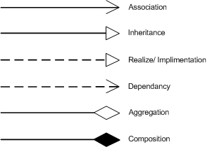
UML notations
The Class diagrams, physical data models, along with the system overview diagram are in my opinion the most important diagrams that suite the current day rapid application development requirements.

Slide 6


UML notations How to draw Class Diagram?
The following points should be remembered while drawing a class diagram:
The name of the class diagram should be meaningful to describe the aspect of the system.
Each element and their relationships should be identified in advance.
Responsibility (attributes and methods) of each class should be clearly identified.
For each class minimum number of properties should be specified. Because unnecessary properties will make the diagram complicated.
Use notes when ever required to describe some aspect of the diagram. Because at the end of the drawing it should be understandable to the developer/coder.
Finally, before making the final version, the diagram should be drawn on plain paper and rework as many times as possible to make it correct.
Now the following diagram is an example of an Order System of an application. So it describes a particular aspect of the entire application.
First of all Order and Customer are identified as the two elements of the system and they have a one to many relationship because a customer can have multiple orders.
We would keep Order class is an abstract class and it has two concrete classes (inheritance relationship) SpecialOrder and NormalOrder.
The two inherited classes have all the properties as the Order class. In addition they have additional functions like dispatch () and receive ().

Slide 7
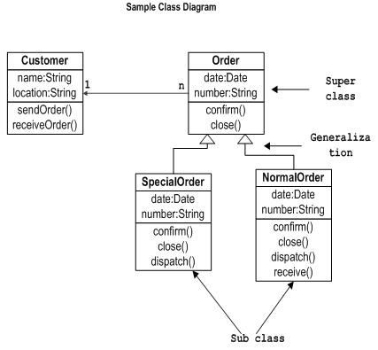
UML notations How to draw Class Diagram?
So the following class diagram has been drawn considering all the points mentioned above:

Slide 8

2. Java - Basic Data types
Variables are nothing but reserved memory locations to store values. This means that when you create a variable you reserve some space in memory.
Based on the data type of a variable, the operating system allocates memory and decides what can be stored in the reserved memory. Therefore, by assigning different data types to variables, you can store integers, decimals, or characters in these variables.
There are two data types available in Java:
Primitive Data Types
Reference/Object Data Types

Slide 9


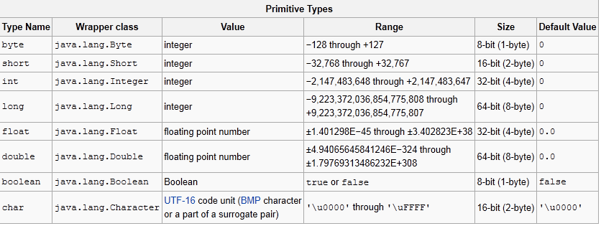
Java - Basic Data types Primitive Data Types

Slide 10


Java - Basic Data types Reference/Object Data Types
Reference variables are created using defined constructors of the classes. They are used to access objects. These variables are declared to be of a specific type that cannot be changed. For example, Employee, Puppy etc.
Class objects, and various type of array variables come under reference data type.
Default value of any reference variable is null.
A reference variable can be used to refer to any object of the declared type or any compatible type.
Example: Animal animal = new Animal("giraffe");

Slide 11
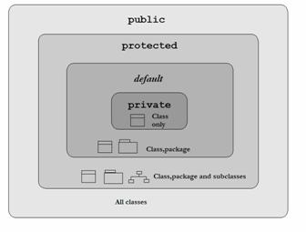

3. Access modifiers
Java provides a number of access modifiers to set access levels for classes, variables, methods and constructors. The four access levels are:
Visible to the package. the default. No modifiers are needed.
Visible to the class only (private).
Visible to the world (public).
Visible to the package and all subclasses (protected).

Slide 12

Access modifiers
Default Access Modifier - No keyword
Default access modifier means we do not explicitly declare an access modifier for a class, field, method, etc.
A variable or method declared without any access control modifier is available to any other class in the same package. The fields in an interface are implicitly public static final and the methods in an interface are by default public.
Example:
String version = "1.5.1";
boolean processOrder() {
return true;
}

Slide 13

Access modifiers Private Access Modifier - private
Methods, Variables and Constructors that are declared private can only be accessed within the declared class itself.
Private access modifier is the most restrictive access level. Class and interfaces cannot be private.
Variables that are declared private can be accessed outside the class if public getter methods are present in the class.
Using the private modifier is the main way that an object encapsulates itself and hide data from the outside world.
Example:
public class Logger {
private String format;
public String getFormat() {
return this.format;
}
public void setFormat(String format) {
this.format = format;
}
}

Slide 14

Access modifiers Public Access Modifier - public
A class, method, constructor, interface etc declared public can be accessed from any other class. Therefore fields, methods, blocks declared inside a public class can be accessed from any class belonging to the Java Universe.
However if the public class we are trying to access is in a different package, then the public class still need to be imported.
Because of class inheritance, all public methods and variables of a class are inherited by its subclasses.
Example:
public static void main(String[] arguments) {
// ...
}

Slide 15

Access modifiers Protected Access Modifier - protected
Variables, methods and constructors which are declared protected in a superclass can be accessed only by the subclasses in other package or any class within the package of the protected members' class.
The protected access modifier cannot be applied to class and interfaces. Methods, fields can be declared protected, however methods and fields in a interface cannot be declared protected.
Protected access gives the subclass a chance to use the helper method or variable, while preventing a nonrelated class from trying to use it.
Example:
class AudioPlayer {
protected boolean openSpeaker(Speaker sp) {
// implementation details
}
}
class StreamingAudioPlayer {
boolean openSpeaker(Speaker sp) {
// implementation details
}
}

Slide 16
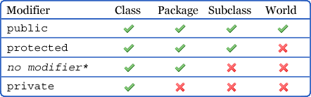
Access modifiers Access Control and Inheritance:
The following rules for inherited methods are enforced:
Methods declared public in a superclass also must be public in all subclasses.
Methods declared protected in a superclass must either be protected or public in subclasses; they cannot be private.
Methods declared without access control (no modifier was used) can be declared more private in subclasses.
Methods declared private are not inherited at all, so there is no rule for them.

Slide 17

4. Non-access modifiers
Java provides a number of non-access modifiers to achieve many other functionality.
The static modifier for creating class methods and variables
The final modifier for finalizing the implementations of classes, methods, and variables.
The abstract modifier for creating abstract classes and methods.
The synchronized and volatile modifiers, which are used for threads.

Slide 18

Non-access modifiers Static Modifier
Static Modifiers are used to create class variable and class methods which can be accessed without instance of a class.
Static Variables:
The static key word is used to create variables that will exist independently of any instances created for the class. Only one copy of the static variable exists regardless of the number of instances of the class.
Static variables are also known as class variables. Local variables cannot be declared static.
Static Methods:
The static key word is used to create methods that will exist independently of any instances created for the class.
Static methods do not use any instance variables of any object of the class they are defined in. Static methods take all the data from parameters and compute something from those parameters, with no reference to variables.
Class variables and methods can be accessed using the class name followed by a dot and the name of the variable or method.

Slide 19

Non-access modifiers
The final Modifier:
final Variables:
A final variable can be explicitly initialized only once. A reference variable declared final can never be reassigned to refer to an different object.
However the data within the object can be changed. So the state of the object can be changed but not the reference.
With variables, the final modifier often is used with static to make the constant a class variable.
Example:
public class Test{
final int value = 10;
// The following are examples of declaring constants:
public static final int BOXWIDTH = 6;
static final String TITLE = "Manager";
public void changeValue()
value = 12;
//will give an error
}
}

Slide 20

Non-access modifiers
final Methods:
A final method cannot be overridden by any subclasses. As mentioned previously the final modifier prevents a method from being modified in a subclass.
The main intention of making a method final would be that the content of the method should not be changed by any outsider.
Example:
You declare methods using the final modifier in the class declaration, as in the following example:
public class Test{
public final void changeName(){
// body of method
}
final Classes:
The main purpose of using a class being declared as final is to prevent the class from being subclassed. If a class is marked as final then no class can inherit any feature from the final class.
Example:
public final class Test {
// body of class
}

Slide 21
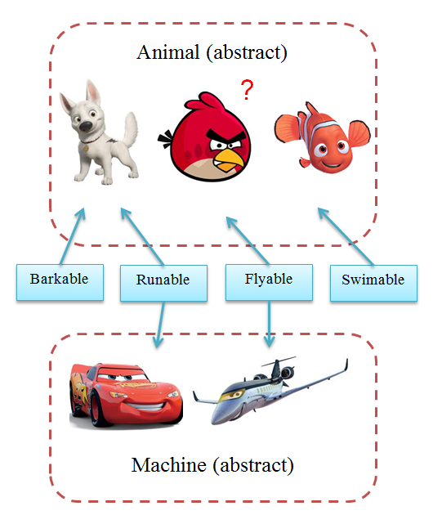
Non-access modifiers The abstract Modifier:
abstract Class:
An abstract class can never be instantiated. If a class is declared as abstract then the sole purpose is for the class to be extended.
A class cannot be both abstract and final. (since a final class cannot be extended). If a class contains abstract methods then the class should be declared abstract. Otherwise a compile error will be thrown.
An abstract class may contain both abstract methods as well normal methods.
Example:
abstract class Caravan{
private double price;
private String model;
private String year;
public abstract void goFast(); //an abstract method
public abstract void changeColor();
}

Slide 22

Non-access modifiers
abstract Methods:
An abstract method is a method declared with out any implementation. The methods body(implementation) is provided by the subclass. Abstract methods can never be final or strict.
Any class that extends an abstract class must implement all the abstract methods of the super class unless the subclass is also an abstract class.
If a class contains one or more abstract methods then the class must be declared abstract. An abstract class does not need to contain abstract methods.
The abstract method ends with a semicolon. Example: public abstract sample();
Example:
public abstract class SuperClass{
abstract void m();
//abstract method }
class SubClass extends SuperClass{
// implements the abstract method
void m(){
......... }
}

Slide 23


Non-access modifiers
The synchronized Modifier:
The synchronized key word used to indicate that a method can be accessed by only one thread at a time. The synchronized modifier can be applied with any of the four access level modifiers.
Example:
public synchronized void showDetails(){
.......
}
The transient Modifier:
An instance variable is marked transient to indicate the JVM to skip the particular variable when serializing the object containing it.
This modifier is included in the statement that creates the variable, preceding the class or data type of the variable.
Example:
public transient int limit = 55; // will not persist
public int b; // will persist

Slide 24

Non-access modifiers
The volatile Modifier:
The volatile is used to let the JVM know that a thread accessing the variable must always merge its own private copy of the variable with the master copy in the memory.
Accessing a volatile variable synchronizes all the cached copied of the variables in the main memory. Volatile can only be applied to instance variables, which are of type object or private. A volatile object reference can be null.
Example:
public class MyRunnable implements Runnable
{
private volatile boolean active;
public void run()
{
active = true;
while (active) // line 1
{
// some code here
}
}
public void stop() {
active = false; // line 2
}
}
Usually, run() is called in one thread (the one you start using the Runnable), and stop() is called from another thread. If in line 1 the cached value of active is used, the loop may not stop when you set active to false in line 2. That's when you want to use volatile.

Slide 25

5. Java constructor
Java constructor has the same name as the name of the class to which it belongs. Constructor’s syntax does not include a return type, since constructors never return a value.
Constructors may include parameters of various types. When the constructor is invoked using the new operator, the types must match those that are specified in the constructor definition.
Java provides a default constructor which takes no arguments and performs no special actions or initializations, when no explicit constructors are provided.
The only action taken by the implicit default constructor is to call the superclass constructor using the super() call. Constructor arguments provide you with a way to provide parameters for the initialization of an object.

Slide 26

Java constructor CONSTRUCTOR CHAINING
Every constructor calls its superclass constructor. An implied super() is therefore included in each constructor which does not include either the this() function or an explicit super() call as its first statement. The super() statement invokes a constructor of the super class.
The implicit super() can be replaced by an explicit super(). The super statement must be the first statement of the constructor.
The explicit super allows parameter values to be passed to the constructor of its superclass and must have matching parameter types A super() call in the constructor of a subclass will result in the call of the relevant constructor from the superclass, based on the signature of the call. This is called constructor chaining.

Slide 27

Java constructor CONSTRUCTOR CHAINING
Below is an example of a class demonstrating constructor chaining using explicit super() call.
class Cube {
int length;
int breadth;
int height;
public int getVolume() {
return (length * breadth * height);
}
Cube(int l, int b, int h) {
length = l;
breadth = b;
height = h;
System.out.println("Finished with Parameterized Constructor having
3 params of Cube");
}
}
public class SpecialCube1 extends Cube {
int weight;
SpecialCube1() {
super(10, 20, 30); //Will Give a Compilation Error without this line
weight = 10;
}
public static void main(String[] args) { SpecialCube1 specialObj1 = new SpecialCube1();
System.out.println("Volume of SpecialCube1 is : "+ specialO bj1.getVolume());
}
}

Slide 28

6. this keyword Using the this Keyword
Within an instance method or a constructor, this is a reference to the current object — the object whose method or constructor is being called. You can refer to any member of the current object from within an instance method or a constructor by using this.
Using this with a Field
The most common reason for using the this keyword is because a field is shadowed by a method or constructor parameter.
Example
public class Point {
public int x = 0;
public int y = 0;
//constructor
public Point(int x, int y) {
this.x = x;
this.y = y;
}
}

Slide 29

this keyword
Using this with a Constructor
From within a constructor, you can also use the this keyword to call another constructor in the same class. Doing so is called an explicit constructor invocation. Rectangleclass, with a different implementation from the one in the Objects section.
public class Rectangle {
private int x, y;
private int width, height;
public Rectangle() {
this(0, 0, 1, 1);
}
public Rectangle(int width, int height) {
this(0, 0, width, height);
}
public Rectangle(int x, int y, int width, int height) {
this.x = x;
this.y = y;
this.width = width;
this.height = height;
}
...
}
This class contains a set of constructors. Each constructor initializes some or all of the rectangle's member variables. The constructors provide a default value for any member variable whose initial value is not provided by an argument. For example, the no-argument constructor creates a 1x1 Rectangle at coordinates 0,0. The two-argument constructor calls the four-argument constructor, passing in the width and height but always using the 0,0 coordinates. As before, the compiler determines which constructor to call, based on the number and the type of arguments.
If present, the invocation of another constructor must be the first line in the constructor.

Slide 30

7. void keyword
Void – type, type of specificator and keyword in programming language
Syntactically, void is type of specificators included in more general group of specificators classifieds, but in some programming languages realized in form of operator. For example, in JavaScript void it is operator and always returns undefined:
void expression === undefined;
Example void in Java:
void message()

Slide 31

8. return keyword
The return keyword is used to stop execution of a method and return a value for the caller. Usage of this keyword is as following:
return value;
where value is can be of:
A reference of any Java object.
A literal of String, boolean, number or null.
For example:
String getName() {
return "Peter";
}
int getAge() {
int myAge = 29;
return myAge;
}
Object getObject() {
Object myObject = new Object();
// do something with my object...
return myObject;
}

Slide 32

return keyword
The return keyword can also be used to stop execution of a void method and return to the caller, for example:
void doSomething() {
// do something
if (condition) {
return;
}
}

Slide 33
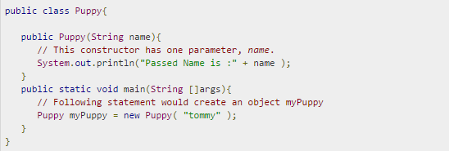
9. Creation of class instances (objects) Creating an Object:
class provides the blueprints for objects. So basically an object is created from a class. In Java, the new key word is used to create new objects.
There are three steps when creating an object from a class:
Declaration: A variable declaration with a variable name with an object type.
Instantiation: The 'new' key word is used to create the object.
Initialization: The 'new' keyword is followed by a call to a constructor. This call initializes the new object.
Example:

Slide 34
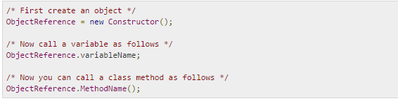
Creation of class instances (objects) Accessing Instance Variables and Methods:
Instance variables and methods are accessed via created objects. To access an instance variable the fully qualified path should be as follows:

Slide 35
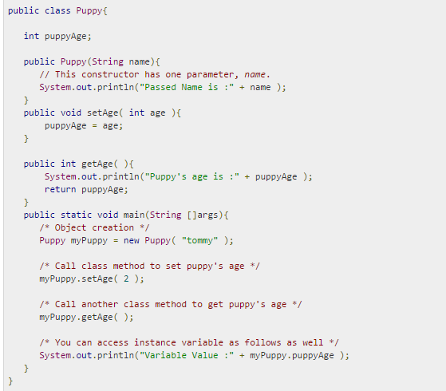
Creation of class instances (objects) Accessing Instance Variables and Methods:
Example:
This example explains how to access instance variables and methods of a class:

Slide 36

Creation of class instances (objects) Source file declaration rules:
Declaration rules
These rules are essential when declaring classes, import statements and package statements in a source file.
There can be only one public class per source file.
A source file can have multiple non public classes.
The public class name should be the name of the source file as well which should be appended by .java at the end. For example : The class name is . public class Employee{} Then the source file should be as Employee.java.
If the class is defined inside a package, then the package statement should be the first statement in the source file.
If import statements are present then they must be written between the package statement and the class declaration. If there are no package statements then the import statement should be the first line in the source file.
Import and package statements will imply to all the classes present in the source file. It is not possible to declare different import and/or package statements to different classes in the source file.

Slide 37

Creation of class instances (objects)
Java Package:
In simple, it is a way of categorizing the classes and interfaces. When developing applications in Java, hundreds of classes and interfaces will be written, therefore categorizing these classes is a must as well as makes life much easier.
Import statements:
In Java if a fully qualified name, which includes the package and the class name, is given then the compiler can easily locate the source code or classes. Import statement is a way of giving the proper location for the compiler to find that particular class.
For example, the following line would ask compiler to load all the classes available in directory java_installation/java/io :
import java.io.*;

