Slide 1

Patterns
Decorator

Slide 2
Definition
Attach additional responsibilities to an object dynamically. Decorators provide a flexible alternative to subclassing for extending functionality.

Slide 3
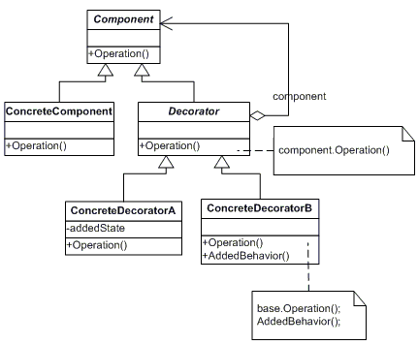
UML class diagram

Slide 4
Participants
The classes and objects participating in this pattern are:
Component
  defines the interface for objects that can have responsibilities added to them dynamically.
ConcreteComponent
  defines an object to which additional responsibilities can be attached.
Decorator
  maintains a reference to a Component object and defines an interface that conforms to Component's interface.
ConcreteDecorator
  adds responsibilities to the component.
Notes:
Create distinct objects to represent request and response payloads. Consolidate the mapping logic that reads and writes these structures.
Data Transfer Objects (a.k.a. DTOs) are reusable classes that contain related data and no business logic. They may be defined on the service side, client side, or both sides of the communication channel. Their properties (i.e. getters/setters) may wrap primitive data types (e.g. integers, strings, etc.) or other DTOs. Data Transfer Objects were first described as a means to reduce the number of method calls in distributed object systems (e.g. CORBA, DCOM). However, this same pattern can also be used by web services to simplify manipulation of request and response data, and to decouple message structures from domain layer entities. DTOs make it easier for services to manipulate request and response data because the services don't have to use structure-specific APIs (i.e., for JSON, XML, etc.). DTOs also decouple domain layer entities from request and response structures because they are created as separate entities whose sole purpose is to define how data is received and returned from a service. Data may be mapped into and out of DTOs through custom code or with data-binding technologies. With the former approach, the logic to move data to and from DTOs may be centralized in the DTO itself, or within Request Mappers and Response Mappers.

Slide 5
Examples

