Slide 1
Twitter Text Classification & Sentiment Analysis
CKME 136 Data Analytics: Capstone Crs Ian Santillan – 500866649 Section DA0 - Ceni Babaoglu

Slide 2

Outline
Methodology
Twitter Classification & Sentiment Analysis
How does Text Classification & Sentiment Analysis work?
Data collection & Preprocessing
Exploratory Data Analysis
Sentiment Analysis
Topic Modeling
Conclusion
Future Work & Next Steps

Slide 3







Methodology
Python, Anaconda, Jupyter Notebook
Packages:
Pandas
Numpy
Tweepy
TextBlob
VADER
WordCloud
Matplotlib
Scikitlearn
LDA, NMF
Re
Notes:
https://spectrum.ieee.org/at-work/innovation/the-2018-top-programming-languages# - Institute of Electrical and Electronics Engineers
Python, c++, c, java, c#, php, r r topped in 2016 at rank #5, now at 7.
tweepy - An easy-to-use Python library for accessing the Twitter API.
numpy - the fundamental package for scientific computing with Python
pandas - for using data structures and data analysis tools
re - regex
Sckitlearn – machine learning
CountVectorizer - converts a collection of text NMF - LDA -
SentimentIntensityAnalyzer - VADER (Valence Aware Dictionary and sEntiment Reasoner) is a lexicon and rule-based sentiment analysis tool that is specifically attuned to sentiments expressed in social media.
documents to a matrix of token counts sentiment analysis
textblob - is a Python (2 and 3) library for processing textual data. It provides a simple API for diving into common natural language processing (NLP) tasks such as part-of-speech tagging, noun phrase extraction, sentiment analysis, classification, translation
wordcloud - A little word cloud generator in Python
matplotlib - a Python 2D plotting library which produces publication quality figures in a variety of hardcopy formats and interactive environments across platforms

Slide 4


Text Classification & Sentiment Analysis
Text classification is the task of assigning predefined categories to free-text documents. It can provide conceptual views of document collections.
Sentiment Analysis also known as Opinion Mining is the process of extracting and understanding human feelings from data. Sentiment analysis is widely applied to reviews and social media for a variety of applications, ranging from marketing to customer service.
Notes:
Twitter is a treasure trove of sentiment. People around the world output thousands of reactions and opinions on every topic under the sun, every second of every day. It's like one giant psychological database that is constantly being updated and we can use it to analyze millions of text snippets, in seconds, with the power of machine learning.

Slide 5
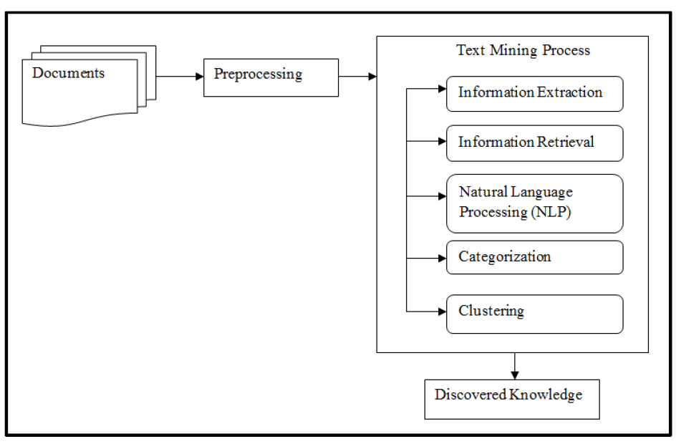
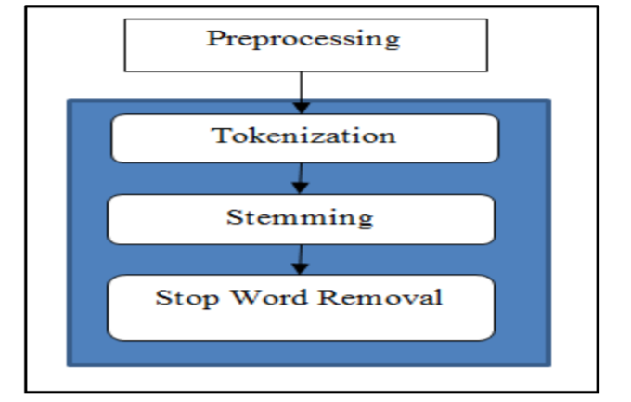
How does Text Classification & Sentiment Analysis work?
Notes:
Tokenization is the process of breaking a stream of textual content up into words, terms, symbols, or some other meaningful elements called tokens.
Stemming is the removal of "variable" parts of words, leaving only the stem. Treating words with the same stem as the same for analysis:
likes > like
liked > like
liking > like
like > like
Lemmatization is similar to stemming, but leaves the real word, not the stem:
creativity > create
Stopwords are common words that carry less important meaning than keywords, such as ‘the, is, are, a, an, etc’

Slide 6
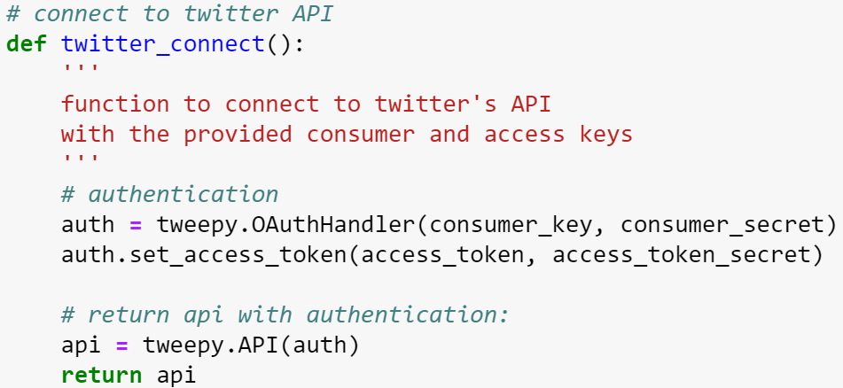
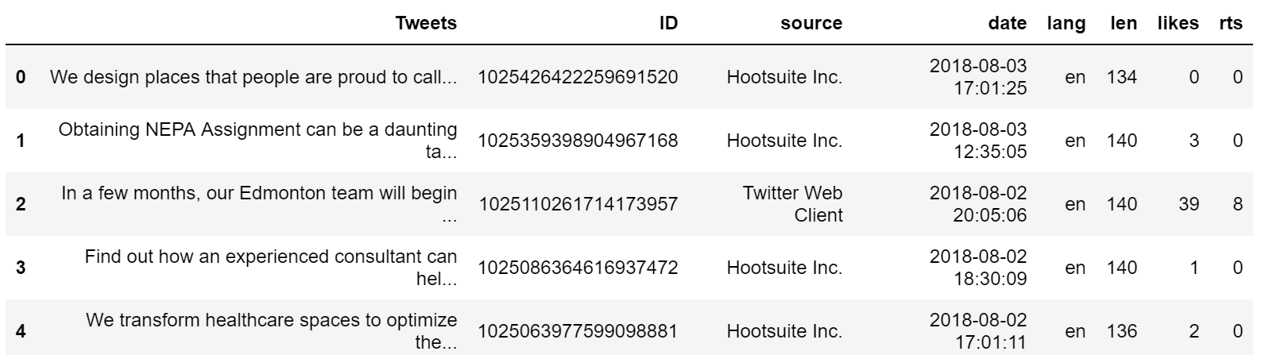
Data collection & Preprocessing
Twitter App → Twitter API
Consumer_key
Consumer_secret
Access_token
Access_token_secret
Notes:
['__class__', '__delattr__', '__dict__', '__dir__', '__doc__', '__eq__', '__format__', '__ge__', '__getattribute__', '__getstate__', '__gt__', '__hash__', '__init__', '__init_subclass__', '__le__', '__lt__', '__module__', '__ne__', '__new__', '__reduce__', '__reduce_ex__', '__repr__', '__setattr__', '__sizeof__', '__str__', '__subclasshook__', '__weakref__', '_api', '_json', 'author', 'contributors', 'coordinates', 'created_at', 'destroy', 'entities', 'favorite', 'favorite_count', 'favorited', 'geo', 'id', 'id_str', 'in_reply_to_screen_name', 'in_reply_to_status_id', 'in_reply_to_status_id_str', 'in_reply_to_user_id', 'in_reply_to_user_id_str', 'is_quote_status', 'lang', 'parse', 'parse_list', 'place', 'possibly_sensitive', 'retweet', 'retweet_count', 'retweeted', 'retweets', 'source', 'source_url', 'text', 'truncated', 'user']

Slide 7
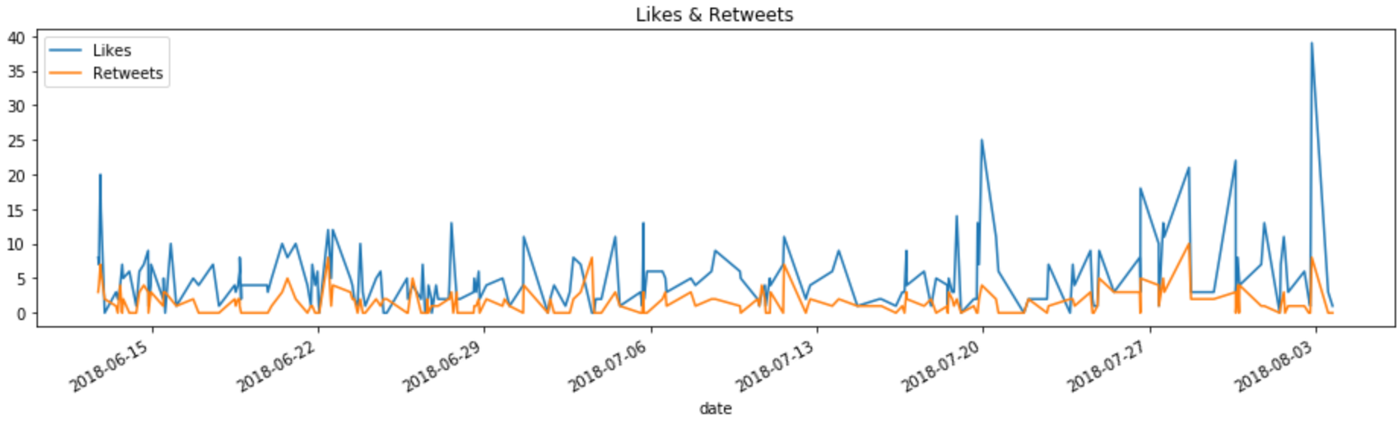
Exploratory Data Analysis
The tweet that has the most likes is:
In a few months, our Edmonton team will begin moving into the Stantec Tower! Yesterday, signage from one of our off… https://t.co/7zh2OytWPx Date & Time: 2018-08-02 20:05:06 Number of likes: 39
The tweet that has the most retweets is:
Don’t miss the new season of Project Impossible this weekend on HISTORY Canada. Stantec-designed projects are featu… https://t.co/a6X8ls7Fu0 Date & Time: 2018-07-28 16:01:05 Number of retweets: 10
Tweet average length is: 138.34
Notes:
Twitter max length 140 increased to 280 as of September of 2017
The Stantec Tower will be 66 stories high (251 metres), making it the tallest building in the country outside Toronto.
HISTORY Canada. Stantec-designed projects are featured in Episode 6 (July 28 at 2pm PDT) and Episode 9 (July 28 at 4pm PDT)

Slide 8
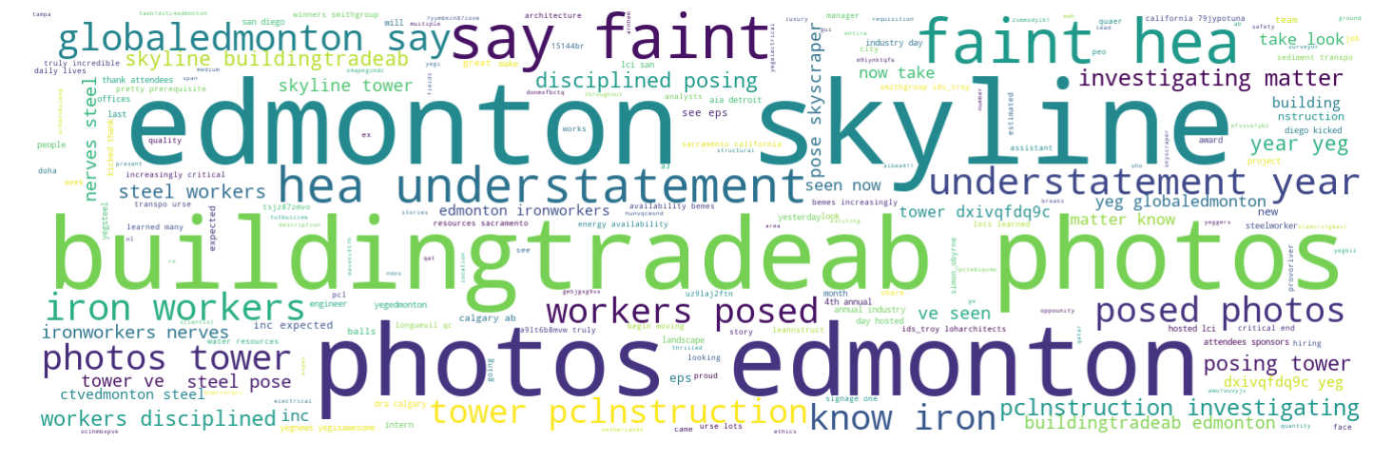
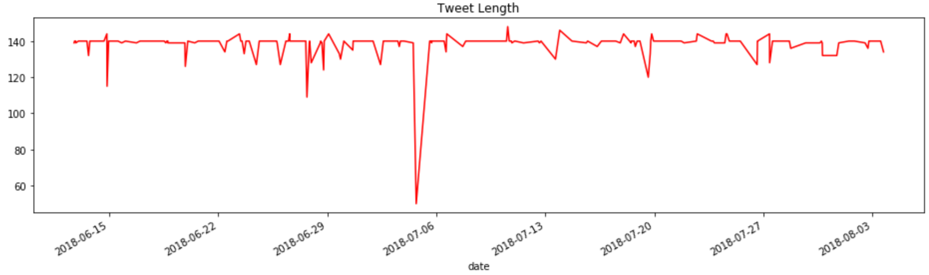

Exploratory Data Analysis
Notes:
Twitter max length 140 increased to 280 as of September of 2017
20 characters

Slide 9
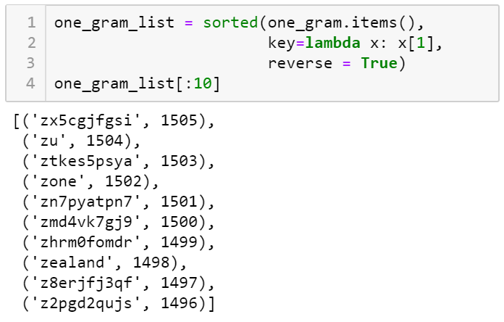
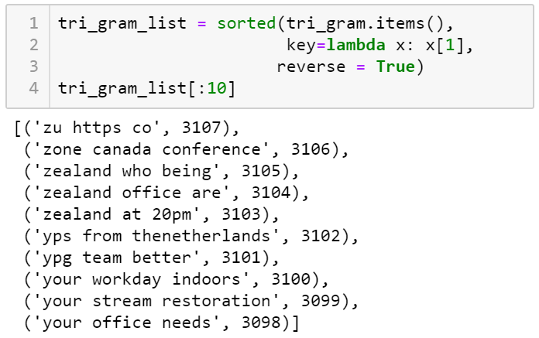
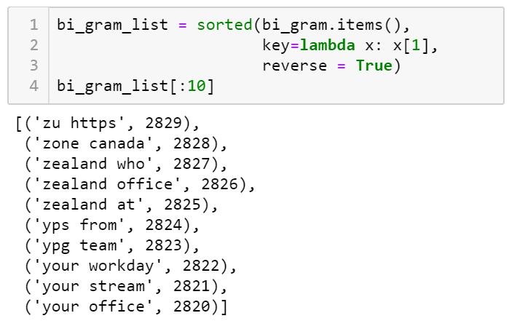
Exploratory Data Analysis
N-Grams

Slide 10
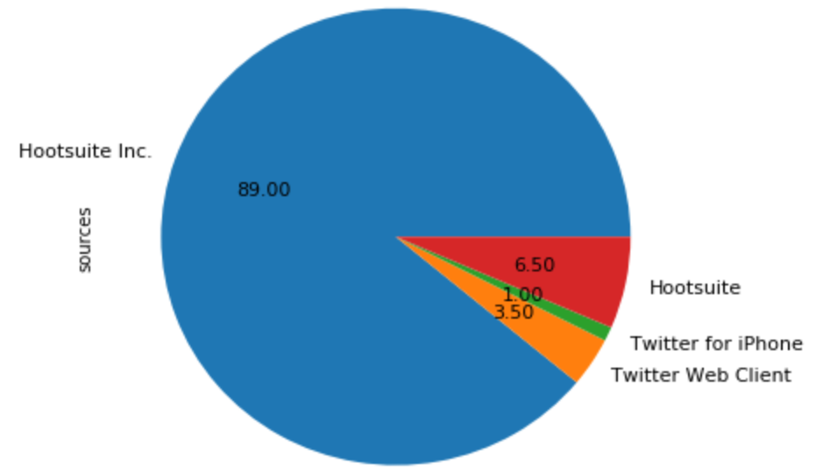
Exploratory Data Analysis
Tweet Sources
Hootsuite is a social media management platform based out of Vancouver. The system’s user interface takes the form of a dashboard, and supports social network integrations for Twitter, Facebook, Instagram, LinkedIn, Google+ and YouTube.

Slide 11
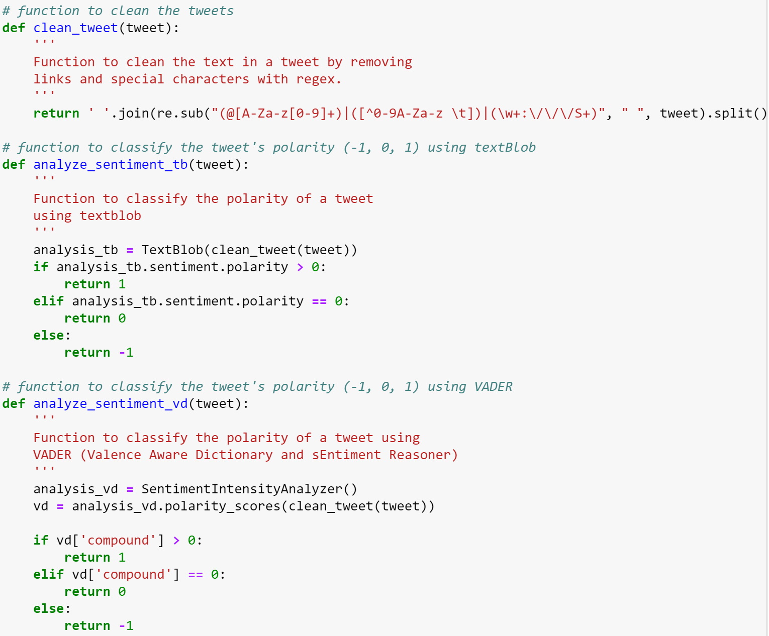
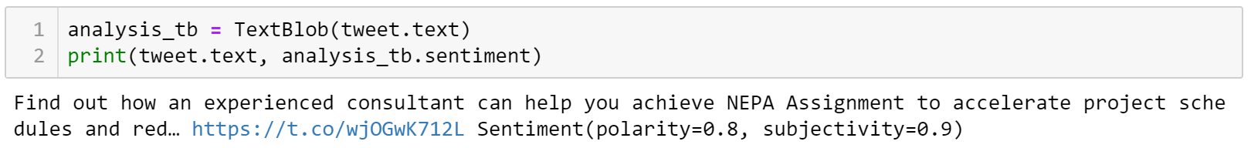
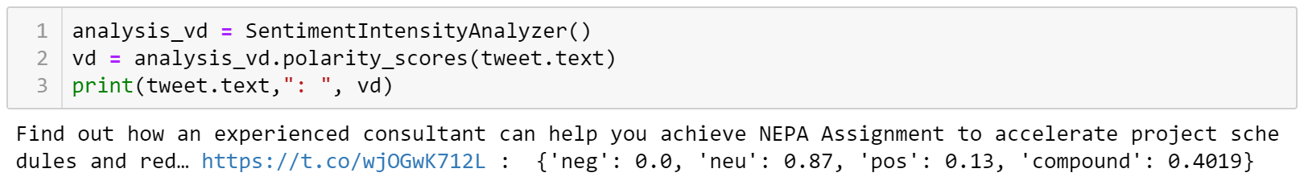
Sentiment Analysis
TextBlob - The sentiment property returns a namedtuple of the form Sentiment(polarity, subjectivity). The polarity score is a float within the range [-1.0, 1.0]. The subjectivity is a float within the range [0.0, 1.0] where 0.0 is very objective and 1.0 is very subjective.
Polarity measures how positive or negative some texts is and subjectivity measures how much of an opinion it is versus how much factual.
VADER - The compound score is computed by summing the valence scores of each word in the lexicon, adjusted according to the rules, and then normalized to be between -1 (most extreme negative) and +1 (most extreme positiv
Notes:
VADER (Valence Aware Dictionary and sEntiment Reasoner) is a lexicon and rule-based sentiment analysis tool that is specifically attuned to sentiments expressed in social media.

Slide 12
Sentiment Analysis
TextBlob - Percentage of positive tweets: 50.0%
TextBlob - Percentage of neutral tweets: 39.5%
TextBlob - Percentage of negative tweets: 10.5%
VADER - Percentage of positive tweets: 58.0%
VADER - Percentage of neutral tweets: 33.5%
VADER - Percentage of negative tweets: 8.5%
Notes:
VADER (Valence Aware Dictionary and sEntiment Reasoner) is a lexicon and rule-based sentiment analysis tool that is specifically attuned to sentiments expressed in social media.

Slide 13
Topic Modeling
latent Dirichlet allocation (LDA) is a generative statistical model that allows sets of observations to be explained by unobserved groups that explain why some parts of the data are similar
TFIDF - Term Frequency - Inverse Document Frequency is a numerical statistic that is intended to reflect how important a word is to a document in a collection or corpus. Gives more weight to rare words.
Non-negative Matrix Factorization (NMF) is a Linear-algeabreic model, that factors high-dimensional vectors into a low-dimensionality representation
The bag of words model (BoW model) is a reduced and simplified representation of a text document from selected parts of the text based on word frequency.
Notes:
LDA, or Latent Derelicht Analysis is a probabilistic model
Non-negative Matrix Factorization is a Linear-algeabreic model
https://medium.com/ml2vec/topic-modeling-is-an-unsupervised-learning-approach-to-clustering-documents-to-discover-topics-fdfbf30e27df

Slide 14
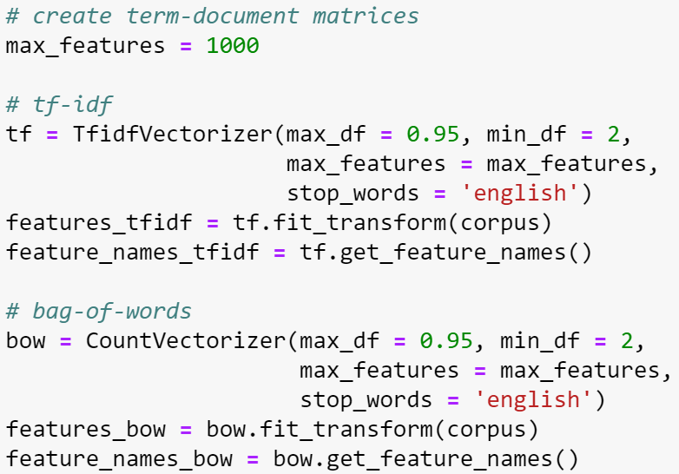
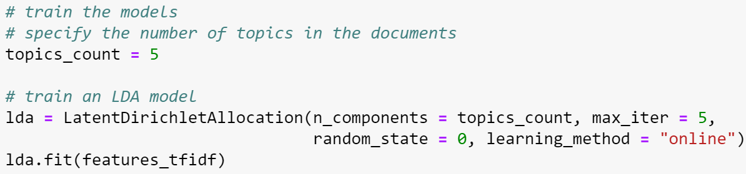
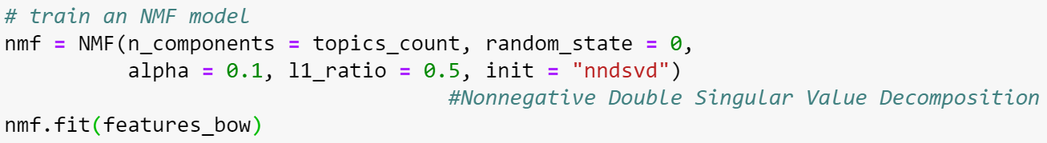
Topic Modeling

Slide 15
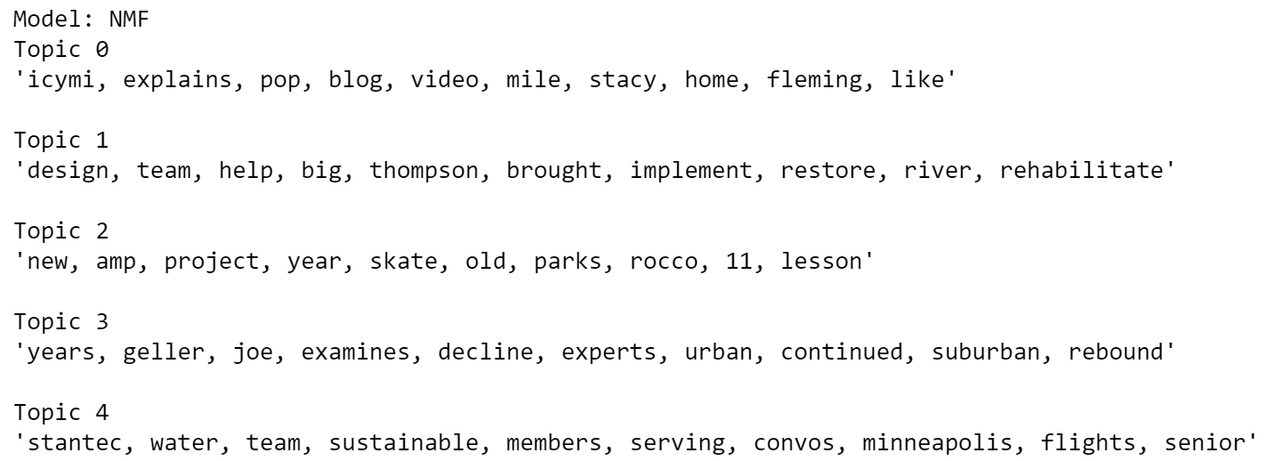
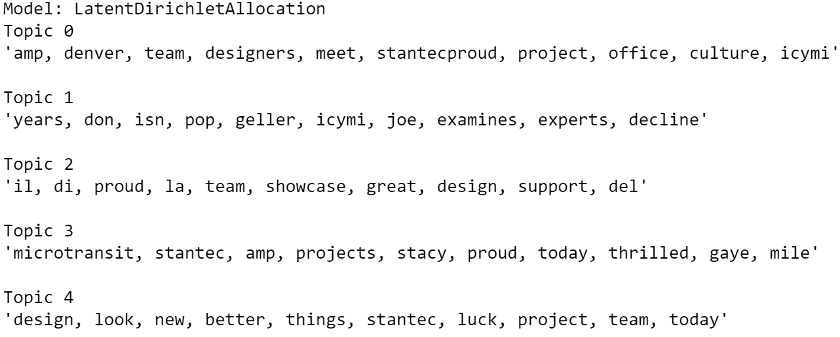
Topic Modeling

Slide 16
Conclusion
Explored the data
WordCloud
N-grams
Text Classification
Sentiment Analysis
Topic Modeling
Many different ways for doing a single task
Explore, have fun with it and see what works best for you

Slide 17
Future Work & Next Steps
use the coordinates from the tweepy object to plot the tweets on a geographical map
use different feature representation, ie: Word2Vec, GloVe
use neural network for modelling
use other Natural Language toolkits like, SpaCY, Genism, Spark NLP

Slide 18

THANK YOU
THANK YOU

