Slide 1

Toronto Crime Data Analysis
Predictive Policing - Ian Santillan

Slide 2
OUTLINE
TORONTO CRIME DATA ANALYSIS
MOTIVATION
SOLUTIONS
DATA COLLECTION
EXPLORATORY DATA ANALYSIS
ANALYSIS & INSIGHTS
FUTURE WORK & NEXT STEPS

Slide 3

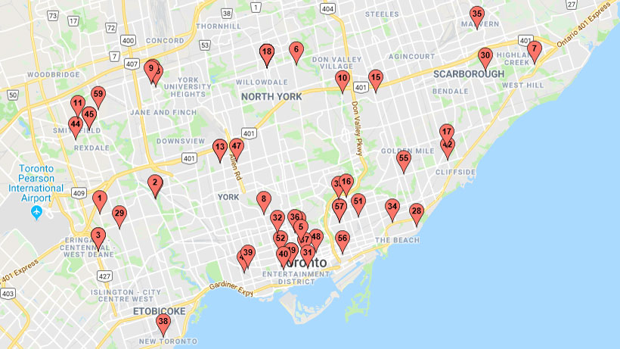
MOTIVATION
TORONTO GUN VIOLENCE
There has been 225 shootings since January 1, 2018.
Last year, there were a total of 196 shootings.
Toronto has seen about a 60% increase in fatal shootings which results in 38% increase in death since last year.
A map of the homicides in Toronto as of July 27, 2018.

Slide 4


SOLUTIONS
City officials announced a $15-million plan to combat gun violence in the city.
Council also committed $4 million over two years to purchase highly controversial ShotSpotter technology
170 new police officers to be hired.

Slide 5

CRIME SYSTEMS IN THE U.S.
DIFFERENT TOOLS THAT ARE CURRENTLY IN-USE IN THE UNITED STATES
1
2
3
ShotSpotter
PredPol
Compas
detects 90% of gunfire incidents with a precise location in less than 60 seconds to significantly improve response times. Acoustic sensors are strategically placed in a coverage area. When a gun is fired, the sensors detect shots fired. Audio triangulation pinpoints gunfire location and machine-learning algorithms analyze the sound. If the sound and visual audio signature match gunfire it is passed along to the Incident Review Center (IRC).
was created in 2012 by UCLA scientist working with the Los Angeles Police Department, with the goal of seeing how scientific analysis of come data could help spot patterns of criminal behavior. It is now used by more than 60 police departments around the US. It identifies areas in a neighborhood where serious crimes are more likely to occur during a particular period.
COMPAS—or the Correctional Offender Management Profiling for Alternative Sanctions**—purports to predict a defendant’s risk of committing another crime. It works through a proprietary algorithm that considers some of the answers to a 137-item questionnaire.

Slide 6



DATA COLLECTION
TORONTO’S OPEN CRIME DATA
premisetype, occurrenceyear, occurrencemonth, occurrenceday, occurrencedayofyear, occurrencedayofweek, occurrencehour, MCI, Division, Neighbourhood,
Lat, Long
Major Crime Indicators
Assault, Auto Theft, Break& Enter, Homicide, Robbery, Theft Over
12 features
2014 - 2017
Data collected from 2014 - 2017

Slide 7
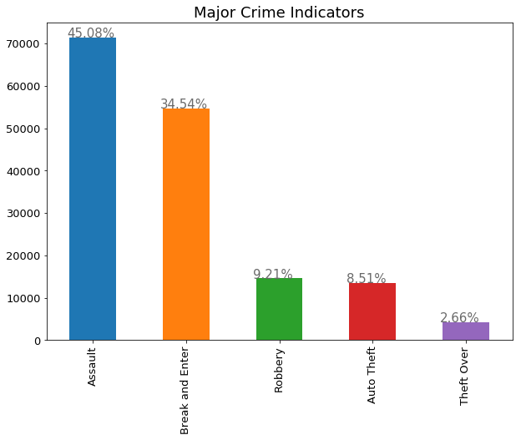
MAJOR CRIME INDICATORS
EXPLORATORY DATA ANALYSIS

Slide 8
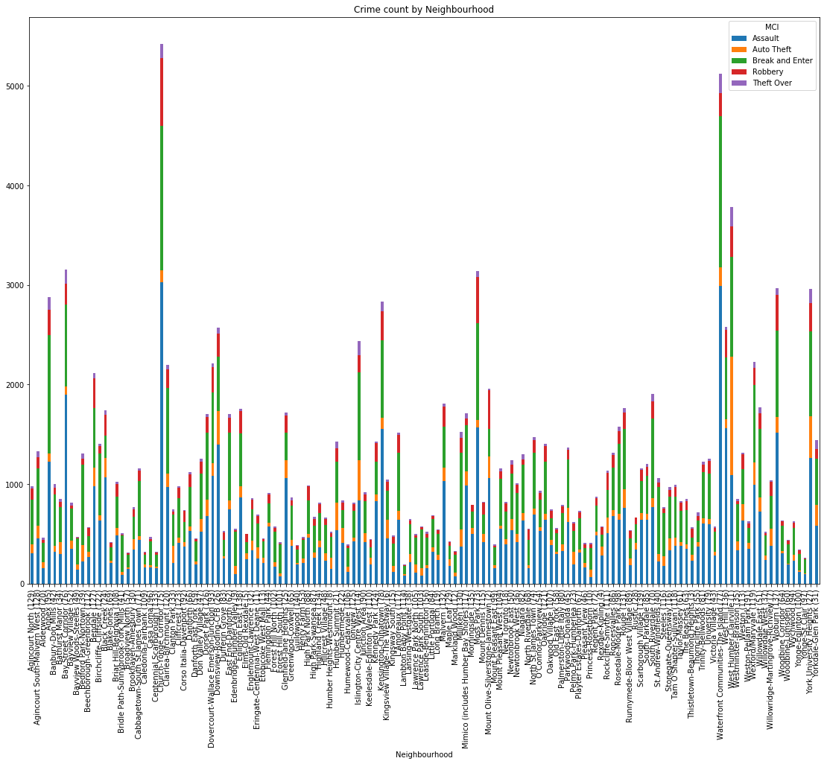
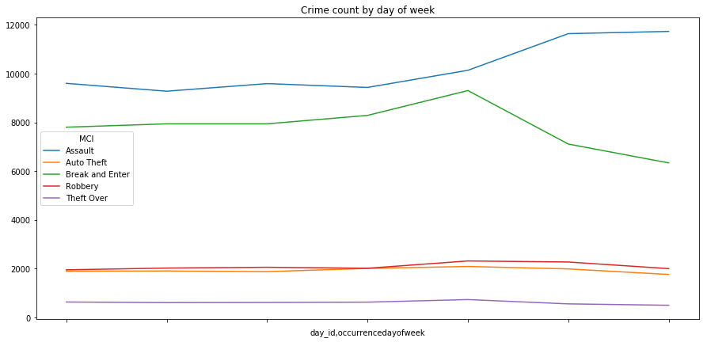
EXPLORATORY DATA ANALYSIS
MCI by Neighborhood
MCI by Day of week
Notes:
Top 3
Church & Yonge
Waterfront communities – The Island
WestHumber - Clairville

Slide 9
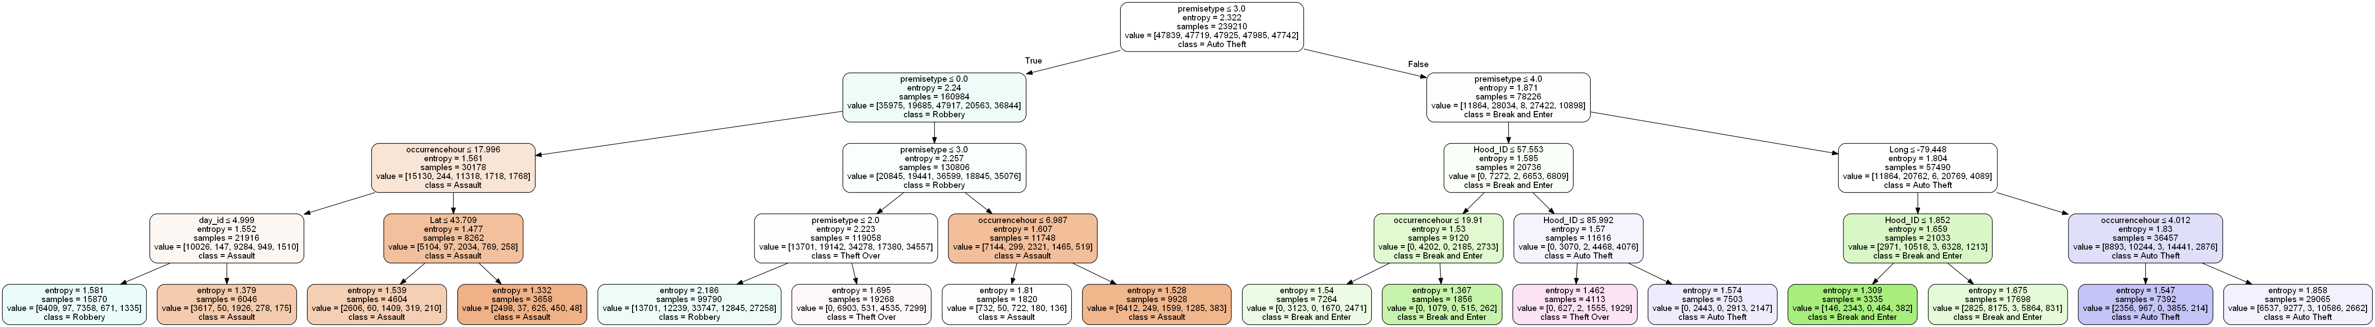

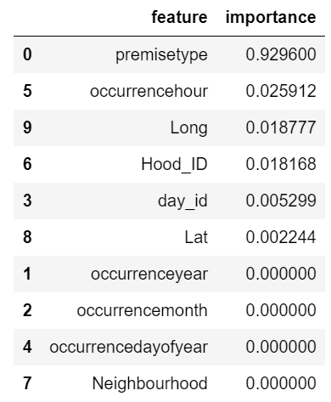
ANALYSIS & INSIGHTS
Decision Tree Classifier
Split | Function | Accuracy | Log-Loss
50 | Entropy | 0.411 | 1.29
300 | Entropy | 0.411 | 1.29
500 | Entropy | 0.411 | 1.29
50 | Gini | 0.455 | 1.21
300 | Gini | 0.455 | 1.21
500 | Gini | 0.455 | 1.21

Slide 10
ANALYSIS & INSIGHTS
Gaussian Naïve Bayes
K-Nearest Neighbor
Features | Accuracy | Log-Loss
n-components=5 | 32.46% | 1.51
n-components=3 | 31.39% | 1.51
Features | n_neighbor | Accuracy | Log-Loss
All | 30 | 0.52 | 1.27
All | 60 | 0.46 | 1.29
All | 100 | 0.41 | 1.36
All | 300 | 0.34 | 1.49

Slide 11
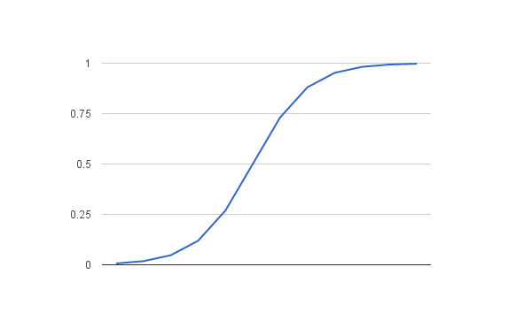
ANALYSIS & INSIGHTS
Classs | Precision | Recall | F1-Score
0 | 0.17 | 0.09 | 0.11
1 | 0.40 | 0.52 | 0.45
3 | 0.33 | 0.57 | 0.42
4 | 0.28 | 0.33 | 0.33
Logistic Regression

Slide 12
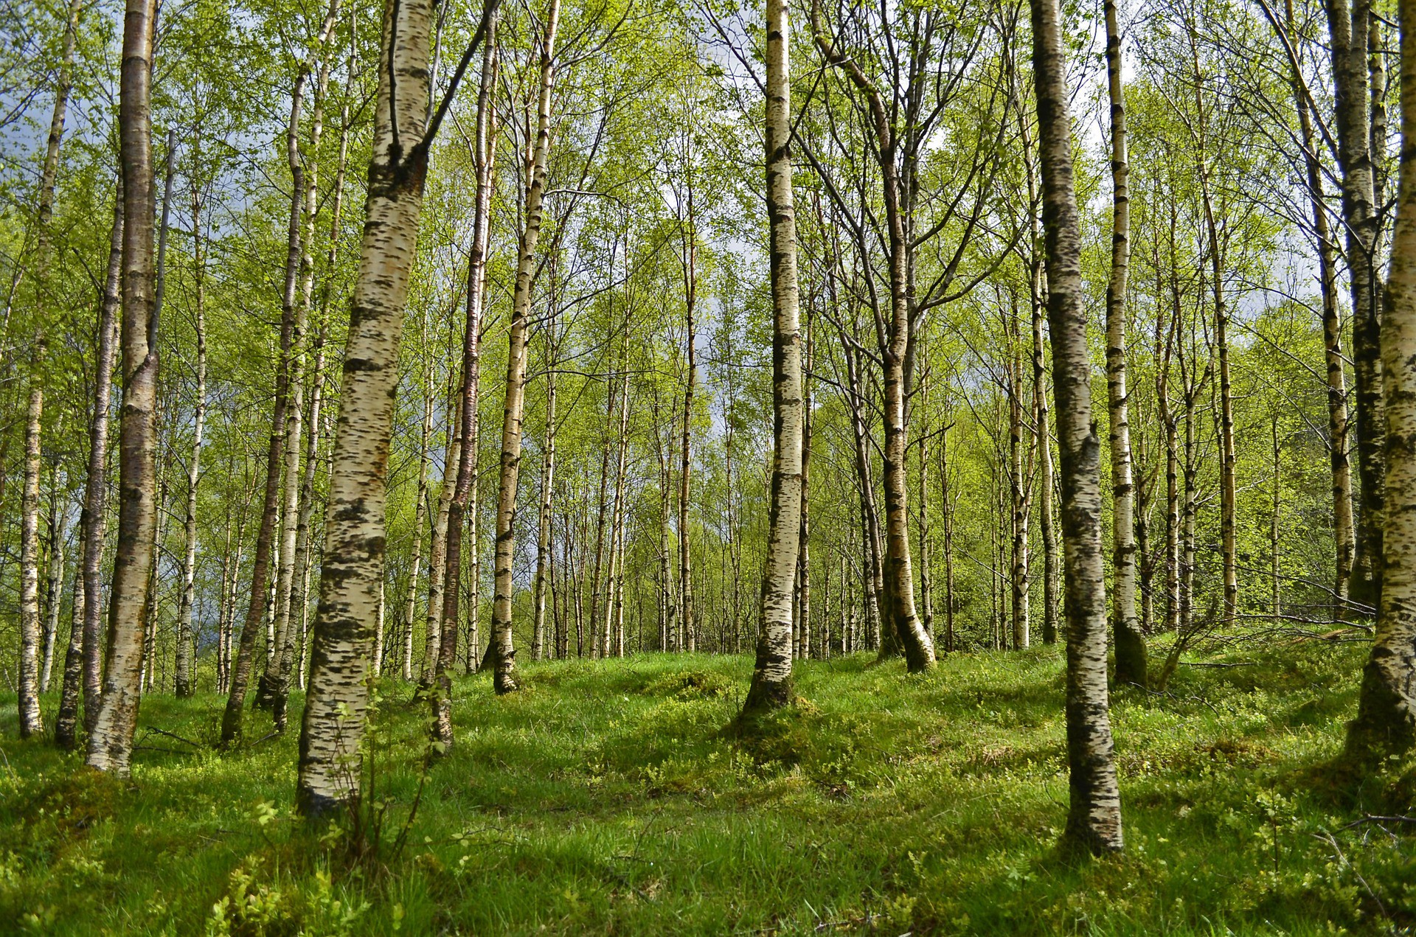
ANALYSIS & INSIGHTS
Split | Function | Accuracy | Log Loss
50 | Entropy | 0.78 | 1.39
300 | Entropy | 0.59 | 1.02
500 | Entropy | 0.57 | 1.05
50 | Gini | 0.66 | 0.87
300 | Gini | 0.59 | 1.01
500 | Gini | 0.57 | 1.05
Random Forest

Slide 13

SUMMARY
Toronto Crime Analysis
For this project we used machine learning techniques to classify a criminal incident by type, depending on its occurrent at a given time and location. We used Toronto’s Open Crime Dataset recorded from 2014-2017.
For this supervised classification problem, we used Decision Tree, Gaussian Naïve Bayes, k-NN, Logistic Regression, Random Forest classification models.
As crime categories in the dataset are imbalanced, we used oversampling methods, such as SMOTE.

Slide 14
FUTURE WORK & NEXT STEPS
Ensemble Poisson Kalman Filter (EnPKF) – 2018-07-25
In a paper published by Computational Statistics and Data Analysis, researchers from Surrey and Georgia, Atlanta, detail a new approach similar to that used in weather forecasting and the Apollo space missions, which supplements ETAS(Epidemic Type Aftershock Sequence) . Researchers were able to use this approach to develop a novel algorithm - the Ensemble Poisson Kalman Filter (EnPKF) - that is able to combine, in real-time, urban crime data and the ETAS model. EnPKF is able to provide real-time forecasts for the crime rate and give an indication to how likely crime could repeat in a certain area. The algorithm can also give police departments suggestions as to where short-term crime hotspots could arise, and what additional resources are needed to address such a rise.

Slide 15

THANK YOU!
Ian Santillan
Phone:
780-901-1909
Email:
ievsantillan@gmail.com
Website:
https://www.linkedin.com/in/ian-santillan/

