Slide 1
How to use the team board
Nine screens. Two minutes. Read once before your first application.
Apply Yourself · iezuri22.github.io/team-board

Slide 2
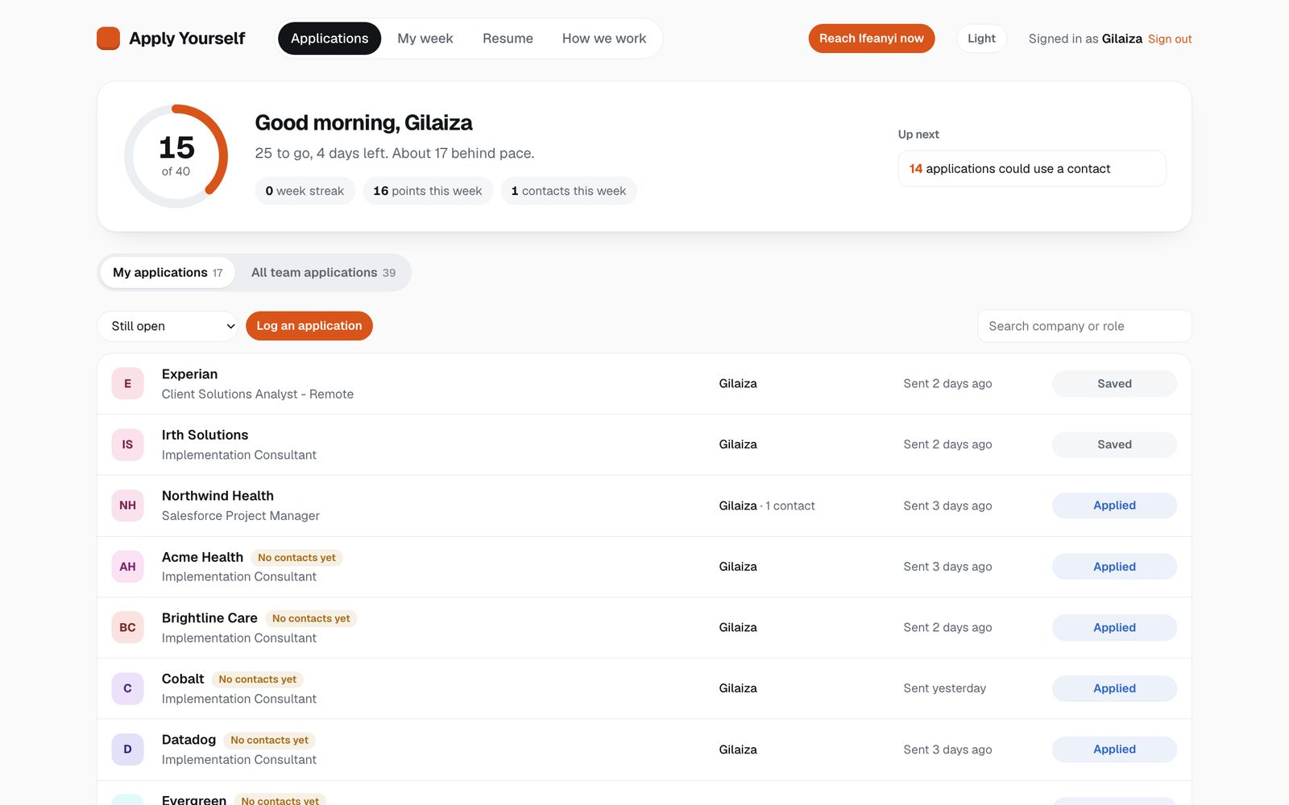
01 / 09
Your week at a glance
Your goal, your progress and what to do next sit at the top. Weeks run Monday to Sunday.

Slide 3
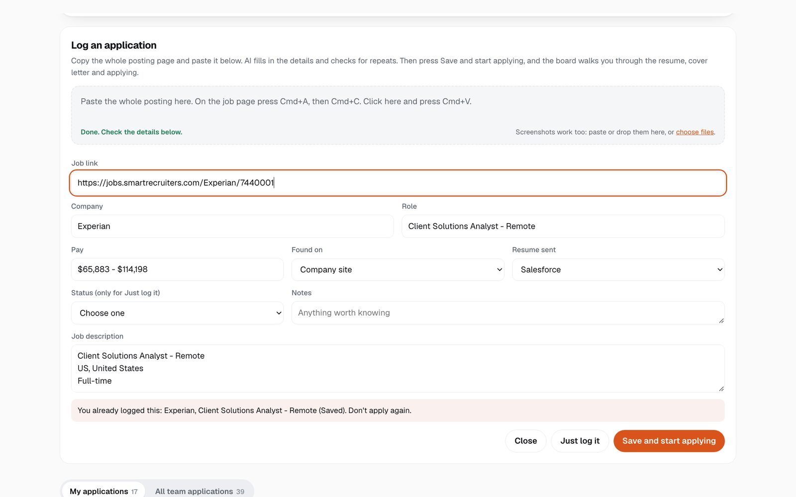
02 / 09
Log a job by pasting it
On the posting, press Cmd+A, then Cmd+C. Paste it into Log an application. AI fills in the details and picks the resume.

Slide 4
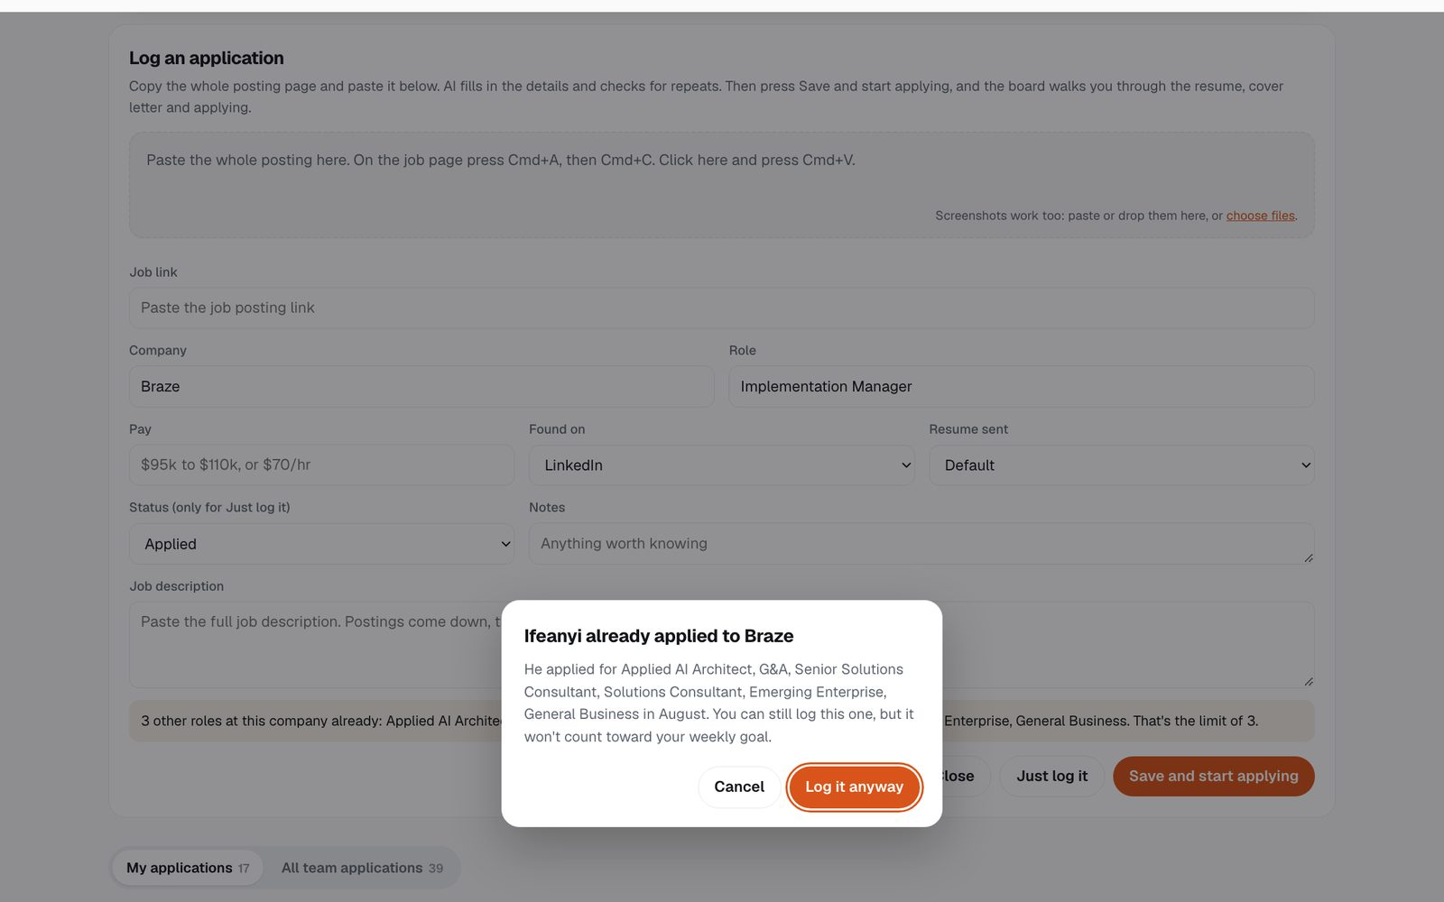
03 / 09
Repeats get flagged
If the job is already on the list, you'll see a warning. Companies Ifeanyi applied to can still be logged, but they don't count toward your goal.

Slide 5
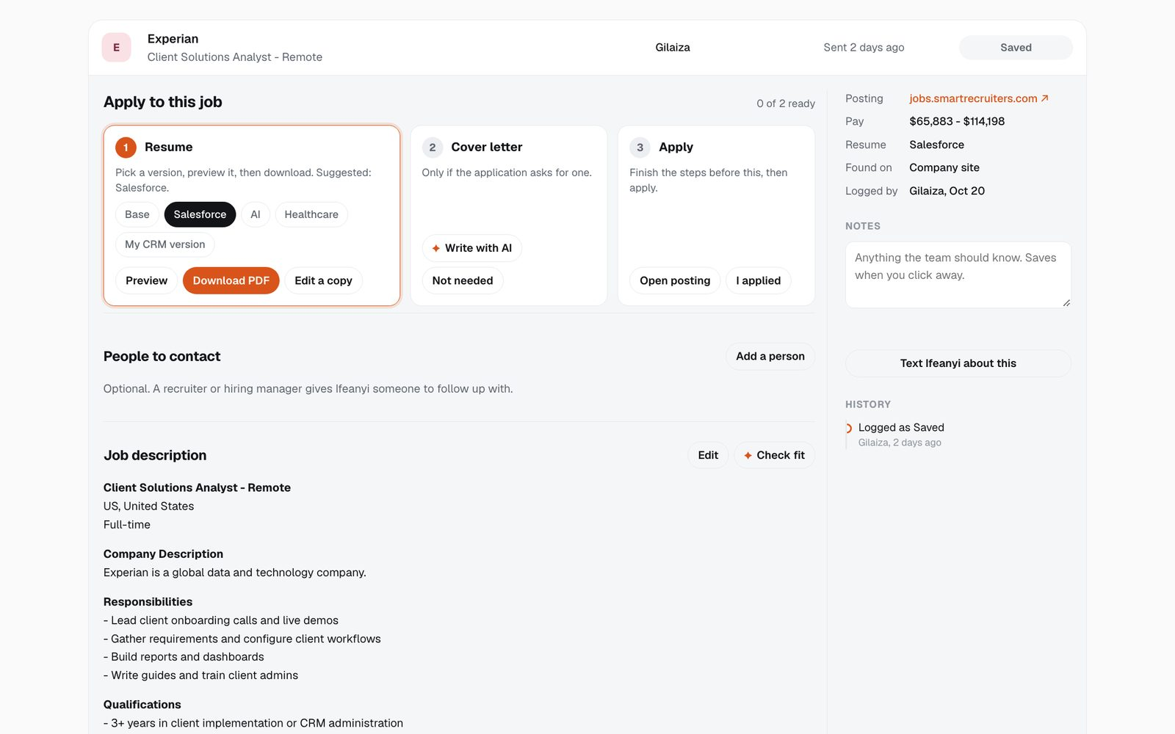
04 / 09
Apply in three steps
Save and start applying opens this checklist. The orange step is next: resume, cover letter, then I applied.

Slide 6
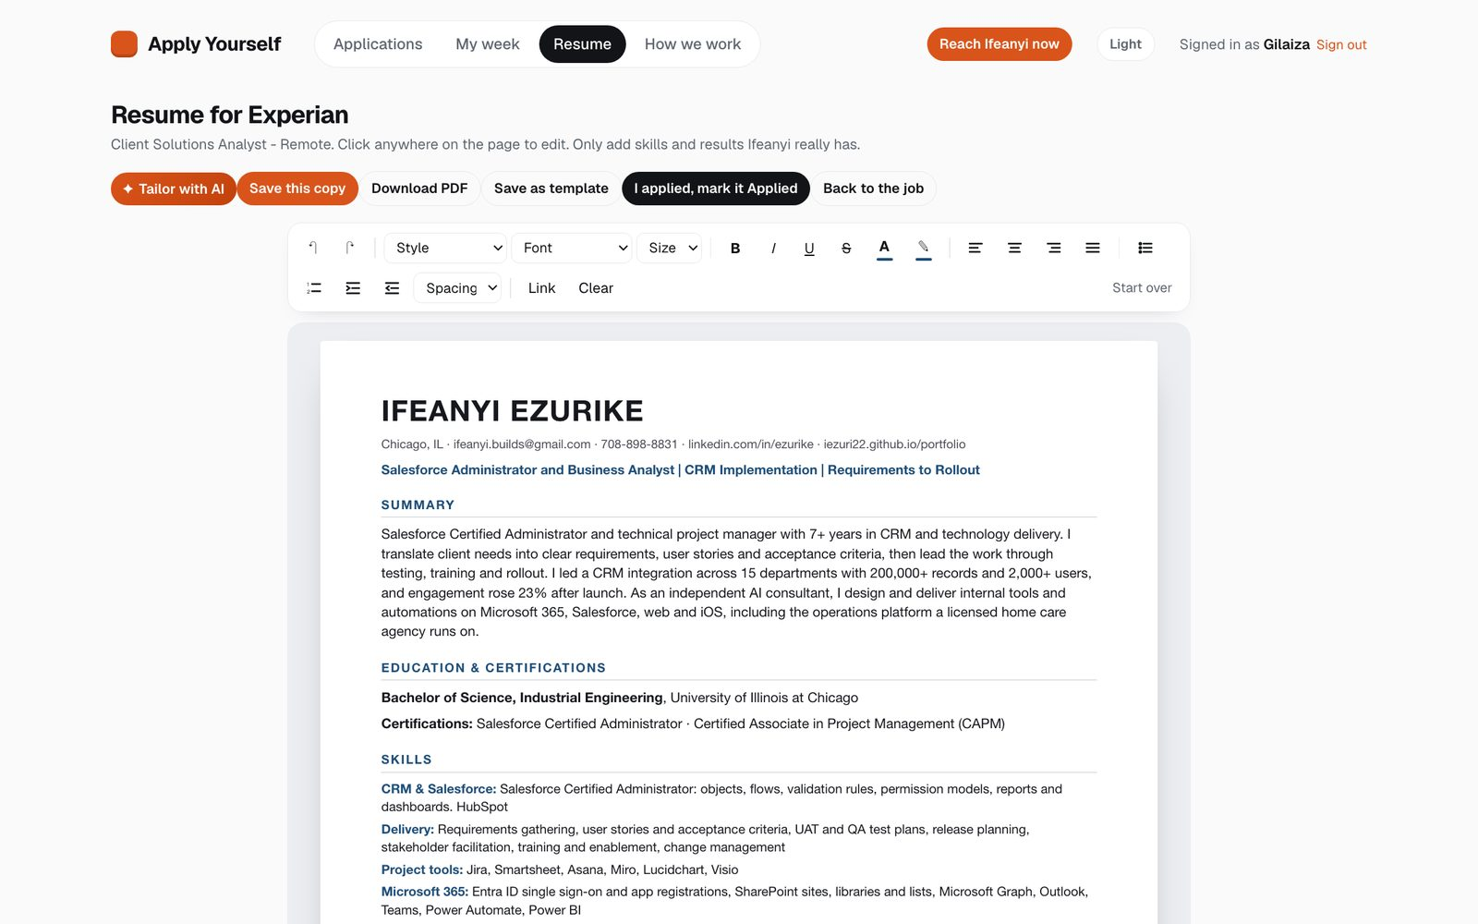
05 / 09
Edit the resume like a Word doc
Pick a version, click into the page and edit. Save as template to reuse it on other jobs.

Slide 7
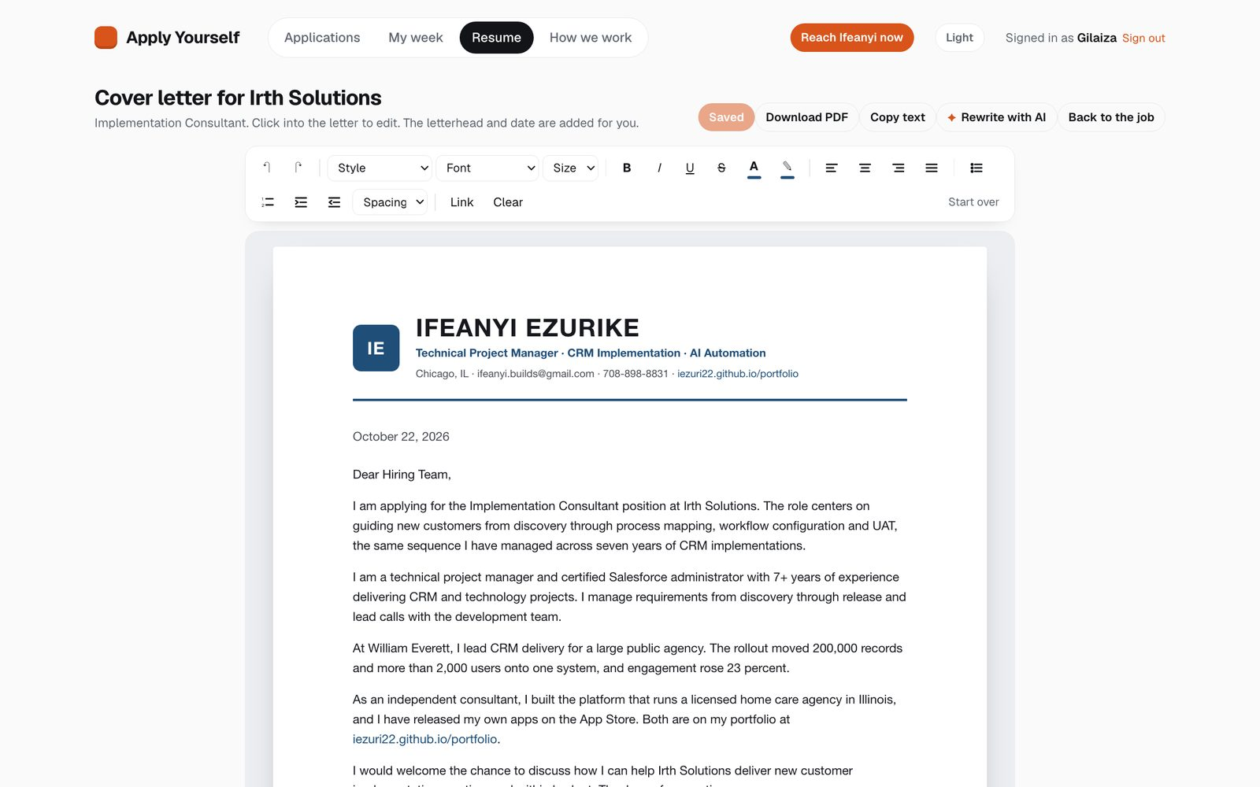
06 / 09
Cover letters, only when asked
Write with AI drafts one from the job description. Read it, edit it, then download the PDF.

Slide 8
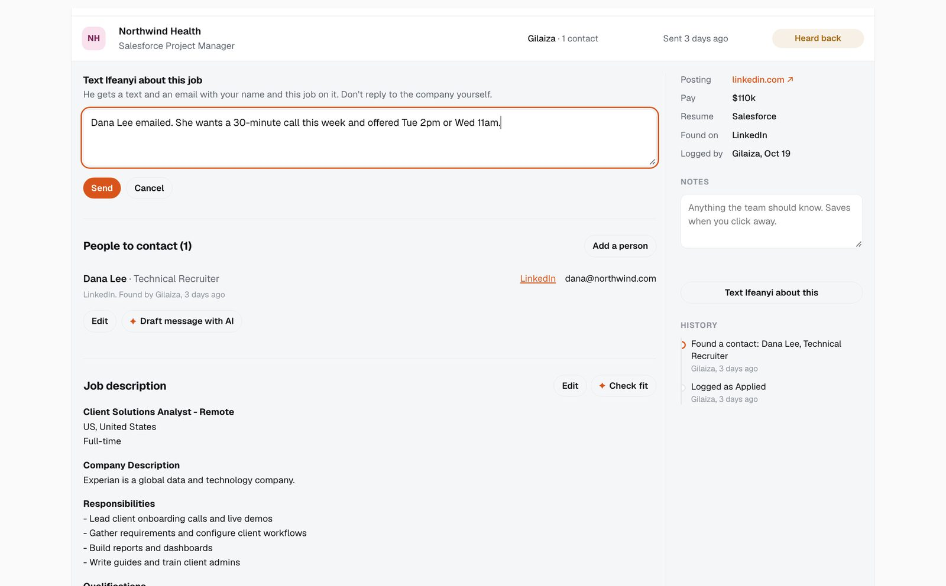
07 / 09
When a company writes back
Change the job's status. A box opens to text Ifeanyi what they said. Never reply to the company yourself.

Slide 9
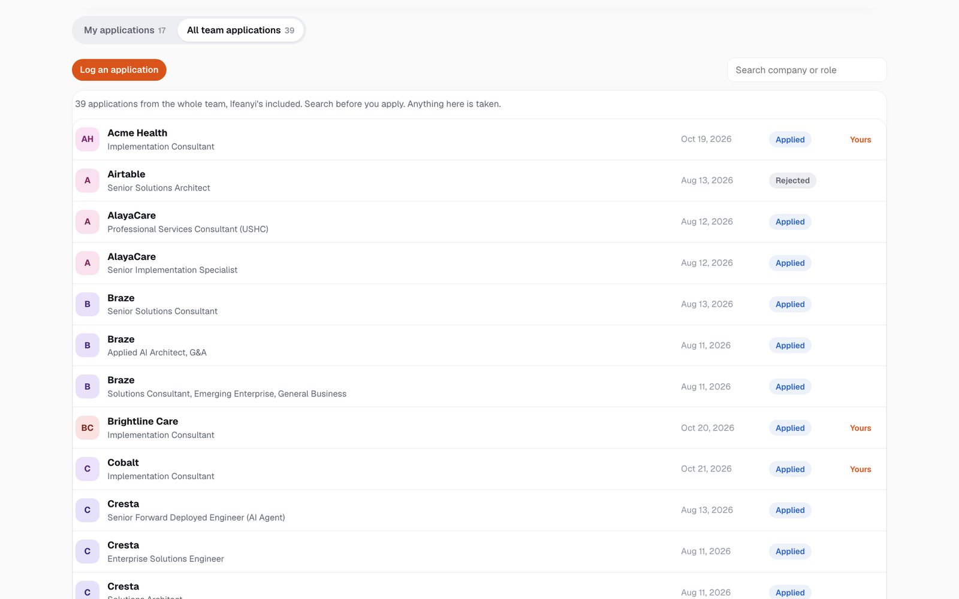
08 / 09
Check the team list first
All team applications shows every job on the board, Ifeanyi's included. If it's there, it's taken.

Slide 10
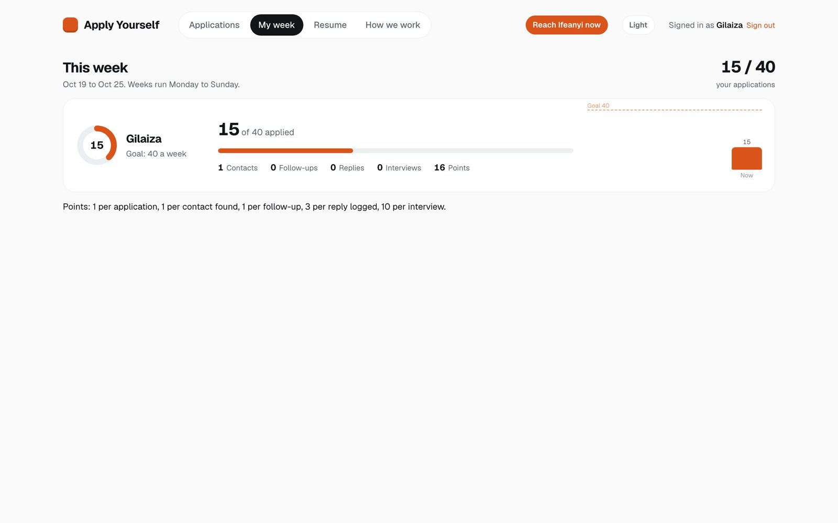
09 / 09
Track your week
My week shows applications, contacts and points against your goal.

