Slide 1
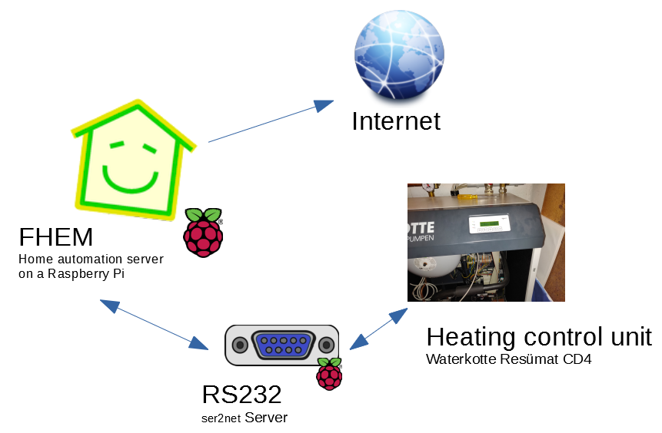
Internet of Things
Explanation
Waterkotte „Resümat CD4“ (2002) as control unit
RS232 serial port available
Serial protocol uses hexadecimal data
Already reverse engineered by people in online forums
Protocol has read and write options
Protocol uses a CRC-16 (checksum) with special parameters

Slide 2
Internet of Things
Protocol: Example
10 02 01 15 0000 00FF 10 03 7C1A
START MODE OFFSET BYTES END CRC
Read 255 bytes starting from 0x00
CRC-16 (Hex)
CRC-16/BUYPASS
Poly: 0x8005
Init: 0x0000
LSB: 0x0000
Inp. rev: no
Res. rev: no
https://crccalc.com
Available modes:
01 15 Read
01 14 Set clock (time + date)
01 13 Write

Slide 3
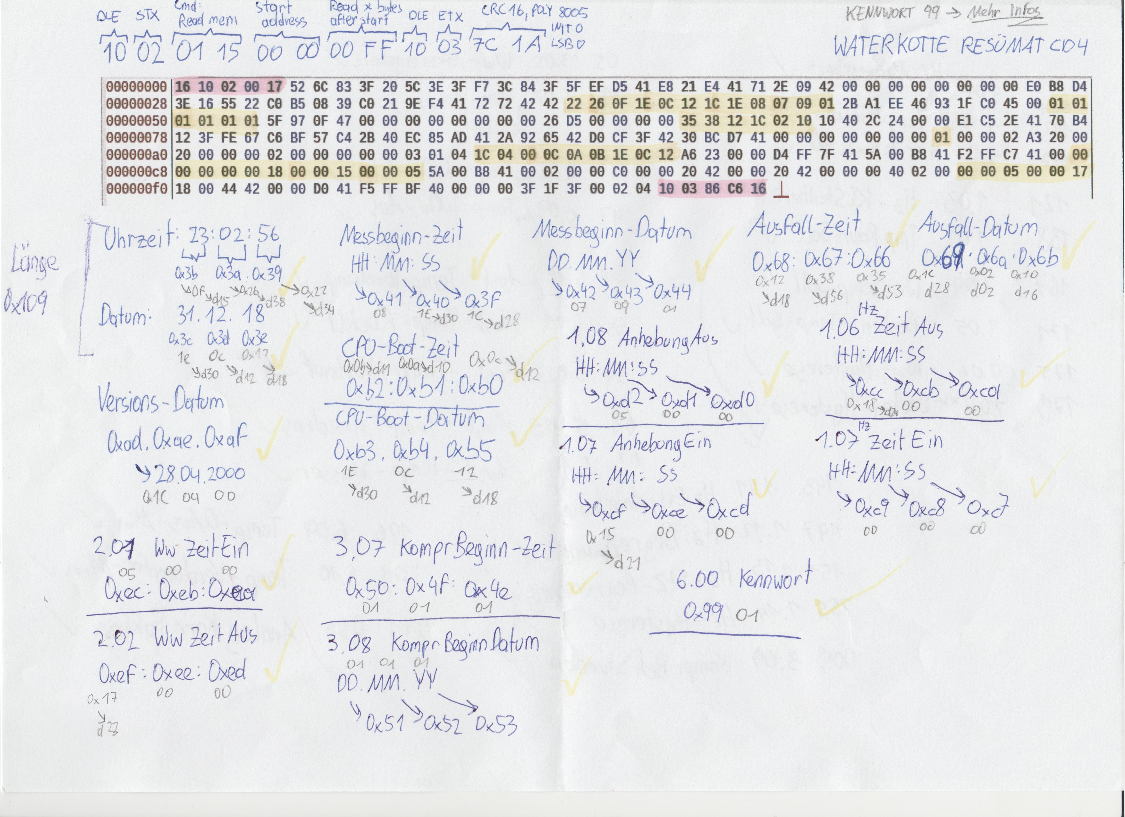
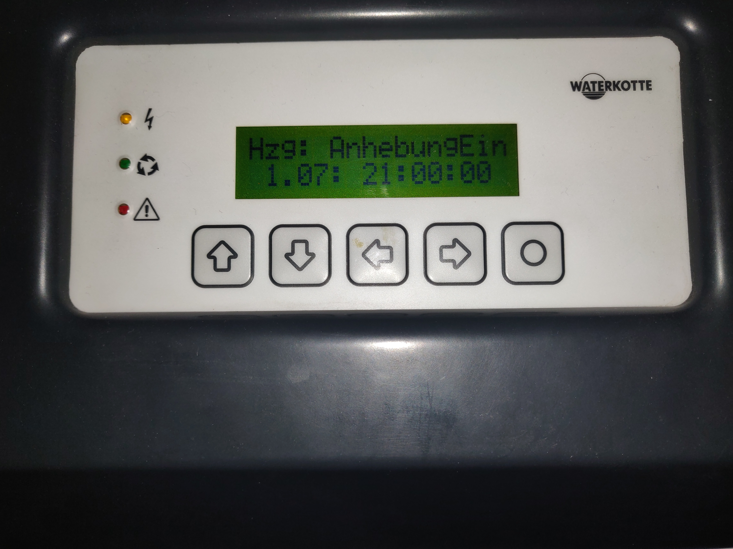
Internet of Things
Manual analysis
Finding out offsets/addresses by comparing hex data with values on the display
Floats: IEEE 754
(little endian)
Used hex editor: Bless

Slide 4
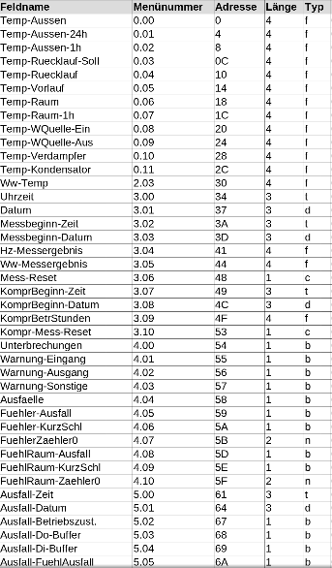
Internet of Things
An eternity later
Inserting the new addresses into the FHEM plugin (Perl)
Add some own improvements (writing special fields)
my %frameReadings = (
'Temp-Aussen' => { addr => 0x000, bytes => 0x004,
menu => '0.00', fmat => '%0.1f', unp => 'f<' },
'Temp-Ruecklauf-Soll‘ => { addr => 0x00C, bytes => 0x004,
menu => '0.03', fmat => '%0.1f', unp => 'f<' },
'Temp-Ruecklauf‘ => { addr => 0x010, bytes => 0x004,
menu => '0.04', fmat => '%0.1f', unp => 'f<' },
'Temp-Vorlauf' => { addr => 0x014, bytes => 0x004,
menu => '0.05', fmat => '%0.1f', unp => 'f<' }
);
FHEM plugin requests and processes heating data every minute

Slide 5
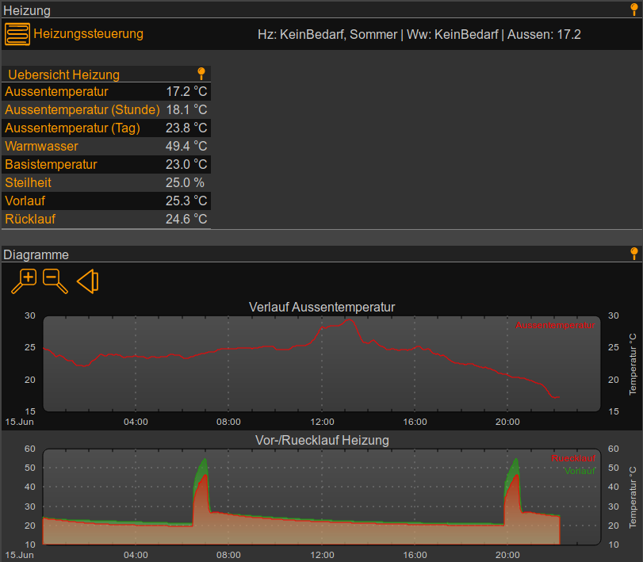
Internet of Things
That‘s it!
Thanks for your attention!
Further questions?
Sources:
Private knowledge
https://www.iotforall.com
https://www.wired.co.uk
https://www.pocket-lint.com
https://digibusters.com
https://www.sap.com

