Slide 1
Arc42 documentation

Slide 2
Requirements Overview
Name of Software:
Regional University Management System (RUMS)
Main Purpose:
To streamline and improve the management of academic, administrative, and financial activities in the university.
Main Features:
Comprehensive Student, Faculty, and Course Management.
Automated Attendance and Grades Management.
Integrated Billing and Payment Processing.
Advanced Reporting and Analytics Tools.
Robust User Authentication and Authorization.

Slide 3
Stakeholder
Role/Name | Expectations
University Administrator (John Smith) | Efficient management of university operations.
Senior Lecturer (Jane Doe) | Streamlined academic and curriculum management.
Chief Information Officer (Michael Lee) | Secure, scalable, and maintainable system architecture.
Student Representative (Emily Chen) | User-friendly interface and access to necessary academic resources.
Financial Officer (Sarah Johnson) | Accurate and efficient financial management and reporting.

Slide 4
Quality Goals
Priority | Quality | Motivation
1 | Usability | Ensure a user-friendly experience for all stakeholders.
2 | Security | Protect sensitive academic and financial data.
3 | Reliability | Provide consistent and dependable system performance.

Slide 5
Solution Strategy
Goal/Requirements | Architectural Approach
Scalable user management | Microservices for handling different user roles and activities.
Secure financial transactions | Secure API integration with external payment gateways.
Real-time data analytics | Utilize big data technologies for advanced reporting and analytics.

Slide 6
Architecture Decisions
Problem | Considered Alternatives | Decision
System Scalability | Monolith vs. Microservices | Chose Microservices for better scalability and maintainability.
Data Storage | SQL vs. NoSQL | Chose NoSQL (MongoDB) for flexibility and performance in handling large datasets.
Client-Side Framework | Angular vs. React | Chose React for its component-based architecture and efficient UI rendering.

Slide 7
Risks and Technical Debt
Risk/Technical Debt | Description
Integration Complexity | Integrating multiple microservices can lead to complexity.
Data Migration | Migrating existing data to the new system might lead to inconsistencies.
Dependency Management | Managing numerous dependencies in a microservices architecture might increase technical debt.

Slide 8
Architecture Constraints
Constraints | Background and/or motivation
Technology Stack (React, Node.js, MongoDB) | Chosen for their performance, scalability, and community support.
Cloud Infrastructure (AWS/Azure) | Provides scalability, reliability, and advanced services.
Compliance with Data Protection Regulations | Mandatory for protecting user data and privacy.
Integration with Existing Systems | Ensures continuity and minimizes the impact of transition.
Responsive Design | Must be accessible on various devices, enhancing usability.

Slide 9
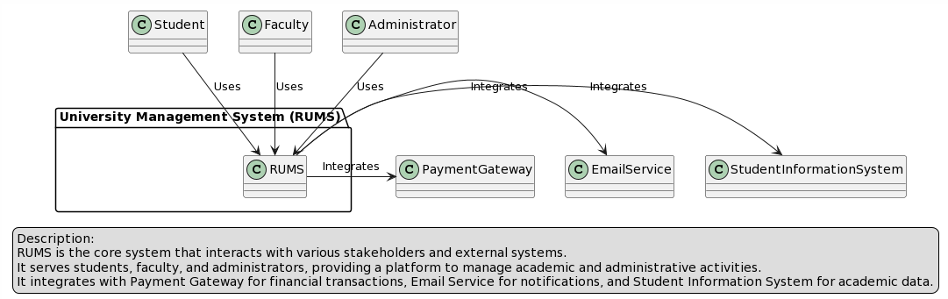
Business Context

Slide 10
Crosscutting Concepts
Development concepts
Agile methodologies for iterative development and continuous integration/continuous deployment (CI/CD) practices.
Architecture and design patterns
Microservices architecture for scalability, and MVC pattern for separating concerns in the application.
Safety and security concepts
Implementation of OAuth for secure authentication, HTTPS for secure communication, and regular security audits.

Slide 11
Decisions
Context | Decision | Consequences
Scalability | We will …adopt a microservices architecture. | More complex orchestration but easier scaling and maintenance.
Data Storage | We will …NoSQL (MongoDB) for our database. | Greater flexibility and performance with large, unstructured datasets.
Frontend Development | We will …use React for the frontend. | Enhanced user interface and component reusability.

Slide 12
Quality Goals and Scenarios
Goal: Ensure system scalability.
Scenario System should handle an increase in user load without performance degradation.
Goal: Maintain high security.
Scenario System should resist XSS and CSRF attacks.
Goal: Ensure data consistency.
Scenario Updates in one module (e.g., grades) should reflect immediately across all relevant modules (e.g., transcripts, billing).

Slide 13
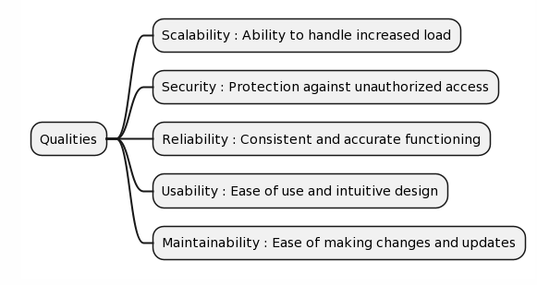
Quality Tree

Slide 14
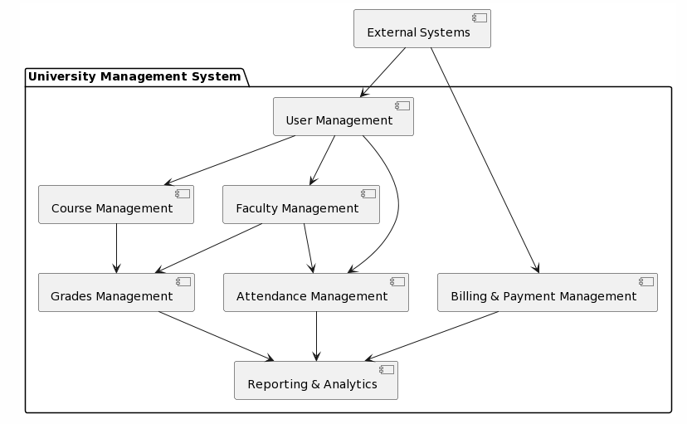
Level 1

Slide 15
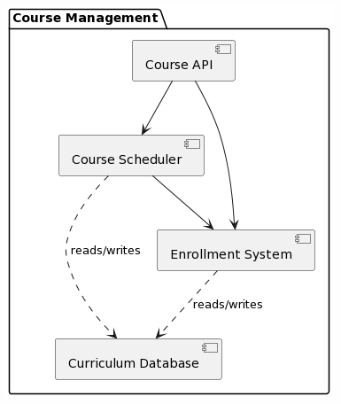
Level 2

Slide 16
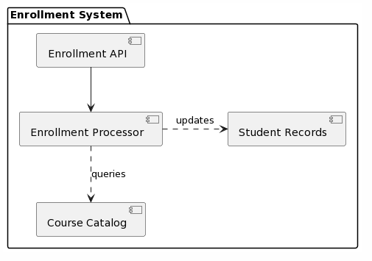
Level 3

Slide 17
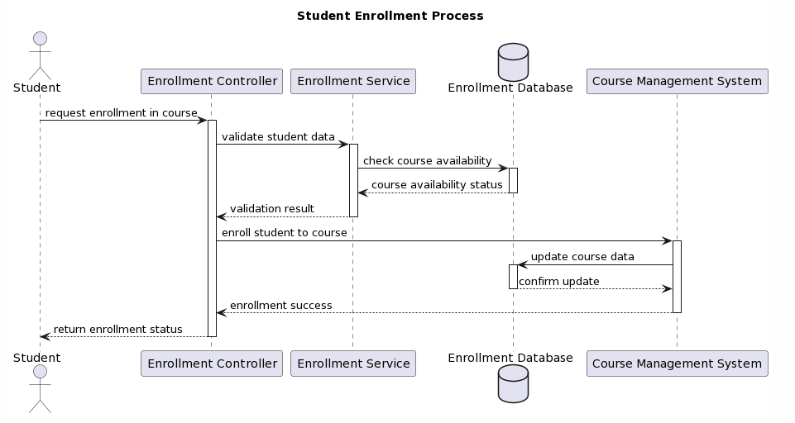
<Functionality 1>

Slide 18
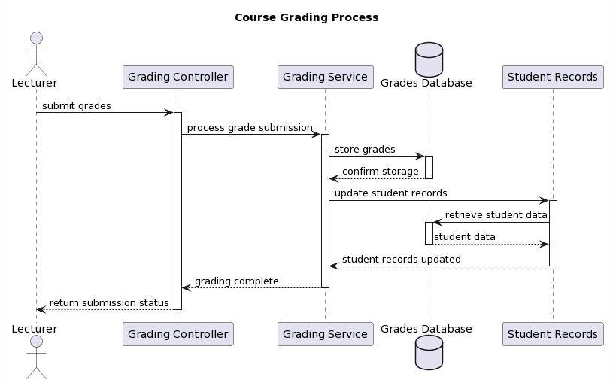
<Functionality 2>

Slide 19
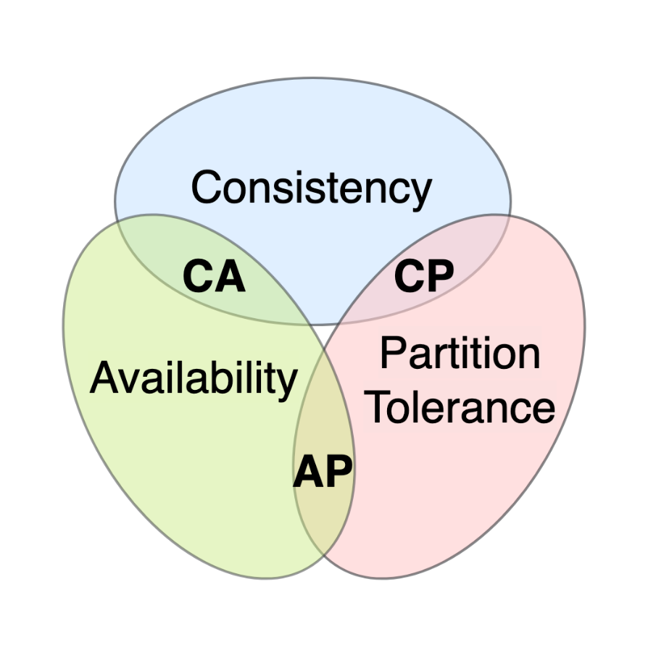
CAP theorem
Consistency: Essential for academic records and financial data to ensure accuracy across the system.
Availability: Crucial for providing uninterrupted access to the system for students and faculty, particularly during key academic periods.
Partition Tolerance: Necessary to maintain system operations during network failures or partitioning events.
Given the need to prioritize, the UMS might:
Prefer Consistency and Partition Tolerance (CP) for features like enrollment and grade submissions, where data accuracy cannot be compromised.
Opt for Availability and Partition Tolerance (AP) for less critical features that can tolerate eventual consistency, like accessing course materials or general notifications.
The balance between these properties would be configured to meet the specific needs and usage patterns of the UMS, ensuring the most critical operations maintain integrity while less critical services remain as available as possible.

Slide 20
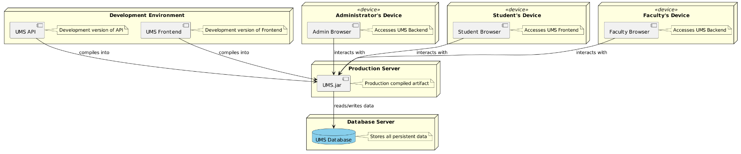
Deployment diagram

