Slide 1
Arc42 documentation

Slide 2
Requirements Overview
Name of Software: Regional University Management System (RUMS)
Main Purpose: To streamline and improve the management of academic, administrative, and financial activities in the university.
Main Features:
Comprehensive Student, Faculty, and Course Management.
Automated Attendance and Grades Management.
Integrated Billing and Payment Processing.
Advanced Reporting and Analytics Tools.
Robust User Authentication and Authorization.
From the point of view of the end users a system is created or modified to improve support of a business activity and/or improve the quality. Keep these excerpts as short as possible.
Define the main purpose of your software and list the main features.
Help: https://docs.arc42.org/section-1/ & https://biking.michael-simons.eu/docs/index.html#section-introduction-and-goals

Slide 3
Stakeholder
Role/Name | Expectations
University Administrator (John Smith) | Efficient management of university operations.
Senior Lecturer (Jane Doe) | Streamlined academic and curriculum management.
Chief Information Officer (Michael Lee) | Secure, scalable, and maintainable system architecture.
Student Representative (Emily Chen) | User-friendly interface and access to necessary academic resources.
Financial Officer (Sarah Johnson) | Accurate and efficient financial management and reporting.
You should know all parties involved in development of the system or affected by the system. Otherwise, you may get nasty surprises later in the development process. These stakeholders determine the extent and the level of detail of your work and its results.
Define five important stakeholders.

Slide 4
Quality Goals
Priority | Quality | Motivation
1 | Usability | Ensure a user-friendly experience for all stakeholders.
2 | Security | Protect sensitive academic and financial data.
3 | Reliability | Provide consistent and dependable system performance.
You should know the quality goals of your most important stakeholders, since they will influence fundamental architectural decisions. Make sure to be very concrete about these qualities, avoid buzzwords. If you as an architect do not know how the quality of your work will be judged, it becomes challenging to meet the expectations.
Define three quality goals ordered by priority.
Help: https://iso25000.com/index.php/en/iso-25000-standards/iso-25010

Slide 5
Solution Strategy
Goal/Requirements | Architectural Approach
Scalable user management | Monolith or SOA or Microservice … Microservices for handling different user roles and activities.
Secure financial transactions | Secure API integration with external payment gateways.
Real-time data analytics | Utilize big data technologies for advanced reporting and analytics.
These decisions form the cornerstones for your architecture. They are the basis for many other detailed decisions or implementation rules.
Define three goals/requirements and their architectural approach. The first approach must be the decision between a Monolith, Service-Oriented Architecture or Microservice approach.
Help: https://docs.arc42.org/section-4/ & https://biking.michael-simons.eu/docs/index.html#section-solution-strategy

Slide 6
Architecture Decisions
Problem | Considered Alternatives | Decision
System Scalability | Monolith vs. Microservices | Chose Microservices for better scalability and maintainability.
Data Storage | SQL vs. NoSQL | Chose NoSQL (MongoDB) for flexibility and performance in handling large datasets.
Client-Side Framework | Angular vs. React | CChose React for its component-based architecture and efficient UI rendering.
Stakeholders of your system should be able to comprehend and retrace your decisions.
Define three important, expensive, large scale or risky architecture decisions including rationales. With “decisions” we mean selecting one alternative based on given criteria.
Help: https://docs.arc42.org/section-9/ & https://biking.michael-simons.eu/docs/index.html#section-design-decisions

Slide 7
Risks and Technical Debt
Risk/Technical Debt | Description
Integration Complexity | Integrating multiple microservices can lead to complexity.
Data Migration | Migrating existing data to the new system might lead to inconsistencies.
Dependency Management | Managing numerous dependencies in a microservices architecture might increase technical debt.
This should be your motto for systematic detection and evaluation of risks and technical debts in the architecture, which will be needed by management stakeholders (e.g. project managers, product owners) as part of the overall risk analysis and measurement planning.
Define three risks and/or technical debts, probably including suggested measures to minimize, mitigate or avoid risks or reduce technical debts.
Help: https://docs.arc42.org/section-11/ & https://docs.arc42.org/examples/risk-htmlsc-1/

Slide 8
Architecture Constraints
Constraints | Background and/or motivation
Technology Stack (React, Node.js, MongoDB) | Chosen for their performance, scalability, and community support.
Cloud Infrastructure (AWS/Azure) | Provides scalability, reliability, and advanced services.
Compliance with Data Protection Regulations | Mandatory for protecting user data and privacy.
Integration with Existing Systems | Ensures continuity and minimizes the impact of transition.
Responsive Design | Must be accessible on various devices, enhancing usability.
Architects should know exactly where they are free in their design decisions and where they must adhere to constraints. Constraints must always be dealt with; they may be negotiable, though.
Define five constraints that constrains software architects in their freedom of design and implementation decisions or decision about the development process.
Help: https://docs.arc42.org/section-2/ & https://biking.michael-simons.eu/docs/index.html#section-architecture-constraints

Slide 9
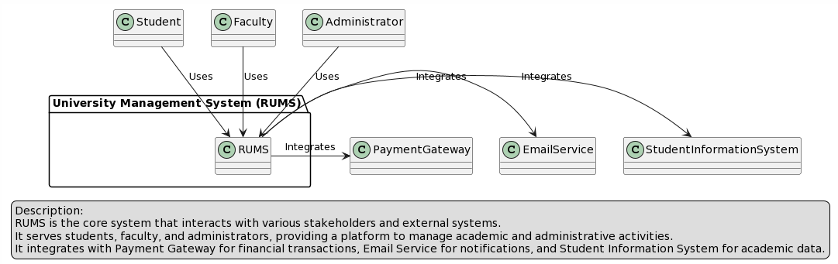
Business Context
The domain interfaces and technical interfaces to communication partners are among your system’s most critical aspects. Make sure that you completely understand them.
Make a business context diagram so all stakeholders understand which data are exchanged with the environment of the system.
Help: https://docs.arc42.org/section-3/ & https://biking.michael-simons.eu/docs/index.html#section-system-scope-and-context

Slide 10
Crosscutting Concepts
Development concepts
Agile methodologies for iterative development and continuous integration/continuous deployment (CI/CD) practices.
Architecture and design patterns
Microservices architecture for scalability, and MVC pattern for separating concerns in the application.
Safety and security concepts
Implementation of OAuth for secure authentication, HTTPS for secure communication, and regular security audits.
Concepts form the basis for conceptual integrity (consistency, homogeneity) of the architecture. Thus, they are an important contribution to achieve inner qualities of your system. Some of these concepts cannot be assigned to individual building blocks (e.g. security or safety). This is the place in the template that we provided for a cohesive specification of such concepts..
Define three crosscutting concepts. You can change the actual concepts if you want to.
Help: https://docs.arc42.org/section-8/ & https://biking.michael-simons.eu/docs/index.html#section-concepts

Slide 11
Decisions
Context | Decision | Consequences
Scalability | We will …adopt a microservices architecture. | More complex orchestration but easier scaling and maintenance.
Data Storage | We will …NoSQL (MongoDB) for our database. | Greater flexibility and performance with large, unstructured datasets.
Frontend Development | We will …use React for the frontend. | Enhanced user interface and component reusability.
Architecture for agile projects has to be described and defined differently. Not all decisions will be made at once, nor will all of them be done when the project begins.
Define three decisions using the Nygard-structure.
Help: https://cognitect.com/blog/2011/11/15/documenting-architecture-decisions

Slide 12
Quality Goals and Scenarios
Goal Ensure system scalability.
Scenario System should handle an increase in user load without performance degradation.
Goal Maintain high security.
Scenario System should resist XSS and CSRF attacks.
Goal Ensure data consistency.
Scenario Updates in one module (e.g., grades) should reflect immediately across all relevant modules (e.g., transcripts, billing).
Since quality requirements will have a lot of influence on architectural decisions you should know for every stakeholder what is really important to them, concrete and measurable.
Define three Quality Goals and Scenarios.
Help: https://docs.arc42.org/section-10/ & https://biking.michael-simons.eu/docs/index.html#_evaluation_scenarios

Slide 13
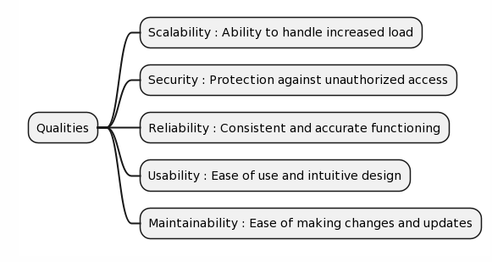
Quality Tree
Since quality requirements will have a lot of influence on architectural decisions you should know for every stakeholder what is really important to them, concrete and measurable.
Define a Quality Tree with at least 5 “arms”.
Help: https://docs.arc42.org/section-10/ & https://biking.michael-simons.eu/docs/index.html#_quality_tree

Slide 14
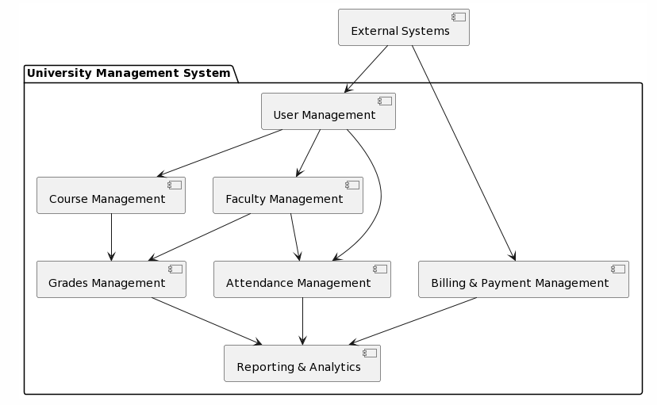
Level 1
Maintain an overview of your source code by making its structure understandable through abstraction.This allows you to communicate with your stakeholder on an abstract level without disclosing implementation details.
Level 1 is the white box description of the overall system together with black box descriptions of all contained building blocks.
Level 2 zooms into some building blocks of level 1. Thus it contains the white box description of selected building blocks of level 1, together with black box descriptions of their internal building blocks.
Level 3 (not shown in the diagram above) zooms into details of selected building blocks of level 2, and so on.
Define three levels of your software. Focus on important components for level 2 and 3.
Help: https://docs.arc42.org/section-5/ & https://biking.michael-simons.eu/docs/index.html#section-building-block-view

Slide 15
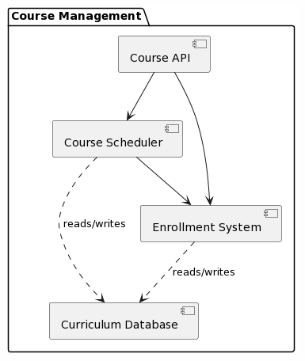
Level 2

Slide 16
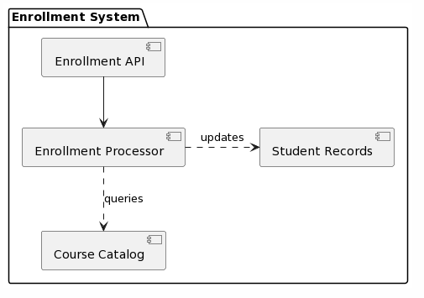
Level 3

Slide 17
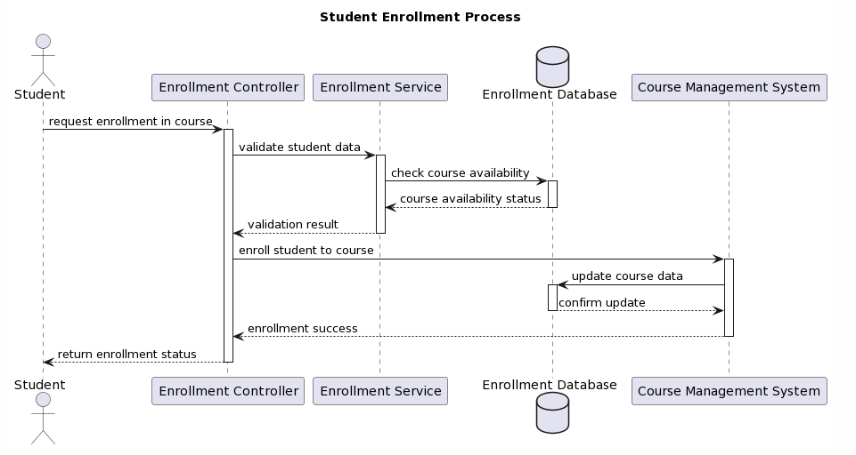
<Functionality 1>
You should understand how (instances of) building blocks of your system perform their job and communicate at runtime. You will mainly capture scenarios in your documentation to communicate your architecture to stakeholders that are less willing or able to read and understand the static models (building block view, deployment view).
Create two runtime views for important functionalities in your software.
Help: https://docs.arc42.org/section-6/ & https://biking.michael-simons.eu/docs/index.html#section-runtime-view

Slide 18
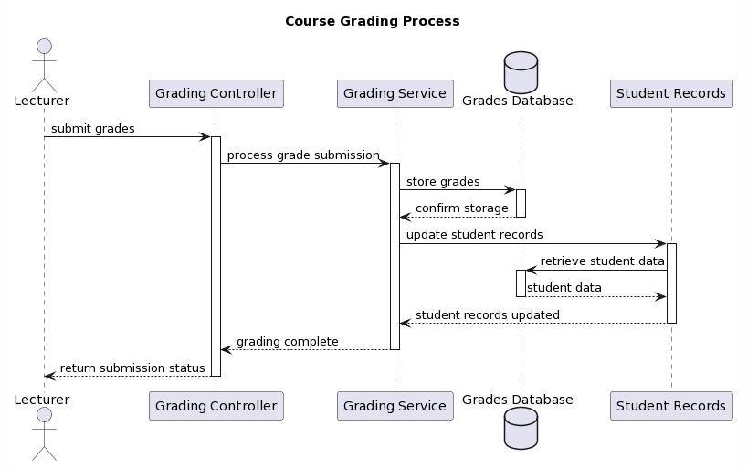
<Functionality 2>

Slide 19
Deployment view
Software Architecture

Slide 20
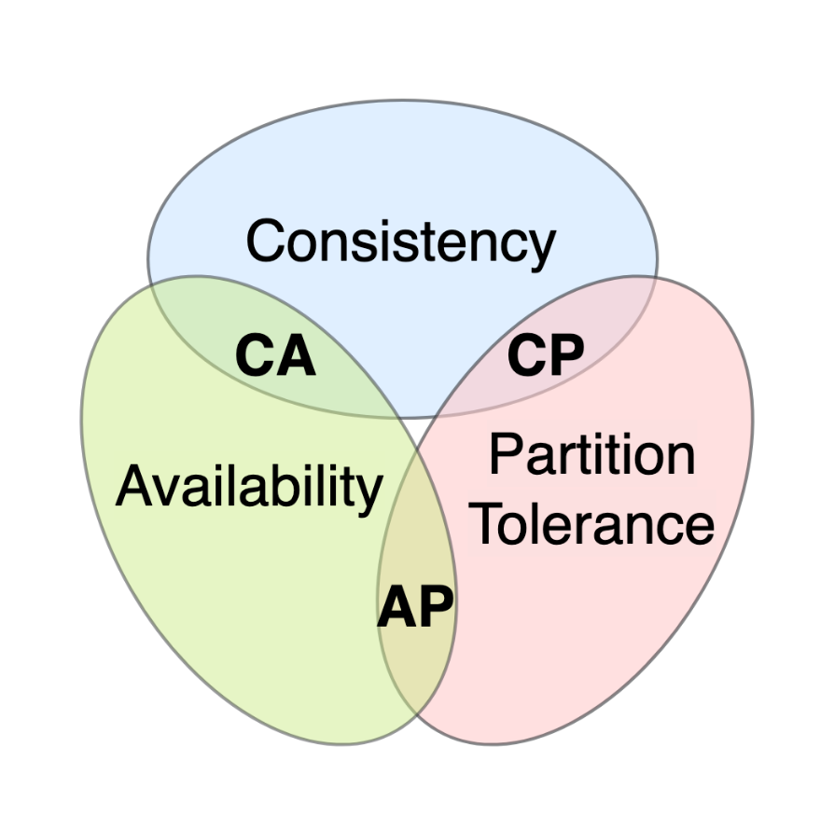
CAP theorem
The CAP theorem tells us that a distributed system can only provide two of the three desired properties: Consistency, Availability and Partition Tolerance.
Present your thoughts about your system and the CAP theorem.
Help: https://en.wikipedia.org/wiki/CAP_theorem
Consistency: Essential for academic records and financial data to ensure accuracy across the system.
Availability: Crucial for providing uninterrupted access to the system for students and faculty, particularly during key academic periods.
Partition Tolerance: Necessary to maintain system operations during network failures or partitioning events.
Given the need to prioritize, the UMS might:
Prefer Consistency and Partition Tolerance (CP) for features like enrollment and grade submissions, where data accuracy cannot be compromised.
Opt for Availability and Partition Tolerance (AP) for less critical features that can tolerate eventual consistency, like accessing course materials or general notifications.
The balance between these properties would be configured to meet the specific needs and usage patterns of the UMS, ensuring the most critical operations maintain integrity while less critical services remain as available as possible.
Notes:
Consistency: Essential for academic records and financial data to ensure accuracy across the system.
Availability: Crucial for providing uninterrupted access to the system for students and faculty, particularly during key academic periods.
Partition Tolerance: Necessary to maintain system operations during network failures or partitioning events.
Given the need to prioritize, the UMS might:
Prefer Consistency and Partition Tolerance (CP) for features like enrollment and grade submissions, where data accuracy cannot be compromised.
Opt for Availability and Partition Tolerance (AP) for less critical features that can tolerate eventual consistency, like accessing course materials or general notifications.
The balance between these properties would be configured to meet the specific needs and usage patterns of the UMS, ensuring the most critical operations maintain integrity while less critical services remain as available as possible.

Slide 21
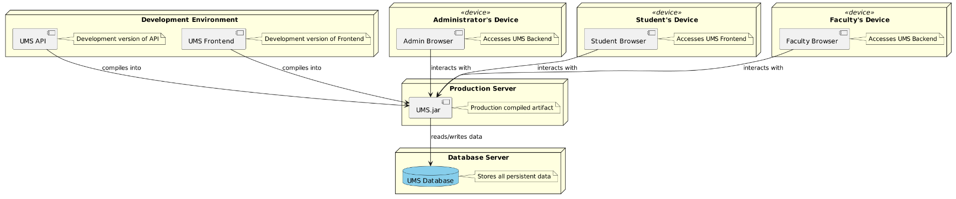
Deployment diagram
Software does not run without hardware. This underlying infrastructure can and will influence your system and/or some cross-cutting concepts. Therefore, you need to know the infrastructure.
Define the deployment of your software.
Help: https://docs.arc42.org/section-7/ & https://biking.michael-simons.eu/docs/index.html#section-deployment-view

