Slide 1
Molecular Evolution:
Distance-Based Phylogenetic Inference
(excerpt from slides on author website for [JP])

Slide 2
Distances in Trees
Edges may have weights reflecting:
  Number of mutations on evolutionary path from one species to another
  Time estimate for evolution of one species into another
In a tree T, we often compute
d_{ij}(T) - the length of a path between leaves i and j
d_{ij}(T) – tree distance between i and j

Slide 3
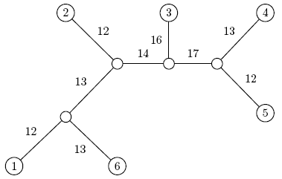
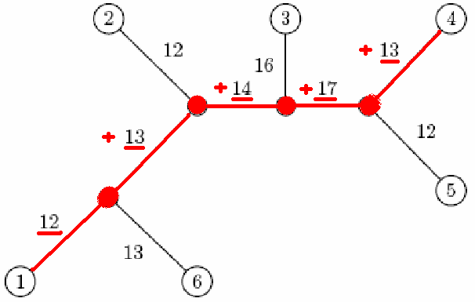
Distance in Trees: an Exampe
j
i
d_{1,4} = 12 + 13 + 14 + 17 + 13 = 69

Slide 4
Distance Matrix
Given n species, we can compute the n x n distance matrix D_{ij}
D_{ij} may be defined as the edit distance between a gene in species i and species j, where the gene of interest is sequenced for all n species.
D_{ij} – edit distance between i and j

Slide 5
Edit Distance vs. Tree Distance
Given n species, we can compute the n x n distance matrix D_{ij}
D_{ij} may be defined as the edit distance between a gene in species i and species j, where the gene of interest is sequenced for all n species.
D_{ij} – edit distance between i and j
Note the difference with
d_{ij}(T) – tree distance between i and j

Slide 6
Fitting Distance Matrix
Given n species, we can compute the n x n distance matrix D_{ij}
Evolution of these genes is described by a tree that we don’t know.
We need an algorithm to construct a tree that best fits the distance matrix D_{ij}

Slide 7
Fitting Distance Matrix
Fitting means D_{ij} = d_{ij}(T)
Lengths of path in an (unknown) tree T
Edit distance between species (known)

Slide 8
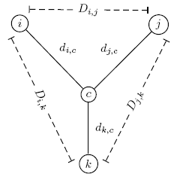
Reconstructing a 3 Leaved Tree
Tree reconstruction for any 3x3 matrix is straightforward
We have 3 leaves i, j, k and a center vertex c
Observe:
d_{ic} + d_{jc} = D_{ij}
d_{ic} + d_{kc} = D_{ik}
d_{jc} + d_{kc} = D_{jk}

Slide 9
Reconstructing a 3 Leaved Tree (cont’d)
d_{ic} + d_{jc} = D_{ij}
+ d_{ic} + d_{kc} = D_{ik}
2d_{ic} + d_{jc} + d_{kc} = D_{ij} + D_{ik}
2d_{ic} + D_{jk} = D_{ij} + D_{ik}
d_{ic} = (D_{ij} + D_{ik} – D_{jk})/2
Similarly,
d_{jc} = (D_{ij} + D_{jk} – D_{ik})/2
d_{kc} = (D_{ki} + D_{kj} – D_{ij})/2

Slide 10
Trees with > 3 Leaves
A tree with n leaves has 2n-3 edges
This means fitting a given tree to a distance matrix D requires solving a system of “n choose 2” equations with 2n-3 variables
This is not always possible to solve for n > 3

Slide 11
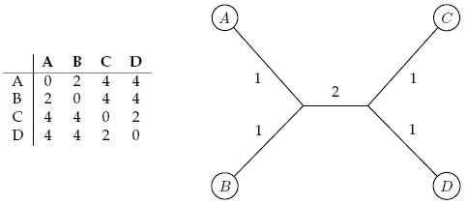

Additive Distance Matrices
Matrix D is ADDITIVE if there exists a tree T with d_{ij}(T) = D_{ij}
NON-ADDITIVE otherwise

Slide 12
Distance Based Phylogeny Problem
Goal: Reconstruct an evolutionary tree from a distance matrix
Input: n x n distance matrix D_{ij}
Output: weighted tree T with n leaves fitting D
If D is additive, this problem has a solution and there is a simple algorithm to solve it

Slide 13
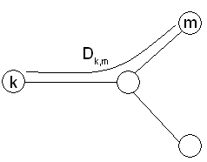
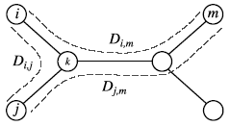
Using Neighboring Leaves to Construct the Tree
Find neighboring leaves i and j with parent k
Remove the rows and columns of i and j
Add a new row and column corresponding to k, where the distance from k to any other leaf m can be computed as:
D_{km} = (D_{im} + D_{jm} – D_{ij})/2
Compress i and j into k, iterate algorithm for rest of tree

Slide 14
Finding Neighboring Leaves
To find neighboring leaves we simply select a pair of closest leaves.

Slide 15
Finding Neighboring Leaves
To find neighboring leaves we simply select a pair of closest leaves.
WRONG

Slide 16
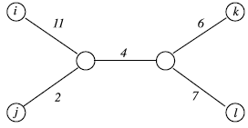
Finding Neighboring Leaves
Closest leaves aren’t necessarily neighbors
i and j are neighbors, but (d_{ij} = 13) > (d_{jk} = 12)
Finding a pair of neighboring leaves is
a nontrivial problem!

Slide 17
Neighbor Joining Algorithm
In 1987 Naruya Saitou and Masatoshi Nei developed a neighbor joining algorithm for phylogenetic tree reconstruction
Finds a pair of leaves that are close to each other but far from other leaves: implicitly finds a pair of neighboring leaves
Advantages: works well for additive and other non-additive matrices, it does not have the flawed molecular clock assumption

Slide 18
Degenerate Triples
A degenerate triple is a set of three distinct elements 1≤i,j,k≤n where D_{ij} + D_{jk} = D_{ik}
Element j in a degenerate triple i,j,k lies on the evolutionary path from i to k (or is attached to this path by an edge of length 0).

Slide 19
Looking for Degenerate Triples
If distance matrix D has a degenerate triple i,j,k then j can be “removed” from D thus reducing the size of the problem.
If distance matrix D does not have a degenerate triple i,j,k, one can “create” a degenerative triple in D by shortening all hanging edges (in the tree).

Slide 20
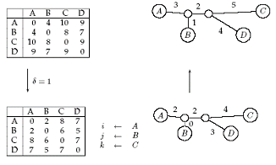
Shortening Hanging Edges to Produce Degenerate Triples
Shorten all “hanging” edges (edges that connect leaves) until a degenerate triple is found

Slide 21
Finding Degenerate Triples
If there is no degenerate triple, all hanging edges are reduced by the same amount δ, so that all pair-wise distances in the matrix are reduced by 2δ.
Eventually this process collapses one of the leaves (when δ = length of shortest hanging edge), forming a degenerate triple i,j,k and reducing the size of the distance matrix D.
The attachment point for j can be recovered in the reverse transformations by saving D_{ij} for each collapsed leaf.

Slide 22
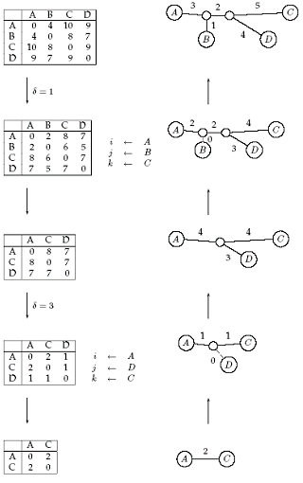
Reconstructing Trees for Additive Distance Matrices

Slide 23
AdditivePhylogeny Algorithm
AdditivePhylogeny(D)
if D is a 2 x 2 matrix
T = tree of a single edge of length D_{1,2}
return T
if D is non-degenerate
δ = trimming parameter of matrix D
for all 1 ≤ i ≠ j ≤ n
D_{ij} = D_{ij} - 2δ
else
δ = 0

Slide 24
AdditivePhylogeny (cont’d)
Find a triple i, j, k in D such that D_{ij} + D_{jk} = D_{ik}
x = D_{ij}
Remove j^{th} row and j^{th} column from D
T = AdditivePhylogeny(D)
Add a new vertex v to T at distance x from i to k
Add j back to T by creating an edge (v,j) of length 0
for every leaf l in T
if distance from l to v in the tree ≠ D_{l,j}
output “matrix is not additive”
return
Extend all “hanging” edges by length δ
return T

Slide 25
The Four Point Condition
AdditivePhylogeny provides a way to check if distance matrix D is additive
An even more efficient additivity check is the “four-point condition”
Let 1 ≤ i,j,k,l ≤ n be four distinct leaves in a tree

Slide 26
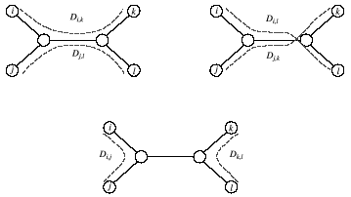
The Four Point Condition (cont’d)
Compute: 1. D_{ij} + D_{kl}, 2. D_{ik} + D_{jl}, 3. D_{il} + D_{jk}
2
3
1
2 and 3 represent the same number: the length of all edges + the middle edge (it is counted twice)
1 represents a smaller number: the length of all edges – the middle edge

Slide 27
The Four Point Condition: Theorem
The four point condition for the quartet i,j,k,l is satisfied if two of these sums are the same, with the third sum smaller than these first two
Theorem : An n x n matrix D is additive if and only if the four point condition holds for every quartet 1 ≤ i,j,k,l ≤ n

Slide 28
Least Squares Distance Phylogeny Problem
If the distance matrix D is NOT additive, then we look for a tree T that approximates D the best:
Squared Error : ∑_{i,j} (d_{ij}(T) – D_{ij})²
Squared Error is a measure of the quality of the fit between distance matrix and the tree: we want to minimize it.
Least Squares Distance Phylogeny Problem: finding the best approximation tree T for a non-additive matrix D (NP-hard).

Slide 29
Sources
http://www.math.tau.ac.il/~rshamir/ge/02/scribes/lec01.pdf
http://bioinformatics.oupjournals.org/cgi/screenpdf/20/3/340.pdf
http://www.absoluteastronomy.com/encyclopedia/M/Mi/Minimum_spanning_tree.htm
Serafim Batzoglou (UPGMA slides) http://www.stanford.edu/class/cs262/Slides
Watkins, W.S., Rogers A.R., Ostler C.T., Wooding, S., Bamshad M. J., Brassington A.E., Carroll M.L., Nguyen S.V., Walker J.A., Prasas, R., Reddy P.G., Das P.K., Batzer M.A., Jorde, L.B.: Genetic Variation Among World Populations: Inferences From 100 Alu Insertion Polymorphisms

