Slide 1
How to Optimise Your Prompt on ChatGPT?
AI in Research Workshop – Ateliers sur l'IA en recherche
Igor Faddeenkov
Research Engineer, CR2TI-U1064

Slide 2
About Me
Igor Faddeenkov – Research Engineer in Bioinformatics
Working at CR2TI-U1064: Center for Research in Transplantation and Translational Immunology
Graduated with a Master's in Mathematics from Technical University of Munich (TUM)
3 years of experience in computational biology and modeling

Slide 3
LLM Chatbots – Timeline and Impact
2018 – BERT (Google) – Context-aware understanding of language/transformers
2020 – GPT-3 (OpenAI) – Breakthrough in generative AI
2022 – ChatGPT – Public interaction with powerful LLMs
2023 – Claude, Gemini, LLaMA, Mistral – Ecosystem expands
2024 – Multimodal models, fine-tuning for domain expertise
Now – LLMs assist in research, hypothesis generation, code writing, and more

Slide 4
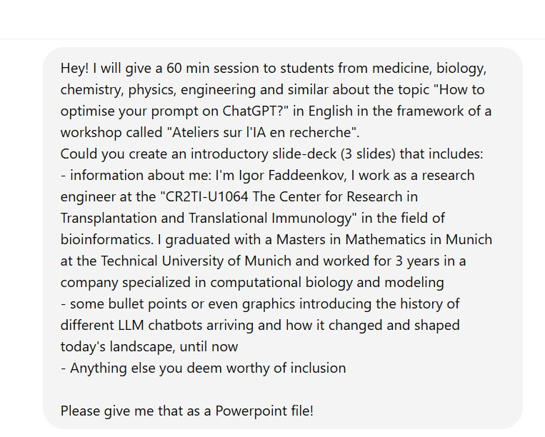

But actually…..

Slide 5
Current genAI chatbots anno 2025
ChatGPT, OpenAI, USA
Gemini, Google Deepmind, USA
Claude, Anthropic, USA
DeepSeek-R1, DeepSeek, China
Microsoft Copilot, Microsoft, USA
Llama, Meta AI, USA
Le Chat, Mistral AI, France

Slide 6
Tips for writing a prompt
Neutrality
No “I heard that the earth is flat, is it true”, “My professor told me to measure algorithm accuracy in apples, can you elaborate on that”,…
Bias in the answers
Clear, precise input AND output direction
Coding
Provide Examples: Dummy dataset and shape/format of output dataset
Split your overall tasks in several subtasks (“abstraction of the problem”)
YET: avoid “XY problem”
Academics/administrative tasks
Explain context and add ANY information you deem worthy of inclusion
Provide documents (PDF) as support of discussion
Affirmative wording (no “not”)
Context (role-based instructions, keywords, target audience)

Slide 7
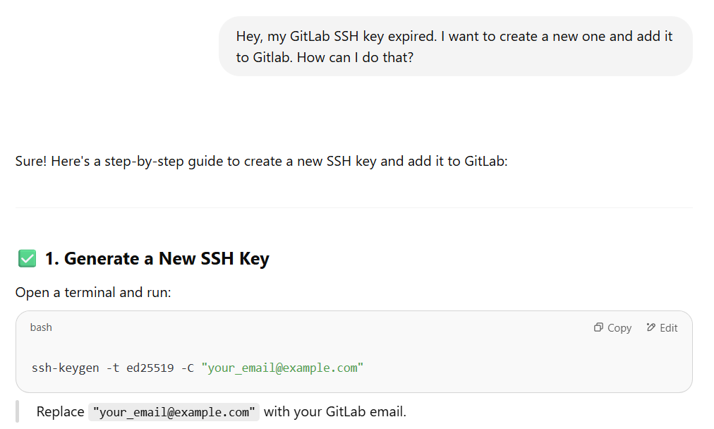
Example 1
What’s your problem?
What do YOU want to do?
What do you want THE GENAI to do?

Slide 8

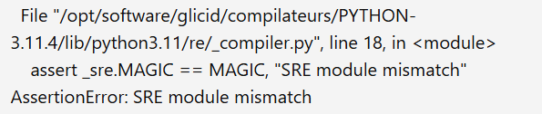

Example 2
What’s your problem?
Context
What do you want THE GENAI to do?

Slide 9
Tips for interpreting genAI answers
Validity check
Double-check used keywords, facts, literature, everything
Re-ask the question differently and compare answers
For “high-stake demands”: use same prompt on different genAI chatbots
NO pure copy-paste
Coding: possible invisible ASCII-code characters
Own typing/reworking/own comments etc.
“Understand” the output prior to incorporation of it into your pipeline
Writing tasks
Possible invisible ASCII-code characters
Beware of “AI formulation” even if prior precision on that in command prompt
Use follow-up questions to refine answers

Slide 10
Tips for subsequent interaction
Challenge/discuss chatbot answer
Coding
Provide error and line of code of error, add own knowledge if possible
Provide exterior knowledge (Stackoverflow, Reddit)
Academics
Challenge validity of scientific papers and associated results (often, ChatGPT suggests papers from pre-print servers/low-citation papers)
Demand more examples
After unsuccessful third or forth try
Try another genAI chatbot
Tell him to “forget everything/start anew” and explain your problem in a different way
Re-split your problem differently

Slide 11
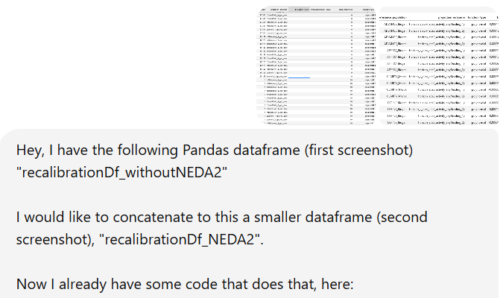

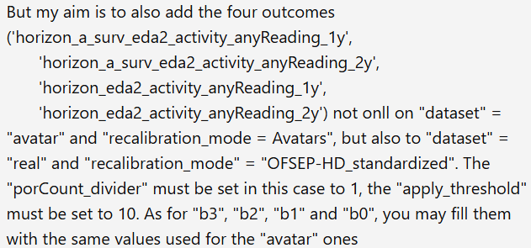


Example 3
<>

Slide 12
Introduction to AI agents
Definition:
“An Agent is a system that leverages an AI model to interact with its environment in order to achieve a user-defined objective.
It combines reasoning, planning, and the execution of actions (often via external tools) to fulfill tasks”
[Hugging Face Inc., 2025]
Goal: Automatisation of tasks
Type of AI models: LLMs, Visual Language Models (VLMs)
Implement actions via “Tools”

Slide 13
More advanced AI agent solutions
LangChain (Python, free)
AutoGen (Microsoft, free)
AutoGPT (ChatGPT/OpenAI, subscription-based, integrated)
Payman (Payman AI Inc, paid, integrated)
CrewAI (Crew AI Inc, paid, integrated)
…

Slide 14
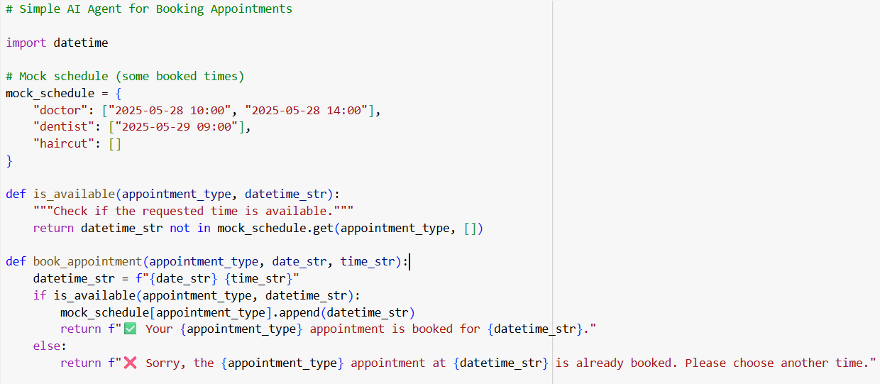
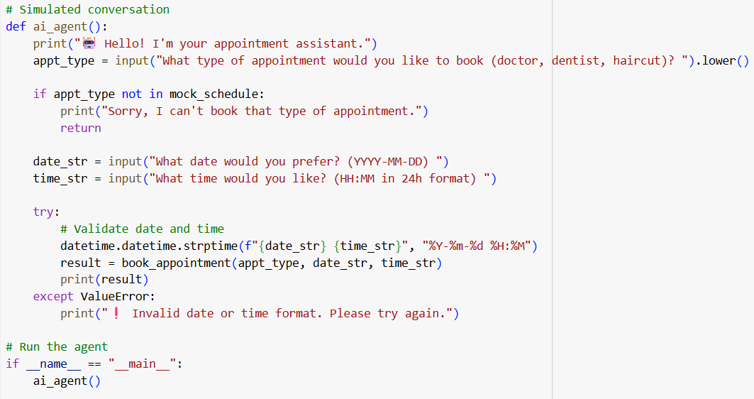
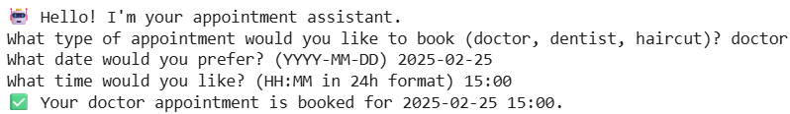
Simple example (Python)

Slide 15
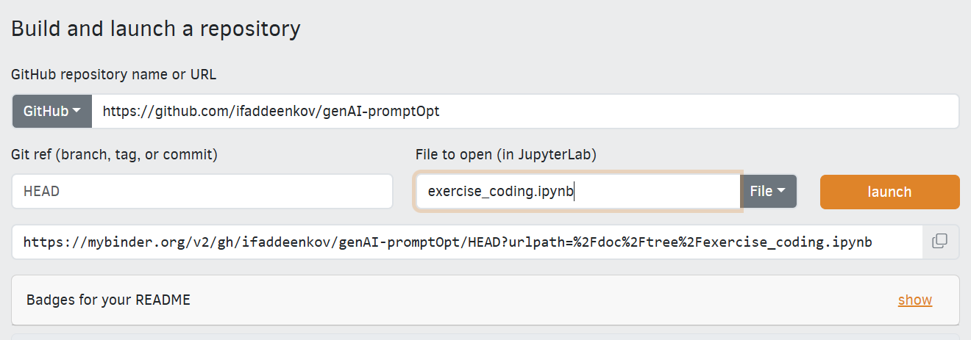
Small exercises
Access the exercises on Github:
https://github.com/ifaddeenkov/genAI-promptOpt.git
Either clone (in Ubuntu or Git Bash/Git emulator):
git clone https://github.com/ifaddeenkov/genAI-promptOpt.git
or, if you use purely Windows, access:
https://mybinder.org/
and then fill in:

