Slide 1


Slide 2

SmartCourse – AI Powered Course Recommendation System

Slide 3
My Introduction
My name is Faisal Mehmood, and I am pursuing a BS in Computer Science at Virtual University of Pakistan. I have a strong interest in technology, software development, and modern digital solutions. I am passionate about learning new skills and improving my knowledge in the field of computer science to build a successful professional career.

Slide 4

INTRODUCTION OF PROJECT
The Smart AI Powered Course Recommendation System is a web-based platform that recommends relevant online courses based on user interests expressed in natural language. It uses TF-IDF and Sentence-Transformer AI models to provide accurate keyword-based and semantic recommendations. The system displays top-ranked courses with relevance scores, course details, and save options through a Flask and Bootstrap-based interface. It also stores search history and saved courses using SQLite and SQLAlchemy ORM.

Slide 5
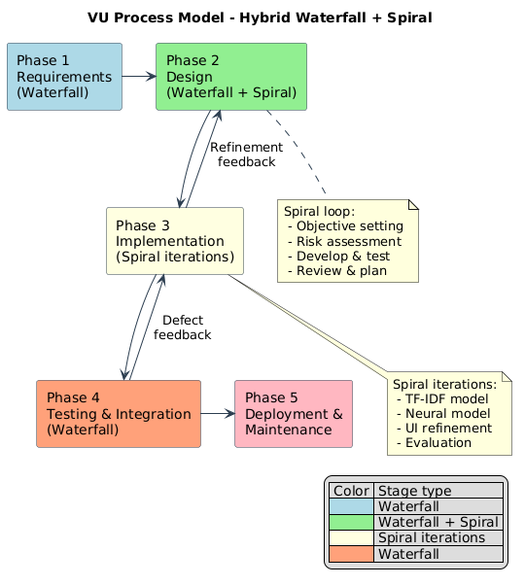

Slide 6
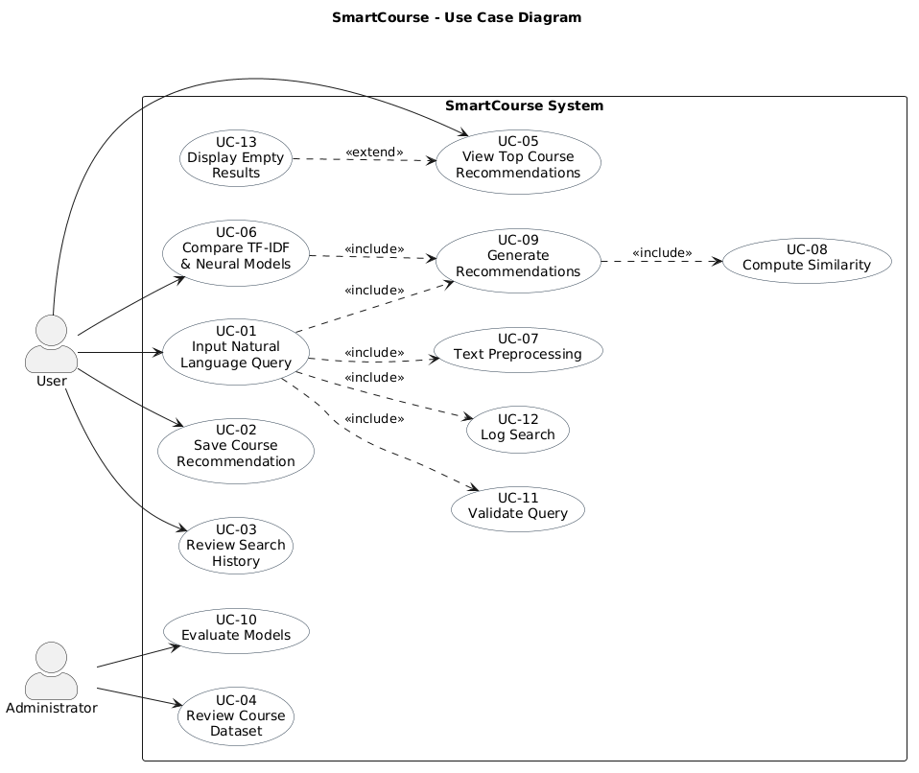
Use Case Diagram

Slide 7
Business Rules Catalog
Business Rules Catalog (Core Engine)
BR-01: Empty queries are rejected (HTTP 400). (Input Validation)
BR-02: Maximum 10 course results per search. (Result Limit)
BR-03: Only courses with relevance score > 0 are shown. (Relevant Results)
BR-04: Scores displayed as normalized percentages with progress bars. (Score Visualization)
BR-05: User must select TF-IDF, Neural, or Compare mode before search. (Mandatory Model Selection)
BR-06: Duplicate course saves in the same session are blocked (HTTP 409). (Duplicate Prevention)
BR-07: Every successful search is automatically logged. (Auto Logging)
BR-08: Dashboard displays latest 50 searches only. (History Limit)
BR-09: Saved courses remain grouped by search session. (Session Grouping)
BR-10: Compare mode stores one combined history record. (Unified Comparison Record)

Slide 8
Business Rules Catalog (Data & Persistence)
BR-11: Saved courses persist even if history is deleted. (Save Persistence)
BR-12: Missing descriptions/ratings are auto-generated. (Data Integrity)
BR-13: TF-IDF uses cleaned and lemmatized text preprocessing. (Text Preprocessing)
BR-14: Neural model uses raw query text directly. (Raw Text Processing)
BR-15: Response SLA: TF-IDF ≤2s, Neural ≤5s. (Performance SLA)
BR-16: Models and embeddings load once at server startup. (Startup Optimization)

Slide 9
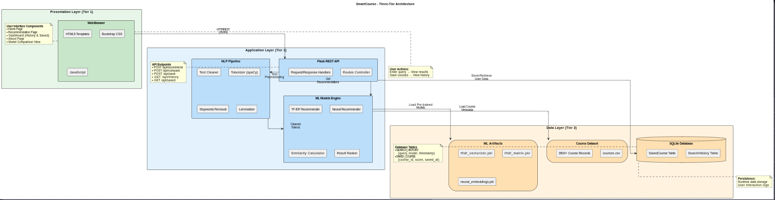
Architectural Design

Slide 10
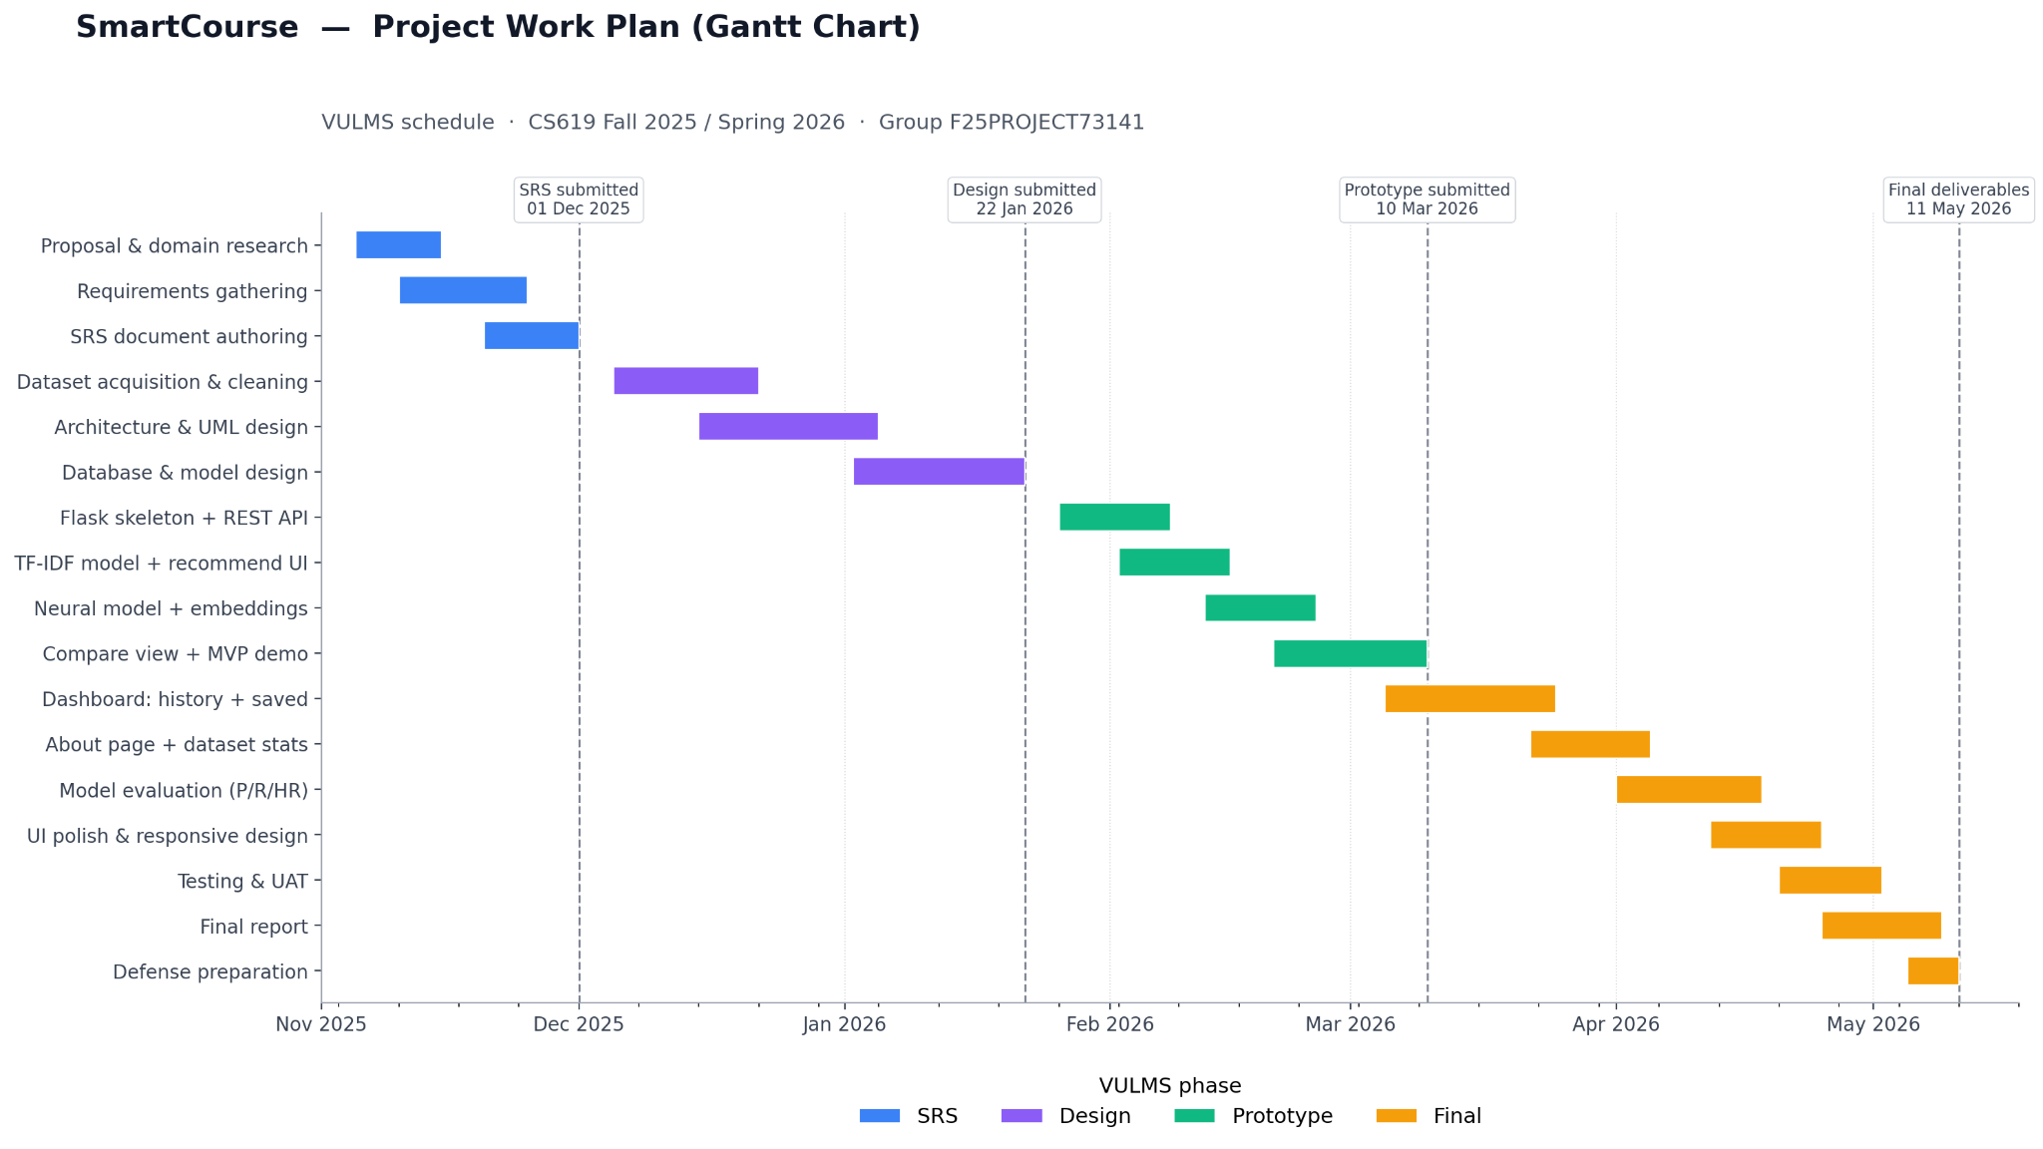
Project Schedule

Slide 11
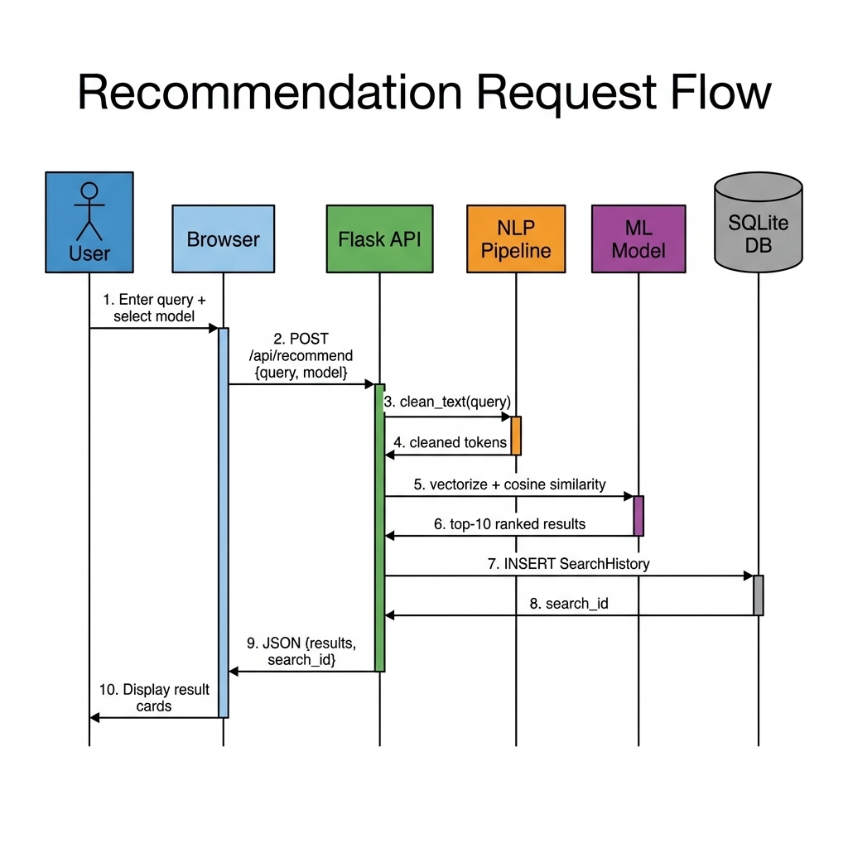
Sequence Diagrams

Slide 12
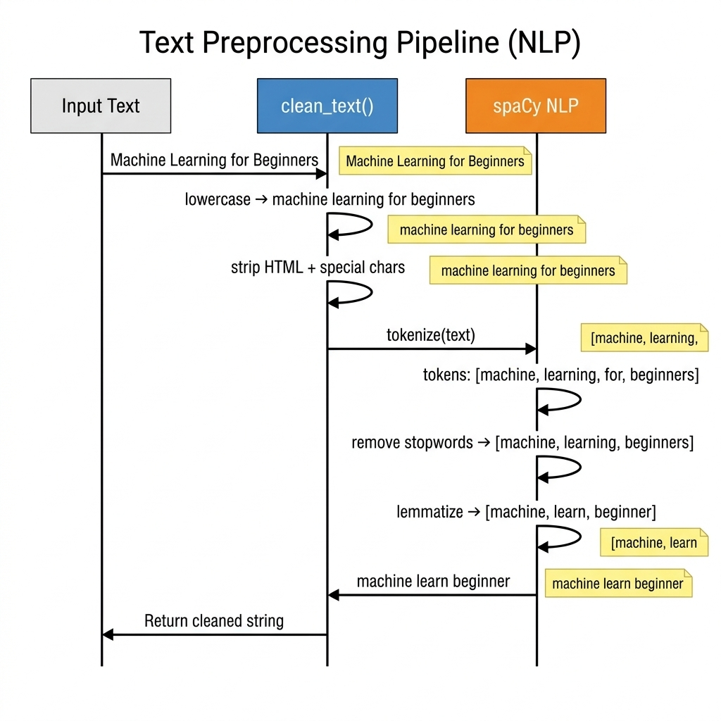

Slide 13
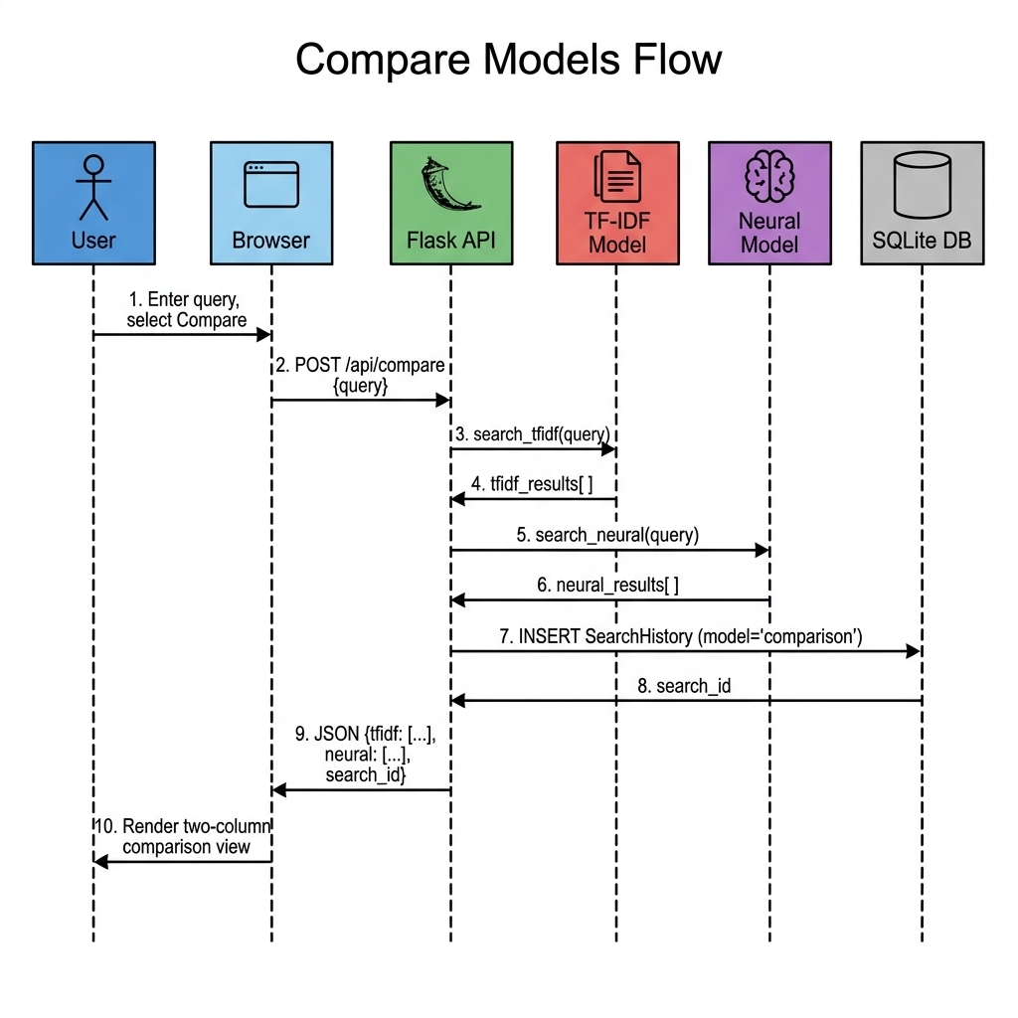

Slide 14
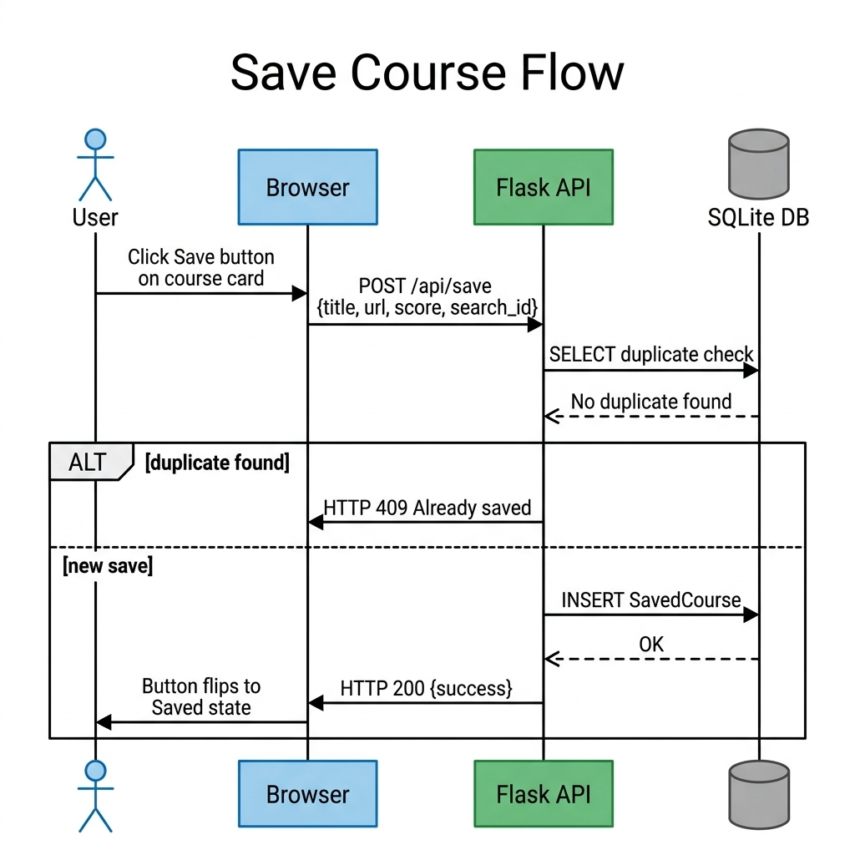

Slide 15
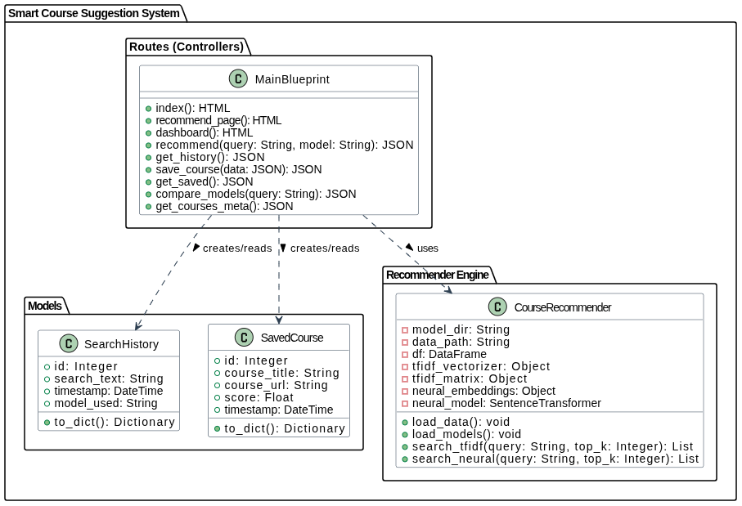
Logical Model/Class Diagram

Slide 16
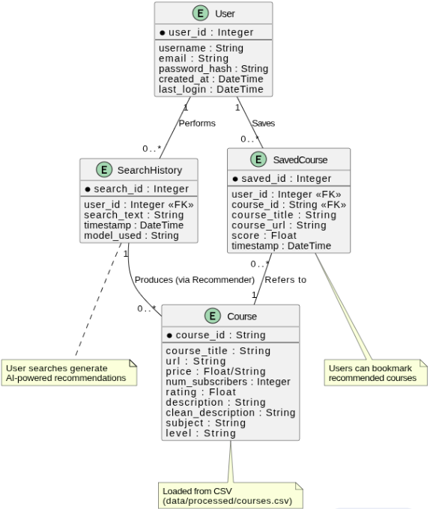
Entity-Relationship Diagram

Slide 17
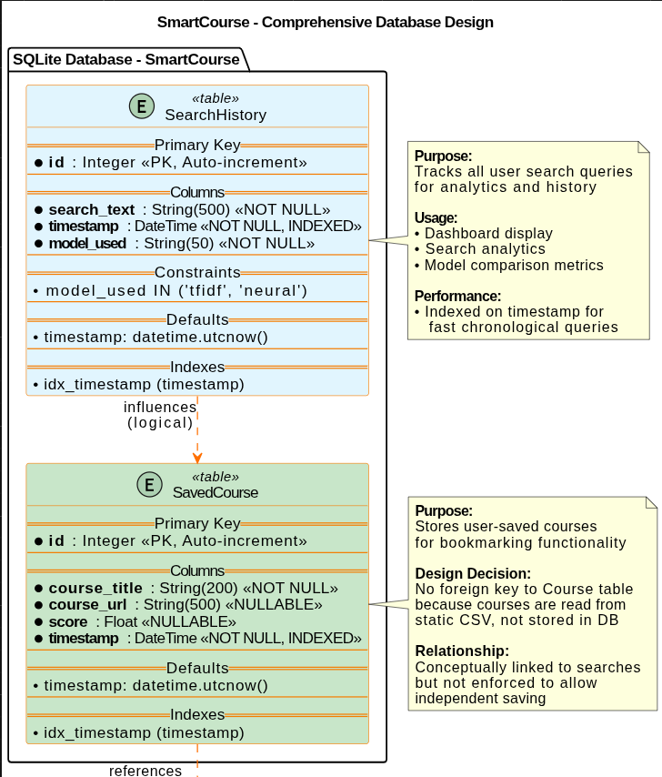
Database Diagram

Slide 18
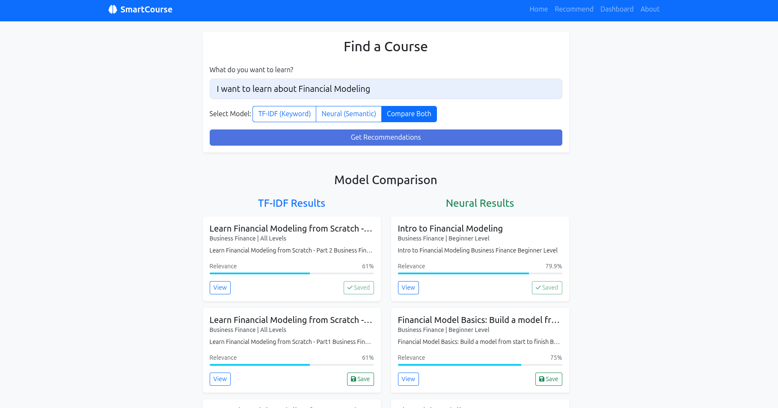
User Interfaces

Slide 19
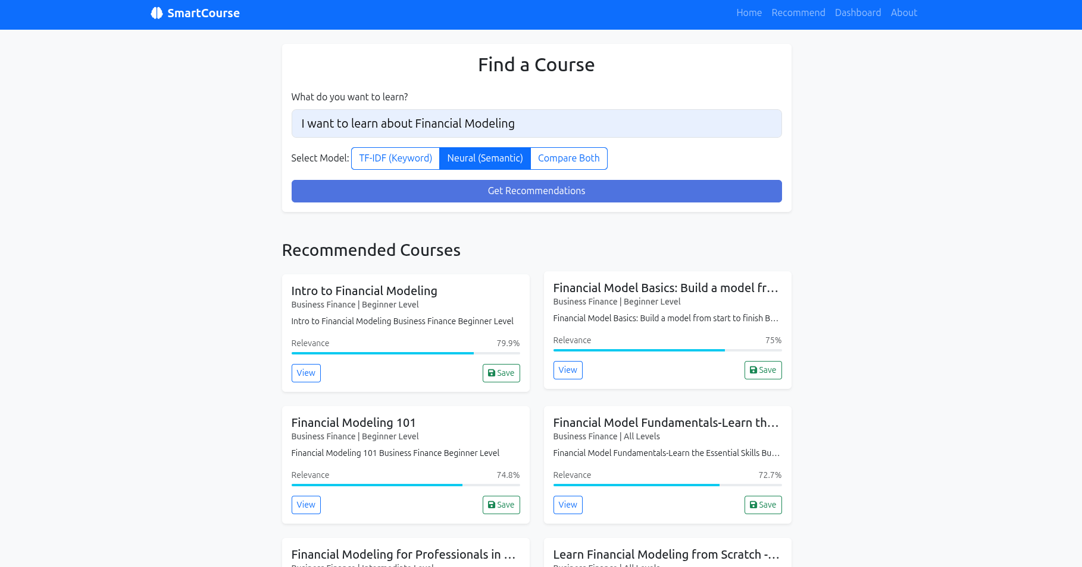

Slide 20
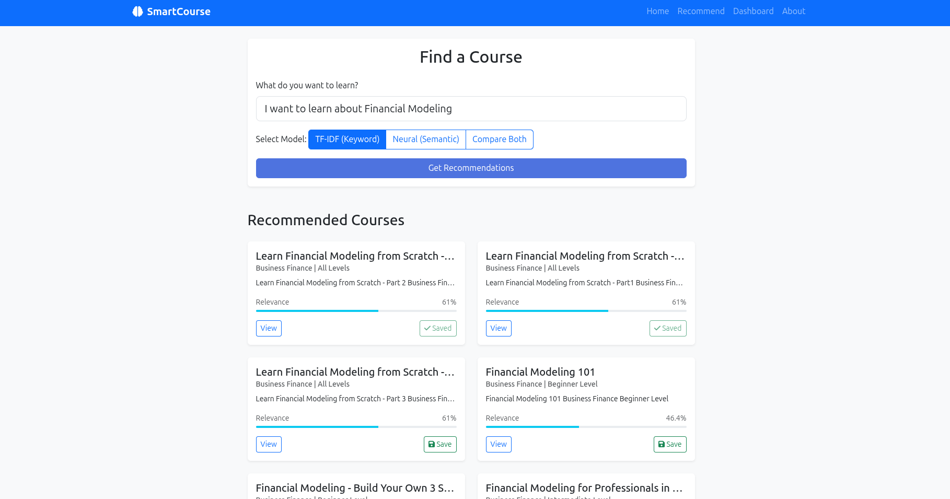

Slide 21
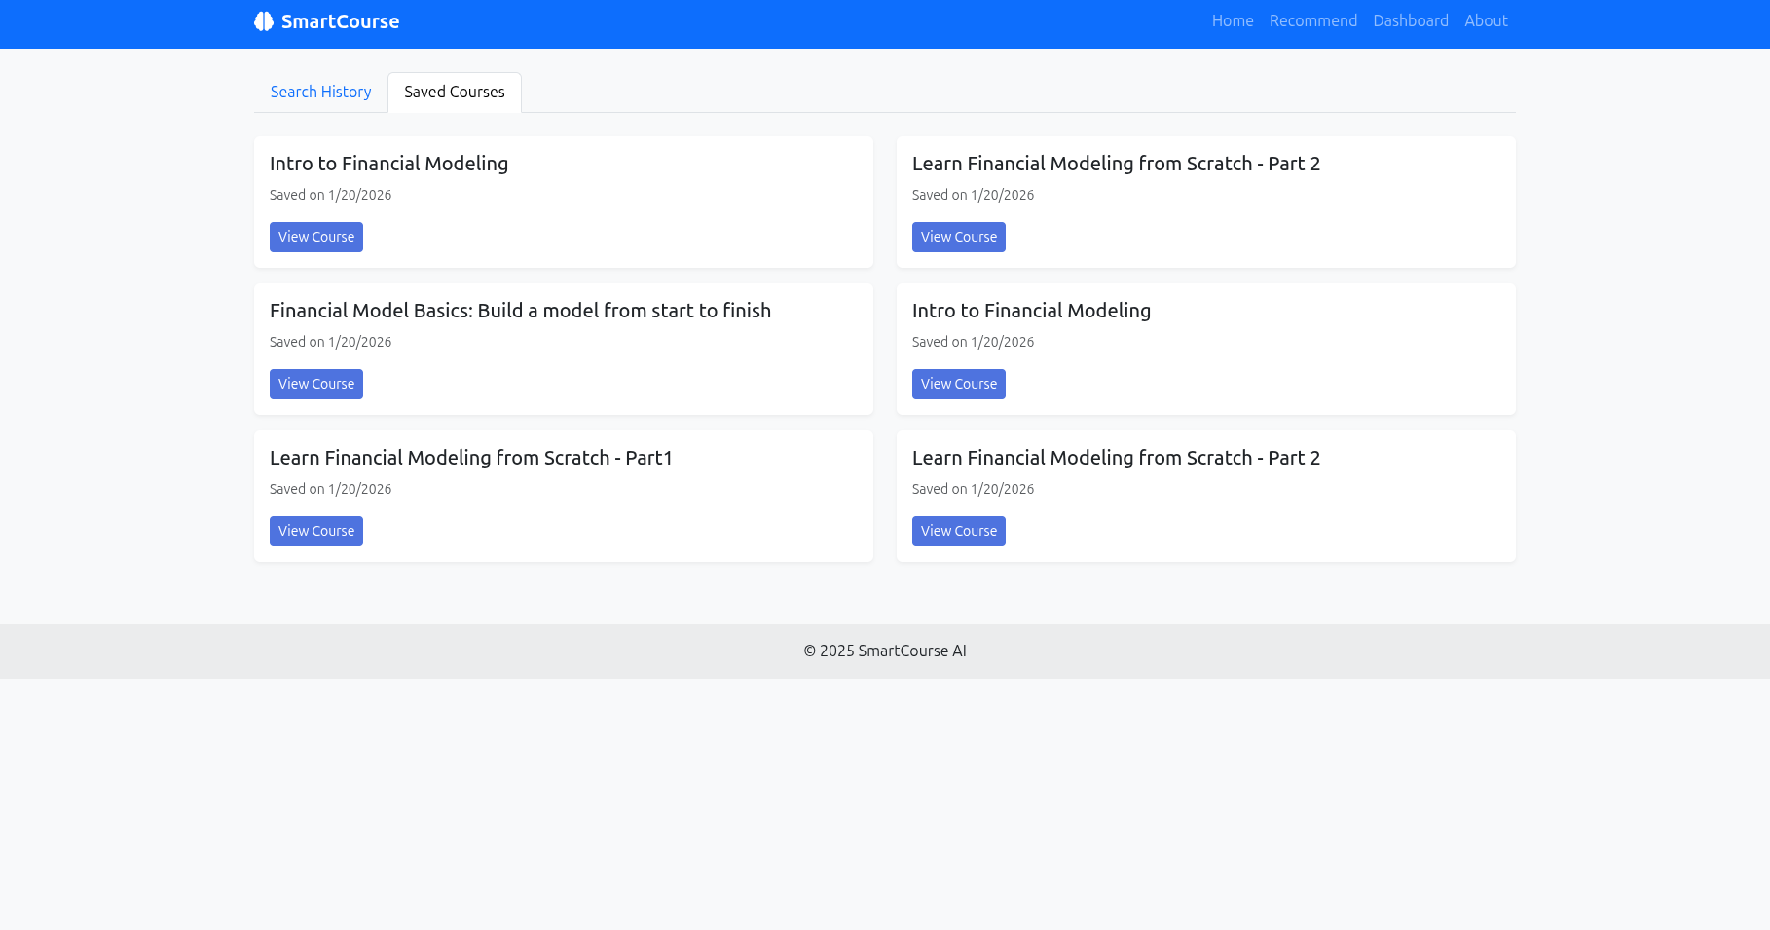

Slide 22
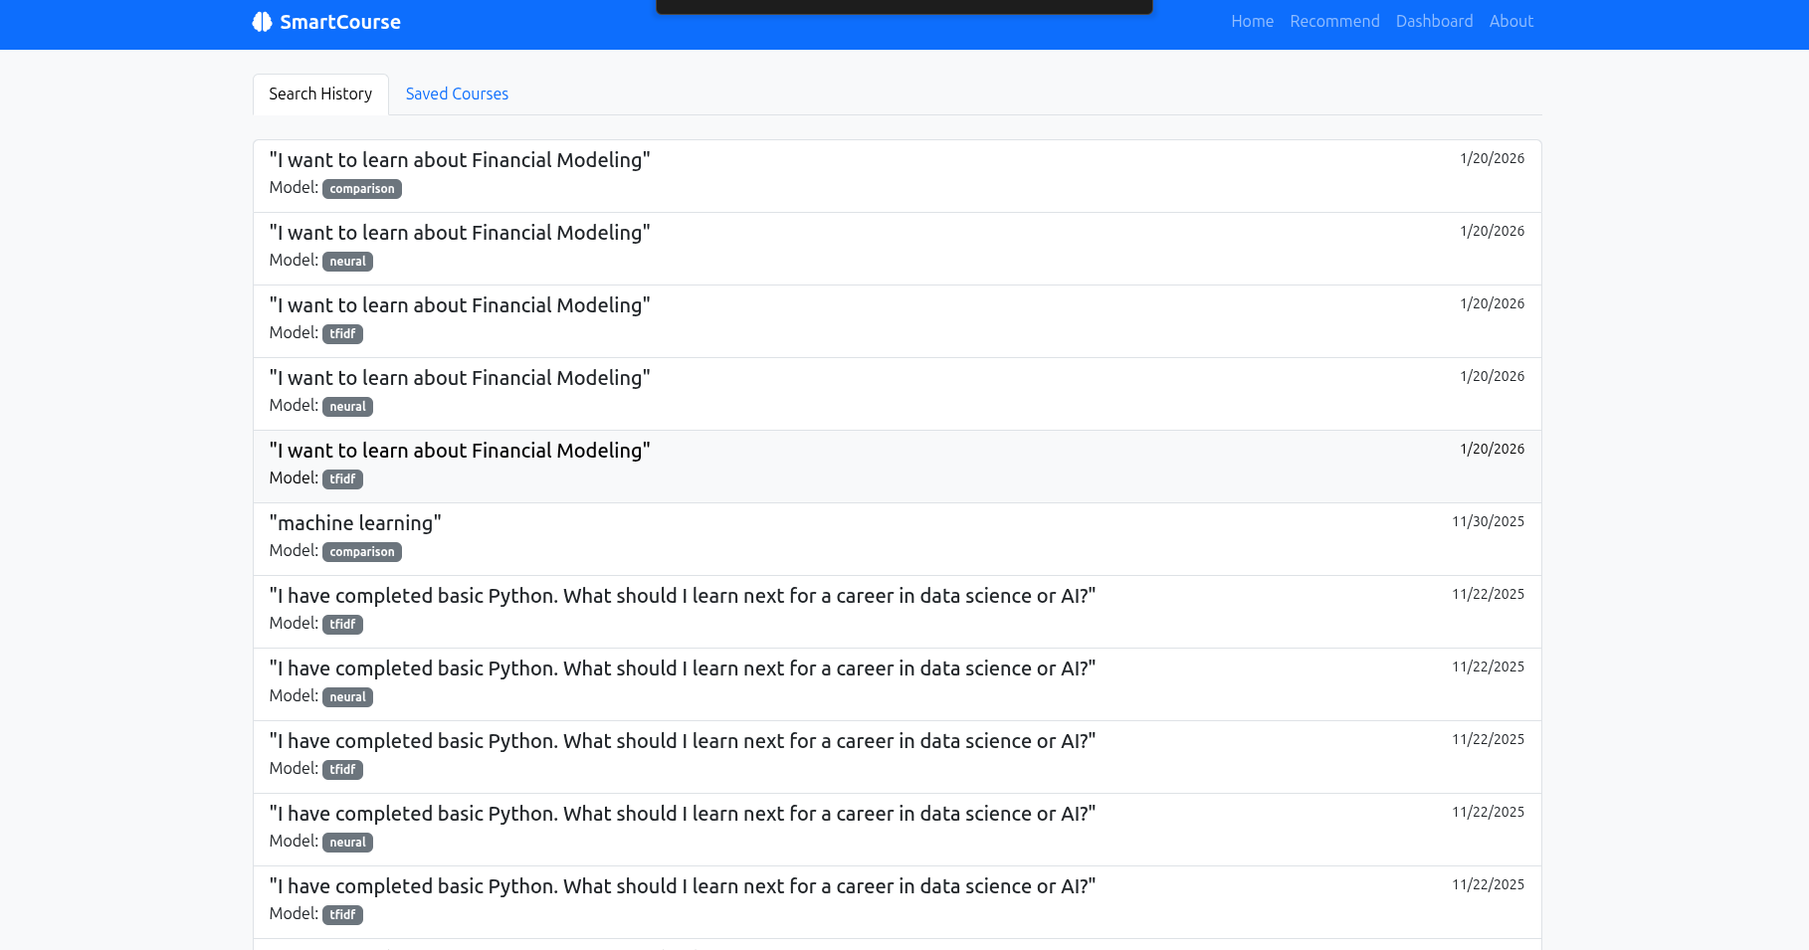

Slide 23
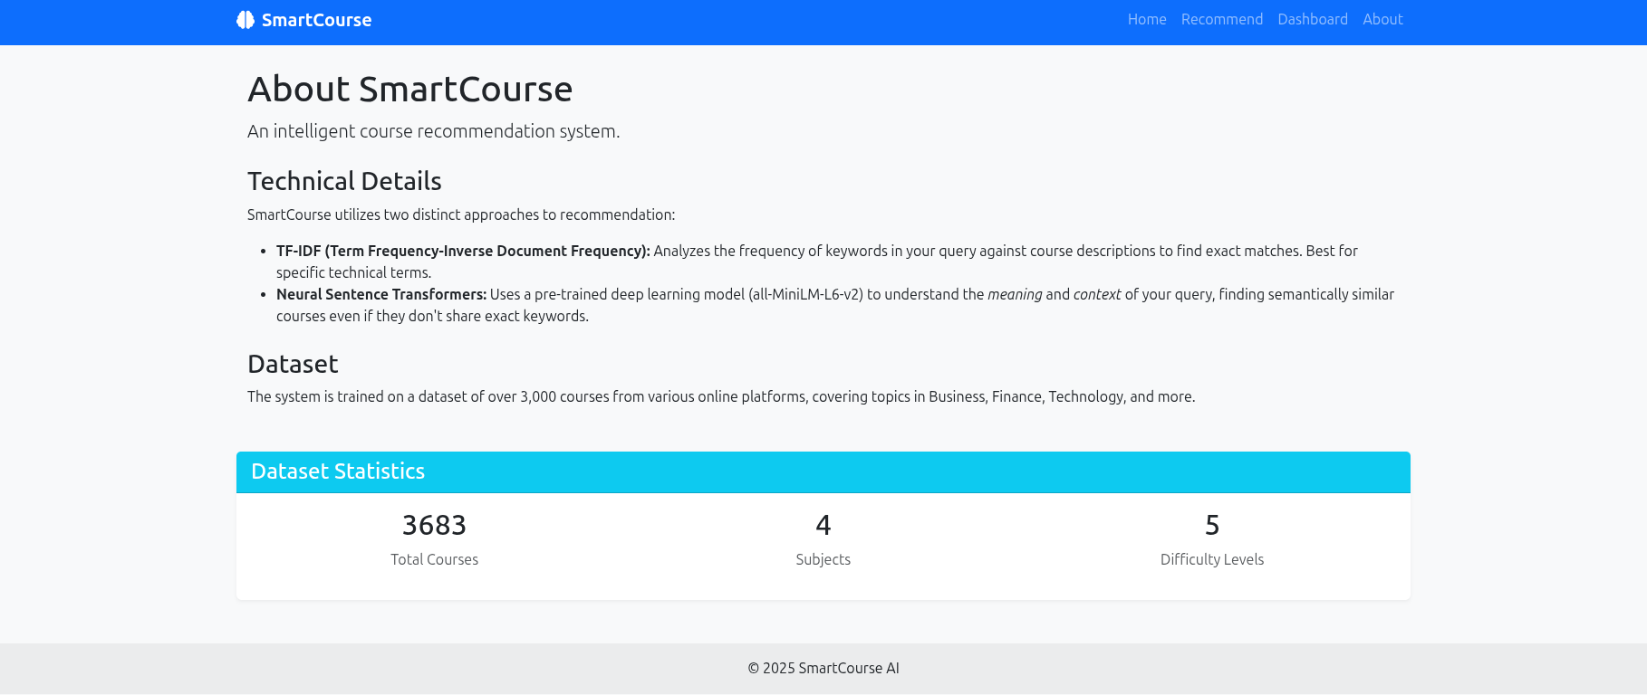

Slide 24
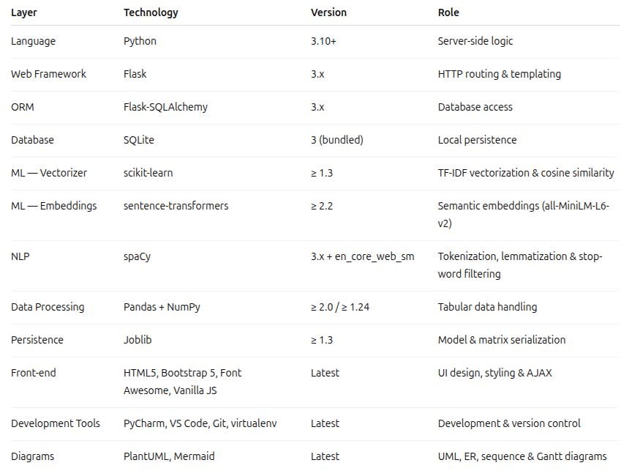
Technology Stack & Tools

Slide 25
The End

