Slide 1

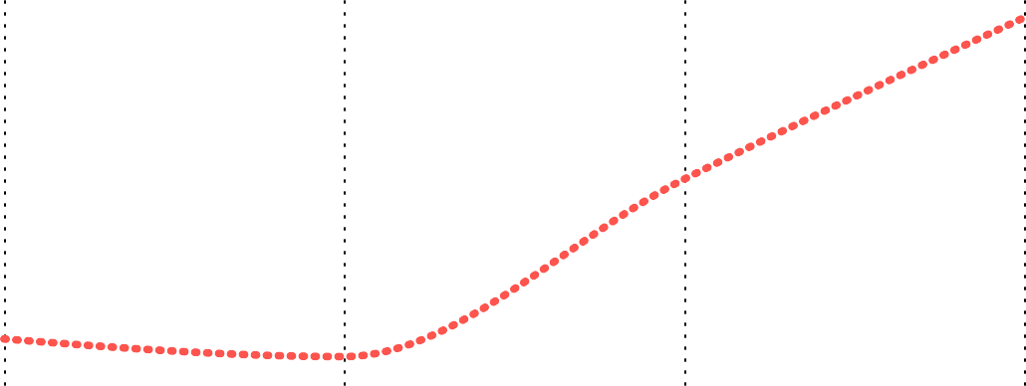
9994
Power BI Desktop
286.40K
Total Profit with Discount
$459
2.30M
Total Orders
Average Order Value Total Sales
Customers with Purchases upto $10k
$25K
Count of Sales by Product Sub-Category
Count of Sales
$0.3M
Purchase
$20K
$19K
$0.2M
$15K
$14K
$14K
$12K
$12K
$12K
$11K
$11K
$11K
$0.1M
$10K
$0.0M
$0K
Phones
Chairs
Storage
Tables
Binders
Copiers
Paper
Supplies
Art
Labels
Machines
Bookcases
Appliances
Envelopes
Fasteners
Accessories
Furnishings
KL-16645
SE-20110
TS-21370
CJ-12010
KF-16285
TC-20980
TA-21385
SC-20095
SV-20365
CL-12565
BS-11365
SM-20320
RB-19360
AB-10105
HL-15040
CC-12370
GT-14710
ME-17320
EH-13765
BM-11140
Sub-Category
Customer ID
Total Sales over Time
Sales by Year and Quarter
$0.3M
$0.73M
$0.7M
Total Sales
$0.2M
$0.61M
Sales
$0.6M
$0.1M
$0.5M
$0.48M
$0.47M
$0.0M
Qtr 1 Qtr 2 Qtr 3 Qtr 4 Qtr 1 Qtr 2 Qtr 3 Qtr 4 Qtr 1 Qtr 2 Qtr 3 Qtr 4 Qtr 1 Qtr 2 Qtr 3 Qtr 4
2011 2012 2013 2014
Quarter
2011
2012
2013
2014
Year

Slide 2
608.98K
781
Repeated Customers
Power BI Desktop
3.96 Days
Total Profit without Discount Average Delivery Time
Profit without Discount by Sub-Category
$100K
Profit and Loss by Sub-Category
$60K
Sum of Profit withou…
Profit / Loss
$40K
$20K
$50K
$0K
($20K)
$0K
Copiers
Phones
Paper
Binders
Chairs
Storage
Art
Labels
Fasteners
Supplies
Tables
Phones
Chairs
Binders
Copiers
Paper
Storage
Tables
Art
Labels
Supplies
Fasteners
Appliances
Envelopes
Machines
Bookcases
Machines
Appliances
Bookcases
Envelopes
Accessories
Furnishings
Accessories
Furnishings
Sub-Category
Sub-Category
Average Shipping Time by Ship Mode
6
5.01
Effect of Discount on Profit
80%
60%
Discount
4
3.24
40%
Days
2.18
2
20%
0%
0
0.04
-2.0
-1.5
-1.0
Profit Margin
-0.5
0.0
Standard Class
Second Class
First Class
Same Day
Ship Mode

Slide 3
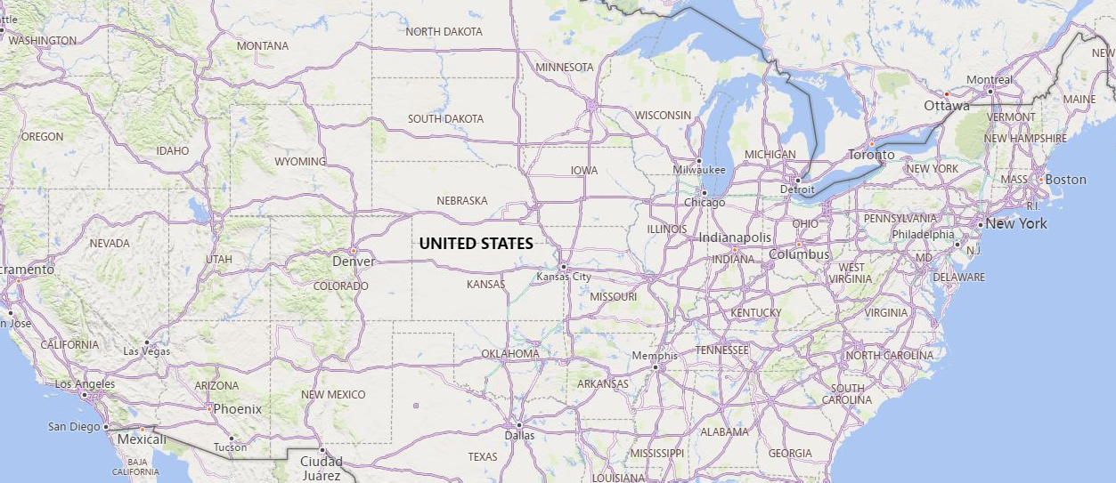















Power BI Desktop
Total Sales by Bubble size in different States
© 2024 TomTom,, © 2024 Miiccrrossofftt Corrporrattiion

