Slide 1

Getting Started With Node.js
Jim Cowart
Blog: http://www.ifandelse.com
Github: http://github.com/ifandelse
Email: jim@ifandelse.com
Twitter: @ifandelse
Notes:
Ask who’s heard of nodejs?
Who’s using it?

Slide 2
The “What”
Evented server-side JavaScript
A set of bindings to the Google V8 JavaScript virtual machine
It’s good at handling lots of simultaneous I/O
Makes network I/O non-blocking
Makes file I/O asynchronous

Slide 3
The “Why”
“to provide purely evented non-blocking infrastructure to script highly concurrent programs.” - Ryan Dahl
Thread-per-process is a leaky abstraction: “Because having many processes not only makes creating more processes more difﬁcult, it also makes choosing which process to run more difﬁcult.” - Felix von Leitner
Context switching isn’t free. Execution stacks take up memory
Asynchronous/Non-blocking techniques handled in code:
Can be difficult to debug
Require overhead from the developer
Are often inconsistent between developers on same project
Notes:
"We're taught to demand input and do nothing until we have it” (Ryan)
“I’m not afraid of threads”…since when is debugging thread bugs easy?
KNOW when your code is going to yield

Slide 4
The “How”
Node.js uses an event loop
Single thread to execute your code
I/O gets dispatched (must use callbacks or events to get data from disk/network/other process)
Unlike Event Machine (Ruby), the event loop is a language construct
“Almost no function in Node directly performs I/O, so the process never blocks. Because nothing blocks, less-than-expert programmers are able to develop fast systems.” - http://nodejs.org/
Notes:
Maybe explain that Ryan originally looked at Lua….but blocking libs made it an issue. This is a complaint leveled at Twisted as well….blocking python libs

Slide 5
What is an Event Loop?
Client A
Hmmm…this is a boring diagram
Event Loop

Slide 6
What is an Event Loop?
Client A
Wait – what’s this? Activity!
ReadFile(callback);
Event Loop

Slide 7
What is an Event Loop?
Client A
Ok – bored again.
ReadFile(callback);
OS Thread
Event Loop
I/O operations dispatched to OS thread

Slide 8
What is an Event Loop?
Client A
callback(err,result);
libeio
ReadFile(callback);
OS Thread
Event Loop
I/O operations dispatched to OS thread
libev
Notes:
Explain callback is enqueued/dequeued immediately on event loop.

Slide 9
JavaScript
Node Standard Library
C
Node Bindings
V8
Thread Pool
(libeio)
Event Loop
(libev)
Notes:
Node standard lib includes things like net, http, querystring, events, child process, etc.

Slide 10
Great – I get it. It’s evented I/O. What does that gain me, exactly?
You get to focus on the problem you set out to solve.
You don’t have to worry about non-blocking infrastructure – it’s simply there.
Well – I lied. There are moments you need to worry – but they’re entirely up to you
Notes:
Those worry moments are more about changing the way we think. We’ve been taught programming through a synchronous lens.
"We're taught to demand input and do nothing until we have it” (Ryan)

Slide 11
Event Loops Behaving Badly

Slide 12

Event Loops Behaving Badly Developer Facepalm
Notes:
If an event loop behaves badly, it’s really a developer issue.
Ex. – winforms or WPF UI w/long running operation….or web page with sync ajax call….

Slide 13
Anatomy of an Evented Facepalm
What the...?
Oh snap!
Client C
Client B
Client A
ReadFile(callback);
ReadFile(callback);
ReadFileSync();
Event Loop
2 GB
File
Anybody have a Snickers?
Nom nom nom nom nom…
Client A blocking event loop
Notes:
Client A, the SYNCHRONOUS LOOP HOG
So the deal is – you have to worry if you do something stupid…

Slide 14
Avoiding Facepalms
Avoid long-running or synchronous operations in the event loop.
You can spawn child processes with “child_process”
Web Worker Abstractions
You can learn C or bribe a C developer to help you extend node
Notes:
This is Node! If you’re I/O bound, it’s the sweet spot. It’s not where you need to be running intensive spatial calculations, crawling huge graphs, etc.

Slide 15
So - JavaScript? Really??

Slide 16
JavaScript – Really!
Designed to be used within an event loop (think browser)
Language has anonymous functions and closures
One callback at a time
Already does evented I/O via DOM event callbacks
JavaScript in Node.js
Global scope is different – module concept is enforced with CommonJS API standards
C developers can extend the language
Proxies (not in ES3) are possible in node
Buffer class – makes it easier & more efficient to deal with streams
Supports JavaScript 1.5 spec extensions, plus partial support of 1.6 and 1.8
And more….(check the docs)
Oh – and you can use CoffeeScript
Notes:
Mention exports piece of modules
1.5, etc specs give you map/filter/forEach and more….

Slide 17
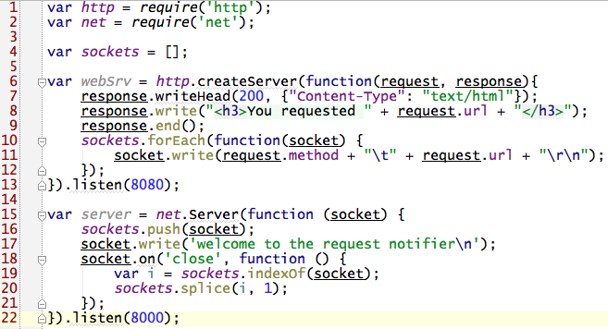
Example Module
Notes:
Module imports
Sockets array
Web server, callback for a request
Socket write call is non-blocking. Entire array will be iterated and invoked before all writing is done
telnet server

Slide 18
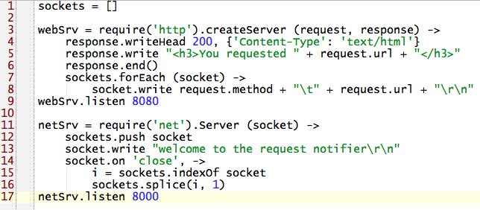
Wait – let’s see that in CoffeeScript

Slide 19
Finally, let’s look at code!

Slide 20
Tools – Package Management
NPM – node package manager
Like an apt-get for Node
Manages installation, updating, removal and more:
npm search {Search Value}
npm install {Package Name}
npm update
npm ls installed
http://search.npmjs.org/ (over 3k packages)
Notes:
Building your own module isn’t terribly difficult.
You include a package.json file in dir root

Slide 21
Tools – Node Version Management
Version management helps you safely run multiple version of node simultaneously
Lessens development headaches
Allows npm package installations per Node version
Two main options:
Nave (Virtual Environments for Node)
Uses sub-shells to run alternate versions
Ex - nave use 0.4.6
Nvm (Node Version Manager)
Must be sourced in shell
Ex – nvm install v0.4.6
Notes:
Both seem great. I use nave most since I found it first, but understand sub shell concerns other’s have

Slide 22
Tools - Debugging
Command line debugger - built into Node.
Node-inspector - attaches to node process, uses Chrome’s developer tools
Eclipse + V8 + node – debugs in Eclipse
A quick look at each…
Notes:
Command line debugger is NOT for the faint of heart, and it’s incomplete at the moment
Node-inspector and Eclipse both connect to V-8 over port 5858 (unless you specify otherwise)
I love that node-inspector is Chrome’s dev tools – it’s familiar…and heap snapshots! (go require v8-profiler NOW)
Eclipse is nice as well – feels less problematic due to the command line kung fu necessary for node-inspector
var profiler = require('v8-profiler');
profiler.startProfiling('startup');
slowStartupFoo();
profiler.stopProfiling('startup');
profiler.takeSnapshot('beforeLeak');
leakyFoo();
profiler.takeSnapshot('afterLeak');

Slide 23
Sample of Interesting Node Projects
Wheat – blog engine built in Node, uses github repository as the backing store.
Showoff.io (https://showoff.io/)
Created by Medium (Chattanooga company
Allows sharing of localhost over the web, super affordable
Socket.io – websockets/long polling/XHR multipart abstraction
express – Sinatra-style web framework
express-resource – very nice RESTful API add-on to express.
Cloud9 – browser-based IDE
Cradle – Couchbase client for Node
Notes:
Howtonode.org implemented in wheat.

Slide 24
Who’s using Node?
37Signals
Voxer
LearnBoost.com
CouchOne
Yahoo
Twitter
Yammer
Proxlet
Bocoup
Medium
LinkedIn
Notes:
Twitter is using node to compile Less to CSS
Yahoo can’t say yet
Bocoup built IRC bot for logging/stats
Proxlet’s plugin uses node as the proxy
Yammer uses node as a proxy for it’s API
Worth mentioning that MS is working with Joyent on the win port of node/libuv
LinkedIn uses node for the mobile server side stack

Slide 25
Resources
Node.js site: http://nodejs.org
Node on github: https://github.com/joyent/node/
NPM: http://npmjs.org
Nave: https://github.com/isaacs/nave
NVM: https://github.com/creationix/nvm
Node Community Blog: http://howtonode.org/
At a bare minimum, anything these guys are doing:
Tim Caswell (https://github.com/creationix)
Ryan Dahl (https://github.com/ry)
Isaac Schlueter (https://github.com/isaacs)
Matt Ranney (https://github.com/mranney)
Community Info: https://github.com/joyent/node/wiki/Community
Notes:
READ CODE READ CODE READ CODE
Tim Caswell will melt your brain in a good way

Slide 26
Slides and Code Samples for this presentation can be downloaded at:
https://github.com/ifandelse/DevLink-2011---Getting-Started-With-Nodejs

