Slide 1


Prepared for the lab seminar – 22/07/19

Slide 2
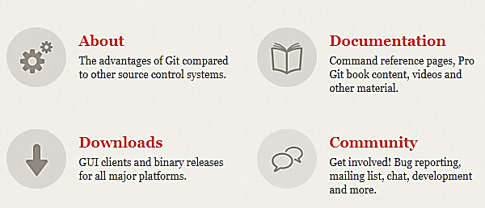
What is Git?
Version control system.
Go to: git-scm.com to download and use it as your main book! (Google is your friend)

Slide 3
Install Git
Linux (Debian-based distribution): $ sudo apt install git-all
MacOS: $ git –version
Win: git-scm.com/download/win
Let’s define ourselves first:
$ git config --global user.email “email”
$ git config --global user.name “username”
$ git init #make a git folder in our computer
$ git status #view your git status

Slide 4
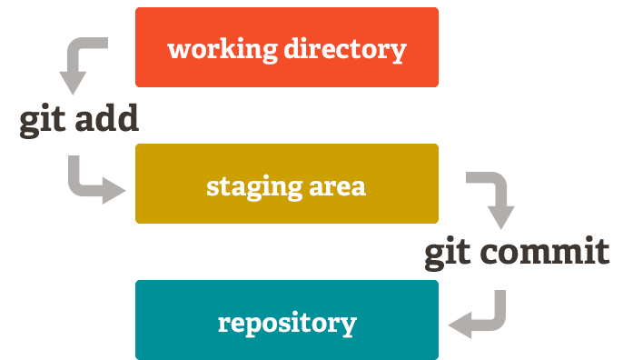
Staging area
Tracked/untracked file: $ git add/rm <filename>
Unmodified
Modified
Staged

Slide 5
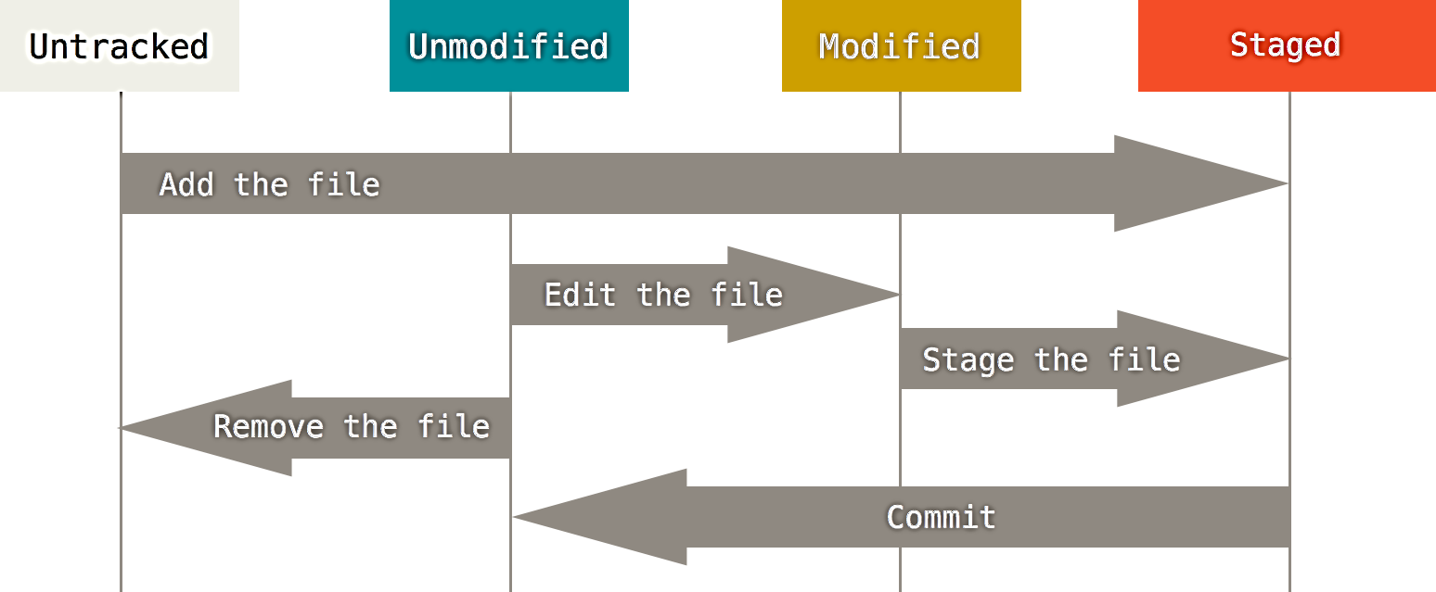
Staging area
Commit file: $ git commit –a –m ‘message’

Slide 6
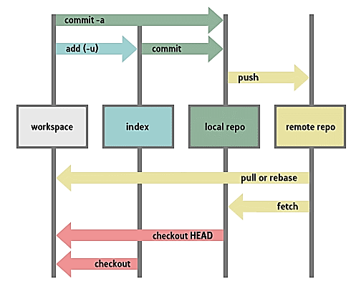

Slide 7
Repository
Repository: A directory or storage space where your projects can live. Sometimes GitHub users shorten this to “repo.” It can be local to a folder on your computer, or it can be a storage space on GitHub or another online host. You can keep code files, text files, image files… inside a repository.
Branch: How do multiple people work on a project at the same time without Git getting them confused? Usually, they “branch off” of the main project with their own versions full of changes they themselves have made. After they’re done, it’s time to “merge” that branch back with the “master,” the main directory of the project.
Commit: This is the command that gives Git its power. When you commit, you are taking a “snapshot” of your repository at that point in time, giving you a checkpoint to which you can reevaluate or restore your project to any previous state.

Slide 8
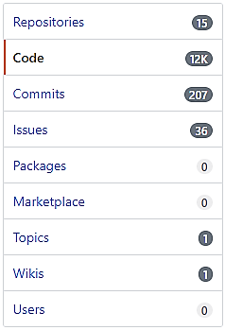
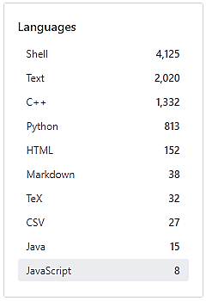
“Languages”

Slide 9
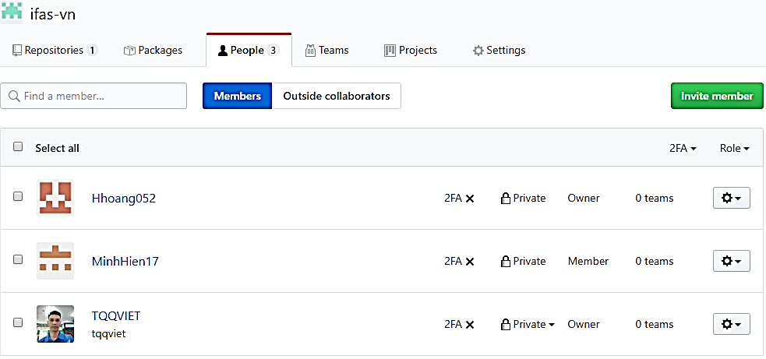
https://github.com/orgs/ifas-vn

Slide 10
Pull /Push a repository
Pull (clone) a repository from github:
$ git pull https://github.com/ifas-vn/moltemplate
$ git remote add origin https://github.com/ifas-vn/moltemplate
# I defined the link as origin.
# No need to write this link every time.
Edited files … Tracked files … Staged files …
$ git commit –am ‘something added’
$ git push origin

Slide 11

One step back
An easy way to revert last commit:
$ git revert HEAD~1..HEAD
$ git push origin

