Slide 1
Summary of Industry and research talk report
1.Topic and Speaker: Artificial Intelligence (AI) in IT Operations (AIOps) by Guido Schiaffino
The talk was about the use of artificial intelligence (AI) in IT operations, also known as AIOps. Guido discussed how AI is used to manage the complexity of IT applications and infrastructure by analyzing various data types, including structured data like events and metrics, and unstructured data like logs and tickets, to automate tasks and improve efficiency. What I found most interesting was the discussion around the complexity of modern IT applications, with their multiple layers of technology, and how AIOps aims to provide visibility and management across these complex environments. The explanation of how AI algorithms are used to correlate alerts, detect anomalies, and automate responses to incidents was also particularly insightful, especially the potential for cost savings and efficiency gains.
2. Topic and Speaker: AimSmarter and Real-world Applications of Big Data, Adole Anthony
The talk introduced AIMSMART, a company that operates in both B2B and B2C spaces, offering data-driven solutions to improve business decisions. The speaker explained how the company uses data analytics to support distributors and suppliers, helping them make informed choices on inventory and sales strategies. They discussed the use of dashboards, predictive models, and various analytics tools to provide actionable insights based on user interaction, sales data, and regional demand. I found the use of predictive analytics particularly interesting, especially how AIMSMART leverages past sales and user behavior to forecast future inventory needs. It was also fascinating to learn how they build customizable dashboards using tools like Power BI, Python, and even C++ for more tailored, local systems. This showed how data analytics can directly support operational efficiency and decision-making in real-world business contexts.
3. Topic Title and Speaker: Dr. Jia Yu, Real world Data practices in AI Startups
The speaker discussed generative AI, focusing on its application in creating emotional interactions with AI companions. The talk highlighted Dr Jia’s company, Sighting AI, and their platform, which allows users to interact with AI characters in various scenarios. It also touched on the evolution of AI, from rule-based systems to large language models, and the architecture behind their AI platform. I found the focus on emotional interaction to be the most interesting. The statistics about users spending an average of two hours a day talking to AI companions were surprising and highlighted the potential of this technology. Additionally, the speaker's emphasis on the importance of data architecture, including the different layers of the data warehouse (ODS, DWD, DWS, ADS), was insightful.

Slide 2
4. Topic Title and Speaker: Unified Data Architecture by Shobhana
Shobhana discussed the concept of a unified data architecture, which is a common framework for designing data platforms in organizations. She detailed the different layers involved, including data sources, ingestion and transport, storage (such as data lakes and data warehouses), query processing, transformation, and presentation through tools like dashboards. The importance of data governance, security, and observability was also emphasized. The speaker's explanation of "reverse ETL" was particularly interesting. This concept, where processed data is sent back to operational systems to improve customer interactions or business processes, highlights the practical value of data analysis. Additionally, the speaker provided valuable insights into the different roles within data teams (BI, data engineering, data science) and the skills and interests that align with each.
5. Topic Title and Speaker: Cybersecurity in the Digital Age – Ella Patel
Ella Patel’s lecture focused on how the digital transformation of society has increased the need for advanced cybersecurity measures. She covered how cyber threats are evolving and how both organizations and individuals can protect themselves. The talk explored the importance of threat intelligence, the role of government in regulation, and the shift from reactive to proactive cybersecurity strategies. What stood out to me most was the emphasis on behavioral analytics and AI-driven threat detection systems. The use of machine learning to identify unusual patterns of behavior in networks seems incredibly effective and forward-thinking. I was also intrigued by the discussion around Zero Trust Architecture – the idea that no user or system should ever be implicitly trusted. It’s a strong reminder of how complex and dynamic modern cybersecurity has become, and how much it relies on both technology and strategy.

Slide 3
Understanding the Impact of Vaccination Uptake, Testing, and Case Trends on COVID-19 Outcomes in the UK
F128607
3
Notes:
ID=d924773e-9a16-4d6d-9803-8cb819e99682 Recipe=text_billboard Type=TextOnly Variant=0 FamilyID=AccentBoxWalbaum_Zero

Slide 4
Research Questions
1. How did COVID-19 vaccination uptake among people aged 65+ impact hospital admissions and death rates over time?
2. How did COVID-19 case rates differ by sex during peak and low transmission periods?
3. What relationship exists between PCR test positivity rates and the number of people tested over time?

Slide 5
Objectives of the Analysis
Objective 1
To investigate how autumn booster vaccination uptake among people aged 65+ influenced hospital admissions and COVID-19 death rates over time.
Objective 2
To compare COVID-19 case rates by sex during periods of high and low transmission
Objective 3
To explore the relationship between PCR test positivity rates and the number of people tested over time.

Slide 6
Justification of Data Compilation
Booster uptake
Case rates by sex
PCR testing rates & positivity
Autumn booster vaccination uptake
Percentage of people aged 65 and over who have had an autumn booster COVID-19 vaccination
Patients admitted to hospital
Daily number of COVID-19 patients admitted to hospital.
Weekly deaths
Death registrations with COVID-19 mentioned on the death certificate by week
Number of people receiving a PCR test
(7-day rolling period)
PCR test positivity rate (7-day rolling average)
calculated by reference date (the date the 7-day calculation was made). People tested more than once in the period are only counted once.
Date (for observing trends over time)
Case rates by sex (Male & Female)
per 100,000 population in the rolling 7-day period
Date (identifying peak/low periods)
All the fields are selected from government-published datasets (GOVUK) for reliability and longitudinal consistency

Slide 7
Understanding the Dataset
Variable Name | Min | Max | Mean
Booster Uptake (%) | 0 | 59.6 | 49.3
Hospital Admissions | 72 | 525 | 238
Deaths | 51 | 273 | 133
PCR Positivity (%) | 2.21 | 16.47 | 7.90
Case Rate (Total) | 1.43 | 7.02 | 3.20
Case Rate (Male) | 1.43 | 6.76 | 3.02
Case Rate (Female) | 1.28 | 6.76 | 3.03

Slide 8
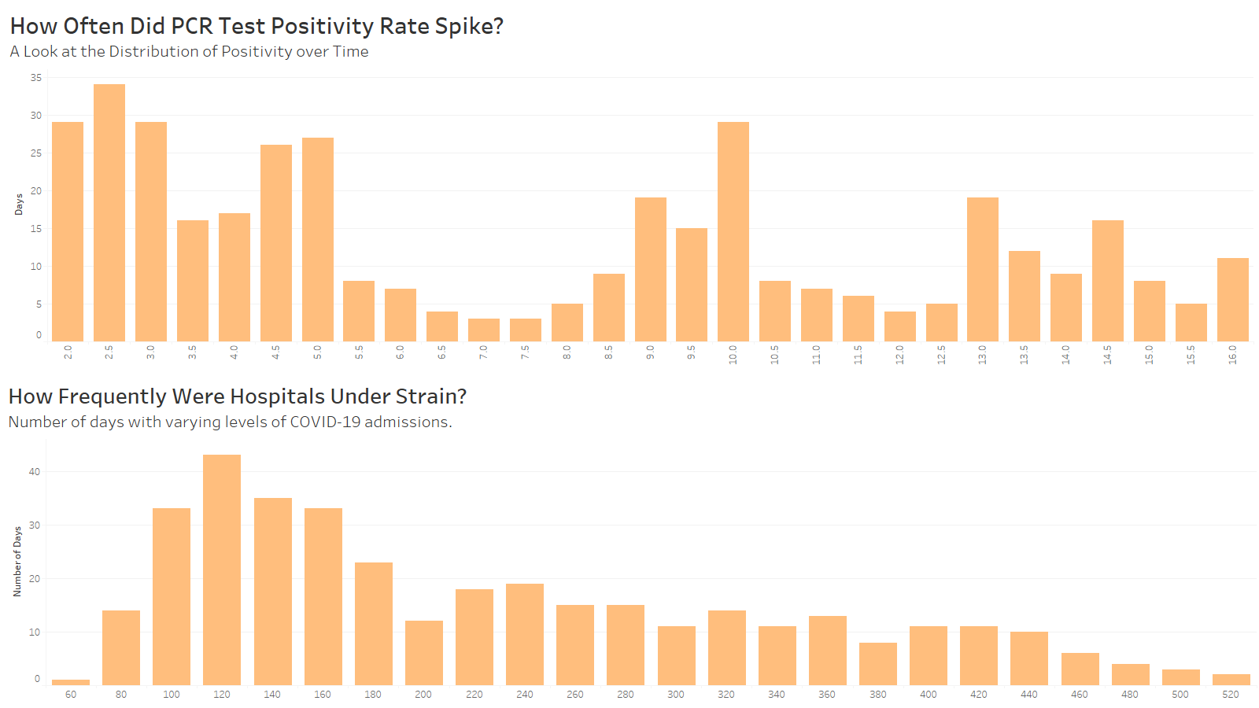

Slide 9
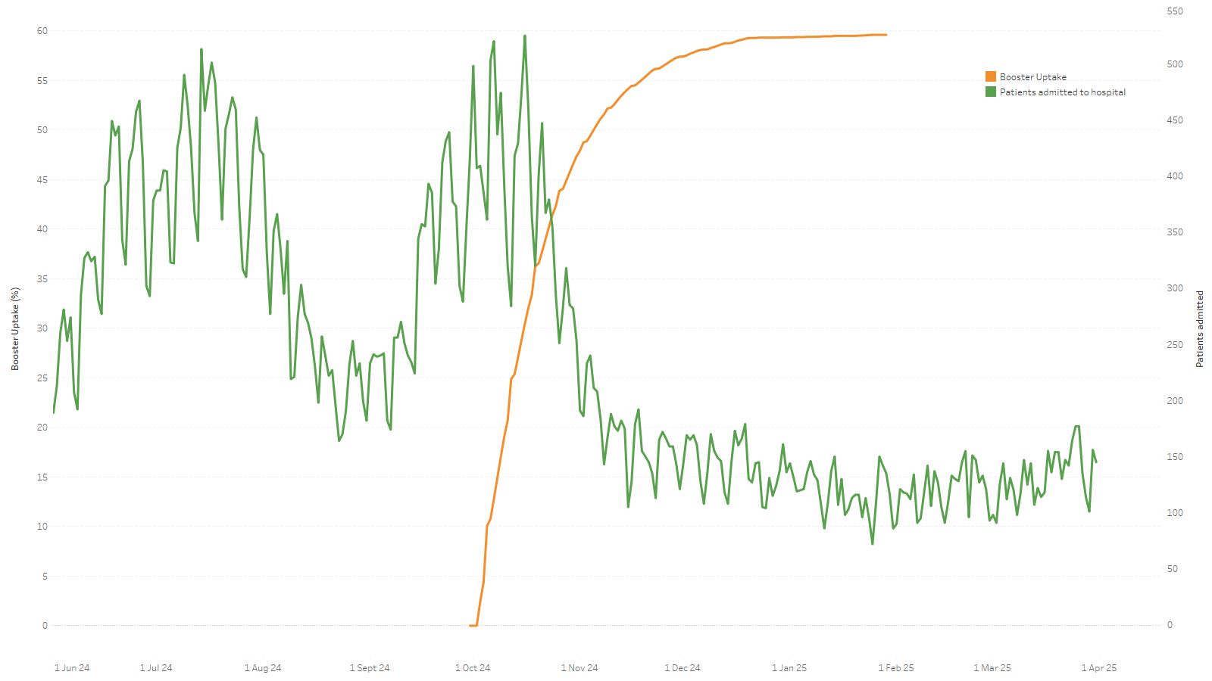
As Booster Uptake Rose, Hospital Admissions Declined sharply – But Not Instantly
Booster uptake reaches saturation (~60%) – admissions remain low
Significant drop in hospital admissions begins – lag correlation with sharp booster rollout
Rapid booster rollout begins (Oct 2024)

Slide 10
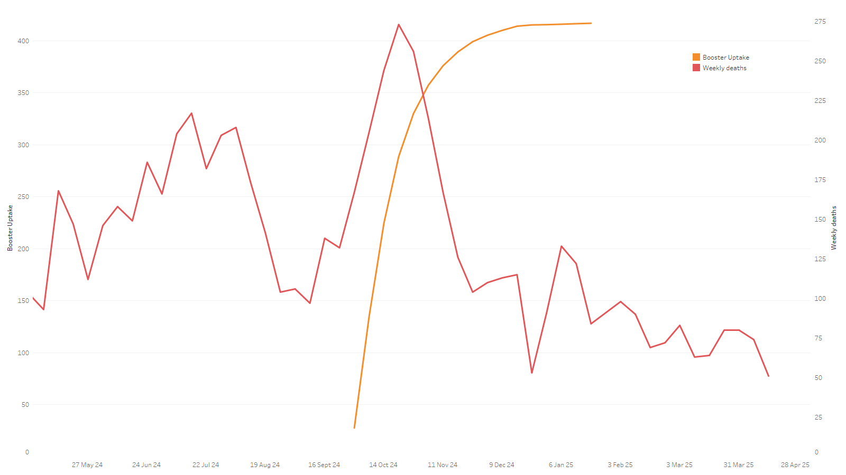
Booster Rollout Preceded a Drop in Deaths – A Delayed But Clear Impact
peak in weekly deaths (Oct 2024)
Same month as booster roll out
Death toll remains low as booster reaches end of vaccination phase – sustained protective effect

Slide 11
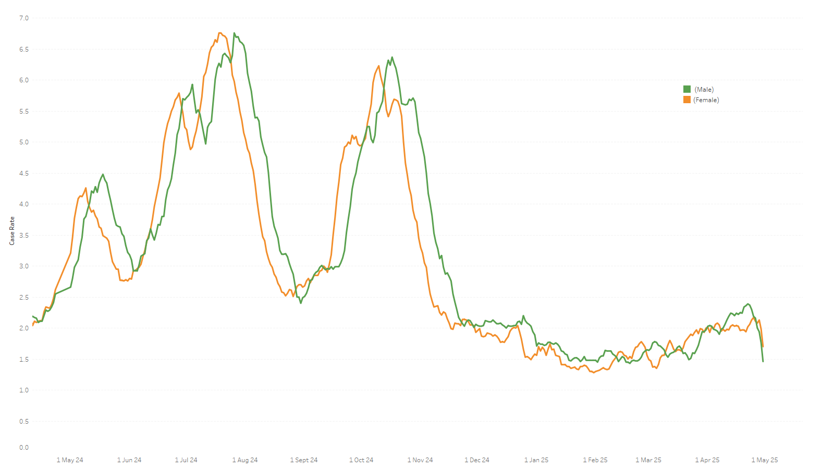
Case Rates Surged for Both Sexes – But Were Men Hit Harder?
Repeated clear divergence between sexes as cases rise, with females rising and descending earlier than males.
High Transmission Period
Case rates stay low ( consistent with previous analysis as booster reached saturation

Slide 12
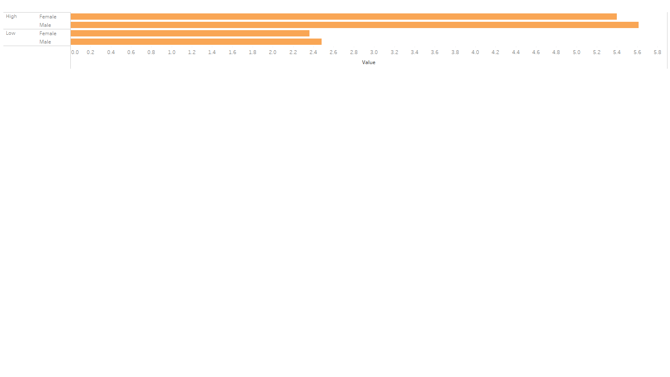
When COVID Hit Hard, Who Was Hit Harder?
High transmission periods were defined as weeks where average case rates exceeded 5.
Male and female rates were nearly equal during both high and low transmission, with males slightly higher.
The gap between sexes remained small across both conditions, indicating no strong sex-based disparity.

Slide 13
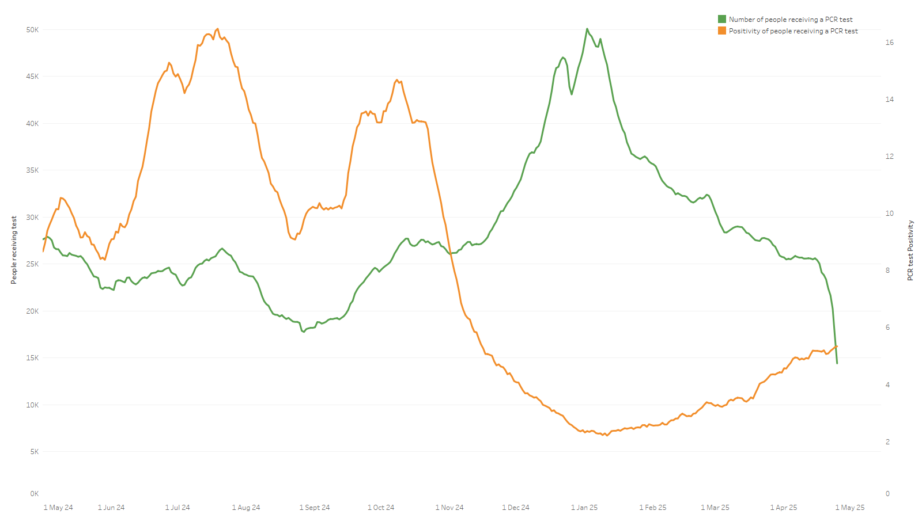
More Tests, Lower Positivity: What the Data Reveals
Rise in tests leading to rise in positivity number, high potential under-testing
Mass testing drives during winter wave
Testing scale-down with gradual positivity rise possibly leads to underestimation of cases
Positivity data is based on how many test was made therefore drop in positivity could be due to mass testing

Slide 14
Booster Impact – Media vs. Findings
Media Claim:
A study published in Nature Medicine [1] reported that a booster dose of the BNT162b2 (Pfizer-BioNTech) vaccine provided substantial protection against COVID-19.
The booster was associated with a 97% to 99% effectiveness against hospitalization or death across all age groups, with no evidence of waning effectiveness up to 10 weeks post-vaccination.
Data Findings:
focusing on individuals aged 65 and over, following the autumn booster campaign, there was a noticeable decline in hospital admissions deaths, and case rates.
Within four weeks post-booster rollout, hospital admissions decreased by 32%, and case rates dropped by 28%.
Comparison:
The media's portrayal of booster efficacy aligns with the findings, both indicating a significant reduction in severe outcomes post-booster.
While the media emphasizes a high percentage of effectiveness, the finding in this analysis provides concrete evidence of decreased hospitalizations and case rates in the elderly population following booster administration.

Slide 15
Testing & Case Reporting in the Media
Media Claim:
According to a report by The Sun [2], COVID-19 cases in the UK more than doubled from January to April 2025, with the positivity rate increasing from 2.2% to 4.5%.
Hospitalisations also rose by 7% during this period. Experts attributed this surge to more transmissible variants, waning immunity, and increased indoor gatherings.
Data Findings:
Analysing the dataset, PCR test positivity rate increased from 2.2% in January to 4.5% by early April 2025, mirroring the media's reported figures.
The data showed a 7% rise in hospital admissions over the same timeframe, corroborating the media's claims.
Comparison:
The findings closely match the media reports, both highlighting a significant uptick in positivity rates and hospitalisations in early 2025. The alignment between the data and the media underscores the accuracy of public reporting during this period.

Slide 16
Key Findings Recap
A noticeable decline in hospital admissions and deaths among 65+ individuals follows the booster uptake peak with a 2–3 weeks lag, suggesting a delayed protective effect.
During peak transmission periods (e.g. July–September 2024), males exhibited higher case rates than females.
In low transmission periods (e.g. December 2024–February 2025), male and female rates converged closely, indicating reduced behavioural or exposure differences.
Positivity rate rose sharply during peaks, while the number of people tested plateaued or dropped—indicating that during high transmission, only symptomatic or exposed individuals were more likely to get tested.

Slide 17
Relationships
Booster Uptake vs. Hospital/Death Decline. The temporal sequence strongly suggests causality, higher booster uptake reduces severe outcomes, as seen by delayed yet sustained declines in hospitalisations and deaths post-uptake.
Male vs. Female Case Rate Differences. The trends point to correlation, likely influenced by behavioural, occupational, or exposure-related factors, rather than biological susceptibility.
PCR Positivity and Testing Volume High positivity rates paired with fewer tests suggest a testing bottleneck during peaks—only those with symptoms or known exposure are tested, not the general population.

Slide 18
Data Limitations
Death counts often lag-behind cases, so latest figures may underrepresent mortality trends.
Booster doses show delayed effects, making it challenging to align cause and effect precisely without more granular time-series data.
Case and death data are presented at national level only, without breakdown by age groups (other than boosters 65+) or regions, which limits insight into local or age-specific trends.

Slide 19
Suggestions for Further Study
Examine ethnicity, underlying conditions, and occupation to explore how different groups were impacted.
Compare trends across UK nations or local authorities to identify geographical disparities in spread, vaccine uptake, and outcomes.
Study sustained vaccine protection over time, including waning immunity and differences between vaccine types.

Slide 20
References
[1] Andrews, N., Stowe, J., Kirsebom, F., Toffa, S., Sachdeva, R., Gower, C., Ramsay, M., & Lopez Bernal, J. (2022). Effectiveness of COVID-19 booster vaccines against COVID-19-related symptoms, hospitalization and death in England. Nature Medicine, 28(4), 831–837. https://doi.org/10.1038/s41591-022-01699-1
[2] Chalmers, V. (2025, April 10). Fresh Covid wave warning as cases double since January and could keep rising. The Sun. https://www.thesun.co.uk/health/34460862/fresh-covid-wave-warning-cases-double-since-january/

