Slide 1
Medical Insurance Cost Prediction Using Machine Learning
Internship Project Presentation
Made By: INAYAT FATEMA JAFRI

Slide 2
Introduction
Health insurance cost prediction is important for insurance companies.
Manual estimation is often inaccurate and time-consuming.
Machine Learning helps in predicting costs based on historical data.
This project builds a predictive model using Linear Regression.

Slide 3
Problem Statement
Insurance companies need accurate cost estimation.
Traditional methods are not efficient.
Need an automated system to predict medical charges.
Goal: Predict insurance cost based on customer details.

Slide 4
Objectives
Analyze the medical insurance dataset.
Perform data preprocessing and cleaning.
Build a Linear Regression model.
Evaluate model performance.
Predict future insurance charges.

Slide 5
Dataset Description
Dataset Name: insurance.csv
Total Records: 1338
Total Features: 7
Features: age, sex, bmi, children, smoker, region, charges

Slide 6
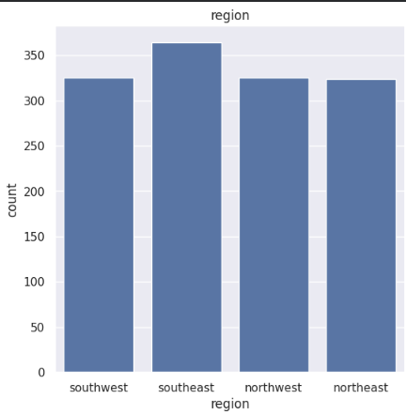
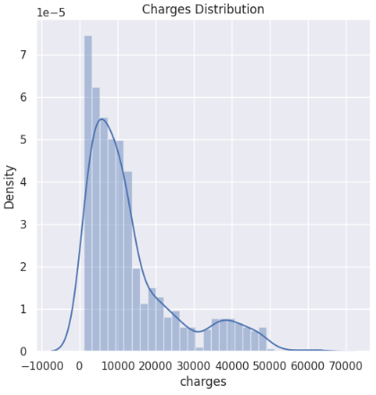
Exploratory Data Analysis (EDA)
Checked dataset shape and structure.
Used info() and describe() for summary.
Verified missing values (none found).
Visualized relationships using plots.
Observed that smokers have higher charges.

Slide 7
Data Preprocessing
Converted categorical data into numerical form.
Encoded sex, smoker, and region.
Selected features and target variable.
Split data into training and testing sets.

Slide 8
Model Used: Linear Regression
Suitable for continuous value prediction.
Simple and easy to interpret.
Fast training time.
Works well as a baseline model.

Slide 9
Model Training
Imported Linear Regression from sklearn.
Trained model on training dataset.
Generated predictions on test dataset.
Compared predicted vs actual values.

Slide 10
Model Evaluation
Evaluation metric used: R² Score.
Measures how well model fits the data.
Value ranges from 0 to 1.
Higher value indicates better performance.

Slide 11
Results & Findings
Model successfully predicts insurance charges.
Smoker feature highly impacts cost.
BMI and age are important factors.
Linear Regression gives reasonable accuracy.

Slide 12
Conclusion
Machine learning model developed successfully.
Linear Regression performed well.
Prediction process automated.
Useful for real-world insurance estimation.

Slide 13
Future Scope
Use advanced models like Random Forest or XGBoost.
Improve accuracy with feature engineering.
Deploy as web application.
Use larger real-time datasets.

Slide 14
Thank You
Thank you for your attention.

