Slide 1
A Comparative Study on Handwritten Digit Recognizer using Machine Learning Technique
CSE 713 :: ADVANCED SYNTACTIC PATTERN RECOGNITION
Submitted By- Group No: 21
22366046 MD. NAFIS RABBI
22273006 MD. RASHIK SAIF
17101111 IFAZ AHMED
Submitted To-
Annajiat Alim Rasel
Senior Lecturer
Department of Computer Science and Engineering
BRAC University
Dhaka, Bangladesh

Slide 2
Introduction
Digit Recognition Problem
Applications: Processing bank check, Online form data input by users using digital device.
The variation in handwriting among people makes it difficult to train the computers to recognize handwritten digits.
In the paper researchers using machine learning techniques to address the digit recognition problem.

Slide 3
Proposed Work
The work focuses on utilizing a tool that would embrace multiple types of classification models with diverse performance metrics to analyze various classification techniques and finding the best technique for digit recognition.
In order to accurately recognize digits from handwritten images algorithms like: Multiclass decision forest, Multiclass decision jungle, Multiclass Neural Network and Multiclass Logistic Regression.
The researchers then tried to identify the model with the best level of accuracy.
Confusion Matrix was used to evaluate the models. To evaluate the performance of the model, accuracy, precision, and recall were determined.

Slide 4
Dataset Description
Dataset: The dataset is considered from MNIST. It contains digit from zero to nine.
Each image is of size 28*28 pixels. Each pixel value indicates the lightness or darkness.
Total 785 columns.
Total number of rows is 4,200.
Dataset is divide into two part: 60% for training and 40% for testing.

Slide 5
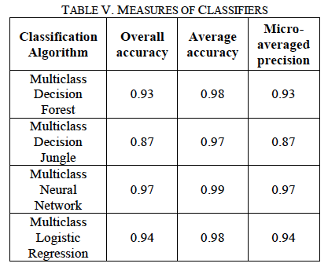


Experiment & Result

Slide 6
Conclusion
Multiclass neural network gives best results.
It can be used by Researchers to conduct experiments.
Can add classification models to webservice.
This methodology will be useful in a variety of security situations when obtaining several samples is difficult.
In future it can be used in real world scenarios.

