Slide 1
Poverty Rate Imputation for India 2017/18
- Ifeanyi Edochie

Slide 2
General Aims
Goal: Estimate 2017/18 poverty rates for India building off previous work (Newhouse & Vyas, 2019 i.e. NV19) using Social Consumption Surveys (SCS) 2017/18
Process Map
Notes:
Mention that appendix with full regression outputs as well as more specific simulation results

Slide 3

The Imputation Process in-brief
$$Stage 1 :\ln\left(y_{hct}\right)=X`β+𝓊_{hct}$$
$$𝓊_{hct}=n_{c}+ε_{ch}$$
$Stage 2 :\ln\left({\hat{y}}_{hct}\right)=X`\hat{β}+{\hat{n}}_{c}+{\hat{ε}}_{ch}$ (for SAE)

Slide 4
Model 0 vs Model 1
Variables:
Age* (0-14, 15-24, 25-34, 35-49, 50+)
household size* (1,2 .. ,6)
Industry of work* (agriculture, manufacturing & services)
Labor type* (self employed, regular wage, casual labor)
Occupational skill level* (high vs middle vs low)
Religion* (Hindu vs other religions)
Rainfall shocks (difference between monthly mean vs historical mean – since 1981)
Social caste (scheduled caste vs others)
Expenditure variables* (transportation, recreation services, miscellaneous services)
Notes:
* Representing dummy variables from which a district level mean variable is created as well as is time interacted as well.

Slide 5
Model 0 vs Model 1 (continued)
Variable Blocks | In Model 0? | In Model 1?
Age* | Y | Y
Household size* | Y | Y
Industry of work* | Y | Y
Labor Type* | Y | Y
Occupational Skill Level* | Y | Y
Religion* | Y | Y
Rainfall Shocks | Y | Y
Rainfall Shocks (squared) | Y | Y
Social Caste | Y | Y
Expenditures | Y | N
Notes:
* Representing dummy variables from which a district level mean variable is created as well as is time interacted as well.

Slide 6
Imputation Results : Model 0 vs Model 1
Poverty Line (per day) | Sector | Model 0 [95% CI] | Model 1 [95% CI]
$1.90 | Rural | 16.79% [15.28% - 18.31%] | 19.93% [17.87% - 22.00%]
$1.90 | Urban | 10.02% [8.54% - 11.49%] | 9.83% [7.89% - 11.76%]
$3.20 | Rural | 60.38% [58.59% - 62.17%] | 63.74% [62.40% - 65.08%]
$3.20 | Urban | 39.06% [36.46% - 41.66%] | 36.05% [33.53% - 39.47%]
$5.50 | Rural | 90.88% [89.94% - 91.82%] | 92.67% [91.34% - 93.99%]
$5.50 | Urban | 74.97% [72.69% - 77.25%] | 70.88% [68.89% - 72.89%]

Slide 7
Imputing Poverty Rates into 2017/18
4 approaches were considered:
Using the variables in Model 1 to impute into SCS Health 2017/18 (Model 2)
Using the variables in Model 2 without interaction terms (Model 3)
Model with ALL variables common to SCS and NSS surveys (Model 4)
Model with variable selection (stepwise regression) – (Model 5a)
Model with variable selection (stepwise regression) allowing non-normality of cluster specific - (Model 5b)

Slide 8
Model Variables
Variables block | Model 2 | Model 3 | Model 4 | Model 5a | Model 5b
Age* | Y | Y | Y | Y | Y
Household size* | Y | Y | Y | Y | Y
Industry of work* | Y | Y | Y | Y | Y
Labor Type* | Y | Y | Y | Y | Y
Occupational Skill Level* | Y | Y | Y | Y | Y
Religion* | Y | Y | Y | N (selection) | N (selection)
Rainfall Shocks | Y | Y | Y | Y | Y
Rainfall Shocks (squared) | Y | Y | Y | N (selection) | N (selection)
Social Caste | Y | Y | Y | Y | Y
Expenditures | N | N | N | N | N
District Level Means (with above variables) | Y | Y | Y | Y | Y
Time interaction (with above variables) | Y | Y | N | N (selection) | N (selection)
Age of Household head (new additions) | N | N | Y | Y | Y
Marital Status of Household head (new additions) | N | N | Y | N (selection) | N (selection)
Educational Attainment of Household Head (new additions) | N | N | Y | Y | Y
Primary energy source for cooking (new additions) | N | N | Y | Y | Y
Notes:
GREEN FOR VARIABLES IN THE MODEL. RED FOR VARIABLES NOT IN THE MODEL
Remember: Some variables are dropped due to multi-collinearity before even the first stage of the analysis is completed! We don’t include the specific variables

Slide 9
Table of Model Results
FGT-0 | Sector | Model 2 | Model 3 | Model 4 | Model 5a | Model 5b
$1.90 | Rural | 1.15% | 12.34% | 5.51% | 8.93% | 7.09%
$1.90 | Urban | 2.61% | 7.30% | 2.31% | 3.51% | 3.64%
$3.20 | Rural | 15.34% | 51.85% | 22.82% | 32.71% | 28.77%
$3.20 | Urban | 16.21% | 29.96% | 11.61% | 16.90% | 16.29%
$5.50 | Rural | 60.73% | 87.62% | 53.58% | 65.26% | 61.63%
$5.50 | Urban | 47.24% | 64.29% | 34.67% | 44.31% | 43.52%
Notes:
Full tables in the Appendix B

Slide 10
Implied Elasticity Estimation
We compute the elasticity of poverty with respect to real GDP per capita (2011 USD PPP)
Model | Overall Poverty (2017/18) | Implied Elasticity
Model 2 | 0.083855 | -3.20729
Model 3 | 0.108784 | -5.35568
Model 4 | 0.04582 | -1.98959
Model 5a | 0.073582 | -2.75231
Model 5b | 0.060895 | -2.34201
Notes:
World Poverty clock estimates overall poverty in India for 2018 at 5.3%

Slide 11
Summary (Updated)
In modelling predicting poverty 2014/15, Rural poverty model is not stable to changes in the set of independent variables. Poverty rates changes by ~2.6% without transportation variables. Urban model only changes ~0.2%.
Dropping the time interactions variables as well therefore makes the poverty picture more realistic (~12.3% in rural and ~7.3% in urban in 2017/18).
Adding all the new variables without any model selection appears to really reduce poverty rates (~5.5% in the rural and ~2.3% in the urban model)
Adding all the new variables with model selection to create a more realistic picture of poverty (~7.1% in the rural areas and about ~3.6 in the urban model)
We compute implied elasticities which seem to show that Model 4 appears to provide a value closest to those in David and Pallavi’s original paper (-2.11).

Slide 12
Appendix A: Stage 1 Model Results

Slide 13
Results Structure
Each imputation exercise contains 5 sets of results.
First stage preliminary OLS model estimates
First stage alpha model estimates
First stage GLS model estimation (imputation model)
First stage post-estimation specification summary
Imputation Results

Slide 14
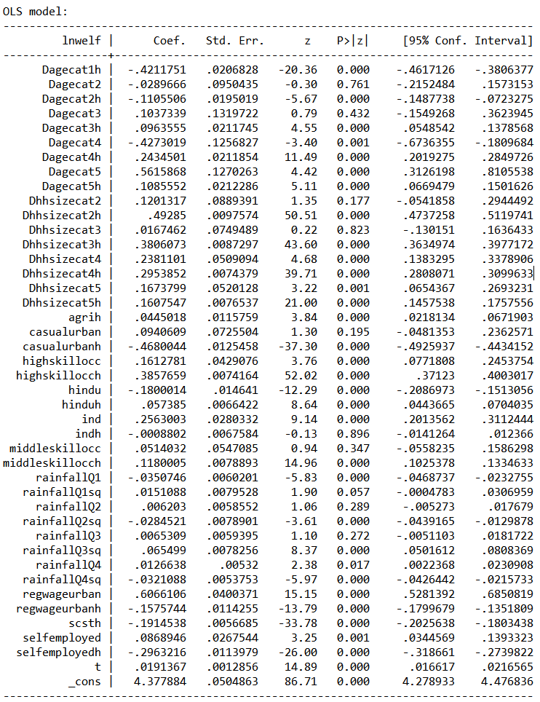
Model 3: Preliminary OLS Estimates (Urban Model)

Slide 15
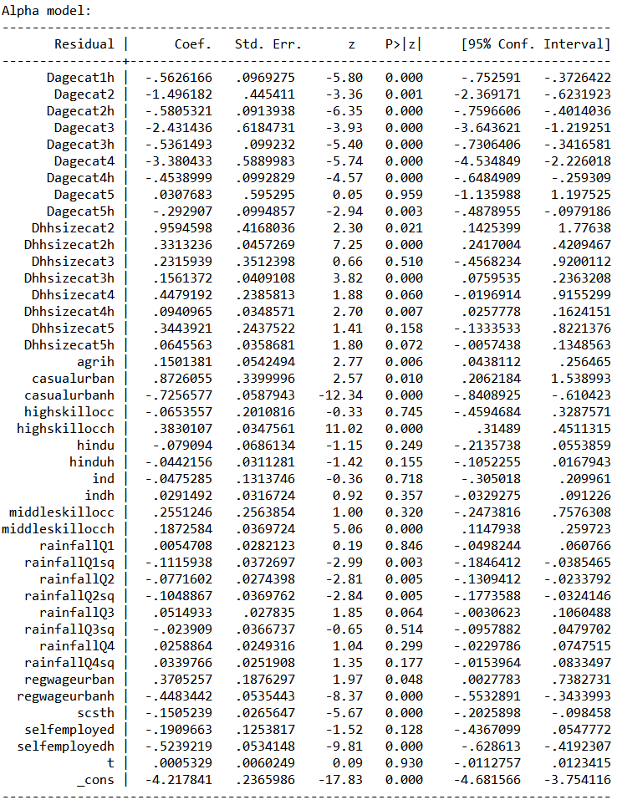
Model 3: Alpha Model Estimates (Urban Model)

Slide 16
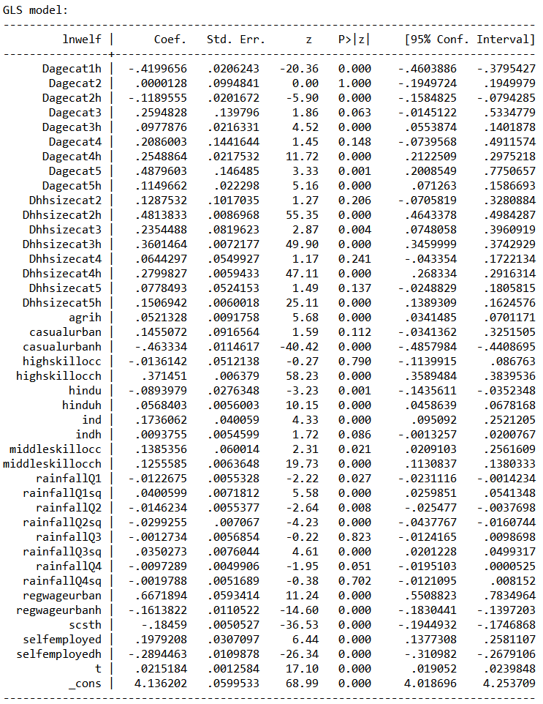
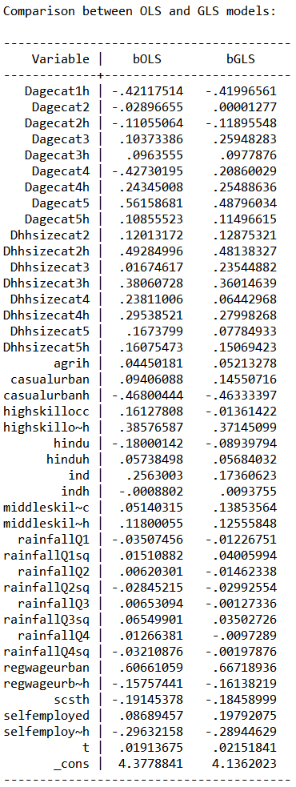
Model 3: GLS Model Estimates and GLS-OLS comparison (Urban Model)

Slide 17
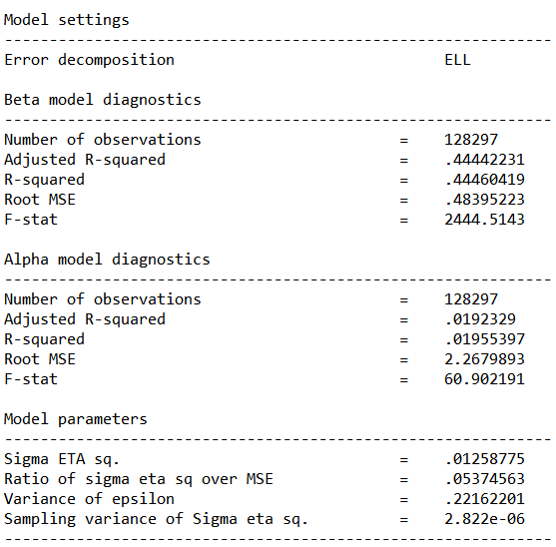
Model 3: Post-Estimation Model specification results (Urban Model)

Slide 18
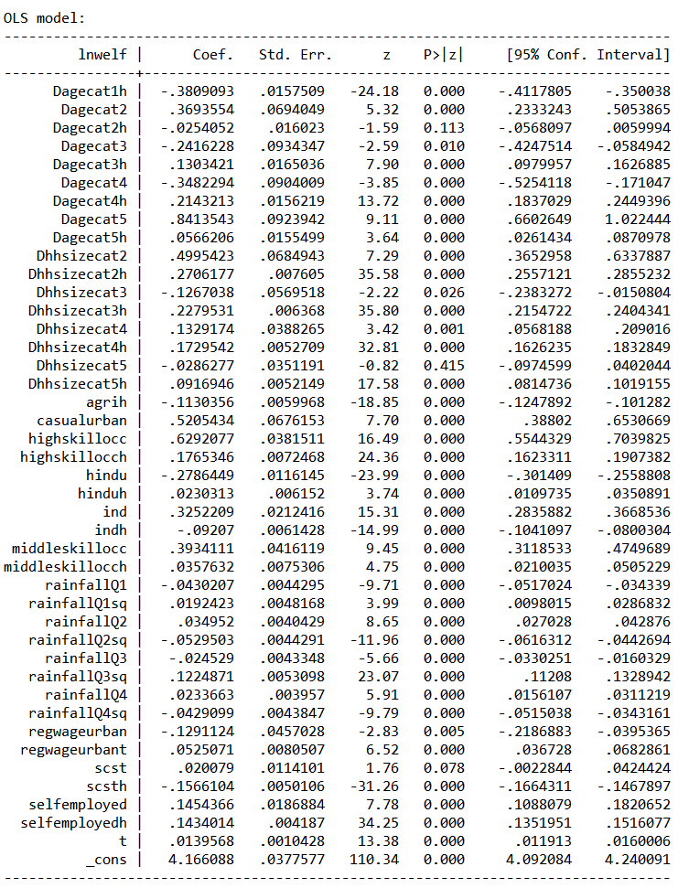
Model 3: Preliminary OLS Estimates (Rural Model)

Slide 19
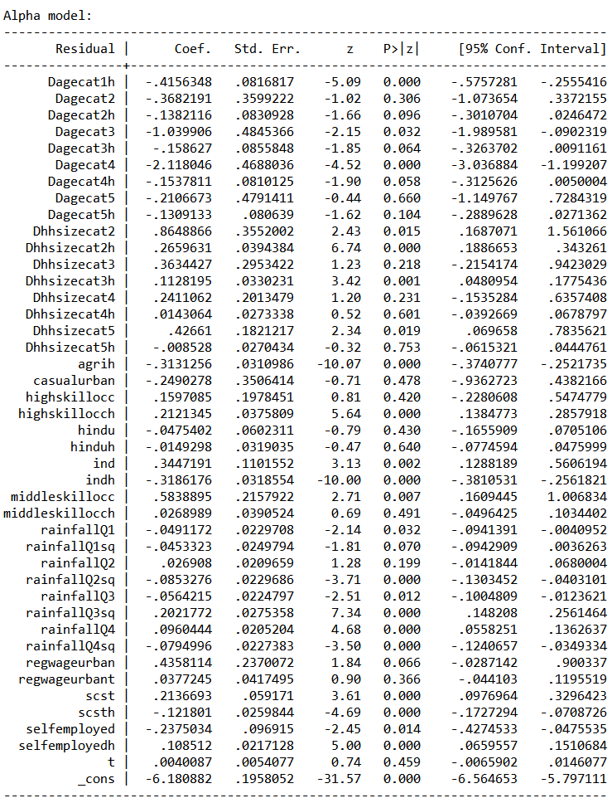
Model 3: Alpha Model Estimates (Rural Model)

Slide 20
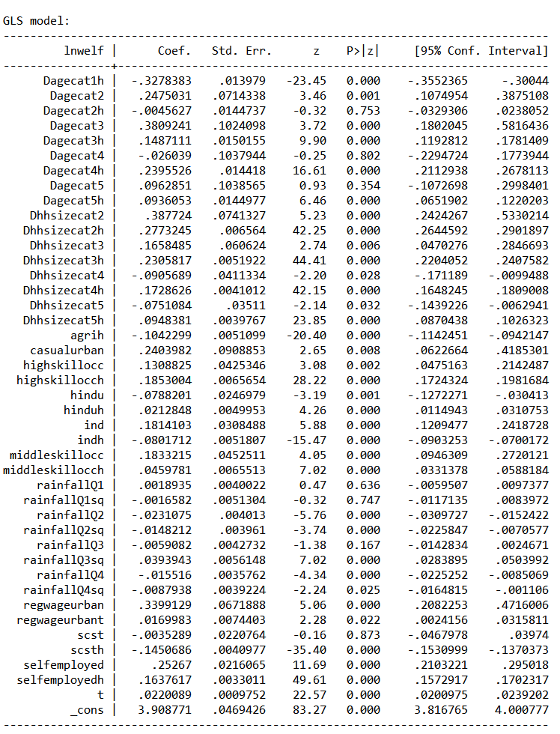
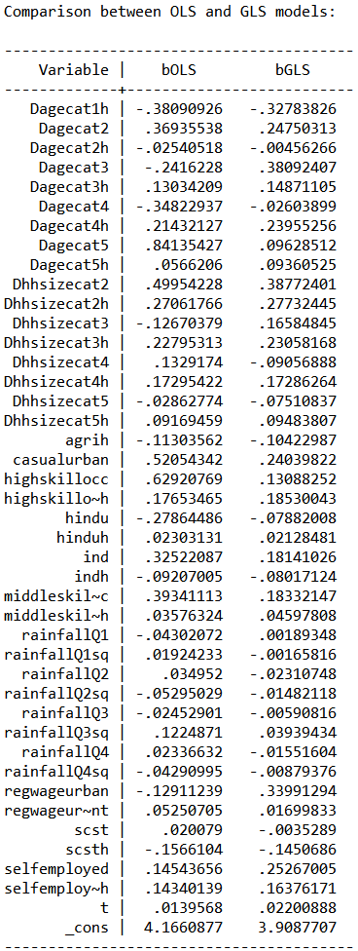
Model 3: GLS Model Estimates and GLS-OLS comparison (Rural Model)

Slide 21

Model 3: Post-Estimation Model specification results (Rural Model)

Slide 22
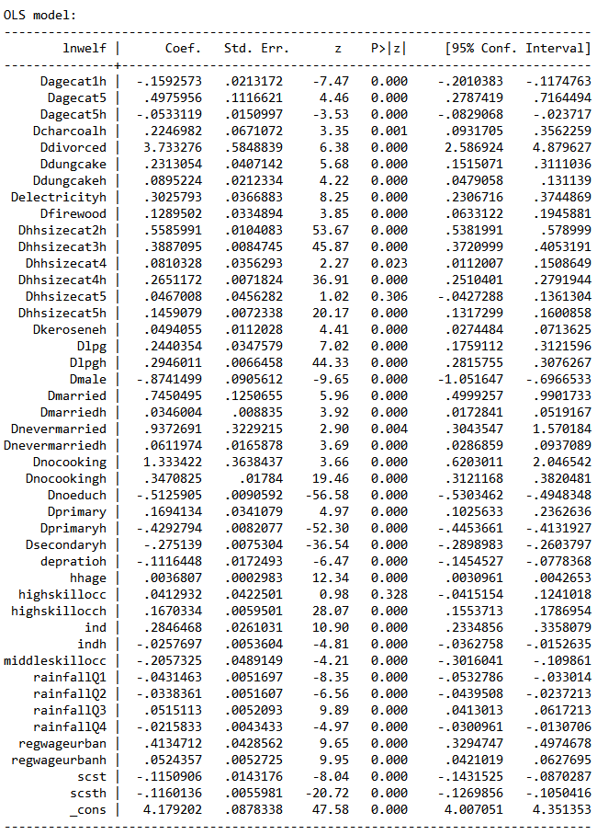
Model 5a: Preliminary OLS Estimates (Urban Model)

Slide 23
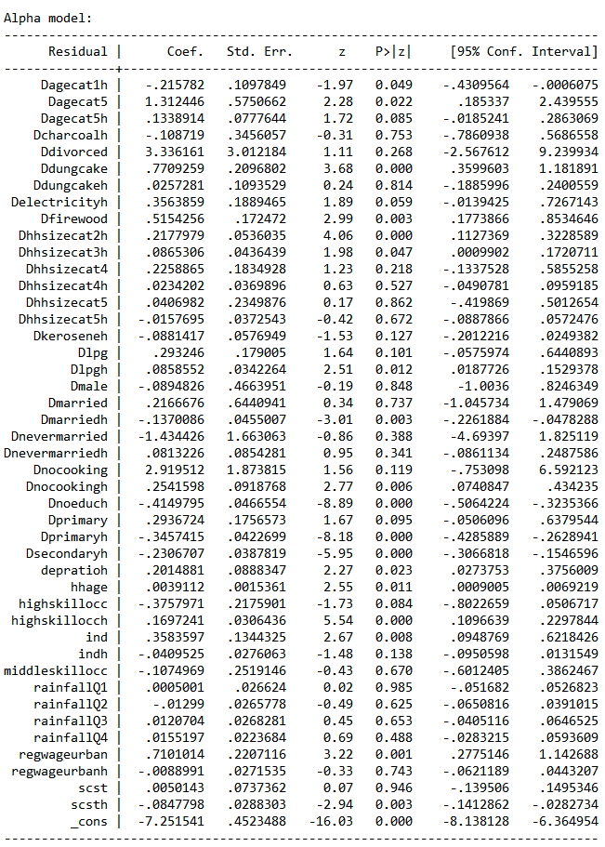
Model 5a: Alpha Model Estimates (Urban Model)

Slide 24
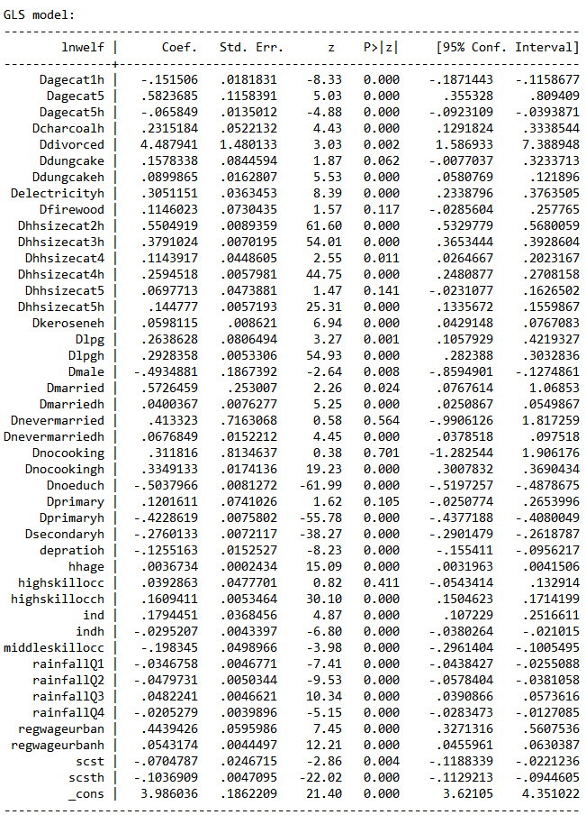
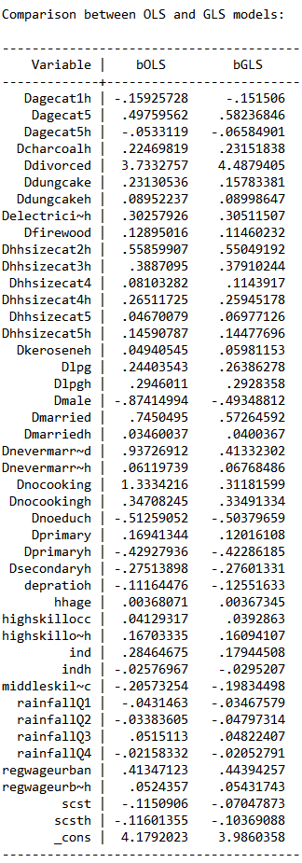
Model 5a: GLS Model Estimates and GLS-OLS comparison (Urban Model)

Slide 25
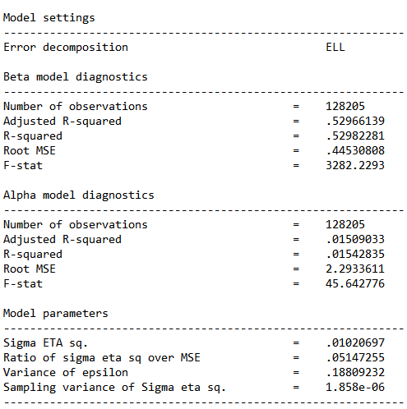
Model 5a: Post-Estimation Model specification results (Urban Model)

Slide 26
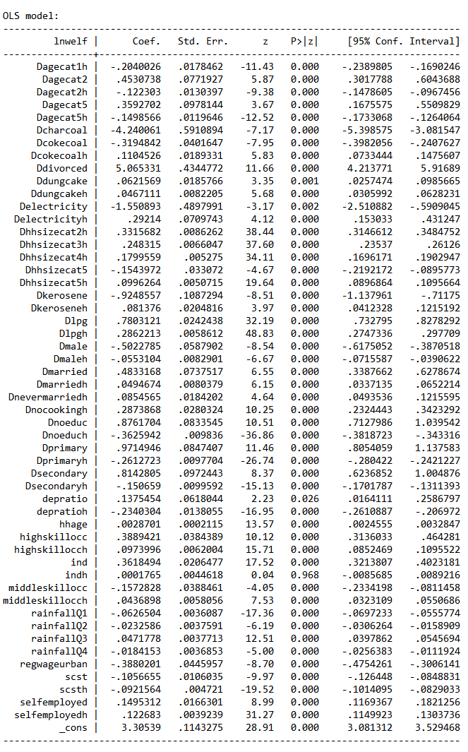
Model 5a: Preliminary OLS Estimates (Rural Model)

Slide 27
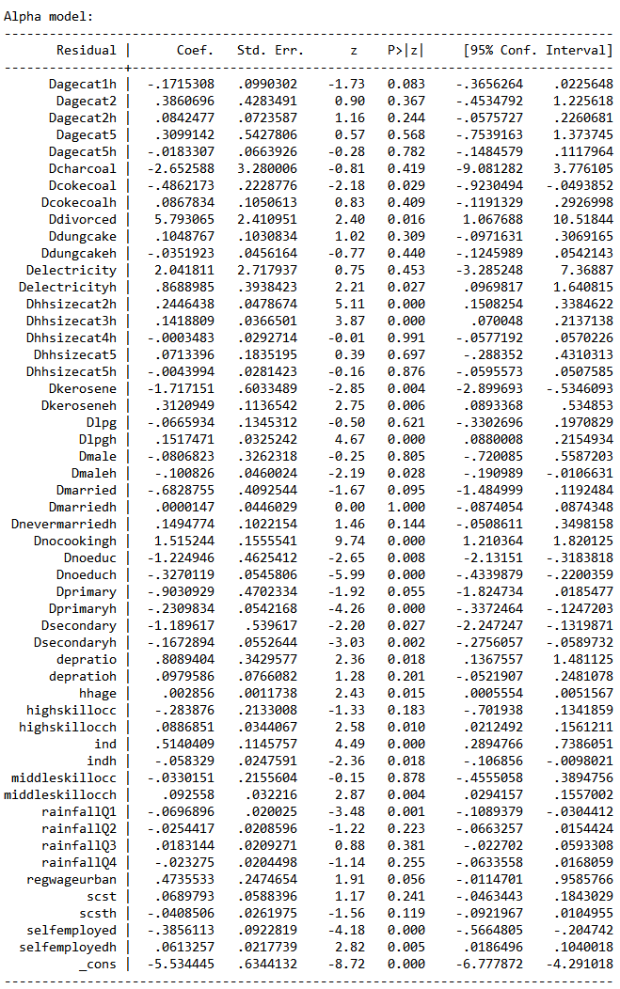
Model 5a: Alpha Model Estimates (Rural Model)

Slide 28
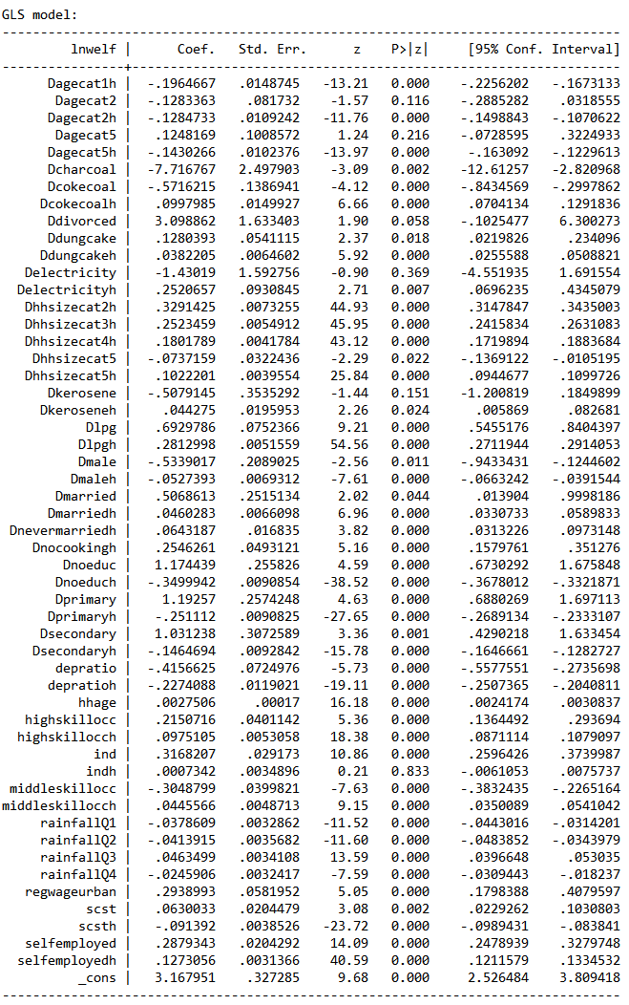
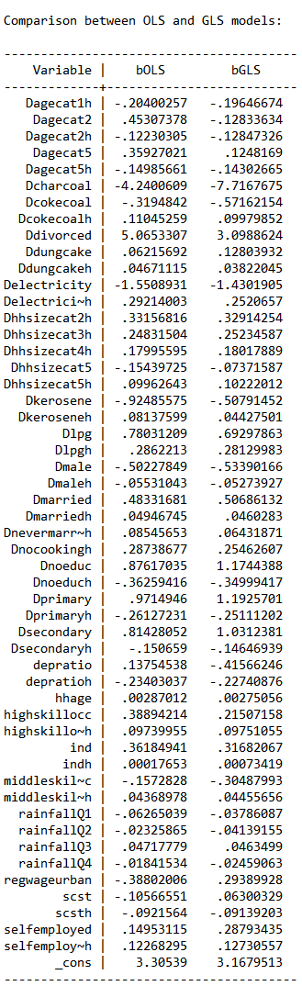
Model 5a: GLS Model Estimates and GLS-OLS comparison (Rural Model)

Slide 29
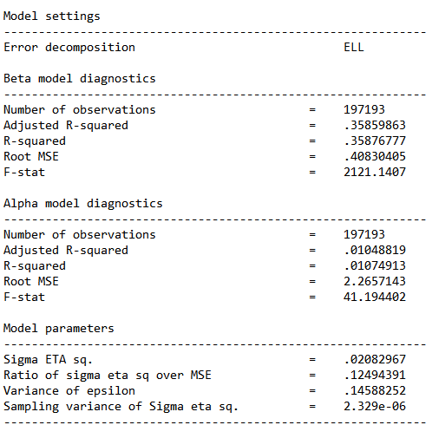
Model 5a: Post-Estimation Model specification results (Rural Model)

Slide 30
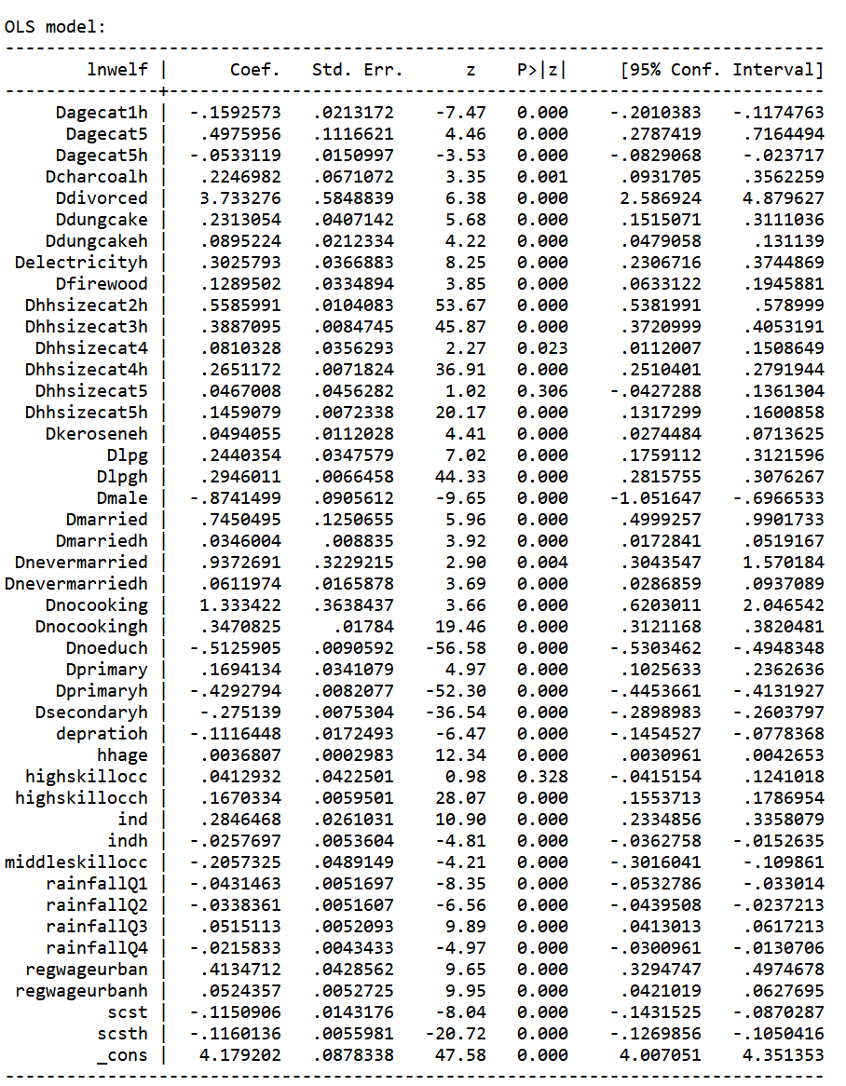
Model 5b: Preliminary OLS Estimates (Urban Model)

Slide 31
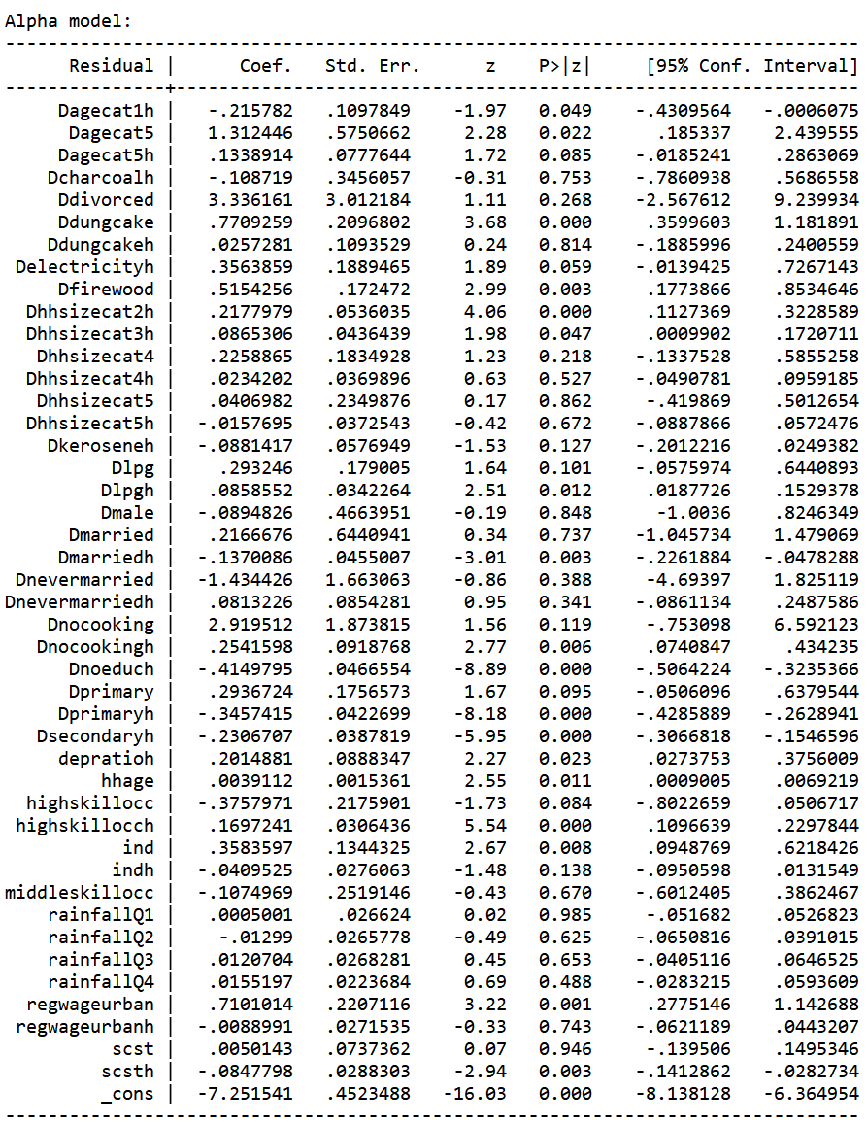
Model 5b: Alpha Model Estimates (Urban Model)

Slide 32
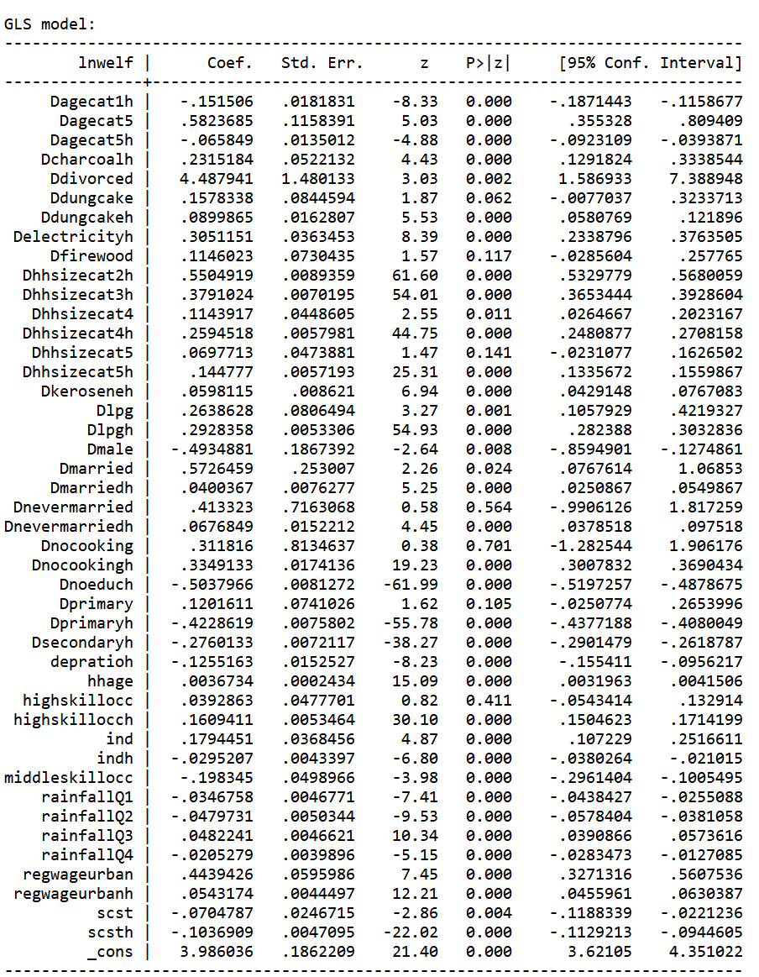
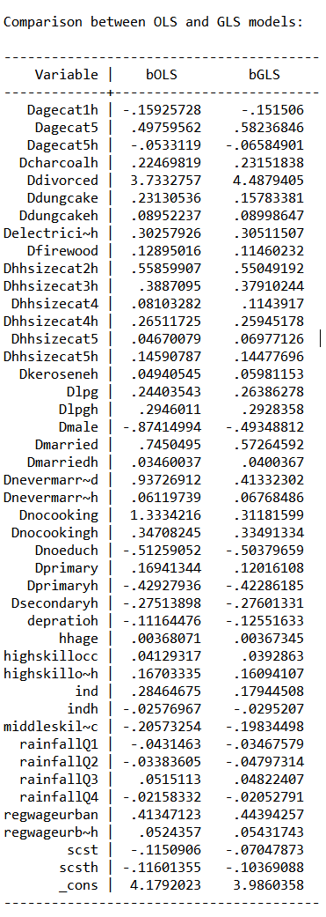
Model 5b: GLS Model Estimates and GLS-OLS comparison (Urban Model)

Slide 33
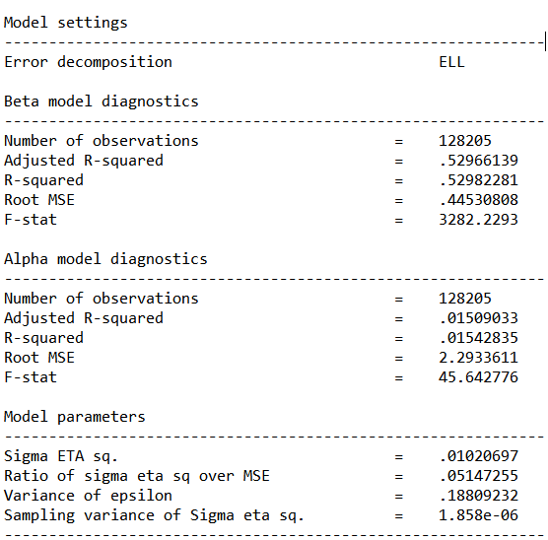
Model 5b: Post-Estimation Model specification results (Urban Model)

Slide 34
Model 5b: Preliminary OLS Estimates (Rural Model)

Slide 35
Model 5b: Alpha Model Estimates (Rural Model)

Slide 36
Model 5b: GLS Model Estimates and GLS-OLS comparison (Rural Model)

Slide 37
Model 5b: Post-Estimation Model specification results (Rural Model)

Slide 38
Appendix B: Full Imputation Results
Poverty 2017/18 Estimates for India

Slide 39
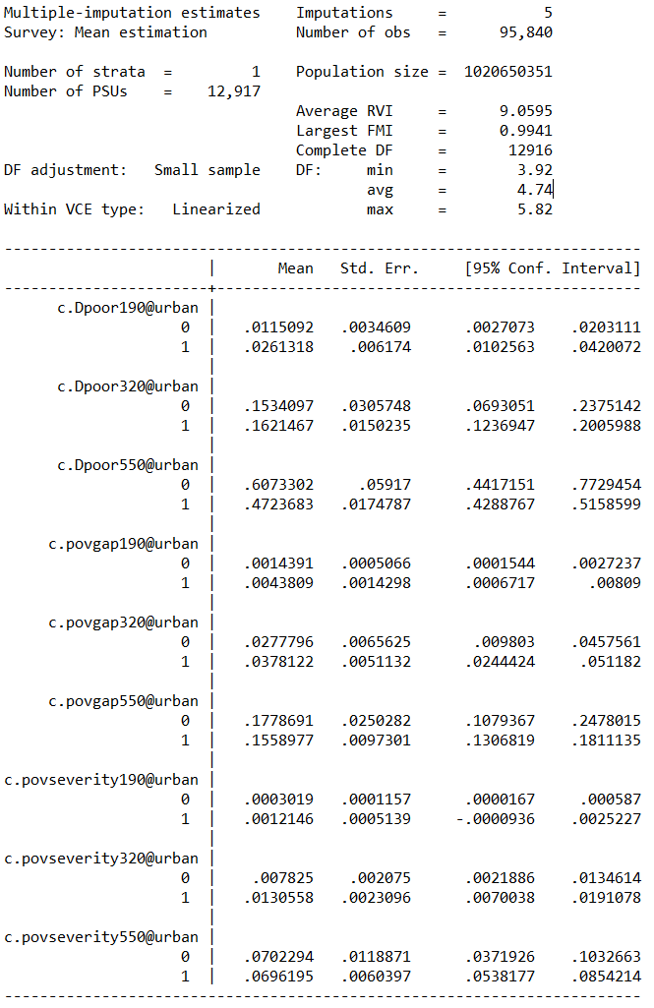
Model 2: Poverty Estimates 2017/18 (Variables in NV19 paper except expenses)

Slide 40
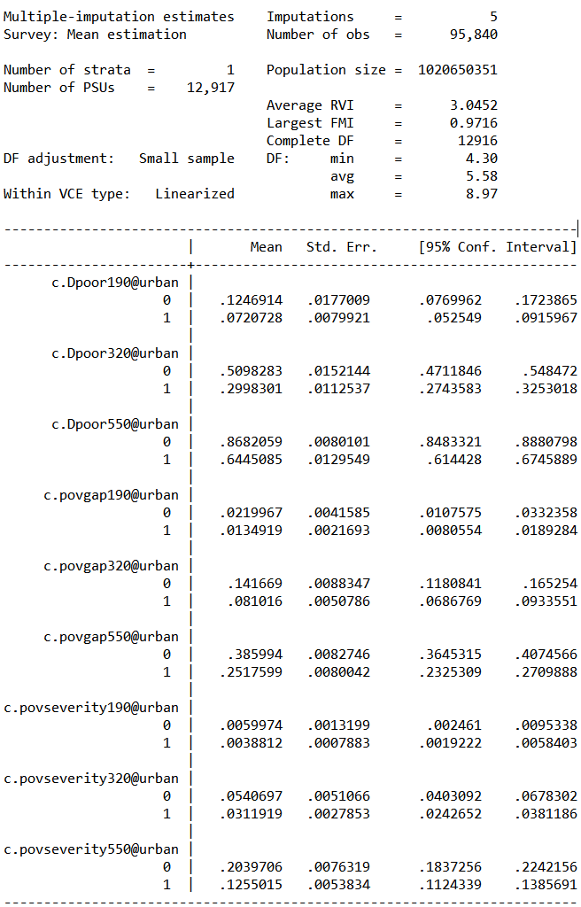
Model 3: Poverty Estimates 2017/18

Slide 41
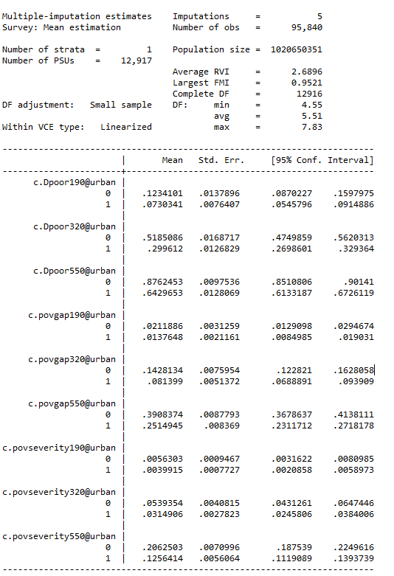
Model Imputation 2017/18: No transportation variables or time interaction variables
Model 3 Alt: Poverty Estimates 2017/18 (allowing for Non-normality)
Notes:
How does spending per capita on education grow over time?

Slide 42
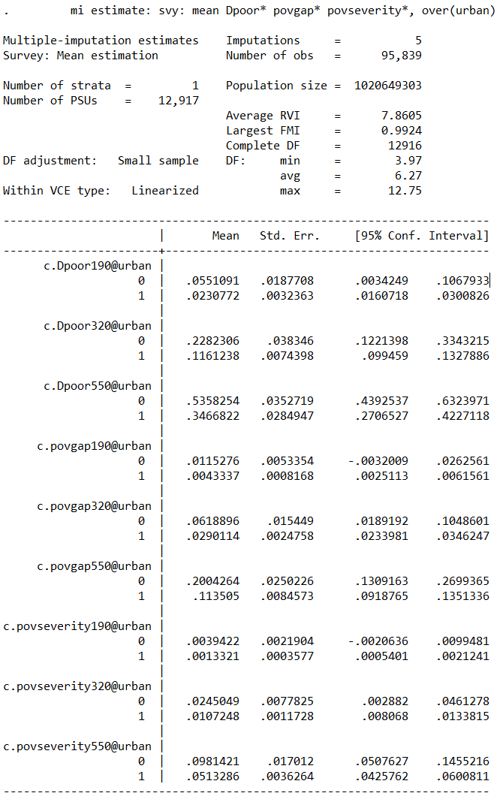
Model 4: Poverty Estimates 2017/18 (All variables common to NSS and SCS Surveys)

Slide 43
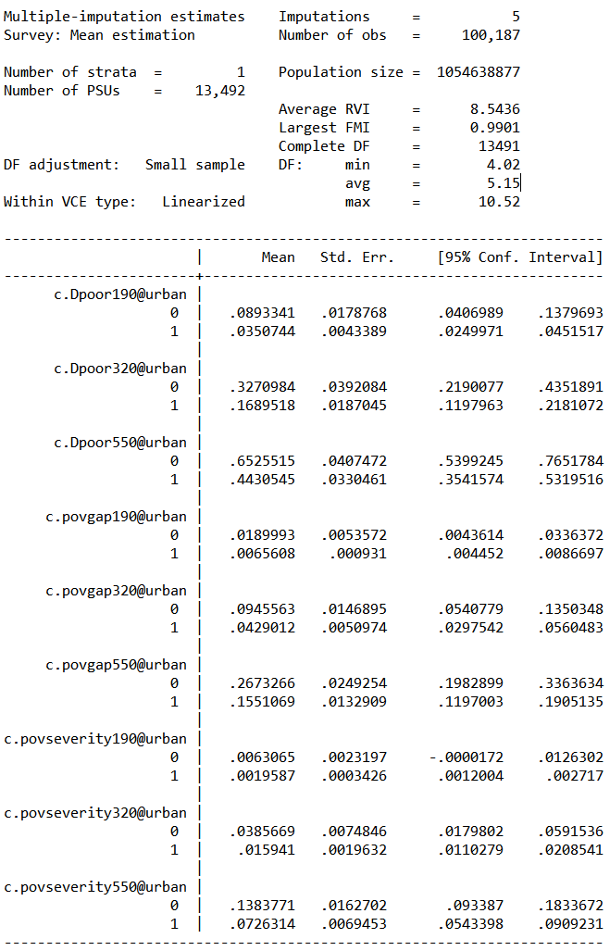
Model 5a: Poverty Estimates 2017/18 (Model Selection assuming Non-normal standard errors)

Slide 44
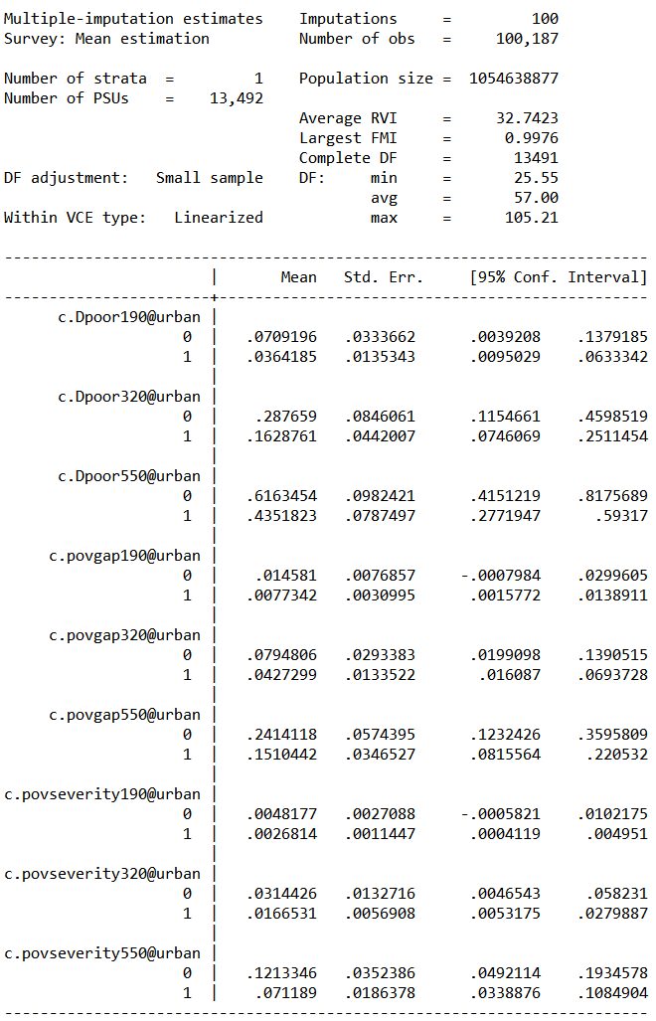
Model 5b: Poverty Estimates 2017/18 (Model Selection assuming Non-normal standard errors)

