Slide 1
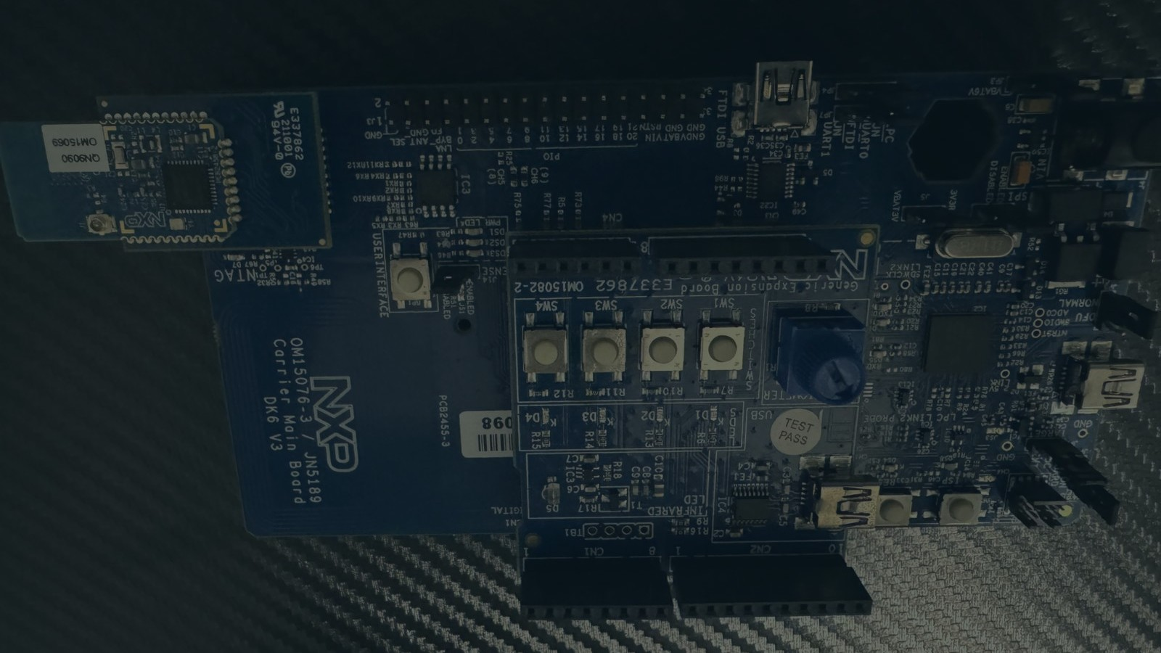
Making Web Bluetooth Work
A field report from a chip on the desk
Ifedayo Agboola · XtremeJS 2026
Notes:
Good morning, and thank you, Haim, for having me. My name is Ifedayo Agboola. I'm a software engineer and founder in Belfast, and most of my work sits where JavaScript meets hardware.
This is a field report. There is a small circuit board on my desk right now. In the next twenty minutes a plain web page in Chrome is going to talk to it, lose it, and find it again, and I'll show you every wall I hit along the way.

Slide 2
What we're building today
A web page that talks to hardware, with nothing to install.
Notes:
Let me start with what we're building and why it's worth your twenty minutes.
We're building a web page that talks to a piece of hardware sitting next to the laptop. You open a link, you click a button, and a light on the board comes on. There's no app to install, no app store, no "download for Windows". If someone has Chrome, they have everything they need.
That matters because most hardware today still ships with an app you have to install before it does anything. A web page that can do the same job removes that whole step, and it works the same on a Windows laptop, a Mac, a Chromebook and an Android phone. That's the promise. The rest of the talk is what the promise actually costs.

Slide 3
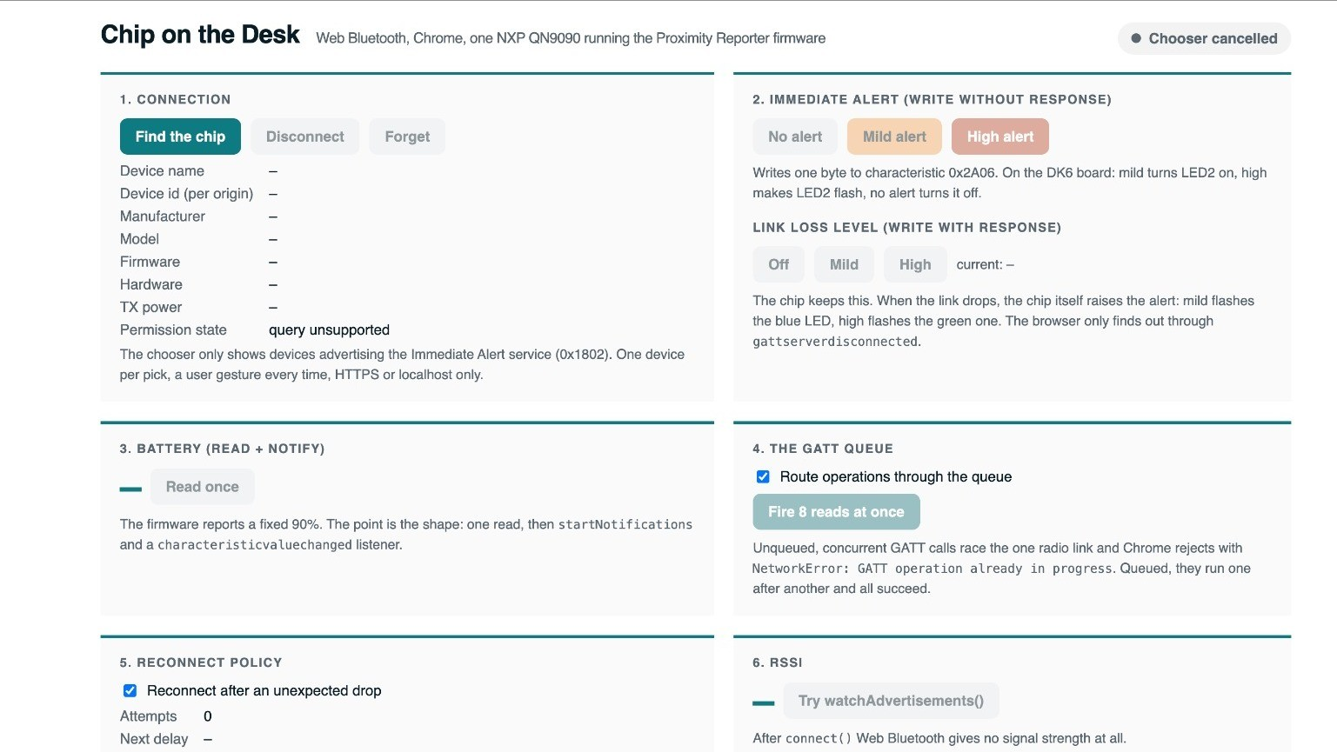
Notes:
This is the page. One HTML file, six panels, and a log along the bottom that stamps every event with the time, because when Bluetooth misbehaves the log is the only witness you have.

Slide 4
What I built before
A tag that shouted, and a phone that listened.
The bike tracker: no connection, no pairing, twenty bikes at once.
Notes:
A bit of history, because this talk grows out of something I built before.
A couple of years ago I built a bike tracker. A small tag on the bike, and a phone app that helps you find your bike in a rack of twenty. The chip on the tag did one thing: it shouted its name into the air about ten times a second, and the phone listened. No connection, no pairing, no password. The phone could hear twenty bikes at once, which is exactly what a tracker needs.
I wrote that up, and the article was picked up by React Status and became a talk in Belfast in May. Then Haim asked me a question that changed the project: most frontend developers will never build a phone app. What happens when the thing listening is a browser?

Slide 5
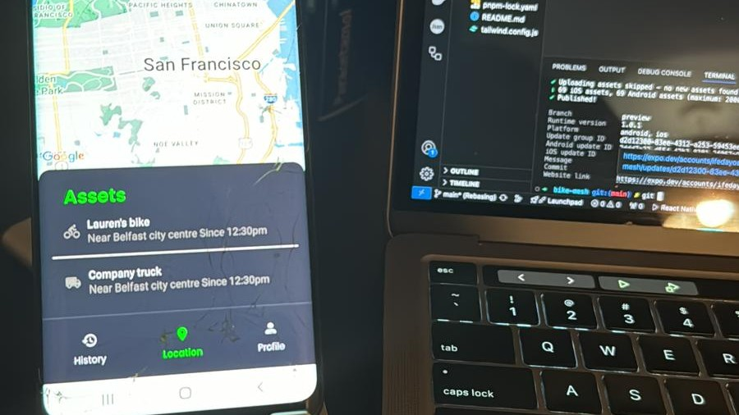
Notes:
That was the app, running on a phone next to the laptop it was built on. Two bikes on the list, both found by listening alone.

Slide 6
What makes this different
This time the listener is a browser tab.
And the chip had to change too.
Notes:
So here's what makes this different.
Last time the listener was a phone app, and the chip shouted. This time the listener is a browser tab, and, as you'll see in a moment, a browser cannot hear shouting at all. It can only have a conversation. So the chip had to change too.
What you're going to see is the same piece of hardware, with both halves rewritten. The program running on the board, and the JavaScript that talks to it. Most writing about Web Bluetooth starts with a device somebody else built. This one starts with a bare board, because the decisions you make on the board are the ones your JavaScript lives with.

Slide 7
Meet the board
A radio and a small computer on one chip.
NXP QN9090 on the DK6 kit: buttons, four lamps, a USB port.
Notes:
Let me introduce the board properly, because for most of you this is the unfamiliar half.
The brain is a chip from NXP called the QN9090. It's a Bluetooth 5 radio and a small computer in one package, about the size of a fingernail. That's the little blue module in the corner of the photo.
On its own a chip is hard to work with, so it sits on a development kit, the DK6. The kit gives it the things you need while you're building: four buttons, four small lamps, which I'll call LEDs from now on, a knob, and a USB port. The USB does two jobs. It powers the board, and it's how you load a program onto the chip from your laptop. That's it. Buttons, lamps, a radio, and a cable.

Slide 8
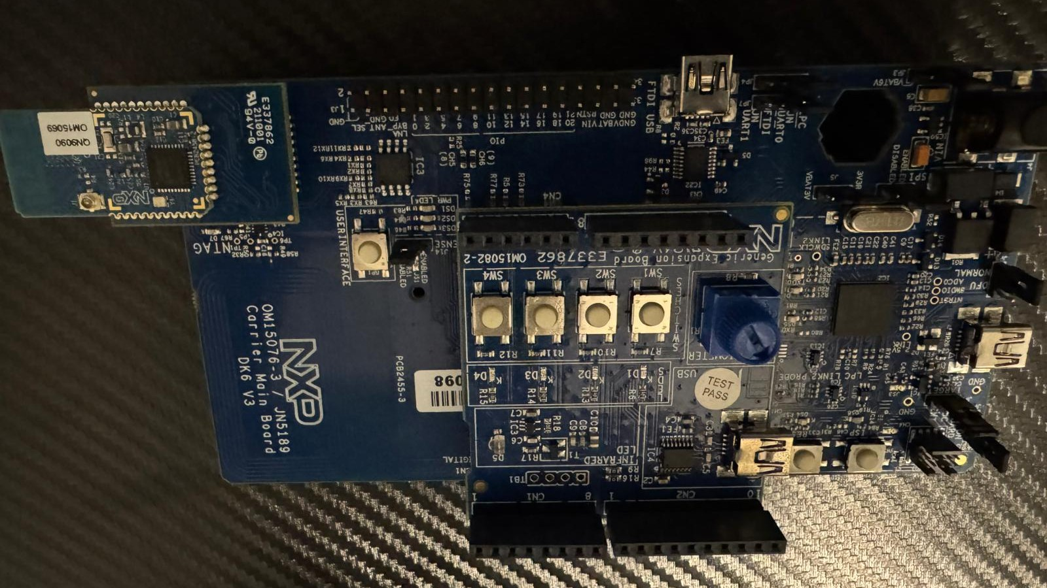
Notes:
Here it is, up close. The blue module at the corner is the chip itself, the radio and the computer together. The row of four buttons and the four lamps beside them are what we'll be watching. And the USB port at the edge is the only cable in this whole talk. Hold that picture in your head, because in a few minutes a browser tab is going to change what those lamps are doing.

Slide 9
A board does nothing until you give it a program
Firmware decides what a browser can see.
Program one shouts. Program two converses. Browsers only converse.
Notes:
Here's the thing nobody tells you about hardware. A board does nothing until you give it a program, and the program on the chip is called firmware. Change the firmware, and the same board becomes a different device.
NXP ships this chip with example programs. Two of them matter today. Program one makes the chip shout: that's what the tracker used. Program two makes the chip hold a conversation: it sits quietly, says "I'm here and you may connect to me", and then answers questions from whoever connects.
A browser can only do the second kind. So the first decision in my Web Bluetooth project was made before I wrote any JavaScript: I loaded the conversation program onto the chip. That takes NXP's free tool, a USB cable, and one click. The lamps blink, and the board is now something a browser can talk to.

Slide 10
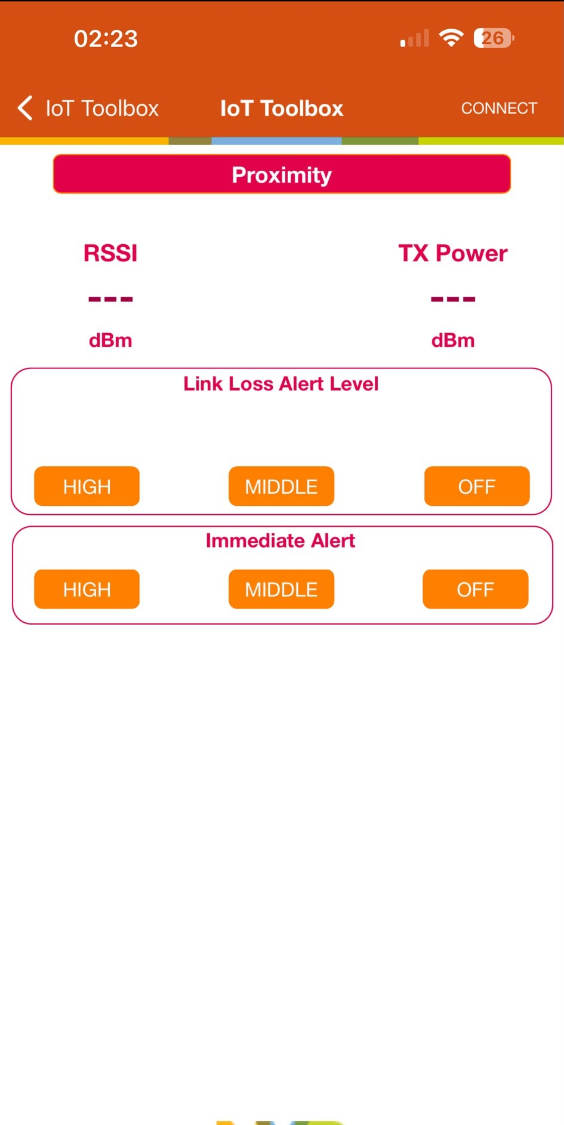
What the board can say now
A conversation is a menu.
Sections, items, and a few bytes for each one.
Notes:
Once the chip can hold a conversation, what can it actually say?
Think of it as a menu. The menu has sections, each section has items, and when you ask for an item the answer is a few bytes. The technical names are services and characteristics, and you'll see them in the code, but it's a menu.
This board's menu has four sections worth knowing. Alert: you send it a number, zero, one or two, and it turns a lamp off, on, or flashing. Link loss: you tell it what to do if you disappear, and it remembers. Power: how loud it's speaking. Battery: how full it is. Small, honest things. And they're enough to show you everything that matters about talking to hardware from a browser.

Slide 11
What Web Bluetooth is, and why it matters
Web Bluetooth turns "download our app" into "open this link".
Notes:
Now the browser half.
Web Bluetooth is the browser's built-in way to talk to Bluetooth devices nearby. It's a JavaScript API like any other: you call a function, you get a promise, you read and write bytes. No plugin, nothing to install.
Why does it matter? Because it moves a whole category of software from "download our app" to "open this link", and I'll show you who has already done that in a moment.
And because it lives in the browser, the web's trust rules apply. The page can't see what's around you. The person at the keyboard chooses the device, every time. That rule shapes everything you'll build with it.

Slide 12


Who already uses it
Bangle.js
Ledger
Niimbot
LEGO Education
Home Assistant
Bangle.js
Ledger
Niimbot
Real products ship on it today.
Set up, control, install, sign, print.
Notes:
This isn't theory. Real products ship on it today.
LEGO Education's classroom app for SPIKE robots runs in Chrome, and when a child plugs nothing in, the hub is talking to the browser over Web Bluetooth. Home Assistant and ESPHome use it to hand a brand-new gadget its Wi-Fi password from a web page, so the first-run experience is a link, not an app. The Bangle.js smartwatch has an app store that is simply a website; you click install and the app goes to your wrist. Ledger's Nano X hardware wallet signs transactions from a browser tab over it. And there's a browser-only label-printing app for Niimbot printers that has never needed an install.
Set up, control, install, sign, print. Five different jobs, and every one of them starts from a link. That's the range of what you can do with it, and it's also the shape of what you'll build with it: something sitting next to the person, and a page that does one clear job with it.

Slide 13
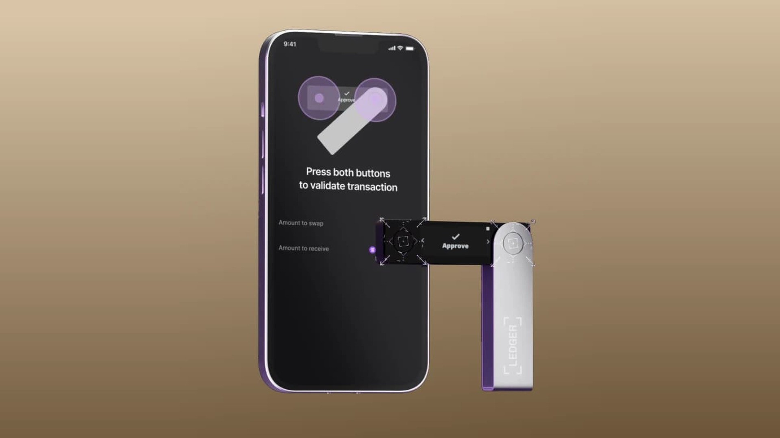
Notes:
One of those up close. A Ledger Nano X, a hardware wallet, approving a transaction that a web page sent it over Bluetooth. If the people guarding money trust this path, it has left the demo stage.

Slide 14
The browser's rules
The user picks the device, every time.
One click, one device, HTTPS only.
Notes:
Those rules, concretely.
You can only start from a click. The browser shows a list of devices it can hear, the user picks exactly one, and your page learns about that one device and nothing else. The page has to be served over HTTPS. There's no background listening and no way to quietly scan the room.
For you as a builder it means every Web Bluetooth product starts with the same moment: a button that says "Connect your device". Design around it, and the rest follows.

Slide 15
Seven lines of JavaScript
const device = await navigator.bluetooth.requestDevice({
filters: [{ services: ['immediate_alert'] }],
optionalServices: ['link_loss', 'tx_power', 'battery_service']
});
const server = await device.gatt.connect();
const service = await server.getPrimaryService('immediate_alert');
const alert = await service.getCharacteristic('alert_level');
await alert.writeValueWithoutResponse(Uint8Array.of(2));
Seven honest lines.
Ask, connect, open the section, pick the item, send the bytes.
Notes:
Here's the whole conversation in seven lines, and I'll read them as English.
Ask the browser for a device, filtered to devices that offer the "alert" section of the menu. The user picks one. Connect to it. Open the alert section. Pick the item called alert level. Send it the bytes for the number two.
Two small things to notice. The filter has to name something the device announces about itself, so you need to know your hardware. And the sections you'll use later have to be declared up front in that optionalServices list, or the browser will refuse to show them to you afterwards. Everything else really is this simple. The spec is honest about these seven lines.

Slide 16
Demo
A byte from a tab lights a lamp.
Demo one: tab to lamp
Notes:
Let me show you. This is one HTML file, plain JavaScript, running on localhost.
I click "Find the chip". Chrome shows me the list, and there's the board, calling itself NXP_PXR. I pick it. Watch the log: connected, then it reads the menu, then it reads the board's details. Made by NXP, model PXR Demo, firmware 1.1.1. That text came off the chip as bytes and we turned it back into words.
Now the part that matters. I press "Mild alert". That's a single byte, a one, sent to the alert item. Look at the board. The lamp is on. "High alert", a two, and it flashes. "No alert", a zero, and it's off.
A browser tab just changed the state of a piece of hardware on my desk, with seven lines of code. That's real. Now let's talk about what it took to make this reliable, because this page is a lot more than seven lines.

Slide 17
Wall one: one question at a time
NetworkError: GATT operation already in progress
The radio answers one question at a time.
Chrome refuses the second. Open issue since 2015.
Notes:
The first wall. You connect, and because you're a good JavaScript developer you ask the board three things at once with Promise.all. And one of them comes back with "GATT operation already in progress".
Here's why. Under the hood, the radio answers one question at a time: you ask, you wait, you get an answer, then you ask the next. Your operating system knows this and queues your questions. Chrome does not. If a second question reaches Chrome while the first is still waiting, Chrome refuses it on the spot. The browser standards group has had an issue open about this since 2015, and the answer so far is that your page should take turns itself.

Slide 18
The queue
class GattQueue {
tail = Promise.resolve();
run(op) {
const next = this.tail.then(op, op);
this.tail = next.catch(() => {}); // a failure never breaks the chain
return next;
}
}
const gatt = new GattQueue();
await gatt.run(() => battery.readValue());
Take turns in your own code.
One line; every operation waits its turn.
Notes:
So you build a queue, and you should build it on day one. Every operation joins the back of one line and starts only when the one before it has finished. If one fails, the line keeps moving; that's what the catch on the tail is for. And connecting goes through the same line, because connecting is a question too.
Twelve lines. In the demo page there's a checkbox that bypasses it, and in a moment I'll fire eight questions at once both ways so you can see the difference.

Slide 19
Wall two: the line drops
Links drop late and silently.
Reopen the menu, time out every connect, back off, then stop.
Notes:
The second wall is silence. Bluetooth links drop. Someone walks between the laptop and the device, the device goes to sleep, the operating system decides it's had enough. The link is only declared dead after a few seconds of hearing nothing, so the drop can arrive late. When it does, the browser fires one event, and everything you were in the middle of fails.
Three things caught me. After you reconnect, you have to open the menu again; the items you were holding are dead, and using them throws. Connecting can hang without ever answering, so every connect gets a timeout. And you have to know whether the person pressed Disconnect on purpose, because reconnecting after they did is a bug.
The reconnect itself is simple: wait one second, try, wait two, try, four, eight, sixteen, then stop and let the human press the button.

Slide 20
Demo
Kill the link and watch it come back.
Demo two: kill the line
Notes:
Two quick things. First, I untick the queue and fire eight reads at once. Look at the log: some succeed and the rest are refused. Now I tick the queue and fire eight again. All eight, one after another.
Now the drop. I've told the board that if it loses me it should flash its lamp. I switch the laptop's Bluetooth off. In the tab, the status says "Link lost" and the reconnect counter starts: one second, two, four. And on the board, a few seconds later, the lamp starts flashing. That's the board's own decision, made by the program on the chip, no browser involved, once it's sure I'm gone.
I switch Bluetooth back on. The next attempt lands, the page opens the menu again, and we're connected. Nobody pressed anything.

Slide 21
The number the browser won't give you
-65 -72 -78 -70 -85 -68 -92 -74 -69 -88
The browser will not give you this number.
Signal strength stays on the phone.
Notes:
Now the part of the abstract I most wanted to be wrong about.
The tracker's whole job was closeness, and closeness comes from signal strength: a negative number, where closer to zero means closer to you. Here are ten readings from the phone app with the tag sitting still on a desk. Minus sixty-five, minus seventy-two, minus ninety-two. A huge swing with nothing moving, because radio bounces off walls and bodies absorb it. So in the phone app we never showed the number; we sorted it into bands, near, mid, far, and a buzz told you that you were getting warmer.
In the browser I can't even get that far. Once you're connected, the browser gives you no signal strength at all. The only way to get it is to listen to the shouting without connecting, and in November 2026 that is still behind an experimental flag in Chrome, with people reporting this year that it's unreliable even with the flag on. The demo page has a button that tries it, and a normal Chrome tells you plainly that the function doesn't exist.
So the honest line is this. "Set up your device from a web page" is a browser job today. "Find your bike in a rack" is still a phone job.

Slide 22





Where it works, November 2026
Chrome
Edge
Samsung Internet
Firefox
Safari
Most of the world's browsers, and none of Apple's phones.
Notes:
Where does it actually work, as of this week?
Chrome and Edge on Windows, Mac and Chromebooks: yes. Chrome and Samsung's browser on Android: yes. Linux is behind a flag. So are the features that would make this feel finished, like remembering a device so the user doesn't have to pick it every visit.
Firefox's published position is that they have no plan to build it, and Safari's is the same. Because every browser on an iPhone has to use Safari's engine, there's nothing on iPhone or iPad. That's most of the world's browsers and none of Apple's phones. The docs show you the API, and the API looks finished. The platform isn't, and you need to know that before you promise anyone a product.

Slide 23
What to build, and how to build it properly
Build it for the device next to the person.
A check, a queue, a timeout, a reconnect plan, a log, no secrets.
Notes:
Which tells you what to build, and how.
Build it when the person is at a laptop or on an Android phone with the device in front of them, and the job is to set it up, read it, or control it. Device setup. Support pages that read the real state of a customer's gadget. Kiosks and classrooms, because there's nothing to install. Don't build it for anything that runs in the background, anything that must work on an iPhone, or anything that needs to know what's nearby. Those are still app jobs.
And when you build it, the gap between seven lines and a product is this list. Check the browser has Bluetooth before you show the button. One queue. A timeout on every connect. A reconnect plan that knows an accident from a choice. A log of every event with a time, because when it fails in the field the log is all you'll have. And no secrets in the page, because anyone can read a web page's JavaScript; the board on my desk let anyone connect, and if that lamp were a door lock, the board would demand a pairing code and your page would have no say in it.

Slide 24

Notes:
This is what a good fit looks like. A room of laptops, a device in every pair of hands, and nothing to install before the lesson starts.

Slide 25
Where this is heading
The path from chip to tab keeps getting shorter.
Two engines in, two out, and a scanning spec still alive.
Notes:
Where is this going? Three things I'd bet on.
The piece that would let a web page listen to the shouting got a fresh draft from the standards group this June, so it isn't dead. The browser's sister features for talking to hardware, Web Serial, WebHID and WebUSB, are moving faster than Web Bluetooth itself, and they share the same "user picks the device" model, so what you learned today carries over. And the two engines that said no have been saying no for years, so plan for Chrome-family browsers and treat anything else as a bonus.
The direction, though, is one way. In 2023 the only way to talk to this chip was a compiled phone app. This morning it was a text file.

Slide 26
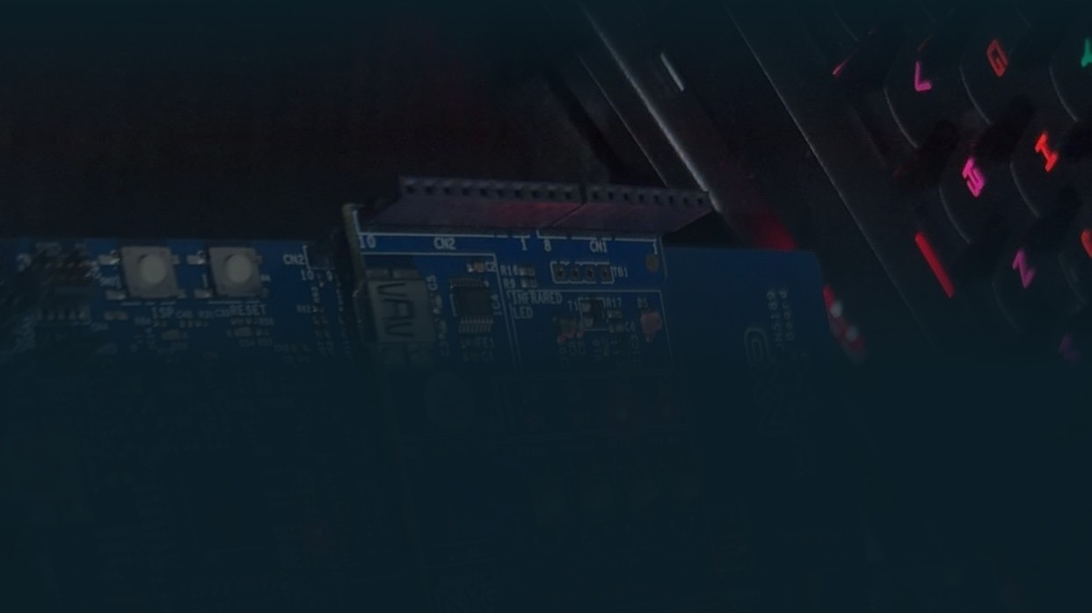
What happened this morning
A lamp on the desk moved from a tab.
Notes:
So, what happened this morning. A bare board got a program that lets it hold a conversation, because a browser cannot hear shouting. Seven honest lines of JavaScript connected a browser tab to it. A queue, a timeout and a reconnect plan made that connection survive the real world. The number I most wanted stayed on the phone, and a lamp on my desk moved from a browser tab.
If you take one thing away: the hardest decisions in Web Bluetooth are made on the board and in the platform list, not in your JavaScript. Know both before you promise the product.

Slide 27

Thank you.
Demo page and slides:
github.com/ifedayoagboola/chip-on-the-desk
The tracker write-up:
dev.to/blackscripts
linkedin.com/in/ifedayoagboola
demo page and slides
Ifedayo Agboola · XtremeJS 2026
Notes:
Thank you. The demo page and these slides are on GitHub at that link, the tracker write-up is on Dev.to, and I'm easy to find on LinkedIn. Haim, over to you for questions.

