Slide 1
Discrete Probability Distributions
Math 32, Fall 2020
Discussion Section #3

Slide 2
Discussion Section #3
Today we will go through an example problem on discrete probability distributions.
Then you will work on a Worksheet in small groups.
We will re-group at the end to discuss and share.
Remember you each must submit your own worksheet by 11:59pm the day of your Discussion.

Slide 3
Types of Random Variables
Discrete Random Variable: An R.V. that can take on only a finite or countably infinite set of outcomes. We can say that a discrete R.V. has distinct values that can be counted.
Example: Coin Flips, Dice Rolls, Outcomes of a Test (+/-)
Continuous Random Variable: An R.V. that can take on any value along a continuum (but may be reported “discretely”)
Example: Height (really continuous, but we usually just report to the nearest inch/centimeter), temperatures.

Slide 4
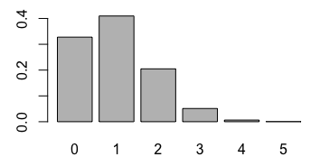
Probability “Functions” = Probability Distribution
Probability Function: Table, Graph, or Formula that describes values a random variable can take on, and its corresponding probability (discrete R.V.) or density (continuous R.V.)
Discrete Probability Mass Function (PMF): Assigns probabilities (masses) to the individual outcomes
P(Y = y)
y (Outcomes)
Notes:
> barplot(dbinom(c(0:5),size=5,prob=0.2),names.arg=c(0:5))

Slide 5
Probability Mass Function
P(Y = y)
Notes:
Discrete: barplot(pbinom(c(0:5),size=5,prob=0.2),names.arg=c(0:5))
Continuous:

Slide 6
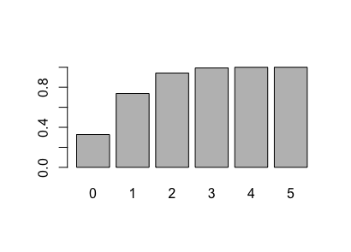
Cumulative Distribution Function
P(Y ≤ y)
Notes:
Discrete: barplot(pbinom(c(0:5),size=5,prob=0.2),names.arg=c(0:5))
Continuous:

Slide 7
Quick Review!
In class you learned 3 probability distributions:
Geometric Distribution: # of trials until 1st success
Bernoulli: Success/Failure 1 trial
Binomial distribution: Number of successes in n trials
We will review an example of a Binomial Distribution!

Slide 8
Binomial Distribution Example
Roll a die 3 times. The random variable X will record the number of 6’s.
Q: What is the sample space?
Ans: 0,1,2,3
Q: What is its probability mass function
Ans: It is Binomial! If we define
S=We roll a a 6,
N=We roll a number other than 6

Slide 9
Binomial Distribution
No six: (x=0)
NNN → (5/6)(5/6)(5/6)
One six: (x=1)
NNS → (5/6)(5/6)(1/6)
NSN → same
SNN → same
Two sixes: (x=2)
NSS → (5/6)(1/6)(1/6)
SNS → same
SSN → same
Three sixes: (x=3)
SSS →(1/6)(1/6)(1/6)

Slide 10
Binomial Distribution
x f(x)
0 (5/6)³
1 3(1/6)(5/6)²
2 3(1/6)²(5/6)
3 (1/6)³

Slide 11
Converting from PMF to CDF
In class we said several times that the probability mass function and the cumulative distribution function are equivalent.
In Lab #1 you secretly converted from a PMF to a CDF.
We will review that now!
Today (Lab #3) you will convert from a CDF to a PMF.

Slide 12
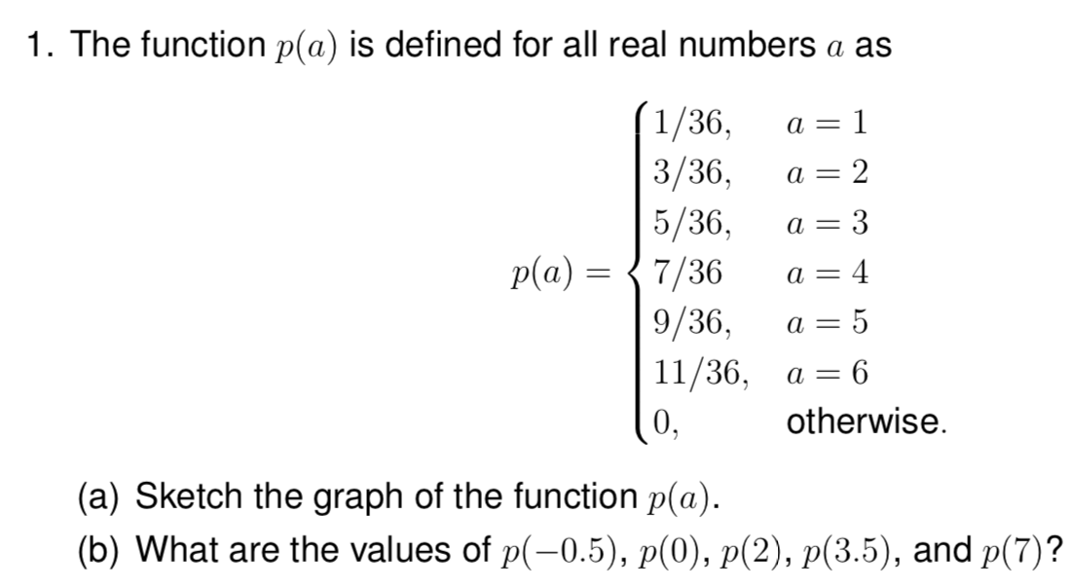
Lab #1, Problem #1

Slide 13
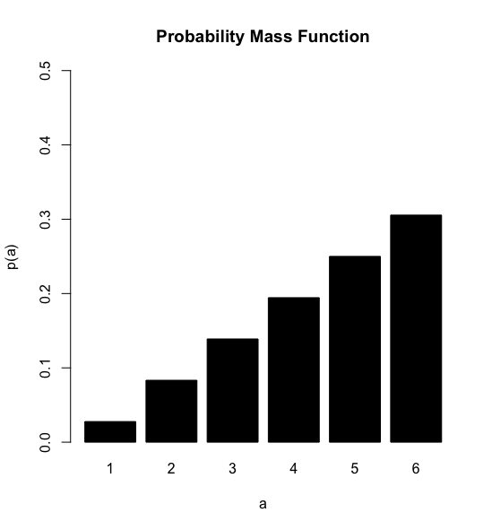
Lab #1, Problem #1
(a)
(b) This is a discrete probability mass function so any value that is NOT 1,2,3,4,5,6 will be 0.
That is,
p(-0.5)=p(3.5) =p(7)=p(0)=0
p(2) = 3/36

Slide 14
Lab #1, Problem #1
We often draw discrete probability mass functions as bar plots to emphasize there discrete state space.
However, we can also draw them with a continuous x-axis (as in the Solutions to Lab #1)

Slide 15
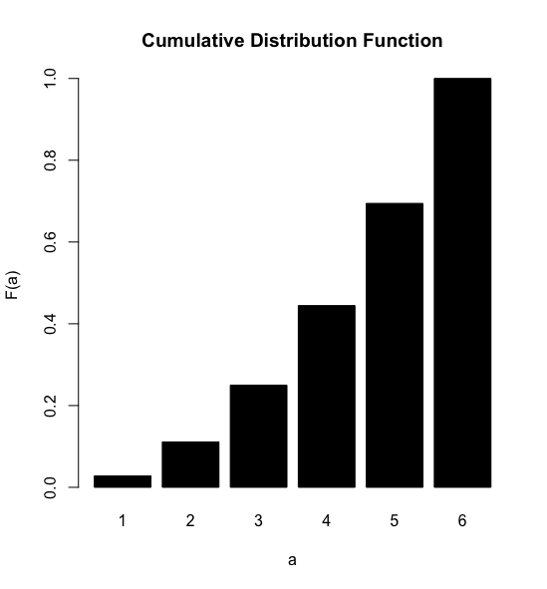
Lab #1, Problem #2
The cumulative distribution function F(a) is the probability that our random variable is less than or equal to a. F(1) = p(1)
F(2) = p(2)+p(1)
F(3) = p(3)+p(2)+p(1)
Etc.

Slide 16
Lab #1, Problem #2
Similarly, we can draw discrete cumulative distribution functions (CDFs) as either bar plots (previous slide) or with a continuous x-axis (as below and in Solutions to Lab #1).

Slide 17
Lab #1, Problem #2
Notice that the jumps in the CDFs occur exactly when the probability function is non-zero. This is important for today’s activity!
The CDF is generally non-zero when p(a) = 0.
Ex: F(3.5) = P(A≤3.5) = p(3) + p(2)+p(1)

Slide 18
Now you’ll get to do more practice together on discrete probability distributions!

Slide 19
Regrouping What lessons did we learn? Do we still have questions?
Don’t forget to submit your worksheet (PDF) by 11:59pm!

