Slide 1
Introduction to R
Math 32, Fall 2020
Discussion Section #2

Slide 2
Discussion Section #2
Today you are going to learn some of the basics of the R programming language.
As I guide you through examples, you should follow along.

Slide 3
What is R?
R is a free, open-source programming language for statistical computing.
More generally, it can handle numerous tasks in applied mathematics, optimization, etc.
It can be used to produce beautiful graphics!
One major strength of R: CRAN (Comprehensive R Archive Network) and free packages available there.

Slide 4
R: Installation
Super easy!
Go to http://cran.r-project.org/
Download appropriate packages for Windows, Mac, or Linux. Install!

Slide 5
R: Programming Environment
Most people use an integrated programming environment (IDE) for R that lets you interact with:
The console: where you tell the computer which R programs/files or commands to run
R Source Code/Files: open/edit any R code you have written. (Typically you write R code in files with a .R suffix.)
Program output: Figures/charts you produce
We will use Rstudio in our examples and work (https://www.rstudio.com/).

Slide 6
R: The Console
When you start R, you’ll see a “> ” prompt. This is the console.
In RStudio the console appears as a window.
You can type commands here into the console and R will run them immediately:
> x = 1
> y = x + 1
> print(y)
[1] 2

Slide 7
R: Upsides of the Console
You can type in a command right away and see if it works.
You can peek into variables.
You can plot something and the plot appears right away.
To summarize: console = instant feedback!

Slide 8
R: Downsides of the Console
Because commands are executed immediately! You can’t undo just one command.
Hard to remember what you did 50-100 commands ago! (So the console is good for only short numbers of commands.)
Some commands (like loops) are hard to type into the interpreter.
Remedy: you must learn how to edit/save/run R source code files.

Slide 9
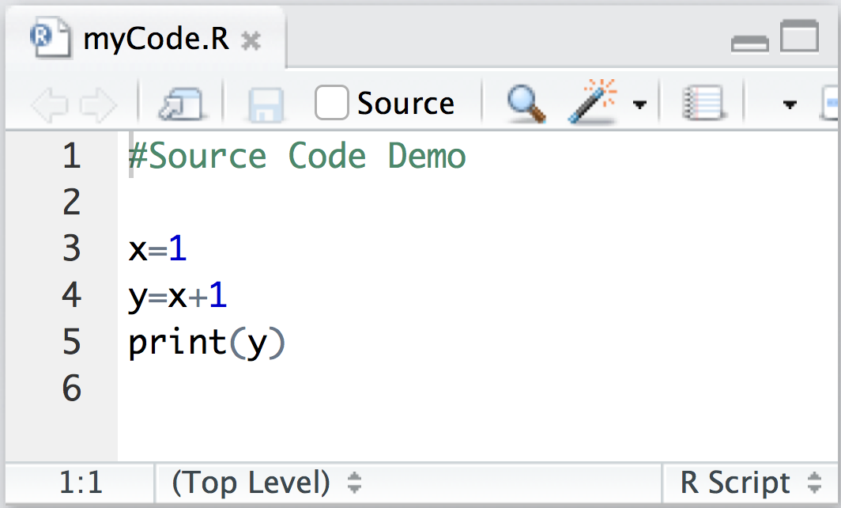
R: Source Code
Concept: put R commands into a file.
Save the file as ‘mycode.R’ in a folder you know and will remember.

Slide 10
R: Source Code
Then, using the interpreter, you run the code:
Note: In order for this to work, the R interpreter must be in the same directory/folder as the source code file ‘mycode.R’.
> source('mycode.R')
[1] 2

Slide 11
R: Changing Directories
From console, use
Again, this assumes that I have saved ‘mycode.R’ to the folder called ‘lab1’ the directory: /Users/suzannesindi/Math32
> setwd('/Users/suzannesindi/Math32/lab1')
> source('mycode.R')
[1] 2

Slide 12
Now let’s get to some of the basics of using R.
Q: How does R treat variables/data-types?

Slide 13
R: Basic Data Types
Three types you should know about:
Vector: Single row or single column of numbers.
Matrix: Has “m” rows and “n” columns of numbers.
Data Frame: Just like a matrix, except that the rows and columns have names (i.e., labels) and can be accessed using those names.
The utility of Data Frames is part of why R is the standard programming language for Prob/Stats.

Slide 14

R: Vectors
Suppose we have dinner with our family and write down everyone’s age:
Mathematically, we store the ages in a vector:
In R, we use the `c’ command:
> v = c(51,49,20,18,15)
> print(v)
[1] 51 49 20 18 15

Slide 15
R: Vectors
What if we want a vector containing the numbers 1 through 100 in order?
What if we want a vector containing 100 zeros? Two ways to do this:
> v = c(1:100)
> v = 0*c(1:100)
> w = vector(mode = "numeric", length = 100)

Slide 16
R: Vectorization
Let’s say you have the numbers from 1 to 10, but what you really want are the squares of those numbers.
It’s super-intuitive to do this:
> v=c(1:10)
> print(v)
[1] 1 2 3 4 5 6 7 8 9 10
> w=v^2
> print(w)
[1] 1 4 9 16 25 36 49 64 81 100

Slide 17
R: Vectorization
Vectorization means that an operation, such as squaring a number (^2), is applied to each element of the vector in turn.
You can do this with sums, products, powers, and many other operations.
Good use of vectorization can help you avoid writing slow loops.

Slide 18
Lab Activity!

Slide 19
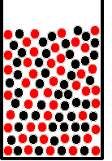
Balls and Urns in R
We calculated probabilities in class
Today, you will do this with simulations in R!
You will receive a sample code to modify
Basic idea:
We will create a vector called “urn” that contains the identities of all N balls in the urn.
We will use sample to generate samples either with or without replacement.
We will use sum & == to count which samples fit our criteria.
We will plot the empirical (simulation) probability against our true probability

Slide 20
sample
There is an R function called sample that works perfectly!
vec is the vector you’re sampling from
nt is the number of samples you’d like
replace={False,True} without/with replacement
Basic syntax – sampling without replacement: sample(vec,nt,replace=FALSE)
Basic syntax – sampling with replacement: sample(vec,nt,replace=TRUE)

Slide 21
Balls & Urn, Draw Samples
Q: “I start with an urn filled with 5 red and 5 black balls, randomly mixed. I draw three balls from the urn, sampling without replacement. What is the probability that at least one is black?”
Create the urn
Draw 3 balls without replacement
urn = c(replicate(5,"red"),replicate(5,"black"))
drawnballs = sample(urn,3,replace=FALSE)
> drawnballs
[1] "black" "red" "black"

Slide 22
Balls & Urn, Count Samples
Determine which balls drawn are black
We have produced a vector of True/False.
R* considers
True = 1,
False = 0
Use sum to add up the True/False entries and count the number of balls.
> drawnballs=="black"
[1] TRUE FALSE TRUE
> sum(drawnballs=="black")
[1] 2

Slide 23
Recapping Two Points
Sum: sum(v) = the sum of elements in v
Logical ↔ integer conversion (v==3) = vector of logical values TRUE/FALSE sum(v==3)= # of elements in v that equal 3.
Remember:
R converts TRUE to 1, FALSE to 0
R converts non-zero # to TRUE, zero to FALSE

Slide 24
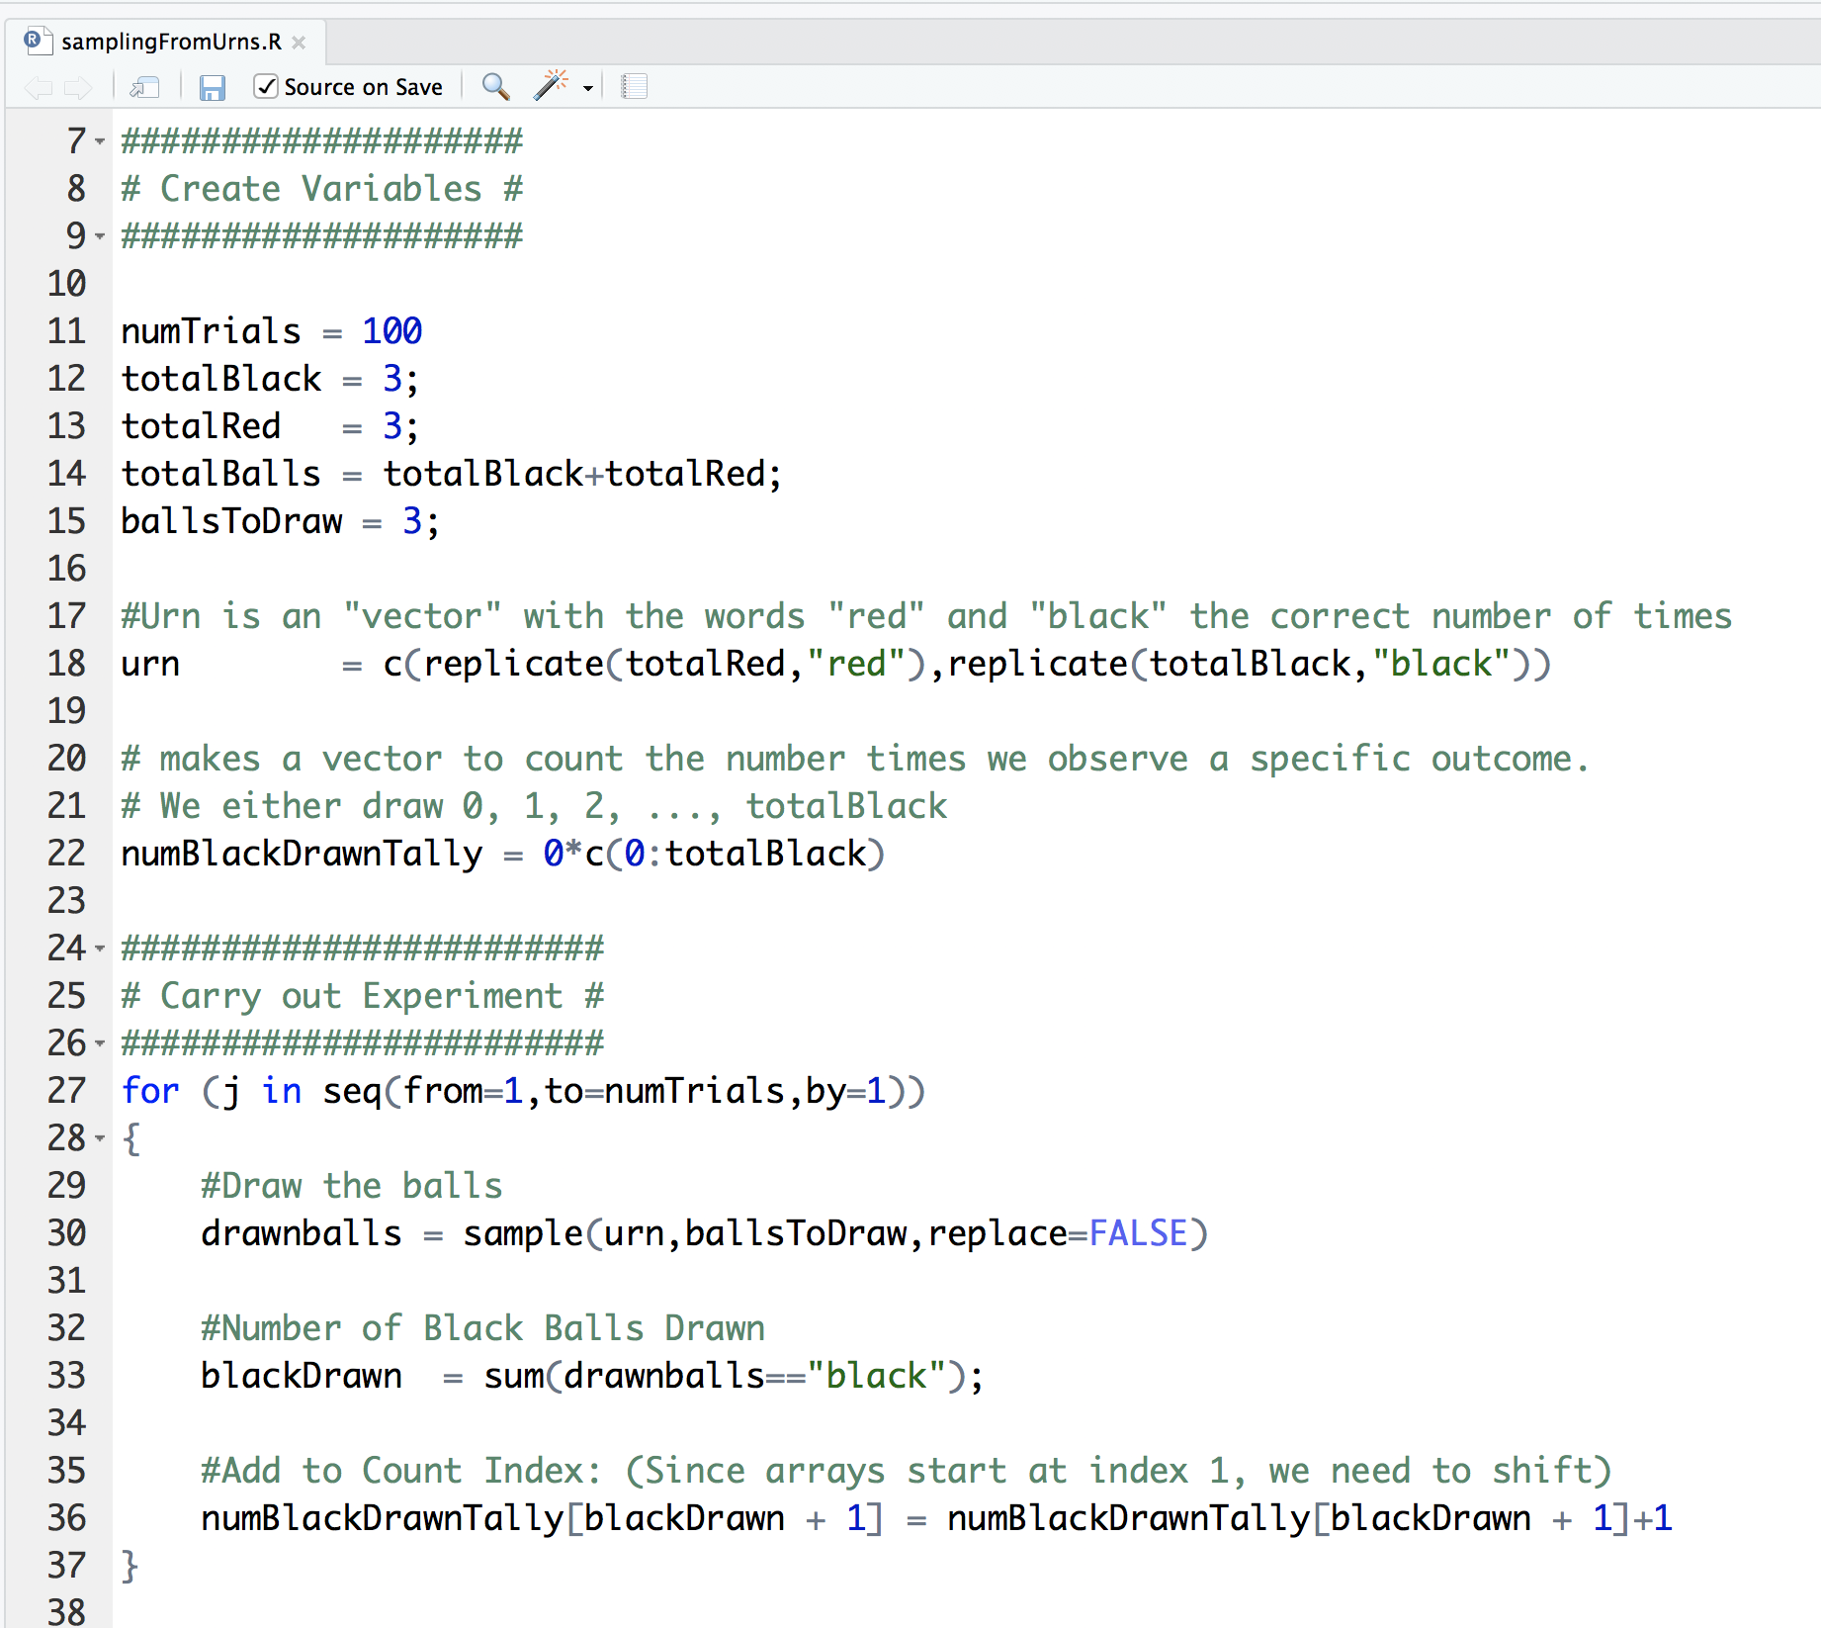
samplingFromUrns.R
R converts False = 0, True = 1

Slide 25
Example Output

Slide 26
Sample Code:
You will receive a short R code (samplingFromUrns.R) which counts the number of black balls in this scenario
Total 8 Balls: 4 Red, 4 Black
Draws 4 balls without replacement
Plots the experimental probability (blue) and compares it with the true probability (black)

Slide 27
Lab #2 Assignment
In this class you will do the following.
Change the code to draw 3 balls without replacement from a total of 7 balls (4 red, 3 black). Note: You will have to change only a small part of the code.
Show the output for at least two different numbers of total trials: N = 10², N = 10⁴.
Write up your results (see Lab assignment)

