Slide 1
Maximum Likelihood Estimation, Least Squares Regression & Confidence Intervals
Math 32, Fall 2020
Discussion Section #10

Slide 2
Discussion Section #10
In class (and on Homework #11) you have been working on problems in
Maximum Likelihood Estimation
Least Squares Regression
Confidence Intervals
Today in Lab, you will do computational versions in R of problems on Homework #11.

Slide 3
Discussion Section #10
For today, you will receive 2 R scripts (Lab10FollowAlong.R and Lab10.R) and 1 CSV file (testDataExp.csv).
Lab10FollowAlong.R: Will go through this lecture
Lab10.R: Template for your worksheet
It is important to have all of these in the same directory on your computer and this directory needs to be set as the working directory.
You can set the working directory in R by with the “Session menu” (Session -> Set Working Directory)

Slide 4
R: Programming Environment
Most people use an integrated programming environment (IDE) for R that lets you interact with:
The console: where you tell the computer which R programs/files or commands to run
R Source Code/Files: open/edit any R code you have written. (Typically you write R code in files with a .R suffix.)
Program output: Figures/charts you produce
Prof Sindi uses and recommends RStudio (https://www.rstudio.com/).

Slide 5
Problem #1: Maximum Likelihood Estimation
These next 2 slides are from Lecture 22 and illustrate maximum likelihood estimation.
Setting: You are given a set of data from a specified model with unknown parameter.
Approach: You select that parameter to maximize the probability (i.e., the likelihood) of the data you have.

Slide 6
Maximum Likelihood Estimation
Example: Flip a coin 5 times and get HTTHH. What is the probability of heads?
Let p be the probability of heads. Then 1-p is the probability of tails.
The probability of getting HTTHH: P(HTTHH) = P(H) x P(T) x P(T) x P(H) x P(H) = p x (1-p) x (1-p) x p x p = p³ (1-p)²
We want to maximize the probability of the data we observe, or maximize the probability of the function: L(p) = p³ (1-p)²

Slide 7
Maximum Likelihood Coin Flip
In Class we used calculus, in R we use optimize
The data we observe: HTTHH, 3 out of the 5 flips were “heads”. So this makes sense with our intuition as well.

Slide 8
Maximum Likelihood Estimation
#Likelihood Function (Probability of the Data)
likelihood <- function(p,numHeads,numTails) p^(numHeads)*(1-p)^(numTails);
#Data
data = c("H","T","T","H","H");
dataHeads = length(which(data=="H"));
dataTails = length(which(data=="T"));
#Maximize the Likelihood
lowerB = 0;
upperB = 1;
opt <- optimize(likelihood, lower = lowerB, upper = upperB,
numHeads = dataHeads, numTails=dataTails, maximum=TRUE)
pMax = opt$maximum;
maxLikelihood = opt$objective;
#Plot the Results
x = seq(lowerB,upperB,0.01);
plot(x,likelihood(x,dataHeads,dataTails),type='l',main="The Likelihood of the Data”, ylab="L(p)",xlab="p")
points(pMax,maxLikelihood,type='p',col='red')

Slide 9
Maximum Likelihood Estimation
#Likelihood Function (Probability of the Data)
likelihood <- function(p,numHeads,numTails) p^(numHeads)*(1-p)^(numTails);
#Data
data = c("H","T","T","H","H");
dataHeads = length(which(data=="H"));
dataTails = length(which(data=="T"));
#Maximize the Likelihood
lowerB = 0;
upperB = 1;
opt <- optimize(likelihood, lower = lowerB, upper = upperB,
numHeads = dataHeads, numTails=dataTails, maximum=TRUE)
pMax = opt$maximum;
maxLikelihood = opt$objective;
#Plot the Results
x = seq(lowerB,upperB,0.01);
plot(x,likelihood(x,dataHeads,dataTails),type='l',main="The Likelihood of the Data”, ylab="L(p)",xlab="p")
points(pMax,maxLikelihood,type='p',col='red')
Likelihood Function
f(p) =p³(1-p)²

Slide 10
Maximum Likelihood Estimation
#Likelihood Function (Probability of the Data)
likelihood <- function(p,numHeads,numTails) p^(numHeads)*(1-p)^(numTails);
#Data
data = c("H","T","T","H","H");
dataHeads = length(which(data=="H"));
dataTails = length(which(data=="T"));
#Maximize the Likelihood
lowerB = 0;
upperB = 1;
opt <- optimize(likelihood, lower = lowerB, upper = upperB,
numHeads = dataHeads, numTails=dataTails, maximum=TRUE)
pMax = opt$maximum;
maxLikelihood = opt$objective;
#Plot the Results
x = seq(lowerB,upperB,0.01);
plot(x,likelihood(x,dataHeads,dataTails),type='l',main="The Likelihood of the Data”, ylab="L(p)",xlab="p")
points(pMax,maxLikelihood,type='p',col='red')
Process the data
Count heads and tails

Slide 11
Maximum Likelihood Estimation
#Likelihood Function (Probability of the Data)
likelihood <- function(p,numHeads,numTails) p^(numHeads)*(1-p)^(numTails);
#Data
data = c("H","T","T","H","H");
dataHeads = length(which(data=="H"));
dataTails = length(which(data=="T"));
#Maximize the Likelihood
lowerB = 0;
upperB = 1;
opt <- optimize(likelihood, lower = lowerB, upper = upperB,
numHeads = dataHeads, numTails=dataTails, maximum=TRUE)
pMax = opt$maximum;
maxLikelihood = opt$objective;
#Plot the Results
x = seq(lowerB,upperB,0.01);
plot(x,likelihood(x,dataHeads,dataTails),type='l',main="The Likelihood of the Data”, ylab="L(p)",xlab="p")
points(pMax,maxLikelihood,type='p',col='red')
Maximize Likelihood
Set lower and upper bound for parameters
Specify the values of dataHeads, dataTails
Set maximum = TRUE (Default is minimize!)
Note: You get back BOTH the value of the maximum AND the function value at that maximum.

Slide 12
Maximum Likelihood Estimation
#Likelihood Function (Probability of the Data)
likelihood <- function(p,numHeads,numTails) p^(numHeads)*(1-p)^(numTails);
#Data
data = c("H","T","T","H","H");
dataHeads = length(which(data=="H"));
dataTails = length(which(data=="T"));
#Maximize the Likelihood
lowerB = 0;
upperB = 1;
opt <- optimize(likelihood, lower = lowerB, upper = upperB,
numHeads = dataHeads, numTails=dataTails, maximum=TRUE)
pMax = opt$maximum;
maxLikelihood = opt$objective;
#Plot the Results
x = seq(lowerB,upperB,0.01);
plot(x,likelihood(x,dataHeads,dataTails),type='l',main="The Likelihood of the Data”, ylab="L(p)",xlab="p")
points(pMax,maxLikelihood,type='p',col='red')
Plot the Function and designate the maximum

Slide 13
Problem #2 Lab 10
Problem #2 is another Maximum Likelihood Estimation problem.
You will need to modify code Lab10.R and answer questions.

Slide 14
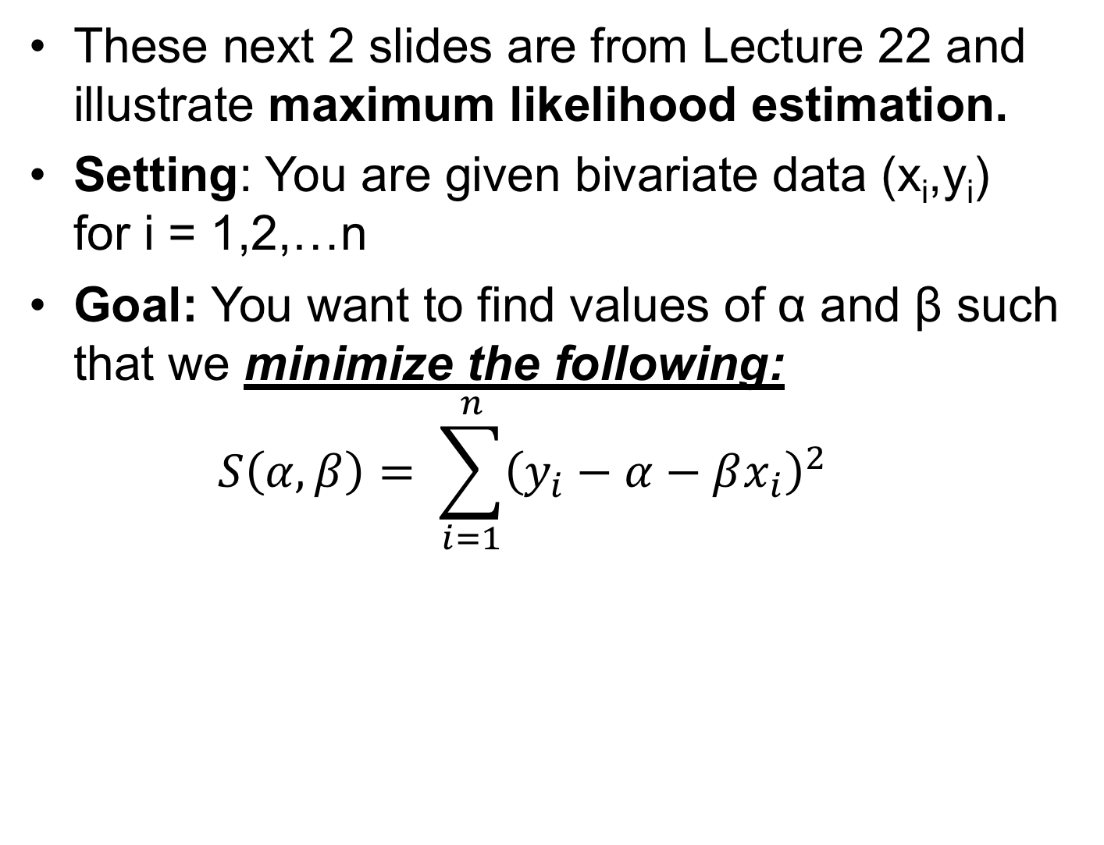
Problem #3: Least Squares Regression
These next 2 slides are from Lecture 22 and illustrate maximum likelihood estimation.
Setting: You are given bivariate data (x_{i},y_{i}) for i = 1,2,…n
Goal: You want to find values of α and β such that we minimize the following: $S\left(α,β\right)= \sum_{i=1}^{n}{{\left(y_{i}−α−βx_{i}\right)}^{2}}$

Slide 15

Chapter 22: Least Squares Regression
Minimize the squared error: $S\left(α,β\right)= \sum_{i=1}^{n}{{\left(y_{i}−α−βx_{i}\right)}^{2}}$
α + β x_{i}
y
x

Slide 16
Temperature Data Set
We will go through 3 steps:
Make a data set to perform linear regression on. (This is the hardest part!)
Perform linear regression
Analyze our results:
Analyze the model fit
Make a plot of our data and model

Slide 17
Step 1: Make the Data Set
#Linear Model (What you will attempt to learn)
alpha = 5.00; #<- Change this line
beta = -0.01; #<- Change this line
#Number of Data Points
N = 30; #<- Change this line
#Noise Function
mu = 0;
sigma = 0.075;
U = rnorm(N, mu, sigma)
#Generate Data
lowTemp = 100;
highTemp = 400;
X = runif(N,lowTemp,highTemp);
Y = alpha + beta*X + U;
#Store these values in a Data Frame
reactionTimes = data.frame(temp=X,time=Y)
Set up the alpha & beta
You will then try to “learn”

Slide 18
Step 1: Make the Data Set
#Linear Model (What you will attempt to learn)
alpha = 5.00; #<- Change this line
beta = -0.01; #<- Change this line
#Number of Data Points
N = 30; #<- Change this line
#Noise Function
mu = 0;
sigma = 0.075;
U = rnorm(N, mu, sigma)
#Generate Data
lowTemp = 100;
highTemp = 400;
X = runif(N,lowTemp,highTemp);
Y = alpha + beta*X + U;
#Store these values in a Data Frame
reactionTimes = data.frame(temp=X,time=Y)
Set how many points you will sample

Slide 19
Step 1: Make the Data Set
#Linear Model (What you will attempt to learn)
alpha = 5.00; #<- Change this line
beta = -0.01; #<- Change this line
#Number of Data Points
N = 30; #<- Change this line
#Noise Function
mu = 0;
sigma = 0.075;
U = rnorm(N, mu, sigma)
#Generate Data
lowTemp = 100;
highTemp = 400;
X = runif(N,lowTemp,highTemp);
Y = alpha + beta*X + U;
#Store these values in a Data Frame
reactionTimes = data.frame(temp=X,time=Y)
Set the properties of your measurement error

Slide 20
Step 1: Make the Data Set
#Linear Model (What you will attempt to learn)
alpha = 5.00; #<- Change this line
beta = -0.01; #<- Change this line
#Number of Data Points
N = 30; #<- Change this line
#Noise Function
mu = 0;
sigma = 0.075;
U = rnorm(N, mu, sigma)
#Generate Data
lowTemp = 100;
highTemp = 400;
X = runif(N,lowTemp,highTemp);
Y = alpha + beta*X + U;
#Store these values in a Data Frame
reactionTimes = data.frame(temp=X,time=Y)
Generate temperatures X & times Y that follow the linear model

Slide 21
Step 1: Make the Data Set
#Linear Model (What you will attempt to learn)
alpha = 5.00; #<- Change this line
beta = -0.01; #<- Change this line
#Number of Data Points
N = 30; #<- Change this line
#Noise Function
mu = 0;
sigma = 0.075;
U = rnorm(N, mu, sigma)
#Generate Data
lowTemp = 100;
highTemp = 400;
X = runif(N,lowTemp,highTemp);
Y = alpha + beta*X + U;
#Store these values in a Data Frame
reactionTimes = data.frame(temp=X,time=Y)
Store the results in a data frame with named columns for “temp” and “time”

Slide 22
Step 2: Perform Linear Regression
#Do the linear regression
linearModel = lm(time ~ temp, data = reactionTimes)
R is super cool! Linear regression (and even more fancy models) are just 1 line of code!!

Slide 23
Step 3: Analyze the Model Fit
Summary is the standard R report on the model
#Look at our Model Results
print(summary(linearModel))
Call:
lm(formula = time ~ temp, data = reactionTimes)
Residuals:
Min 1Q Median 3Q Max
-0.174186 -0.041803 0.008788 0.038296 0.157556
Coefficients:
Estimate Std. Error t value Pr(>|t|)
(Intercept) 5.0709251 0.0356501 142.24 <2e-16 ***
temp -0.0102546 0.0001444 -71.02 <2e-16 ***
---
Signif. codes: 0 ‘***’ 0.001 ‘**’ 0.01 ‘*’ 0.05 ‘.’ 0.1 ‘ ’ 1
Residual standard error: 0.06916 on 28 degrees of freedom
Multiple R-squared: 0.9945, Adjusted R-squared: 0.9943
F-statistic: 5044 on 1 and 28 DF, p-value: < 2.2e-16

Slide 24
Step 3: Analyze the Model Fit
Reminds you of the function you ran (super helpful!)
#Look at our Model Results
print(summary(linearModel))
Call:
lm(formula = time ~ temp, data = reactionTimes)
Residuals:
Min 1Q Median 3Q Max
-0.174186 -0.041803 0.008788 0.038296 0.157556
Coefficients:
Estimate Std. Error t value Pr(>|t|)
(Intercept) 5.0709251 0.0356501 142.24 <2e-16 ***
temp -0.0102546 0.0001444 -71.02 <2e-16 ***
---
Signif. codes: 0 ‘***’ 0.001 ‘**’ 0.01 ‘*’ 0.05 ‘.’ 0.1 ‘ ’ 1
Residual standard error: 0.06916 on 28 degrees of freedom
Multiple R-squared: 0.9945, Adjusted R-squared: 0.9943
F-statistic: 5044 on 1 and 28 DF, p-value: < 2.2e-16

Slide 25
Step 3: Analyze the Model Fit
Gives you details on the residuals, the error between the data and the model
#Look at our Model Results
print(summary(linearModel))
Call:
lm(formula = time ~ temp, data = reactionTimes)
Residuals:
Min 1Q Median 3Q Max
-0.174186 -0.041803 0.008788 0.038296 0.157556
Coefficients:
Estimate Std. Error t value Pr(>|t|)
(Intercept) 5.0709251 0.0356501 142.24 <2e-16 ***
temp -0.0102546 0.0001444 -71.02 <2e-16 ***
---
Signif. codes: 0 ‘***’ 0.001 ‘**’ 0.01 ‘*’ 0.05 ‘.’ 0.1 ‘ ’ 1
Residual standard error: 0.06916 on 28 degrees of freedom
Multiple R-squared: 0.9945, Adjusted R-squared: 0.9943
F-statistic: 5044 on 1 and 28 DF, p-value: < 2.2e-16

Slide 26
Step 3: Analyze the Model Fit
Tells you your intercept (alpha) and your slope (temp)
You get estimates, standard error and significance!
#Look at our Model Results
print(summary(linearModel))
Call:
lm(formula = time ~ temp, data = reactionTimes)
Residuals:
Min 1Q Median 3Q Max
-0.174186 -0.041803 0.008788 0.038296 0.157556
Coefficients:
Estimate Std. Error t value Pr(>|t|)
(Intercept) 5.0709251 0.0356501 142.24 <2e-16 ***
temp -0.0102546 0.0001444 -71.02 <2e-16 ***
---
Signif. codes: 0 ‘***’ 0.001 ‘**’ 0.01 ‘*’ 0.05 ‘.’ 0.1 ‘ ’ 1
Residual standard error: 0.06916 on 28 degrees of freedom
Multiple R-squared: 0.9945, Adjusted R-squared: 0.9943
F-statistic: 5044 on 1 and 28 DF, p-value: < 2.2e-16

Slide 27
Step 3: Analyze the Model Fit
Coefficients:
Estimate Std. Error t value Pr(>|t|)
(Intercept) 5.0709251 0.0356501 142.24 <2e-16 ***
temp -0.0102546 0.0001444 -71.02 <2e-16 ***
---
Signif. codes: 0 ‘***’ 0.001 ‘**’ 0.01 ‘*’ 0.05 ‘.’ 0.1 ‘ ’ 1
Residual standard error: 0.06916 on 28 degrees of freedom
Multiple R-squared: 0.9945, Adjusted R-squared: 0.9943
F-statistic: 5044 on 1 and 28 DF, p-value: < 2.2e-16
Confidence Intervals: Estimates +/- Standard Error
α = (Intercept) = (5.0709251-0.0356501,5.0709251+0.0356501)
β = temp = (-0.0102546-0.0001444,-0.0102546+0.0001444)
Significance
Probability of finding this association by chance!
Both of our values have the probability < 2x10⁻¹⁶
We would say that is exceptionally significant! So we have a true association.

Slide 28
Step 3: Analyze the Model Fit
Other Useful Statistics:
R-squared higher (close to 1) is great.
#Look at our Model Results
print(summary(linearModel))
Call:
lm(formula = time ~ temp, data = reactionTimes)
Residuals:
Min 1Q Median 3Q Max
-0.174186 -0.041803 0.008788 0.038296 0.157556
Coefficients:
Estimate Std. Error t value Pr(>|t|)
(Intercept) 5.0709251 0.0356501 142.24 <2e-16 ***
temp -0.0102546 0.0001444 -71.02 <2e-16 ***
---
Signif. codes: 0 ‘***’ 0.001 ‘**’ 0.01 ‘*’ 0.05 ‘.’ 0.1 ‘ ’ 1
Residual standard error: 0.06916 on 28 degrees of freedom
Multiple R-squared: 0.9945, Adjusted R-squared: 0.9943
F-statistic: 5044 on 1 and 28 DF, p-value: < 2.2e-16

Slide 29
Lab #10
Complete the Lab #10 (Lab10.pdf) worksheet.
Note: These problems are very similar to Homework #11 and will (hopefully) help you with this assignment and Homework #11 Quiz.

