Slide 1
Markov Chain Monte Carlo
Allan Zhang

Slide 2
Roadmap
Examining the motivations and background of Markov Chain Monte Carlo (MCMC)
  Monte Carlo – random sampling of an unknown distribution
  Markov Chain – Stationary distributions and convergence
Why previous methods are insufficient
  Inverse CDF
  Rejection Sampling
Key insights/Formal derivation of widely used MCMC techniques
  Metropolis and Metropolis-Hastings
  Gibbs Sampling
Surface-level exploration of advanced MCMC techniques
  Simulated Annealing
  Hamiltonian MCMC and the NUTS sampler
  Interacting Particle

Slide 3
I’m assuming you know...
Linear algebra
Probability theory (distributions)
Bonus if you are familiar with:
Markov Chain/Stochastic Processes
Sampling techniques

Slide 4
MCMC – A random sampling technique
Markov Chain Monte Carlo is a family of algorithms used to draw samples from a probability distribution
Best applied to distributions are are highly complex or high-dimensional

Slide 5
Monte Carlo – “approximate” solutions can be better than exact ones
Monte Carlo is the method of exploring a process/distribution/system via random sampling (or simulating the random process)
  The philosophy is that an analytical/exact solution may be hard to compute, but by randomly sampling from a distribution over the domain and performing a computation on the outputs, the aggregate of the outputs approaches the exact solution
In other words, given global parameter θ and sample parameter θ′, θ→θ′ as sample size increases.
Seems completely obvious to us now, but Monte Carlo methods have always been closely tied to computational processing power: we take fast simulation for granted!

Slide 6
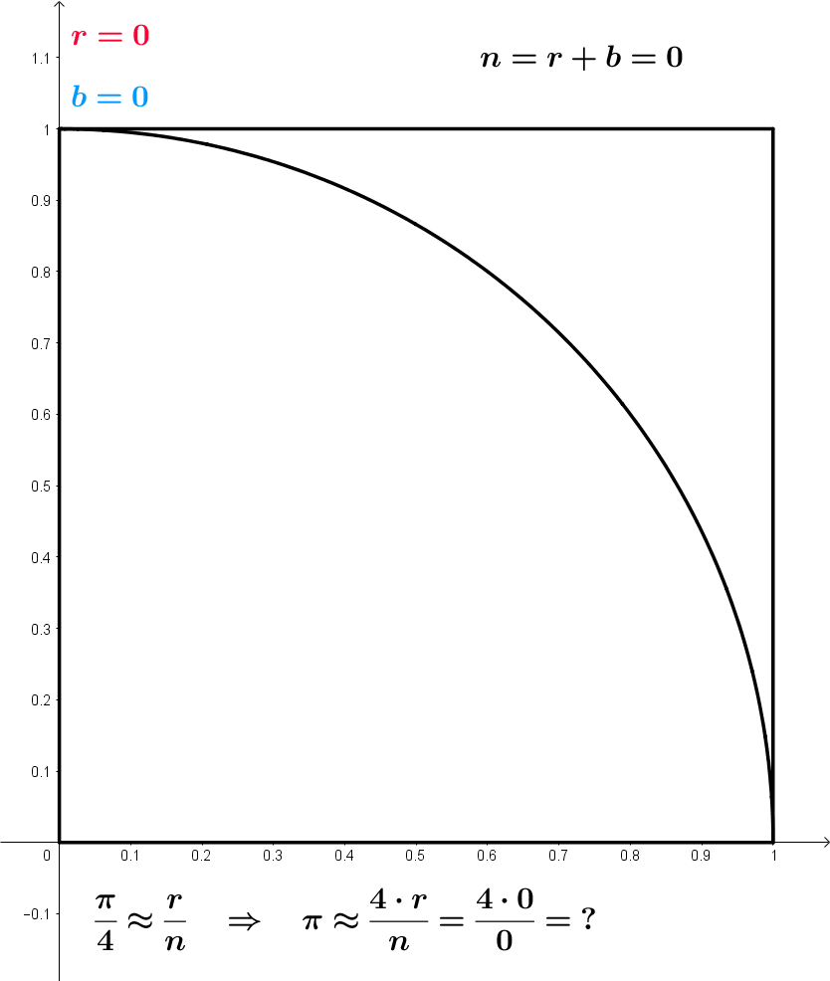
Monte Carlo Examples
Ex 1: Approximating π
Wikipedia

Slide 7
Monte Carlo Examples
Ex 2: A wacky distribution – see notebook!

Slide 8
Markov Chains – Only “now” matters
Markov Chains are stochastic processes describing a sequence of events
Given sequence (an)={a1,a2,a3,...}
Markov property:
P(an=xn|an−1=xn−1)=P(an=xn|an−1=xn−1,an−2=xn−2,an−3=xn−3,...)
In other words, Markov Chains are memoryless

Slide 9
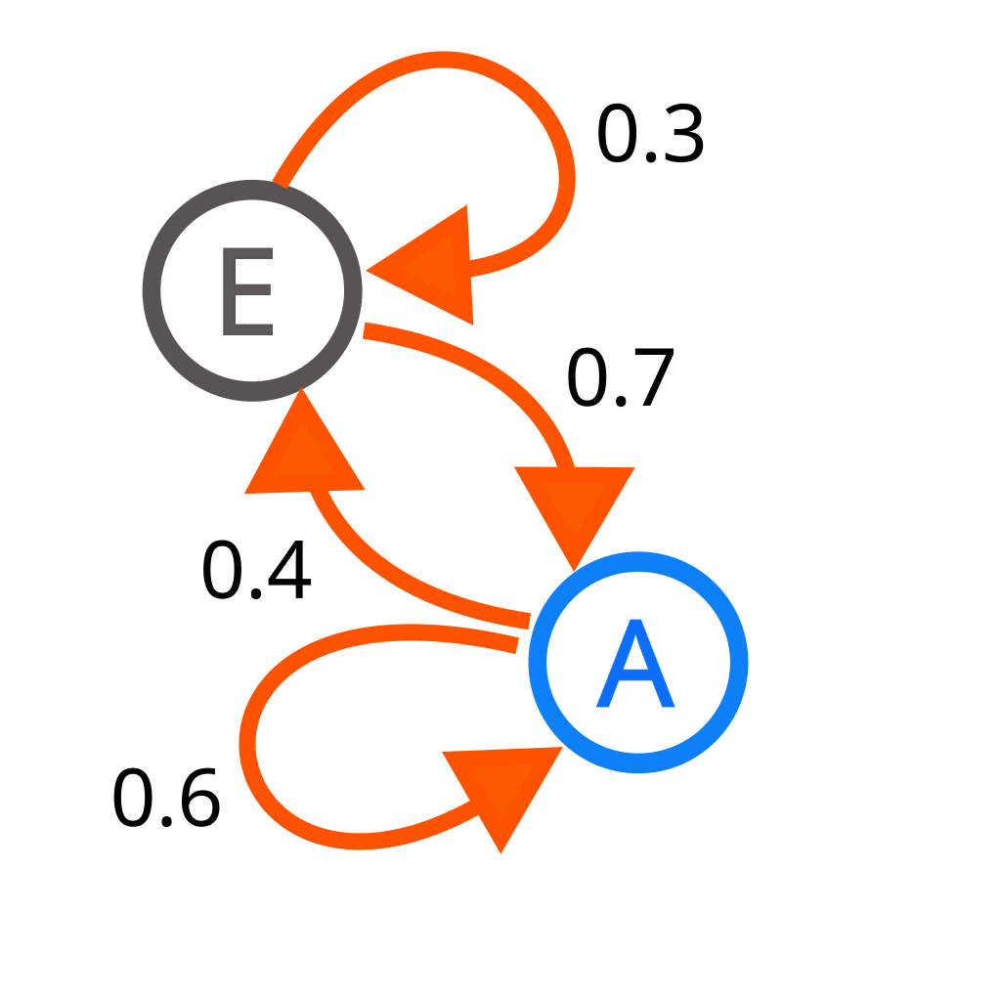

Markov Chains
Homogeneous Markov Chains can often be described by a transition matrix:
  Let be the s initial state of the chain
  Let D(t,s) be the state of the chain given initial state s at time t≥ 0
Wikipedia

Slide 10
Walking along a Markov Chain
Observe that given a transition matrix, one can determine the exact probability of some “walker” being in some state after t periods.
See notebook demo!
Now what if we extended some single “walker” into a more general notion?
Observe that we can replace the notion of a “walker” instead with an initial distribution, and observe how the “density” of each node with respect to the total population changes over time.

Slide 11
Markov Chain Key insight
You might have noticed something interesting: no matter what initial distribution we started with, after a while, the distribution will converge.
This is a key property that arises if we construct Makov chains in a certain way, which we will now formally define.

Slide 12
Fundamental Theorem of Markov Chains
Consider a Markov chain that is irreducible, positive-recurrent, and aperiodic:
  Positive-recurrent and irreducible: for all pairs of states/nodes si,sj it is possible to eventually reach sj if one starts in si
  Aperiodic: the chain has no directed-cycle
Then for all states s,
Where π=Pπ denotes the stationary distribution, and is independent of time and initial state.

Slide 13
Why we love stationary distributions
Stationary distributions are essentially the reason why MCMC algorithms work
Consider again the “single walker”: if we have a Markov chain that has already converged to stationary distribution π, then “walking along” the chain is equivalent to drawing random samples from π
This is also an application of Bayesian statistics

Slide 14
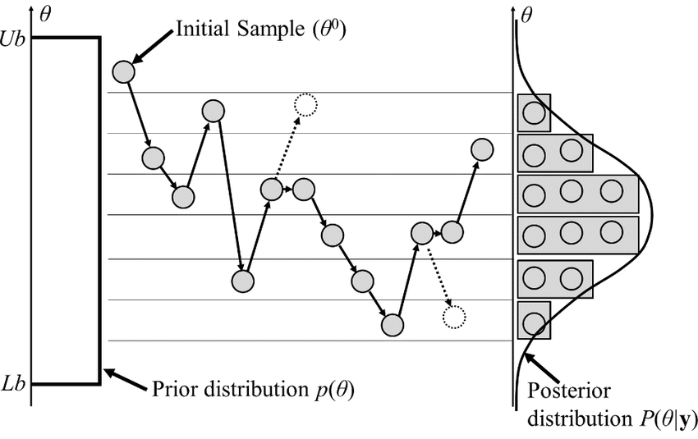
Wikipedia

Slide 15
Why the fuss about MCMC?
We already have many existing methods of generating random samples from distributions
Inverse CDF: works only when the distribution has a closed form and is invertible
Rejection sampling: suffers the curse of dimensionality
See notebook demo!
Finally, the simplified nature of MCMC walkers allows for many chains to be run in parallel
  Especially good with modern processing

Slide 16
MCMC Visualizer
https://chi-feng.github.io/mcmc-demo/

Slide 17
Metropolis-Hastings
Goal: create a Markov-Chain that admits a stationary distribution
Issue: our parameter space is continuous, not discrete, and a transition matrix is not well-defined.
Solution: Define a way for a random walker to “move” around the parameter space such that positive-reccurence, irreducibility, and aperiodicity properties hold.

Slide 18
Detailed Balance is the key!
Positive-reccurence, irreducibility, and aperiodicity holds if for any node/state j in our state space S:
Global balance, or π-invariance
  The proportion of “particles” leaving j is equal to the proportion of “particles entering j
  π(j)=∑k∈ S π(k)P(k→ j)
  Designing a proposal method satisfying the above equation is usually difficult or intractable
Detailed balance
  For any node/state k, the proportion of “particles” going from j to k is equal to the proportion of particles going from k to j
  π(j)P(j→ k)=π(k)P(k→ j)
  This is a stronger condition than global balance, and it is easier to design a proposal algorithm satisfying detailed balance

Slide 19
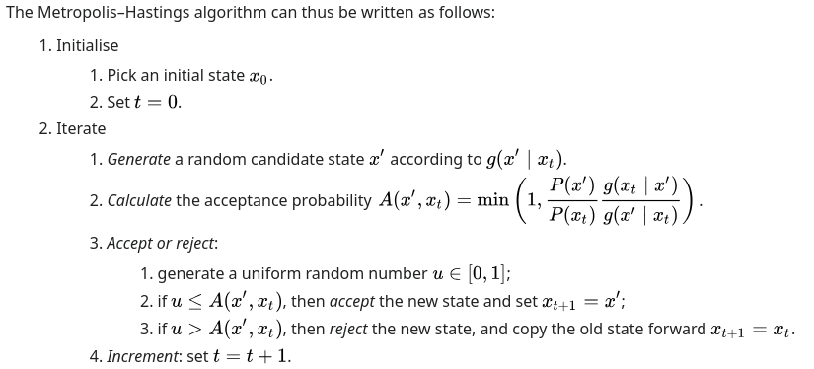
Metropolis Hastings Algorithm
Let P be our desired distribution that we wish to sample from. In fact P can be proportional to our desired distribution.
Remark: The distribution of g heavily affects acceptance probability, and thus convergence to P. Best results are obtained when g is a similar “shape” to P.

Slide 20
Metropolis-Hastings: Pros and Cons
Pros
  Autocorrelation between sampled points ensures areas of high density are explored (“sampled”) more thoroughly
  Relative acceptance rule means stationary distribution need not be a “real” distribution – just proportional to one. No need for annoying scalar constant
Cons
  Bad choice of proposal method leads to poor convergence
  Sensitive to initialization values – If starting far from a high density area, it can be hard to reach it!
  Locality trap – Once in a high density region, it can be hard to escape it

Slide 21
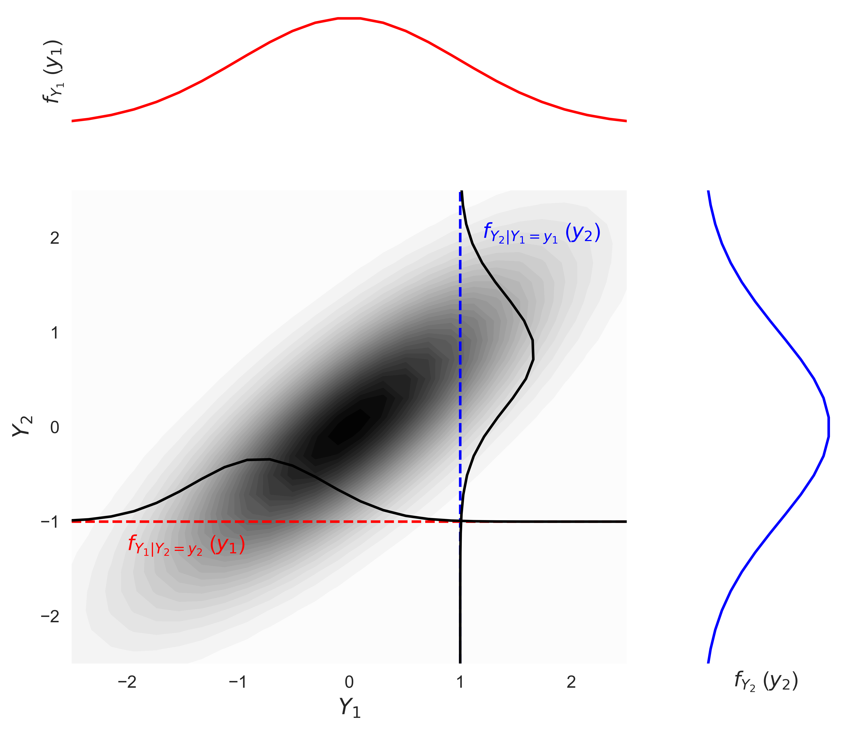
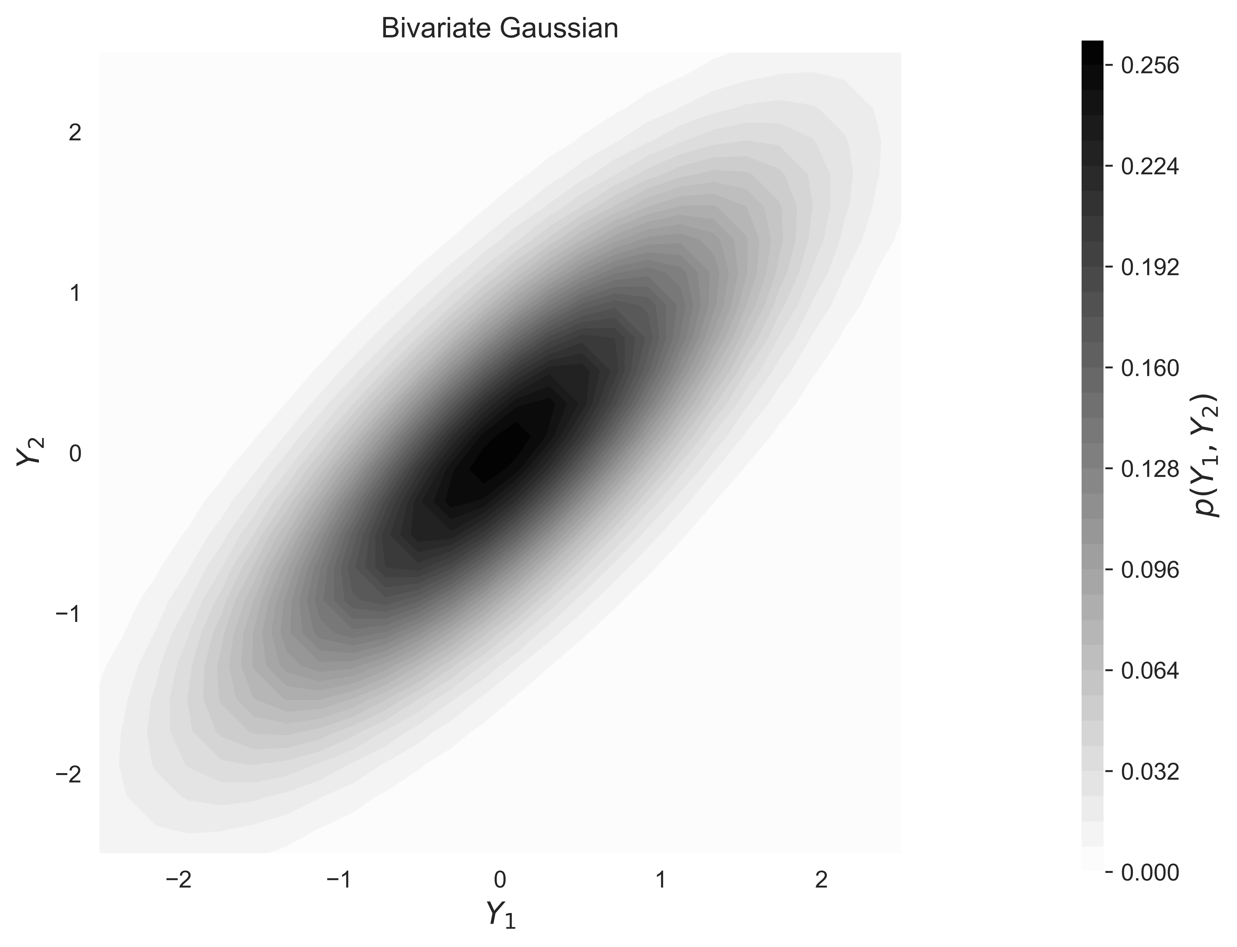
Gibbs sampler
A special case of Metropolis-Hastings in which you ALWAYS accept the proposed point
Key insight: sampling from a multivariate joint distribution is hard. What if we instead sample multiple uni-variate conditional distributions instead?
Sampling these is a lot easier!
Sampling this is hard!
https://geostatisticslessons.com/lessons/multigaussian

Slide 22
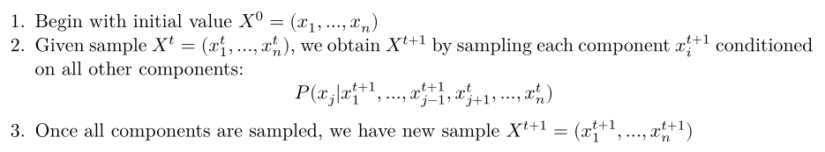
The Gibbs Sampler Algorithm

Slide 23
Gibbs Sampler – Pros and Cons
Pros
  Doesn’t require an acceptance step
  If conditional distributions are simple, calculation can be very fast
  Less vulnerable to locality traps than M-H
Cons
  Conditional distributions must be known and tractable
  High-dimensional data can significantly increase workload

Slide 24
Advanced MCMC Techniques
We can see that the MCMC technique is very flexible: as long as the Markov Chain is properly designed, many things about it can be streamlined/tweaked for efficiency
Usually the best efficiency improves are made by making a “smarter” proposal algorithm
  Spending less time in low density areas
  Properly exploring all local optima
This usually leads to higher acceptance rate for new proposed points
  Shorter time to convergence
  Less rejected (wasted) points

Slide 25
Hamiltonian MCMC – roll a ball, and it’ll stay near wells
Imposes a Hamiltonian physics constraint on the walker
At each step, push the “ball” in a random direction with random momentum
Higher density areas have more “gravity”, so proposal points stay near these regions
Automatic differentiation makes gradient computation realistically fast
No U-Turn Sampler (NUTS) – Halts the rolling ball if it backtracks/orbits
Still struggles with multimodal/ridge densities (AKA topographies!)
See visualizer!

Slide 26
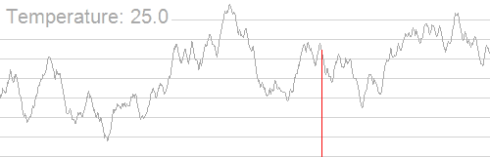
Simulated Annealing – Decrease the jump length over time
Originally not an MCMC algorithm but an optimization one
Key insight: too long of a proposal jump and we can’t stay in high density areas. Too short of a proposal jump and we can’t properly explore the entire space
Make the algorithm accept “worse” points with high probability in the beginning, but lower that over time
Wikipedia

Slide 27
And much much more...
Slice sampling
  “Slice” the distribution curve horizontally, then uniformly choose a point within that
Multiple try MC
  Allow multiple proposal tries at each jump
Reversible jump
  Proposals can change the dimensionality of the space
Nested sampling
  Subdivide the space into smaller and smaller regions and based on likelihood and sample from each region
  Kind of like a Bayesian interpretation of Lebesgue integration

Slide 28
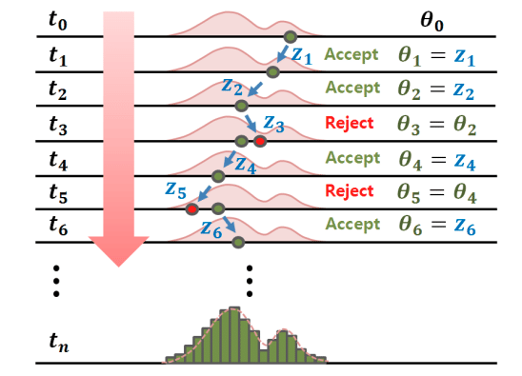
Thank you!
Markov Chain Monte Carlo:
- A random sampling technique
- More resilient to high dimensionality
- Can be parallelized
- Lots of potential for further exploration/optimization
- Widespread application
DOI:10.1080/15732479.2019.1628077

