Slide 1
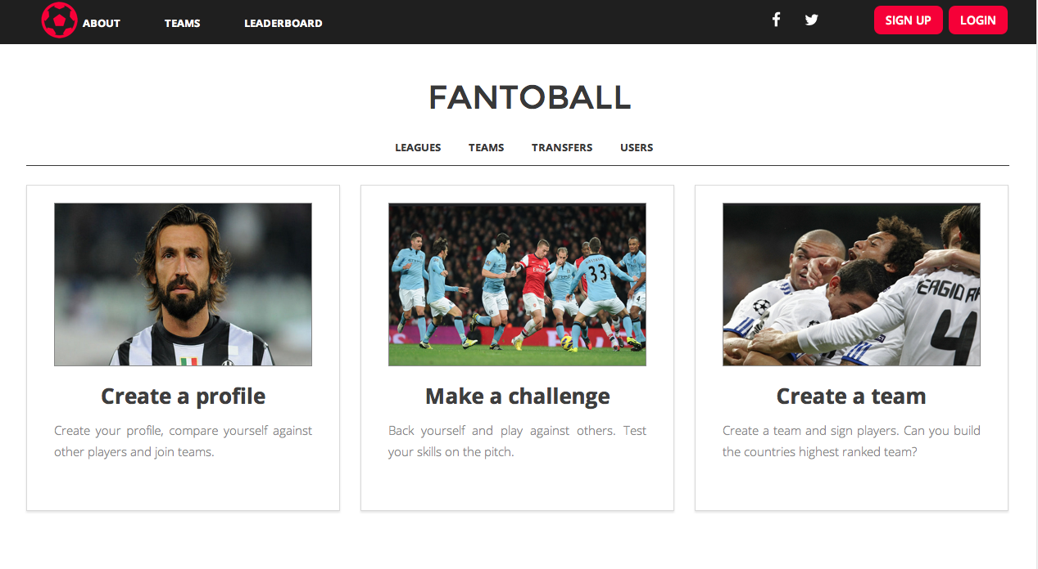

Slide 2

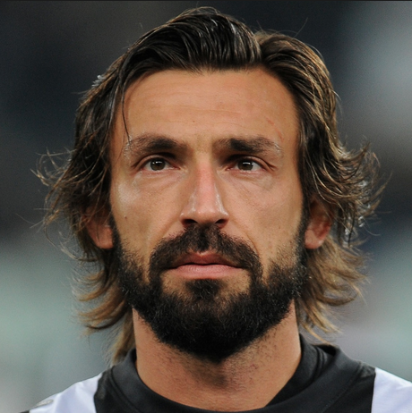


Alexander
Ames
England
Player Profile
create your player profile
Birth
Team
height
Weight
Foot
Position
Specialty
06/04/1993
Bayern Toonich
6 Ft 1 Inch
79 KG
Right
CM
RATING
This rating will change over time as other teams and team mates rate your performances
Appearances 34
goals 12
These statistics are only recorded from official league games.

Slide 3

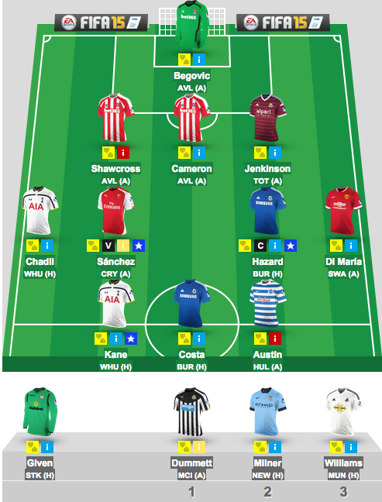
CREATE A TEAM
Search for your friends
How many players per side?
Name age rating send a request
John Smith
Cameron Wimble
Fred Nesbitt
Hubert Morant
Alex Ames
Milo Royds
Luke Davies
Tom martin
Roger phillips
Henry chandler
Max allen
Tom wyatt
Phil bardsley
Harry mcnultey
Charlie tester
Tom garland
Will louis
Ghazi shaker
Louisa roberts
Oscar harris
Tom willis
Russel westbrok

Slide 4
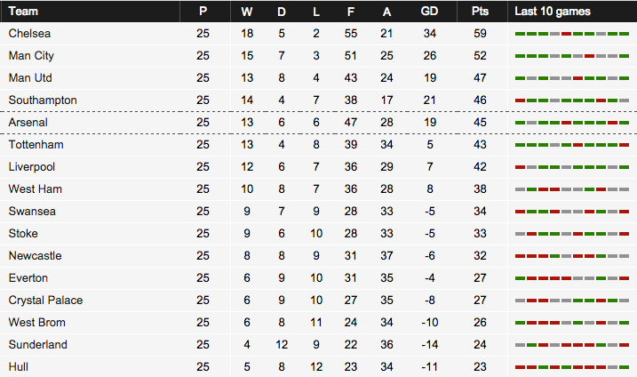
Leaderboards

Slide 5

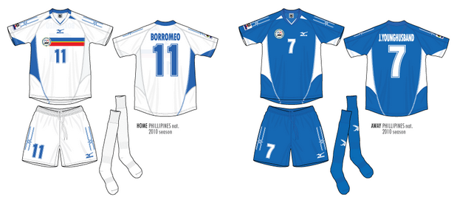

Team Profile
Team Colours
Home
Away
Team Philosophy TIKI TAKA
League Position 2ND
Form WWD
PLAYER PROFILES
TOM MARTIN
LUKE DAVIES
SERGIO AGUERO
MILO ROYDS
CAMERON WIMBLE
ALEX AMES
LIONEL MESSI
TROPHY CABINET

Slide 6
manage your team
pick your starting line up
choose your formation
drop your players if they aren’t performing

Slide 7
Top Goal Scorers
Player | Team | Appearances | Rating | Goals
Will Louis | Bayern Toonich | 11 |  | 15
Milo Royds | Michu at De Gea Ba | 9 |  | 12
Jack Taylor | Murder on Zidanes floor | 15 |  | 10
Charlie Pilkington | Burnley | 15 |  | 10
Luke Davies | Newcastle Wanderers | 12 |  | 9
Cameron Wimble | Bayern Neverloosing | 15 |  | 8
Gus Gould | Harker FC | 10 |  | 5

Slide 8

challenge a team
choose a team:
Or random search
location:
date:
time:
players per side:
CHALLENGE TEAM

