Slide 1
MEDICAL APPOINTMENT
Exploratory Data Analysis
SQL evidence used to understand appointment no-show patterns
DOCUMENTATION DECK
9 business questions • MySQL queries • result snapshots • key observations
Portfolio project documentation

Slide 2
EDA DOCUMENTATION
OVERVIEW
EDA questions and how to read this document
01
Overall no-show rate
02
Day of the week
03
Lead time
04
Age group
05
SMS reminder
06
Neighbourhood
07
Previous appointment history
08
Handicap / disability status
09
Chronic disease status
DOCUMENTATION FORMAT
Each section preserves the original SQL query and returned result snapshot. The takeaway line summarizes the visible result without turning the EDA into a causal claim.
MySQL exploratory analysis • Query and result snapshots

Slide 3
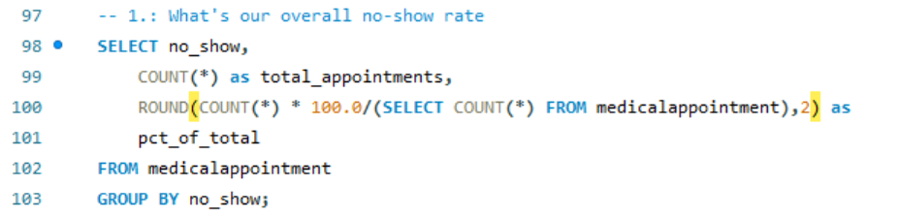
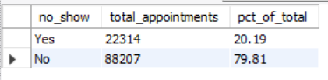
EDA 01
SQL EDA
What is the overall no-show rate?
BUSINESS QUESTION
Establish a baseline for appointment attendance.
QUERY
RESULT
KEY OBSERVATION
20.19% no-show rate
22,314 of 110,521 appointments are recorded as no-shows in the result snapshot.
MySQL exploratory analysis • Query and result snapshots

Slide 4
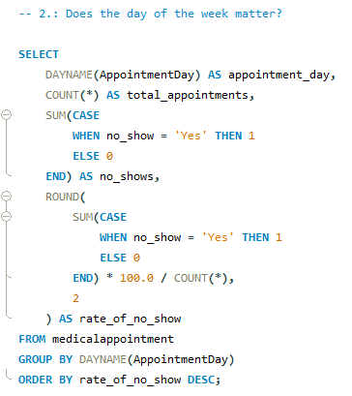
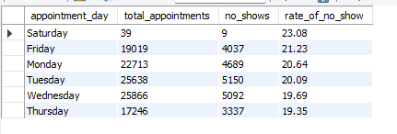
EDA 02
SQL EDA
Does the day of the week matter?
BUSINESS QUESTION
Compare no-show rates across appointment weekdays.
QUERY
RESULT
KEY OBSERVATION
Saturday is highest in this result
Saturday shows 23.08% no-show, while Thursday shows 19.35%.
MySQL exploratory analysis • Query and result snapshots

Slide 5
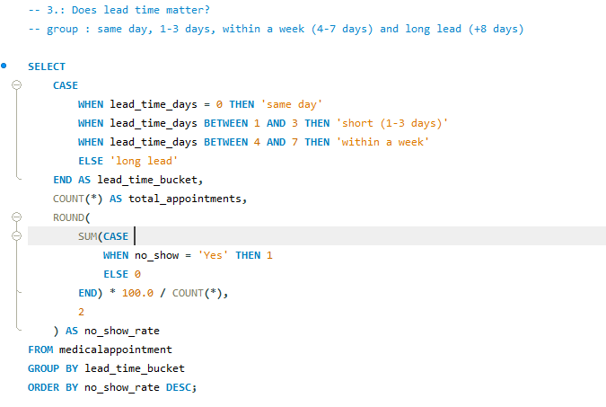
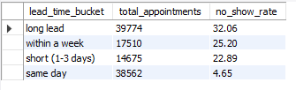
EDA 03
SQL EDA
Does lead time matter?
BUSINESS QUESTION
Compare no-show rates based on how far in advance appointments were scheduled.
QUERY
RESULT
KEY OBSERVATION
Long Lead is highest
Long Lead (8+ days) shows 32.06% no-show versus 4.65% for Same Day.
MySQL exploratory analysis • Query and result snapshots

Slide 6
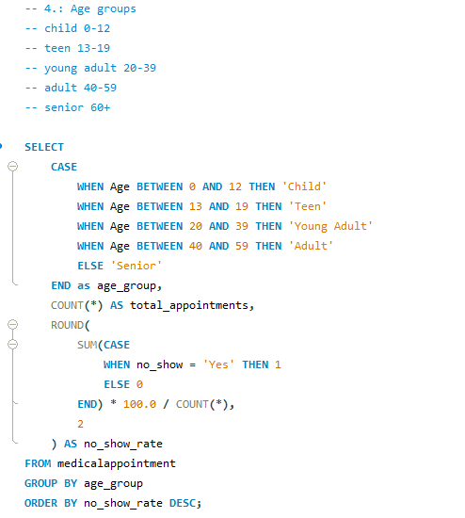
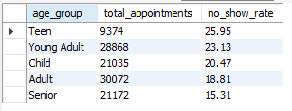
EDA 04
SQL EDA
Do different age groups have different no-show rates?
BUSINESS QUESTION
Compare appointment attendance across age groups.
QUERY
RESULT
KEY OBSERVATION
Teen is highest in this result
Teen shows 25.95% no-show, while Senior shows 15.31%.
MySQL exploratory analysis • Query and result snapshots

Slide 7
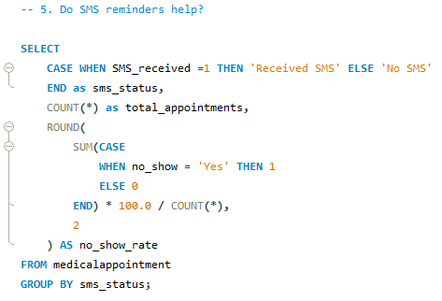

EDA 05
SQL EDA
Is SMS reminder receipt associated with no-show rate?
BUSINESS QUESTION
Compare no-show rates for appointments with and without an SMS reminder.
QUERY
RESULT
KEY OBSERVATION
The groups differ in this snapshot
No SMS shows 16.70% no-show versus 27.57% for Received SMS; this is an association, not a causal test.
MySQL exploratory analysis • Query and result snapshots

Slide 8
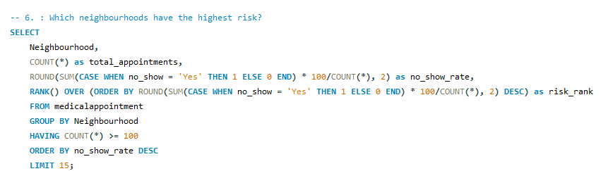
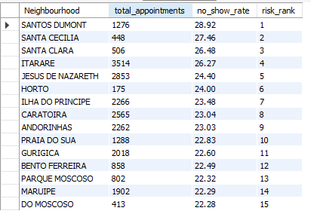
EDA 06
SQL EDA
Which neighbourhoods show higher no-show rates?
BUSINESS QUESTION
Rank neighbourhoods with at least 100 appointments by no-show rate.
QUERY
RESULT
KEY OBSERVATION
Santos Dumont ranks first
SANTOS DUMONT is 28.92%, followed by SANTA CECILIA at 27.46%. The query displays the top 15.
MySQL exploratory analysis • Query and result snapshots

Slide 9
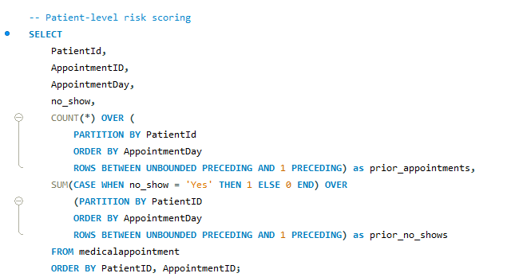
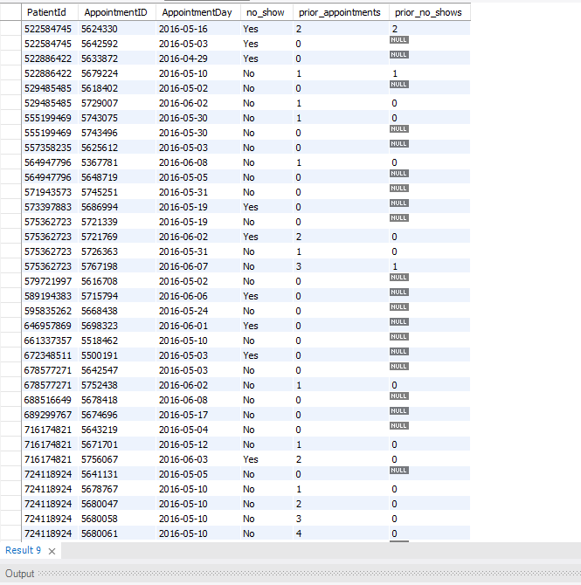
EDA 07
SQL EDA
How does previous appointment history relate to current attendance?
BUSINESS QUESTION
Create prior appointment and previous no-show features for each patient appointment.
QUERY
RESULT
KEY OBSERVATION
Historical features are created
The window function creates prior_appointments and prior_no_shows for each current appointment; the result is patient-level evidence.
MySQL exploratory analysis • Query and result snapshots

Slide 10
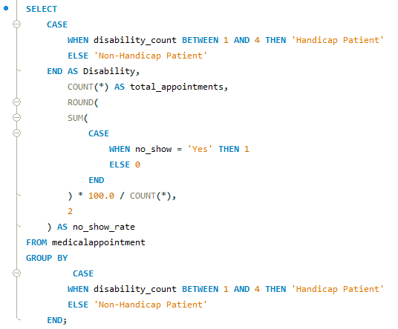

EDA 08
SQL EDA
Is handicap / disability status associated with no-show rate?
BUSINESS QUESTION
Compare no-show rates for recorded handicap/disability status.
QUERY
RESULT
KEY OBSERVATION
The groups differ in this snapshot
Non-Handicap Patient shows 20.23% versus 18.09% for Handicap Patient.
MySQL exploratory analysis • Query and result snapshots

Slide 11
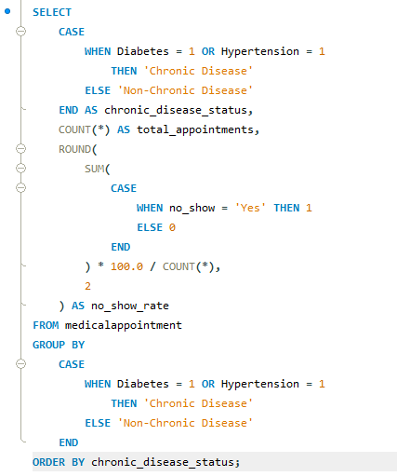

EDA 09
SQL EDA
How does chronic disease status relate to no-show rate?
BUSINESS QUESTION
Compare no-show rates for chronic disease versus non-chronic disease status.
QUERY
RESULT
KEY OBSERVATION
Non-chronic is higher in this result
Non-Chronic Disease shows 20.92% versus 17.46% for Chronic Disease; chronic = diabetes OR hypertension.
MySQL exploratory analysis • Query and result snapshots

Slide 12
EDA DOCUMENTATION
SUMMARY
What the SQL EDA shows
BASELINE
LEAD TIME
AGE
20.19%
Overall no-show rate
32.06%
Long Lead no-show rate
25.95%
Teen no-show rate
SMS
DISABILITY
CHRONIC
27.57%
Received SMS no-show rate
18.09%
Handicap Patient no-show rate
17.46%
Chronic Disease no-show rate
INTERPRETATION NOTE
These are descriptive SQL comparisons from the cleaned dataset. They identify patterns and associations for further analysis in Power BI; they do not by themselves establish causation.
SQL EDA documentation • Detailed evidence is retained in the analysis query file

