Slide 1


Once Upon a there was a thirsty crow.

Slide 2


It was a hot summer day. The crow was very thirsty.
Too hot…

Slide 3
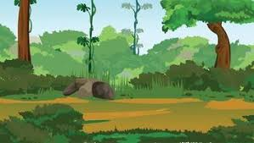
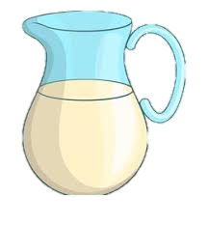
At last, he saw a pitcher with a little water at the bottom

Slide 4

He tried to drink but the water was too low
No water…😥🙂

Slide 5
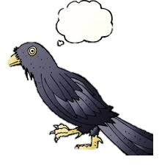
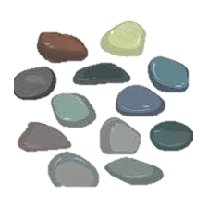
Idea
The clever crow had an idea.

Slide 6
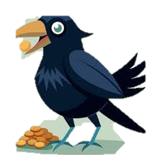

He started dropping pebbles into the pitcher.

Slide 7
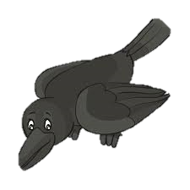
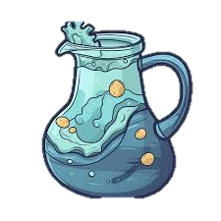
Soon, the water came up to the top
The crow drank the water and felt refreshed

Slide 8

Never give up
Moral: Where there’s a will, there’s a way.

