Slide 1

Most states that have a participation rate of less than 40% will have above-average
SAT scores.
By Iffan Kepan

Slide 2
What is the SAT ?
Fully 1,600 Points
SAT Test
2 Sessions
USA college admissions

Slide 3
Problem Statement
The overall average SAT scores between 2017 and 2019 showed a downward trend.
Participation rates varied across states in the United States during this period.
To better understand this trend, it is important to explore the relationship between participation rates and average SAT scores in each state.

Slide 4
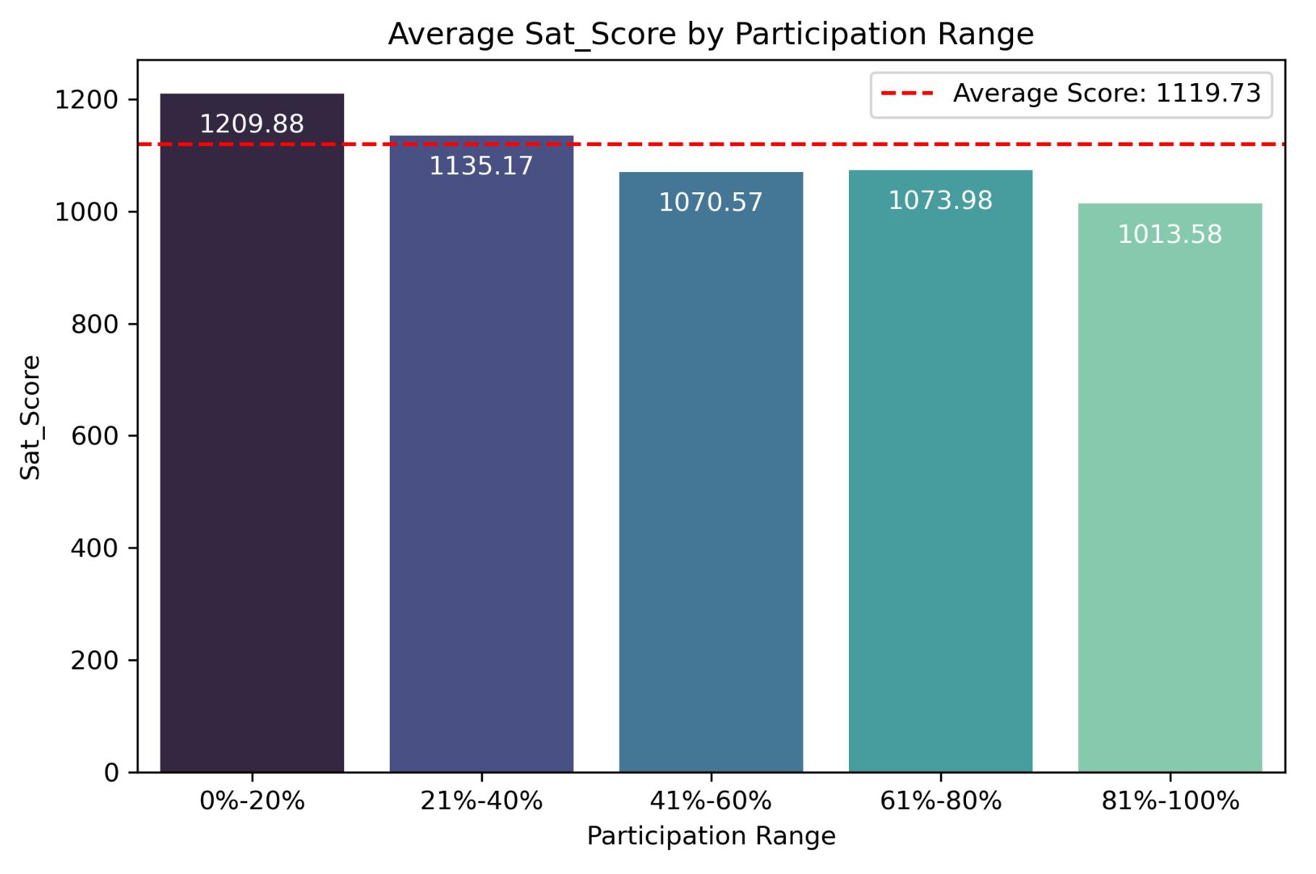
Categorizing SAT Scores Based on
Participation Rates
Average SAT Score By Participation Rate
0 - 20% = 1209.88
21% - 40% =1135.17
41% - 60% = 1070.57
61% - 80% = 1073.98
81% - 100% = 1013.58
Less than 40% of participation rate above average-SAT score

Slide 5
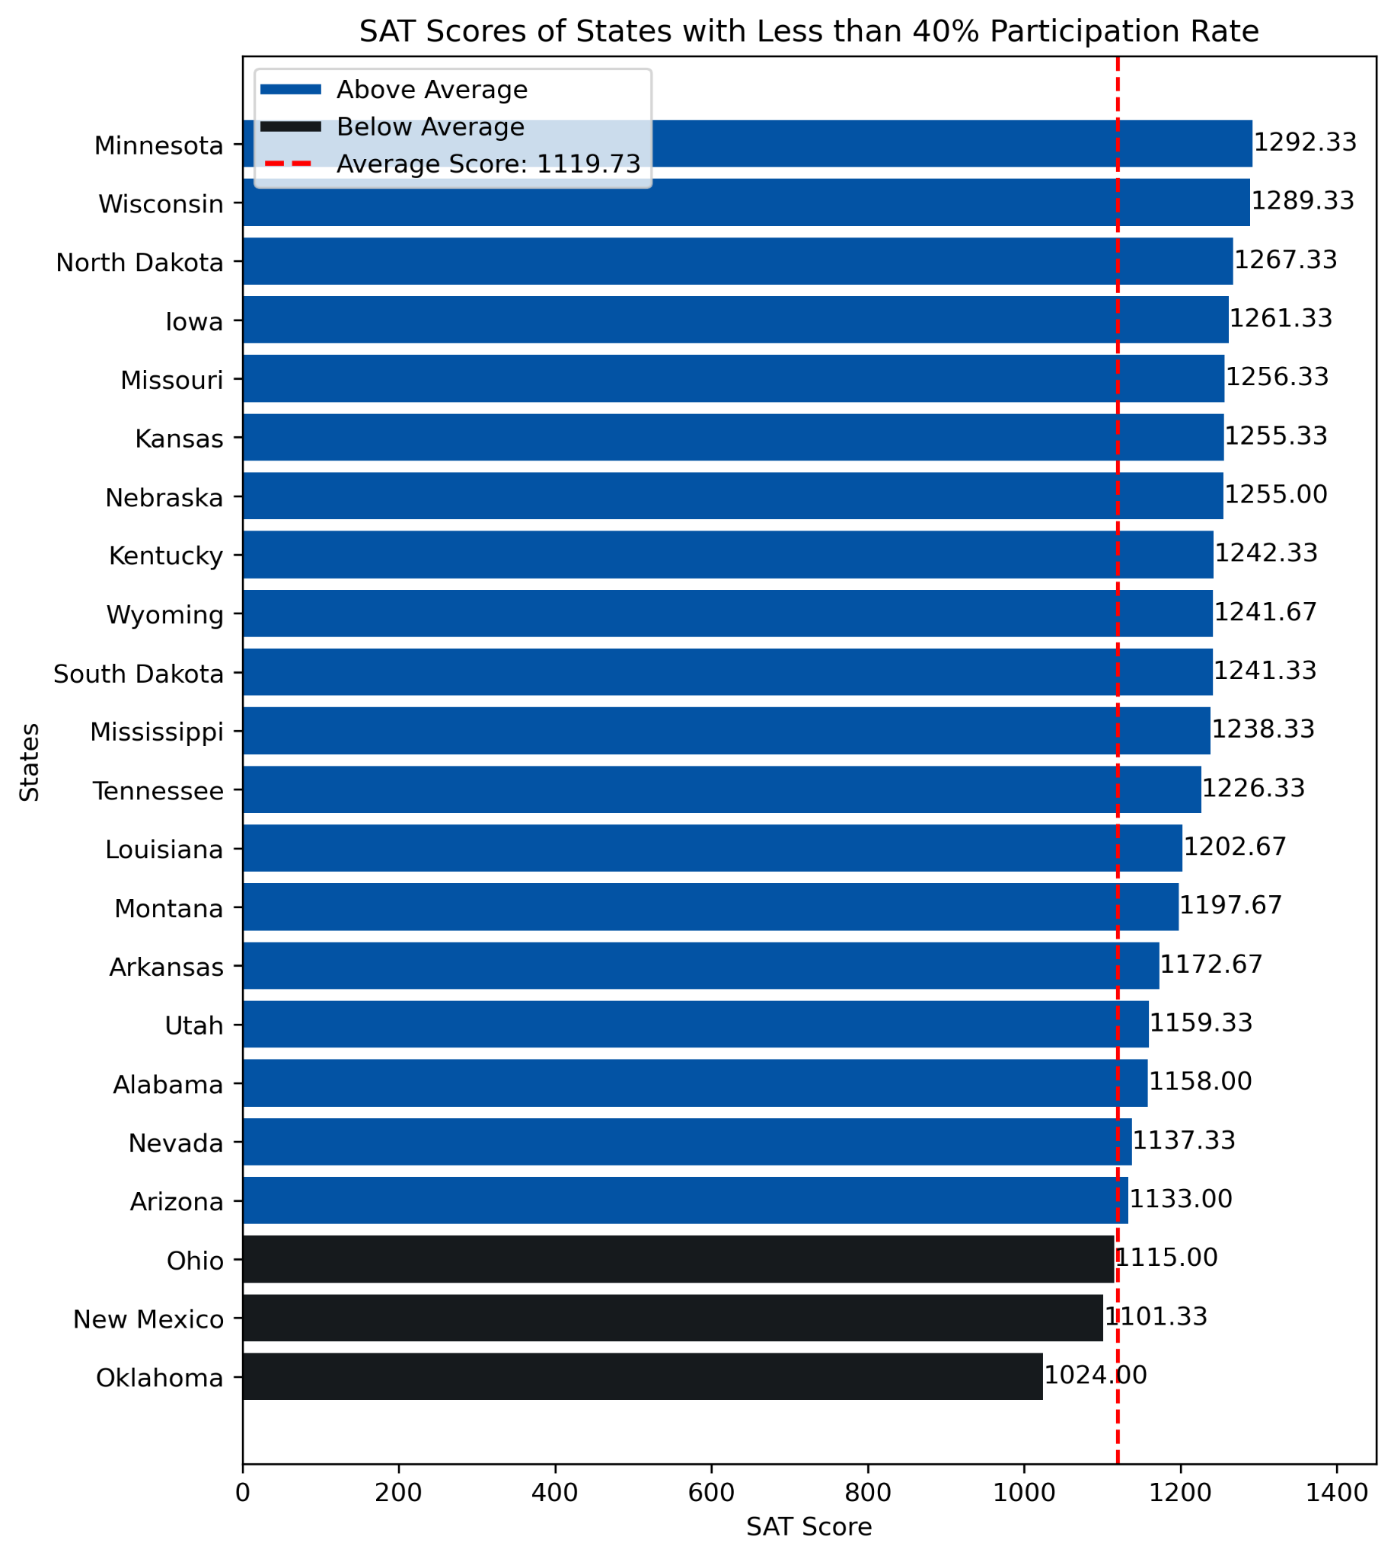
Breakthrough Less than 40 Participation Rate
19/22 States
that over average- SAT score
Only 3 States the on below of average-SAT score : Ohio, New Mexico, Oklahoma

Slide 6
Conclusion
83% of states have a participation rate of less than 40%, while the SAT scores are above average in all of these states. Additionally, in these states, at least 65% of students participated in the ACT, showing a forward trend.

Slide 7
Keys Factors
The hypothesis is influenced by key factors:
Selection Bias
Focus on ACT
School Policies

Slide 8
Recommendation
Encourage to Increases participation
Focusing on Underserved Groups
Awareness Campaigns
Long-Term Data Studies

