Slide 1


Slide 2
About Us
We are a For-Profit Company set up in August 2007 based in Bangalore, Karnataka.
Our intention is to provide India with easy access to generic medicine.
We are well recognised in this area and have over ten years of experience.
We are highly specialised in Pharma, Biotech and Diagnostics Industry.

Slide 3
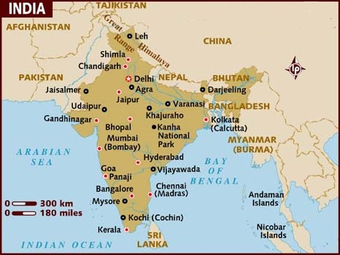
Locations of Infrastructure

Slide 4
Goals
Our primary goal is to raise awareness and provide the public with access to generic medicine
Our long term goal is to expand to the untouched markets of the rural areas.
We wish to increase our revenue to $50 billion in the next five years.
We wish to become a household name in the field of generic medicine.
We wish to surpass our competitors to become the number one provider of pharmaceutical products in India and the world over.

Slide 5
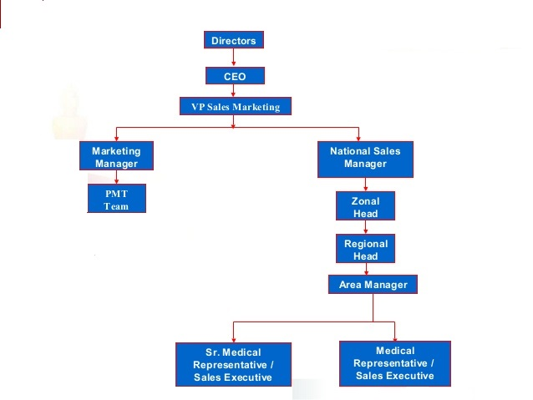
Structure

Slide 6
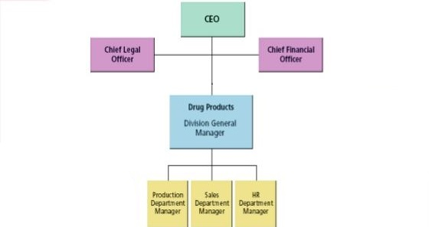
Managerial Staff

Slide 7

Our Products
Diaplex (Metformin)
Flexin (Ibuprofen)
Ranton (Ranitidine)
Peramol (Loperamide)
Cimetone (Cimetidine)
Omeprazole
Lansoprazole
Sulfasalazine
For more details, visit www.genplus.com/products

Slide 8
Revenue Structure

Slide 9
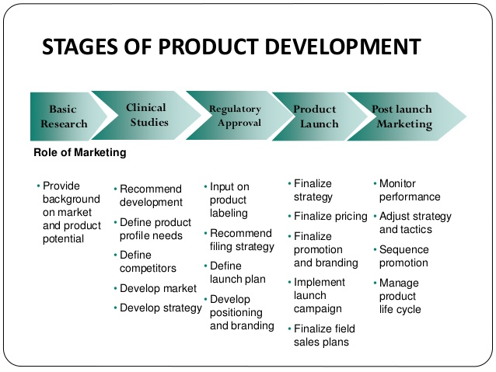
Business Plan

Slide 10
Business Plan - Market Research
Environmental scanning:
Physicians
Pharmacists
Pharmacies
Hospitals
Data gathering and analysis:

Slide 11
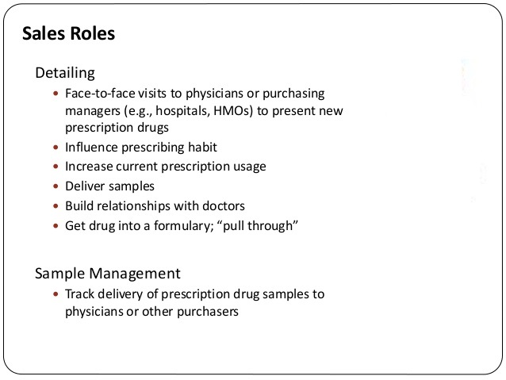

Slide 12
GROWTH PLAN
Vertical integration
We have assimilated the trials and testing on our own, as opposed to companies in the past or independent e-commerce platforms.
Mergers
Merged with Delco, a well know pharma company in the indian market. Deal value $500 million , The primary motive of our company being penetration into new markets by franchising, Delco was facing financial losses and import ban from US drug administration and other legal potholes in India. By opting for an arrangement of the merger for various tax, legal and regulatory reasons, Delco was able to retain its cash surplus, while the shareholders of our company received shares of Delco in exchange.
Acquisition
Acquired Ashwini Labs at a meagre $100 million. Rights to 5 brands and trademarks of drugs and a stronger presence in the indian market were acheived with this endeavour

Slide 13
Growth Rate (in millions)

Slide 14
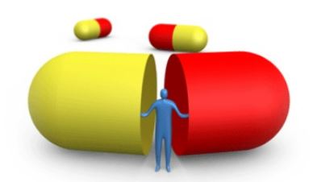
ENTRY TO MARKET

Slide 15
Market Entry Rural Areas
1. Education by partnering with local non profit and governmental organizations
Collaborating with NGOs to help conduct the seminars to educate the public
2. Affordability
We sell our products at a subsidized rate in rural areas where access is limited.
Statistics show that though the price has been lowered, there is an overall profit
due to sheer numbers of sales.
3. We have skilled representatives assigned to specific areas where they meet with doctors once a month, to maintain a good relationship, We often conduct seminars to inform doctors of results of promising drug trials. Doctors who trust in us come together and we focus on educating people of generic health care and inadvertently increase their trust in our products

Slide 16
Market Entry In Urban Areas
Tie Up with Hospitals
Pharmaceutical companies offer “Bonus Schemes” to retailers periodically. In these schemes, on purchase of a specified quantity of drugs retailers get some extra quantity of the same drug for free. For example, in May 2011 Torrent Pharmaceuticals offered “Buy one Get one free scheme” on Thrombiflo which contains Fenobirate – a drug from fibrate class mainly used to reduce cholesterol levels in patients at risk of cardiovascular disease.
We entered a tie up with Fine Fettle Ltd.
Fine Fettle hospitals make it mandatory to buy prescribed medication from their pharmacies only, So that how we gain control of market

Slide 17
Sales following the partnership with Fine fettle Ltd

Slide 18
Market entry: E-commerce
Separate international checkouts for imported medicines and products.
Use local payment methods like MobiWik, PhonePe.

Slide 19
Fast regional shipping and local returns.
In-house local team for delivery
Seasonal Marketing Spend

Slide 20
Our Competitors
LotusCare Ltd.: Recent trials have shown great results for their new pain relief medication. Our R&D lab is working on a revolutionary drug to compete with it.
Aristo Ltd.: The Ciprofloxacin medicine of Aristo gives a tough competition to our Peramol, so we are launching free treatment plans in metro cities and are taking the help of the media for publicity.

Slide 21
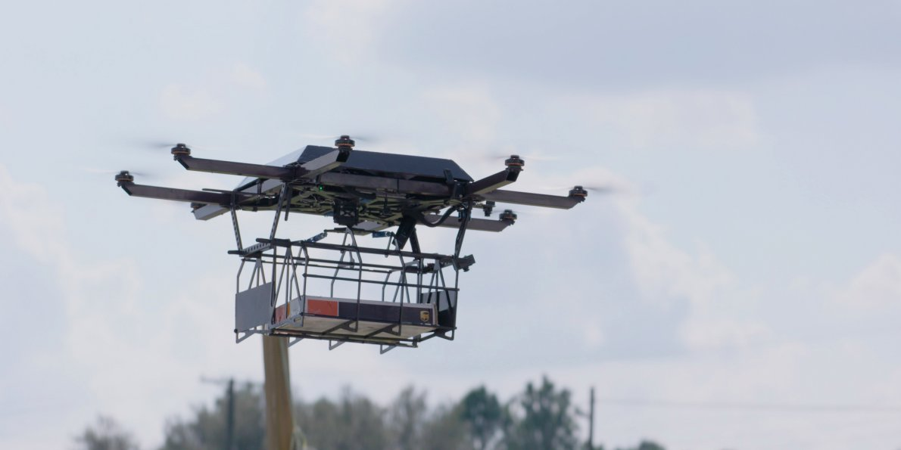
NextGen E-commerce Plans
Implement a few drones in Bangalore to improve the delivery speed and efficiency.
Automation of warehouse using logistics robot arms.

