Slide 1


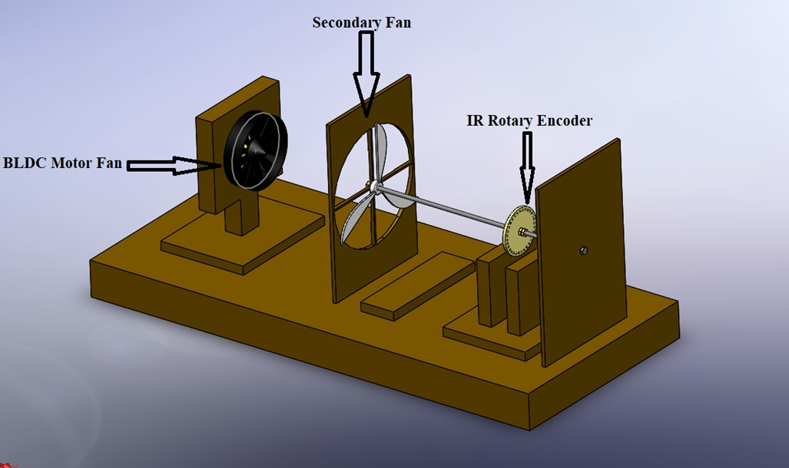
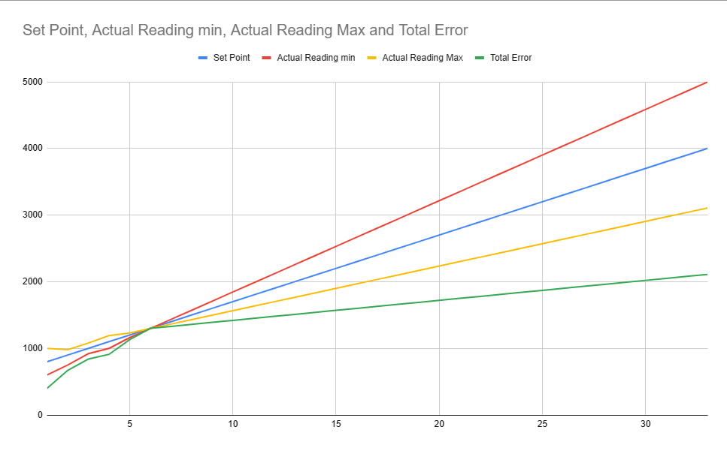
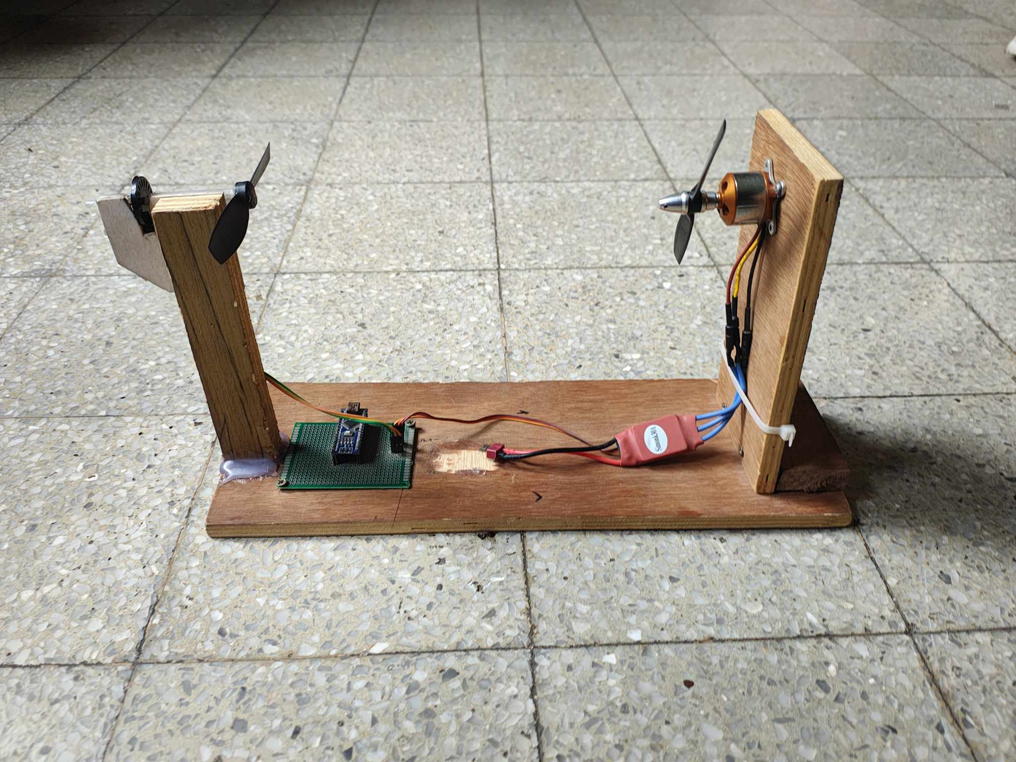
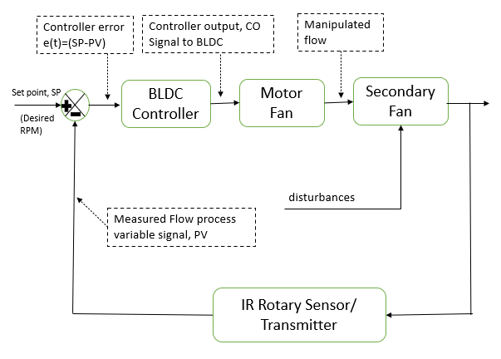
Controlling the RPM of a fan Using Rotary Encoder
Group
B
A. Ajjan(210012101), I.H Khan(210012121), M.R. Mahin(210012125), S.I Siam(210012140), A. Jami(210012153), F.A. Nihal(210012158), A.F. Nahid(210012166), J.A Sakib(210012182)
MIC LAB (ME- 4408) | Academic Year: 2023-24
g
RESULTS & DISCUSSION
INTRODUCTION
SCHEMATIC DIAGRAMS
This project aims to develop a system utilizing a microcontroller and a fan to control the rotation speed of a rotary encoder. The system receives input from the rotary encoder, allowing the microcontroller to dynamically adjust the fan's speed, accordingly, thus controlling the fan's RPM. Through this setup, users can directly manipulate the fan's RPM via the rotary encoder, with the option to implement PID control algorithms for enhanced precision. The project holds potential applications in automation systems, temperature regulation devices, and various other fields. Experimental results are expected to validate the efficiency and accuracy of the system. To control the RPM (revolutions per minute) of a rotary encoder using a fan, we would typically need a motor driver circuit or controller capable of adjusting the speed of the fan based on the input from the rotary encoder. This can be achieved using a microcontroller like Arduino or Raspberry Pi along with appropriate motor driver modules.
Fig1. CAD Model of the Project
Fig.4 Reading Performance Comparison
Target vs. Reading Range: Compares intended amount (target) with the minimum and maximum achieved.
No Clear Trend: Minimum and maximum readings can both be above or below the target.
Fluctuating Error: The difference between target and actual reading keeps changing
MOTIVATION
PID Control is an integral part of Industrial and Production Engineering. This project was basically taken to get a better understanding of the automation process using PID
Fig 2. Schematic model
METHODOLOGY
CHALLENGES
OBJECTIVES
Fan Speed Calibration to match the intended input
Propeller Rotation without the aid of any outside forces
Accurate & Precise speed control
Optimization of power and speed
optimization of power and speed
Preparing the CAD Model
Fabricating the model
Applications
LIMITATIONS
Coding
Testing the equipment
Speed Limitation
Environmental Factor
Temperature Based Fan Speed Control
Ventilation System
Greenhouses
Industrial facilities
Residential spaces
Server rooms
Energy Efficiency
Incubators and Heat Exchangers
FUTURE RECOMMENDATIONS
DC Motor use
Proper Market Research
REFERENCES
Temperature-Based Automatic Fan Speed Control System using Arduino: Author: Ashima Jain , Arup Sarkar Journal: SSRN (Social Science Research Network)Year of Publication: 2022
Fig.3 Flow Control System with BLDC Motor
DEPARTMENT OF MECHANICAL AND PRODUCTION ENGINEERING
ISLAMIC UNIVERSITY OF TECHNOLOGY (IUT)
Notes:
Write your name in short form ( e.g. Abu Bakar Siddiqui > A. B. Siddiqui).
Maintain the given font type and sizes.
Add figure caption in italic (Fig 1. Schematic Diagram of ……..) below the figure with middle alignment.
Add table caption in italic (Table 1. List of ……..) above the table with middle alignment.
Introduction: Describe the research background with proper references. Follow IEEE reference style.
Schematic Diagrams : Include 3D modelling diagrams (CAD) and actual image of the final setup
Methodology: Describe briefly the methodology of the project with a proper flow chart
Result & Discussion: Discuss briefly the performance/evaluation of the fabricated model with necessary figures
References: Name of the first author only, abbreviated journal name, year of publication: volume(issue).

