Slide 1

VUE JS
New technologies

Slide 2
About Vue Js
Released 2014
Library Size: 80 kilobyte
Progressive framework
View layer based core library
HTML based template
Simpler than Angular JS library
Separate directive and components
Notes:
Library size is small compared to react( 100), angular (500)
Progressive framework means it can be designed progressively to be incrementally adaptable.
Core library can be integrated with other libraries to enhance the performance

Slide 3
Where Vue has been used
Facebook: Marketing side of it’s newsfeed
Netflix: 2 smaller internal apps
Adobe: Product named Portfolio
Xiaomi: Various Products
Alibaba
Wizz air
Euro news
Grammarly
Gitlab

Slide 4


Angular- Vue-react

Slide 5
UI and its logic function
Framework layout
Vue requires html and Js basic knowledge for further development.
Notes:
Angular keeps it separate as HTMI and JS file. React and Vue keeps it together but it is customizable.
Angluar is the most mature. As Vue is newer version, it is simple and flexible.

Slide 6
PRO
Simplicity
Integration with other libraries
User-friendly
Customization
Few restriction in development
Documentation available to learn

Slide 7
con
Less support in big projects
High competition (Google, Facebook)
Few plugin (Still developing)

Slide 8
Application

Slide 9
connection

Slide 10
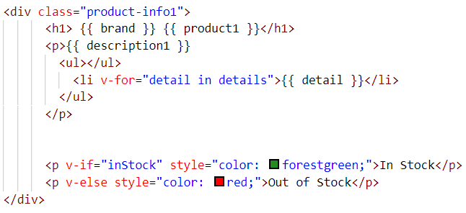
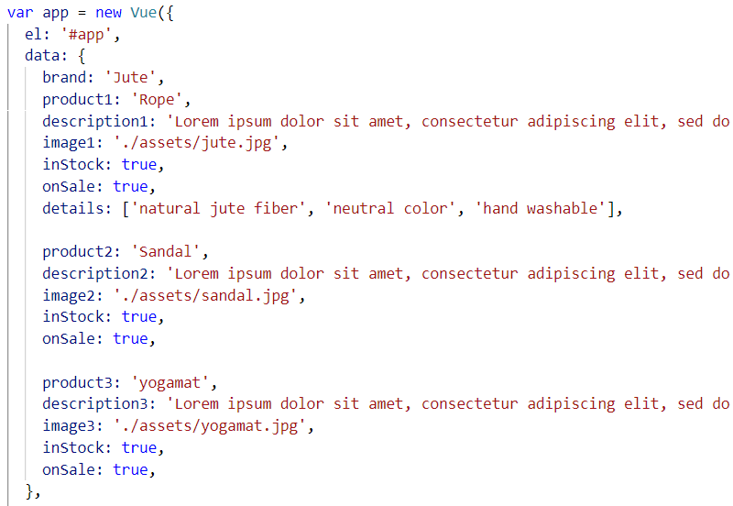

Vue instance and it’s data connection
Index.html
Main.js

Slide 11
Demo

Slide 12
Thank you

